Slide 1
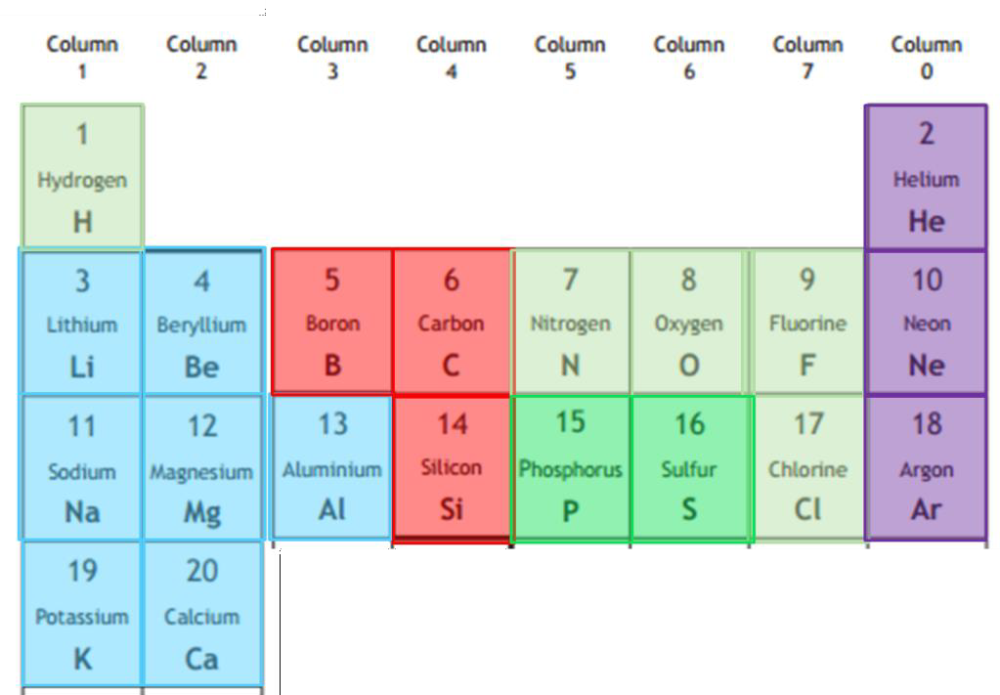
Chemistry Revision Mind Map Unit 1 – Bonding of first 20 elements 1
Annotate the first 20 elements of The Periodic Table to show their
structure and bonding.
Note: Carbon in the form of fullerene (C₆₀) is covalent molecular
Explain why sulfur has a higher melting point than phosphorus?
Going down group 8 elements boiling points increase. Explain why this happens?
Explain why chlorine has a higher melting point than argon?
What is the strongest type of bonding broken when
boron melts?
What is the strongest type of bonding broken when
sulfur melts?
Explain why boron has a higher melting point than
sulfur.
Explain fully in terms of structure and bonding why silicon nitride has a high melting point?

Slide 2
Chemistry Revision Mind Map Unit 1 – Trends in The Periodic Table 2
The covalent radius is a measure of what?
Calculate the energy required for the following reaction;
Na⁺ (g) → Na ³⁺ (g) + 2e⁻
Explain why the first ionisation of sodium is much lower than the second ionisation energy
Explain the trend in covalent radius as you go across a period
Explain the trend in covalent radius as you go down a group
Explain the trend in ionisation energy across a period
Explain why the covalent radius of sodium is larger than the
ionic radius
Explain the trend in ionisation energy down a group
Explain the term electronegativity
Explain why there is a large difference between the third and
fourth ionisation energies of aluminium?
Explain the trend in electronegativity across a period
Define the term first ionisation energy
Write the equation to show the third ionisation energy of chlorine.
Explain the trend in electronegativity down a group

Slide 3
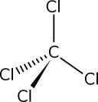
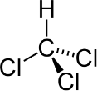
Chemistry Revision Mind Map Unit 1 – Structure and Bonding 3
What is a covalent bond | Decide if each of the following are polar or non-polar molecule and explain your answer | Explain how London dispersion forces arise
What is a polar covalent bond
What is a non-polar/pure covalent bond
 |  | Explain how permanent dipole- permeant dipole interaction arise
Annotate HCl below to show the partial charge on each atom and the location of electrons. H - Cl
 | Name the three types of intramolecular bonding. Are these types of bonding strong?
If a compound has the greatest ionic character, what does this mean in terms of electronegativity difference? |  | Explain how Hydrogen bonding arises.
What is a polar molecule
 | Name the three types of intermolecular bonding. Which is the strongest? | Explain why ethanol is soluble in water.
What is a non polar/pure molecule

Slide 4
Chemistry Revision Mind Map Unit 1 – Oxidation and Reduction 4
Oxidation involves the of electrons. Reduction involves the of electrons. | Name three compounds which are strong oxidising agents? | In a redox equation what is always cancelled out:
 | What is a use of hydrogen peroxide as an oxidising agent?
 |  | Write the ion electron equation for the following reaction: Potassium permanganate reacting with iron metal producing Iron(III) oxide in the presence of an acidic solution.
What is an oxidising agent?
 | What does the term electronegativity mean? If an element is very electronegative will it be an oxidising agent or reducing agent?
What is a reducing agent?
Where in your data booklet will you find strong reducing agents?
 | In the following equation: Mg (s) + Zn²⁺ (aq) → Mg²⁺ (aq) + Zn (s) Write the oxidation reaction Write the reduction reaction Name the oxidising agent Name the reducing agent
 |  | For the following redox equation: C₆H₁₂O₆ + Cu²⁺ + H₂O → C₆H₁₂O₇ + Cu⁺ + 2H⁺ Write the ion-electron equation for the oxidation reaction: Write the ion-electron equation for the reduction reaction:
Where in your data booklet will you find strong oxidising agents?
Name a compound which is a strong reducing agent?

