Slide 1

Auxiliary Verbs
1st June
2020

Slide 2

Lesson
Learning at Home
Today we are going to try something new! This PowerPoint Presentation has been put together by your teachers to help you learn about auxiliary verbs at home.
This presentation will look over what we already know about verbs and explain to you what an auxiliary verb is.
When the presentation is finished, there will be assignment on teams for you to complete and submit to your teacher.

Slide 3
What is a verb?
Milkshake is the object – it is what is affected by or receiving the action.
A verb is a doing word; they show action or a state of being.
The verb is usually performed by the subject of the sentence.
Rex drank the milkshake.
Rex is the subject – the person doing the action.
Drank is the verb – it is the action being completed.

Slide 4
What is a verb?
table is the object – it is what is affected by or receiving the action.
Ball is the subject – the thing doing the action.
Here is another example
The ball bounced off the table.
bounced is the verb – it is the action being completed.

Slide 5
What is a verb?
food is the object – it is what is affected by or receiving the action.
Can you identify the subject, verb and object in this sentence:
The cat ate all of her food.
cat is the subject – the thing doing the action.
ate is the verb – it is the action being completed.

Slide 6
What is a verb?
Can you identify the verbs in these sentences?
1. Olivia ate a mouthful of toast, gulped down some orange juice, then ran out of the house.
Olivia ate a mouthful of toast, gulped down some orange juice, then ran out of the house.
2. The swallows somersaulted though the air as they flew high above the city.
The swallows somersaulted though the air as they flew high above the city.
3. “Duck!” shouted Luke, as the boomerang zoomed back towards Elliot.
“Duck!” shouted Luke, as the boomerang zoomed back towards Elliot.
The verbs we have just looked at are known as ‘action verbs.’ They refer to something a person, animal or thing can do.
Some words can be nouns or verbs depending on how they are used.

Slide 7
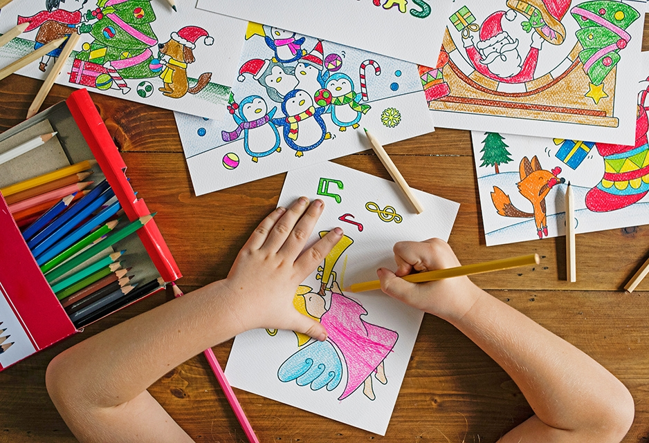
Auxiliary Verbs

Slide 8
What is an auxiliary verb?
An auxiliary verb is also known as a ‘helping verb.’ It comes before the verb in some sentences to help them make sense.
With auxiliary verbs you can write verbs in different tenses (past, present and future)

Slide 9
What is an auxiliary verb?
Past Tense | Present Tense | Future Tense
I danced | I am dancing | I will dance
The snow melted | The snow is melting | The snow will melt
James lied | James is lying | James will lie.
Ella sang | Ella is singing | Ella will sing
I ate | I am eating | I will eat
‘am’, ‘is’ and ‘will’ are the auxiliary verbs, they come from the verb ‘to be.’ They are used before the verb to make the sentence make sense and tell us when it happened.

Slide 10
To be, To do,
To have.
To be, to do and to have are auxiliary verbs and change their form depending on whether they are written:
a.) In the first or third person → I am vs. he is
b.) Past, present or future tense → I was, I am, I will be
c.) Refer to one person or several → She is, they are
You need to be able to identify these three verbs in all of their forms. However, because they are used so frequently it is much easier than it sounds!

Slide 11
To be
Normal Form | Contracted | Negative | Negative Contracted
I am | I’m | I am not | I’m not
you are | you’re | you are not | you aren’t
she/he/it is | she’s/he’s/it’s | she/he/it is not | she/he/it isn’t
we are | we’re | we are not | we aren’t
they are | they’re | they are not | they aren’t
Click here to reveal the auxiliary verbs

Slide 12
To be
Normal Form | Contracted | Negative | Negative Contracted
I am | I’m | I am not | I’m not
you are | you’re | you are not | you aren’t
she/he/it is | she’s/he’s/it’s | she/he/it is not | she/he/it isn’t
we are | we’re | we are not | we aren’t
they are | they’re | they are not | they aren’t

Slide 13
To have
Normal Form | Contracted | Negative | Negative Contracted
I have (got) | I’ve (got) | I have not (got) | I haven’t (got)
you have (got) | you’ve (got) | you have not (got) | you haven’t (got)
she/he/it has (got) | she’s/he’s/it’s (got) | she/he/it has not (got) | she/he/it hasn’t (got)
we have (got) | we’ve (got) | we have not (got) | we haven’t (got)
they have (got) | they’ve (got) | they have not (got) | they haven’t (got)
Click here to reveal the auxiliary verbs

Slide 14
To have
Normal Form | Contracted | Negative | Negative Contracted
I have (got) | I’ve (got) | I have not (got) | I haven’t (got)
you have (got) | you’ve (got) | you have not (got) | you haven’t (got)
she/he/it has (got) | she’s/he’s/it’s (got) | she/he/it has not (got) | she/he/it hasn’t (got)
we have (got) | we’ve (got) | we have not (got) | we haven’t (got)
they have (got) | they’ve (got) | they have not (got) | they haven’t (got)

Slide 15
To do
Normal Form | Contracted | Negative | Negative Contracted
I do | No contraction | I do not | I don’t
you do | No contraction | you do not | you don’t
she/he/it does | No contraction | she/he/it does not | she/he/it doesn’t
we do | No contraction | we do not | we don’t
they do | No contraction | they do not | they don’t
Click here to reveal the auxiliary verbs

Slide 16
To do
Normal Form | Contracted | Negative | Negative Contracted
I do | No contraction | I do not | I don’t
you do | No contraction | you do not | you don’t
she/he/it does | No contraction | she/he/it does not | she/he/it doesn’t
we do | No contraction | we do not | we don’t
they do | No contraction | they do not | they don’t

Slide 17
To be, To do,
To have.
Can you identify the verbs in these sentences?
1. Ava is eating her ice-cream, it has melted a little.
2. I do my spellings after dinner, Jack does his before football practice.
3. You are coming to my house on Saturday. We are going to watch a movie.
4. Milo and Everly are very silly today.
5. I have two cats, they’re called Alan and Nigel.
6. Finley is my little brother. Sometimes I don’t like him much, but I’m very lucky to have him.
Click here to reveal the auxiliary verbs

Slide 18
To be, To do,
To have.
Can you identify the verbs in these sentences?
1. Ava is eating her ice-cream, it has melted a little.
2. I do my spellings after dinner, Jack does his before football practice.
3. You are coming to my house on Saturday. We are going to watch a movie.
4. Milo and Everly are very silly today.
5. I have two cats, they’re called Alan and Nigel.
6. Finley is my little brother. Sometimes I don’t like him much, but I’m very lucky to have him.
REMEMBER: To be, to do and to have can be written in a negative form or shortened using apostrophes for contraction.

Slide 19
Assignment
There are worksheets available on Microsoft Teams for you to test your knowledge of Auxiliary Verbs.

Slide 20

Thank You!

