Slide 1
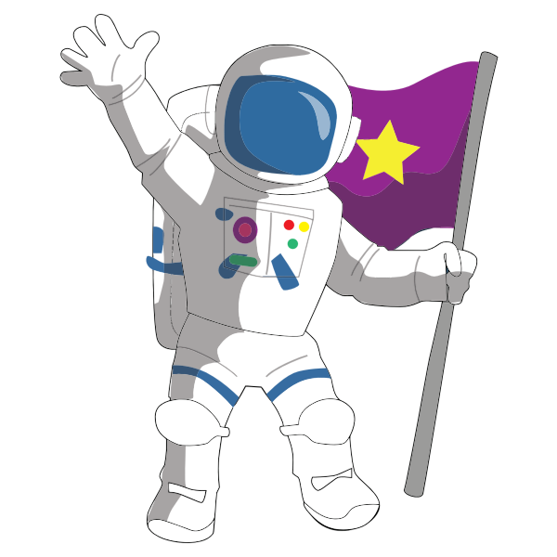
Science Primary 7 – Space Grid LI: I can understand space.
Observe the night sky and draw any constellations that you see.
Record five facts that you learned about stars. Illustrate one of your facts.
Create a picture of our Solar System. You could draw a picture or use different materials.
Can you create some mnemonics to help remember the order of the planets.
(My Very Excited Mother Just Served Us Noodles)
(Mercury, Venus, Earth, Mars, Jupiter, Saturn, Uranus, Neptune)
List and draw ten useful things that you would take into outer space. Explain why you would take them.
Make up a menu for an astronaut for a day. Explain why you chose these foods. Consider packaging and preserving issues.
Keep a sky at night journal for a month. You could draw a picture of the moon every night. Does it change over the course of the month?
Write a poem, song or a rap
about space.
Create a factfile about a
planet of your choice.
Include planet name, size, temperature, What it is made of, does it have any moons, atmosphere, illustration and five fascinating facts.
Create a biography about a space explorer (Neil Armstrong, Tim Peake or your choice) or write a newspaper article about the first moon landing.
If you were a journalist what five questions would you ask an astronaut?
Design a space station or space buggy to be based on the planet Mars.
Moon

