Slide 1
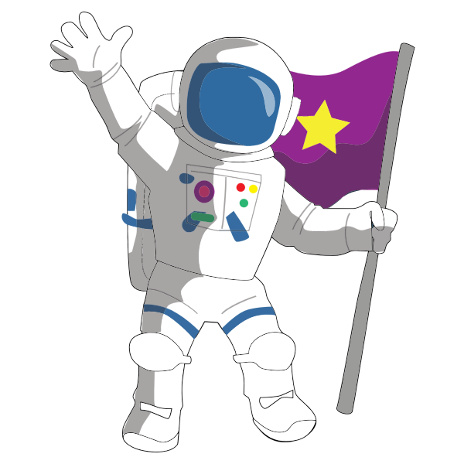
Science Primary 4 – Space Grid LI: I can understand space.
Observe the night sky and draw any constellations that you see.
Record five facts that you learned about stars and draw a picture.
Create a picture of our Solar System. You could
draw a picture or use different materials.
Create a fact file about an astronaut of your choice.
Can you create some mnemonics to help remember the order of the planets.
(My Very Excited Mother Just Served Us Noodles)
(Mercury, Venus, Earth, Mars, Jupiter, Saturn, Uranus, Neptune)
Science
Space Grid
Keep a sky at night journal for a whole month. You could draw a picture of the moon every night. Does it change over the course of the month?
Write a poem, song or a rap about space.
Write a dialogue between an astronaut and a visitor that they meet on another planet.
(Describe the character and the planet they are from)
Moon

