Slide 1
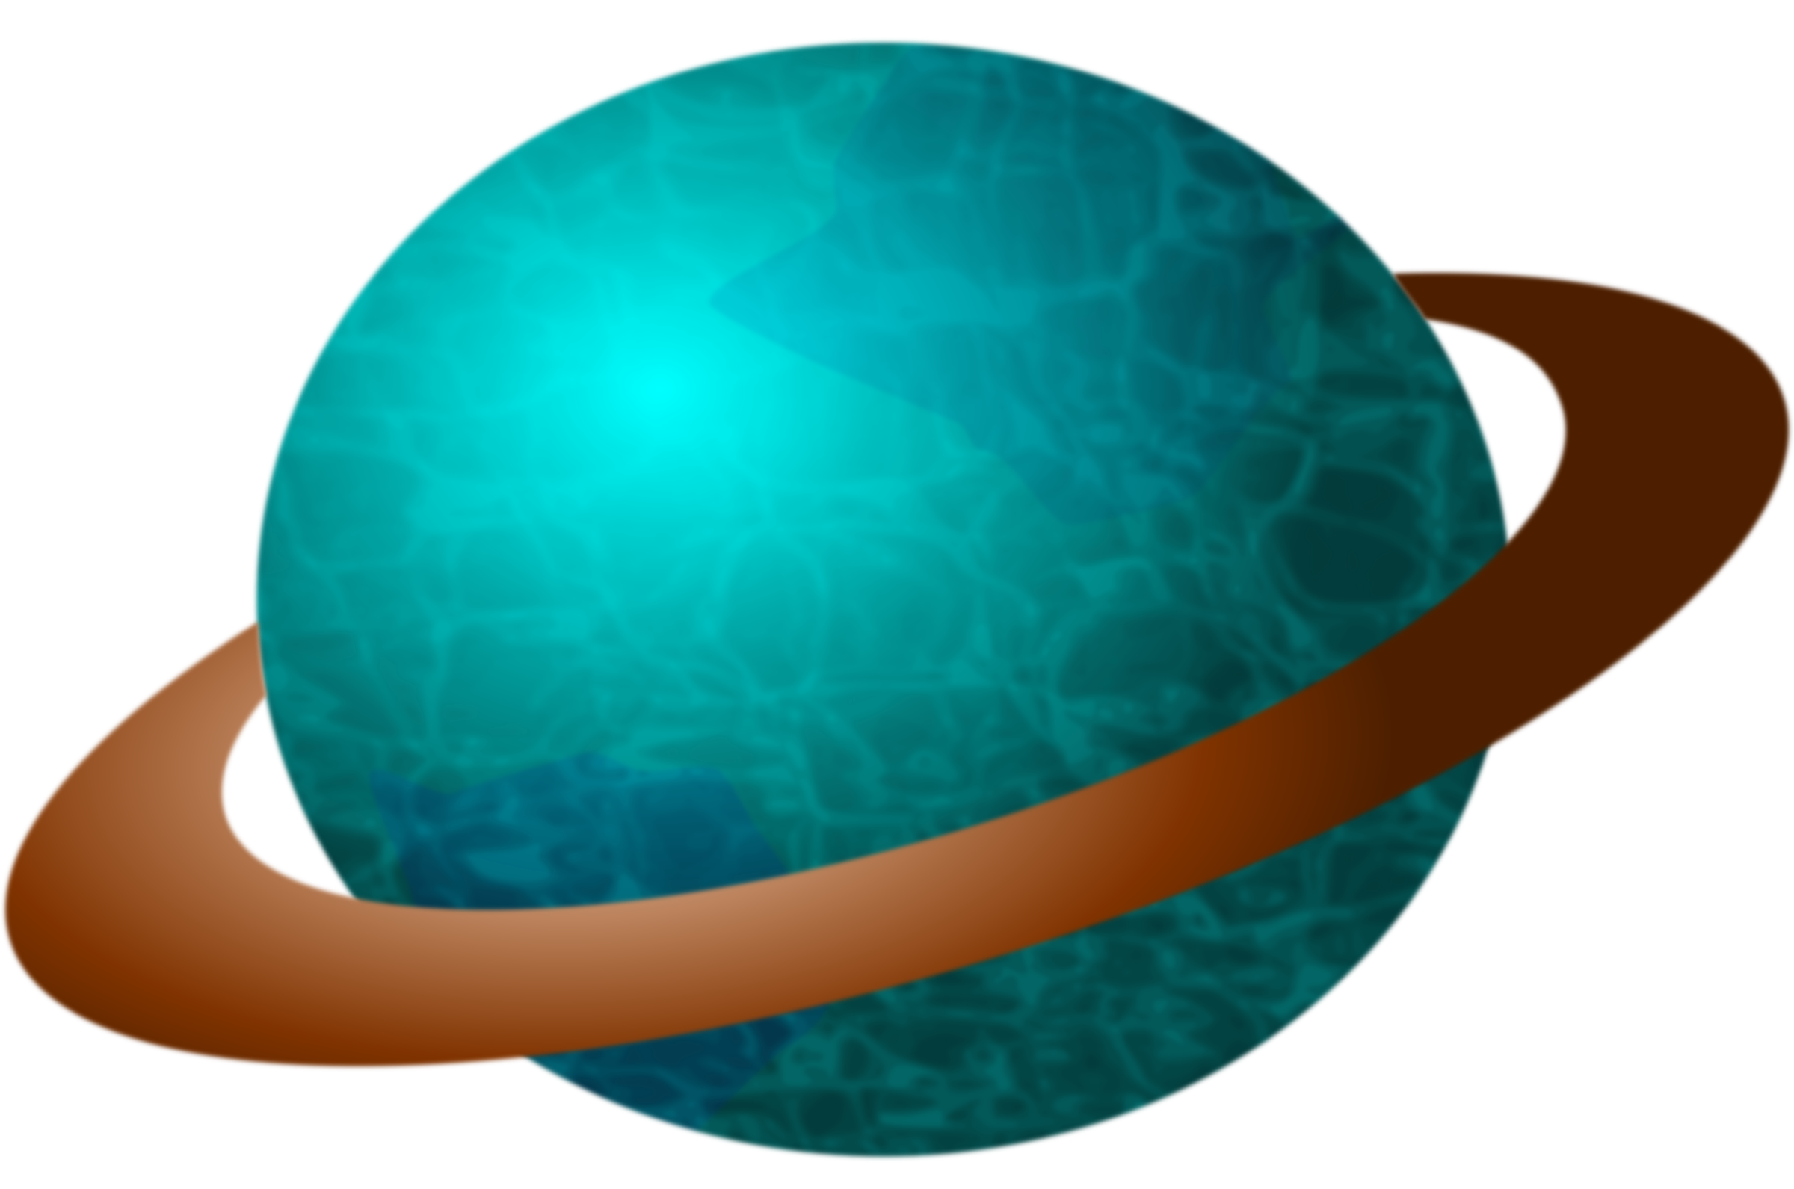
Science Primary 3 – Space Grid LI: I can understand space.
Write a song or a rap about space.
Record three facts that you learned about stars and draw a picture.
Draw a picture of the solar system.
(Include the stars, planets and moon).
Can you create some mnemonics to help remember the order of the planets?
My Very Excited Mother Just Served Us Noodles)
Mercury, Venus, Earth, Mars, Jupiter, Saturn, Uranus, Neptune)
(
Design a new planet. What does it look like? What is it made from?
What have you found on your planet?
Keep a sky at night journal for a two weeks. You could draw a picture of the moon every night. Does it change over the course of the week?

