Slide 1
St. Thomas' Primary
Homework Strategy 2022

Slide 2
Thank you for your support in helping to create this new and flexible approach to homework to suit the needs of all our children and families.

Slide 3
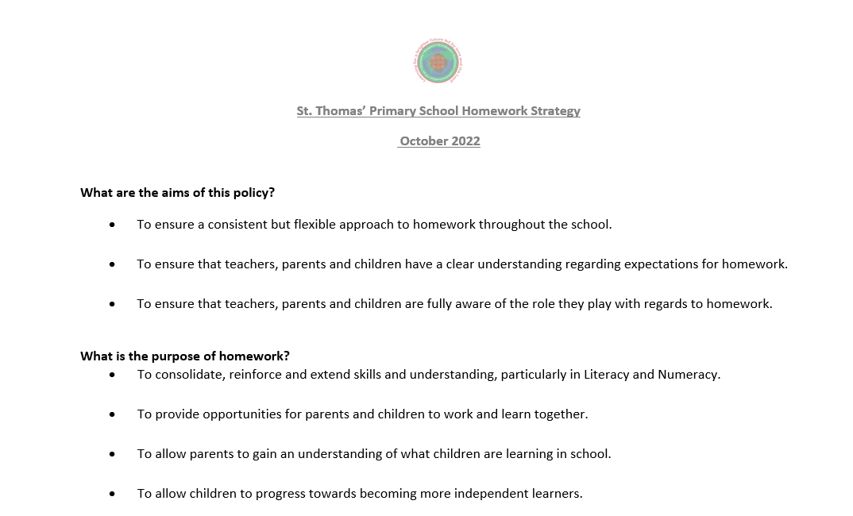

Slide 4
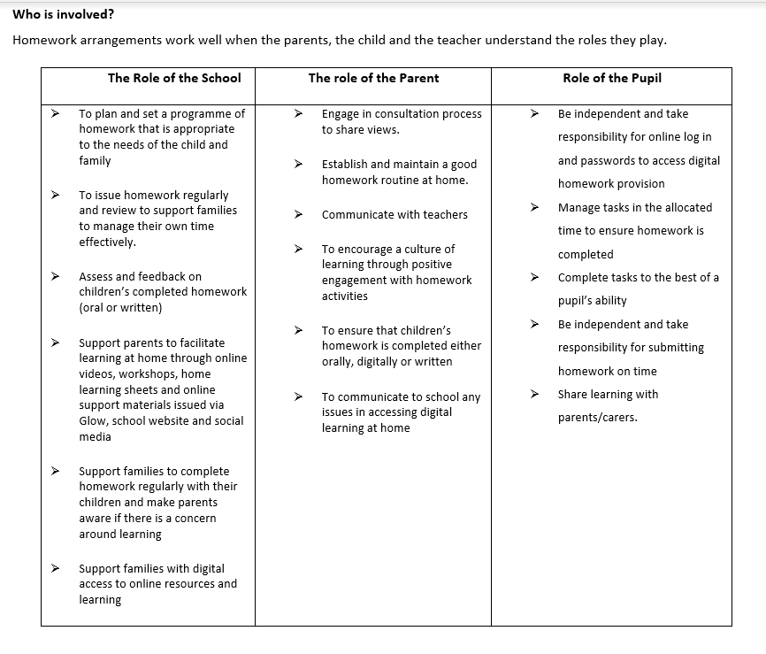

Slide 5
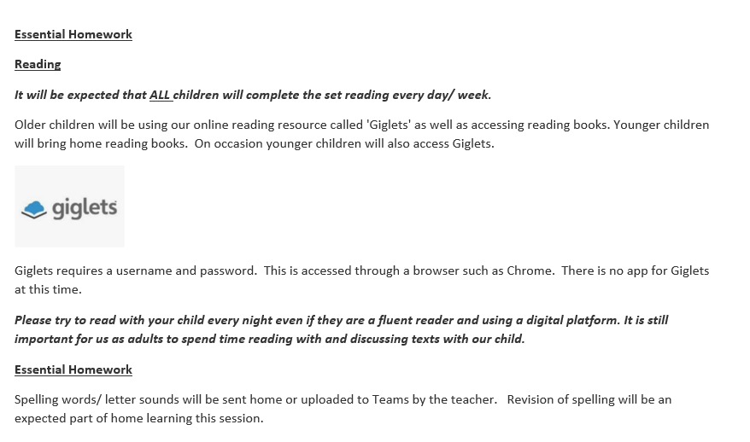
Essential Homework

Slide 6
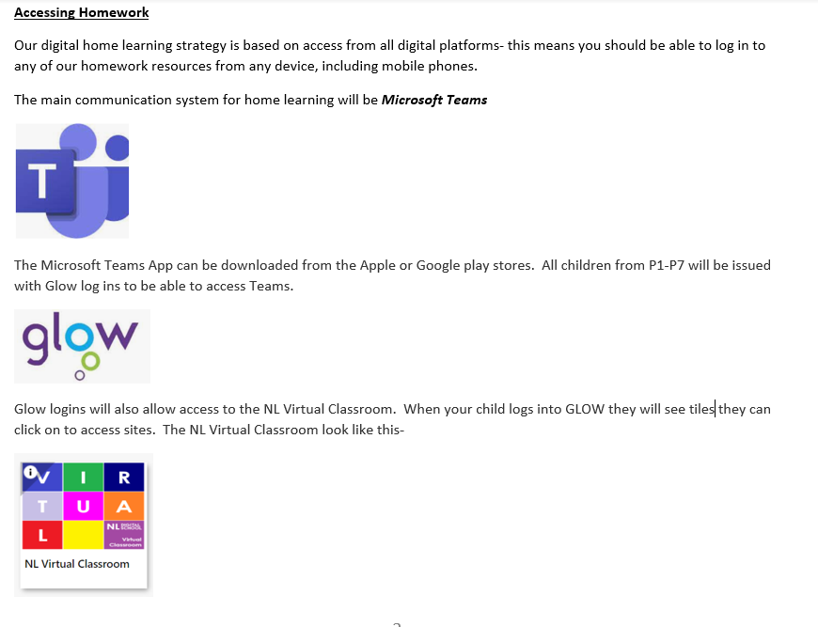
Accessing Homework

Slide 7
Optional Homework
Optional Homework
Every month the teacher will send out a new link to the Virtual Classroom. It contains a wealth of home learning activities in literacy, numeracy, health and wellbeing and STEM (Science, Technology, Engineering and Maths). You can pick and choose learning from this classroom with your child if you wish.
Please click on the example of the P1 Virtual Classroom. For it to be interactive you need to play the slideshow.
Red Virtual Classroom 1.pptx (sharepoint.com)
Optional Homework
All children P2-P7 will be given log in details for Sumdog. This is a digital resource for numeracy and Maths and promotes learning in a fun, game-based way! This is a valuable learning resource that we buy for the children every year so please try to use it. Sumdog can also be downloaded as an app.

Slide 8
Recording Home Learning
Recording Home Learning
Homework jotters will be given to all pupils to record any written homework. Teachers will advise on a class-by-class basis when these jotters should come back into school. Also, digital work can also be uploaded onto the class Team.

Slide 9
Supporting Home Learning
Supporting Home Learning
Please watch out for our parent training guides and videos on accessing, logging into Microsoft Teams, Giglets, Sumdog. These are available on our school website
Digital Support | St Thomas' P.S. & Nursery Class Wishaw (glowscotland.org.uk)
Computer Suite open in school every Monday and Wednesday 3pm-4pm for parents and pupils to use for homework activities. Please sign in at the main entrance.

