Slide 1
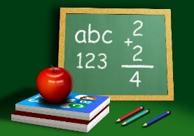
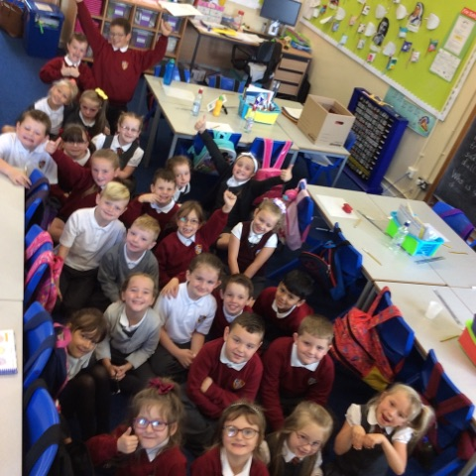
Primary 3 St Serf’s Primary School Mrs Durkin & Mrs Reid Welcome to Primary 3! We are going to have a great fun, hard working year together, with lots of smiles and good times!
General Information
Please ensure your child has an inexpensive pair of black gym shoes to change into as their ‘school slippers’ or indoor shoes. They can also be used for gym.
Our gym days are Monday & Thursday. Please ensure your child brings in their gym kit and has removed any earrings or jewellery. We have been provided with t-shirts promoting Better Movers Better Thinkers this year through a NLC Challenging Attainment initiative so please help your child to bring this and their own shorts to wear during PE.
Please ensure all your child’s clothes are clearly labelled with their name and class and should they be left outside or around the school, they will find their way back to our class.
Please encourage your child to develop a greater independence now they are in Primary 3! Particularly in care of possessions and beginning to tie laces and ties.
We encourage the use of a refillable water bottle filled with water only (no juice) for use throughout the school day. Please fill it at home and your child will have access to water chillers at playtime and lunchtime to refill if required. Please write your child’s name on the bottle also.

Slide 2
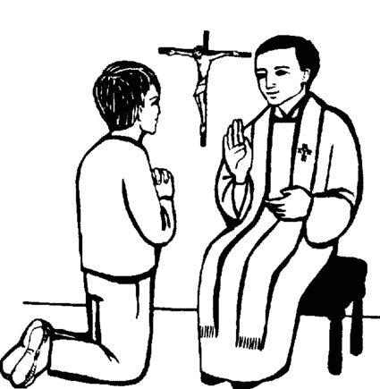
Literacy Reading books will be sent home everyday for practice at home and should be brought back to school each day to be used in different reading activities and tasks. Please encourage your child to read as often as they can and to continue to develop a love of reading. Also remember to use the library as a great free resource to provide a great free variety of books. We will be continuing to learn and revise weekly phonics and spelling words which will be a continual homework focus.
RE
This is a very important year for your child as we are working together to prepare them for receiving their second Sacrament, the Sacrament of Reconciliation. We will be following the This Is Our Faith programme as normal and Reconciliation preparation will be begin in Term 3. We are very fortunate that we attend First Friday Mass as a school but try not let this be your child’s only experience of Church and Mass.
Golden Time
Golden Time will be given on Friday afternoons, similar to previous years. Throughout the week, yellow and red cards are given out in class for children who are not following the class rules. A yellow card is given after an initial warning and a red after a further warning resulting in 5 minutes being taken away from Golden Time. Everyone is given the opportunity to start their day on green, even after a yellow or red the previous day.
The children will be working towards Bronze, Silver and Gold Awards which will be given after a child has had their full golden time for:
Bronze - 10weeks
Silver – 20 weeks
Gold – 30 weeks
The awards for these achievements will be given out before Christmas, Easter and the End of the School Year.
Maths We will be focussing our learning on using a calendar and telling the time, working with numbers up to 100 and then 1000 including place value. We will cover addition and subtraction to develop our mental strategies and written skills. We will also be exploring and developing our knowledge of 2D and 3D shapes.
Interdisciplinary Learning (IDL)
We will be exploring the theme of Road Safety, Castles and the books ‘The Lighthouse Keeper’s Picnic’ and ‘Katie Morag & the Dance Class.’ We will be incorporating craft in our Christmas Enterprise too.
Thank you for taking the time to read our Learning Letter and if there are any worries or queries, please feel free to chat at the end of the school day or arrange an appointment through the Office. We look forward to working together with you this year.
Mrs Durkin & Mrs Reid

