Slide 2
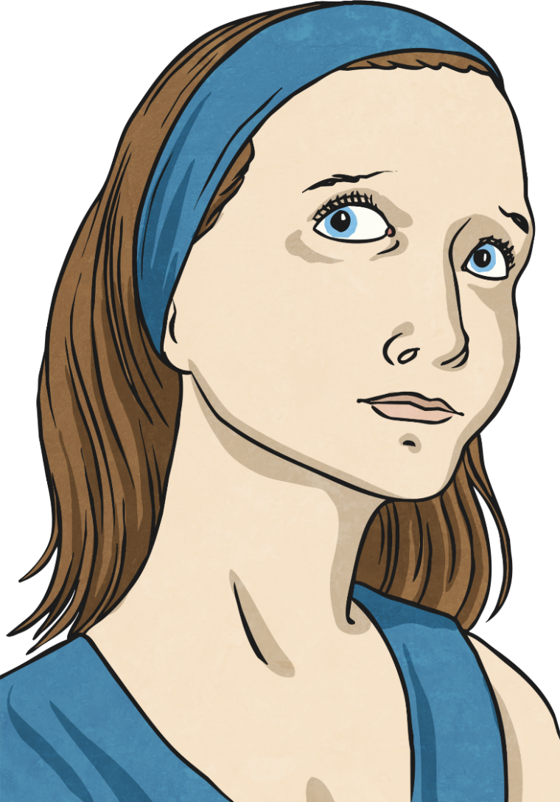
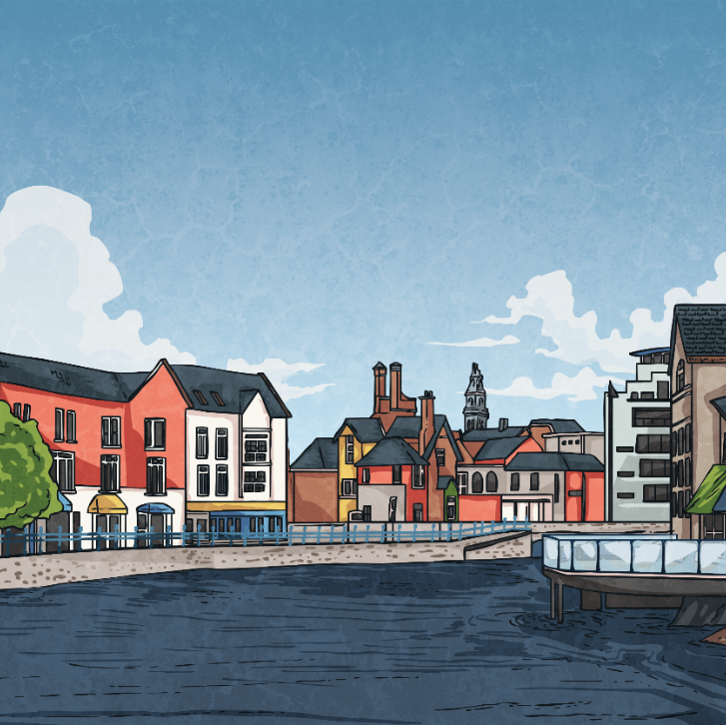
Disaster!
Turn on the news or open a newspaper and you’re likely to read about some kind of disaster.
Click on the circle to find out more.

Slide 3
Natural and Human Disasters
A disaster is an event that causes great damage and loss. Disasters can be divided into two types: natural and human. Click on the circle to found out more.
A disaster caused by human action. These include oil spills, chemical explosions and gas leaks in factories.
A disaster caused by nature or natural events. These include floods, hurricanes and tornadoes..
Human disaster
Natural Disaster

Slide 4
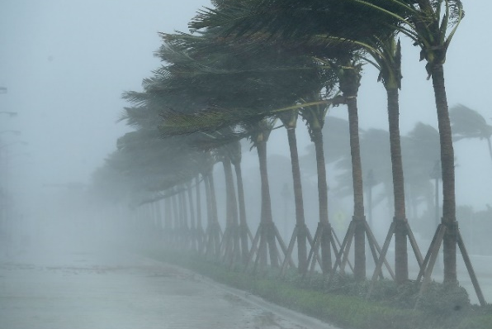
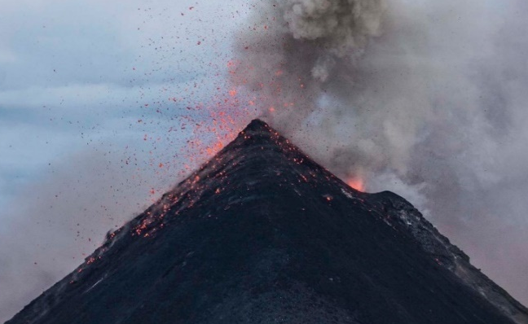
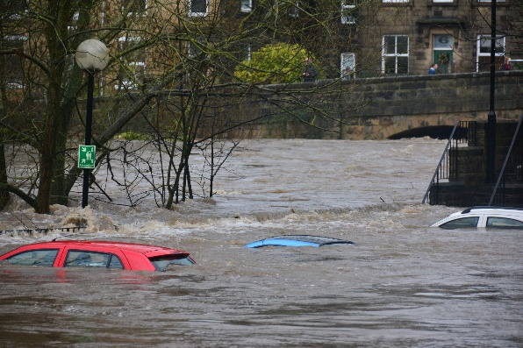
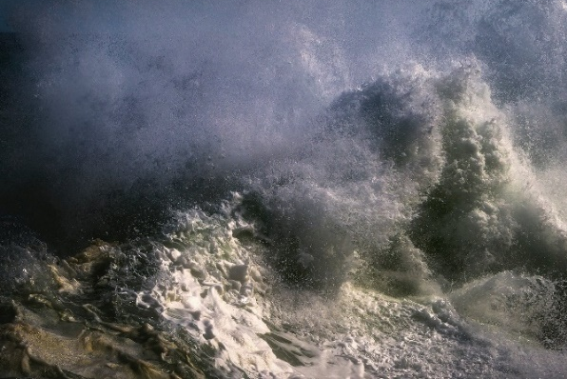
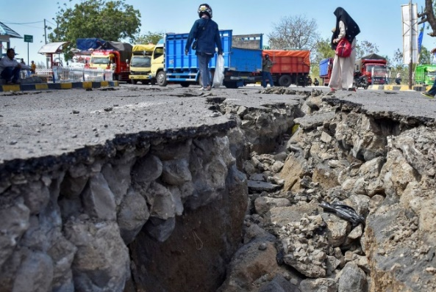
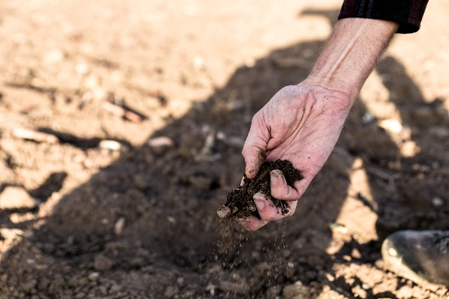
Natural Disasters
Click on the photo to find out more about different natural disasters.
next

Slide 5
Heat Wave
Heat wave - a period of excessively hot weather. A heat wave can have devastating effects on crops, animals and people. Extreme heat can often contribute to other natural disasters such as droughts (prolonged shortage of water).
back

Slide 6
Flood
Flood – when an area or land, that is usually dry, becomes submerged in water. Floods can be caused by an overflow of a body of water such as a river or lake, or by excessive amounts of rainfall over a short period of time.
back

Slide 7
Hurricane
Hurricane – a huge storm that forms over warm seas and oceans. A hurricane can cause winds of over 100 miles per hour. They are often formed in the Gulf of Mexico and the Caribbean.
back

Slide 8
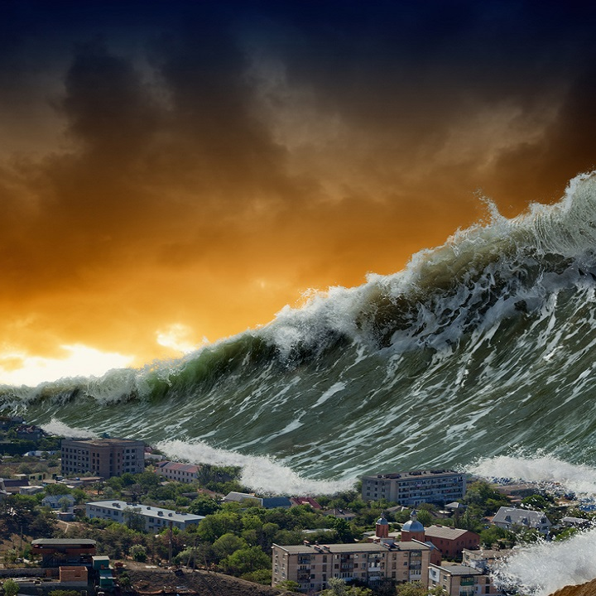
Tsunami
Tsunami – a series of huge waves caused by an earthquake or volcano under the sea.
back

Slide 9
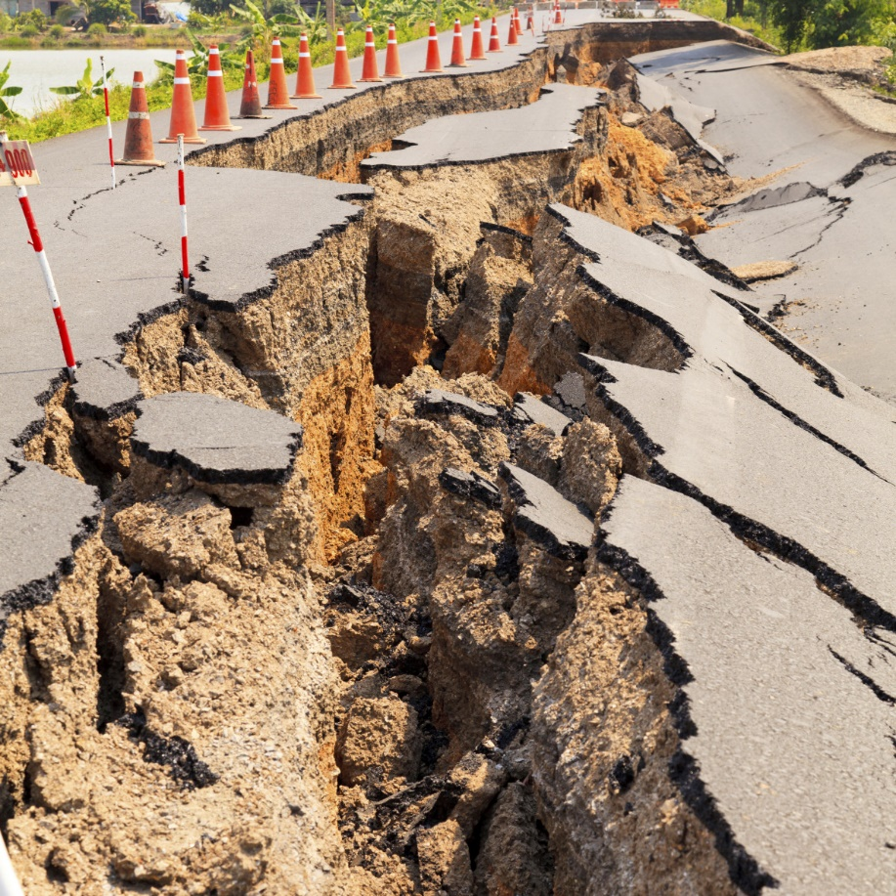
Earthquake
Earthquake – the sudden movement of the Earth’s crusts (its outer layer).
back

Slide 10
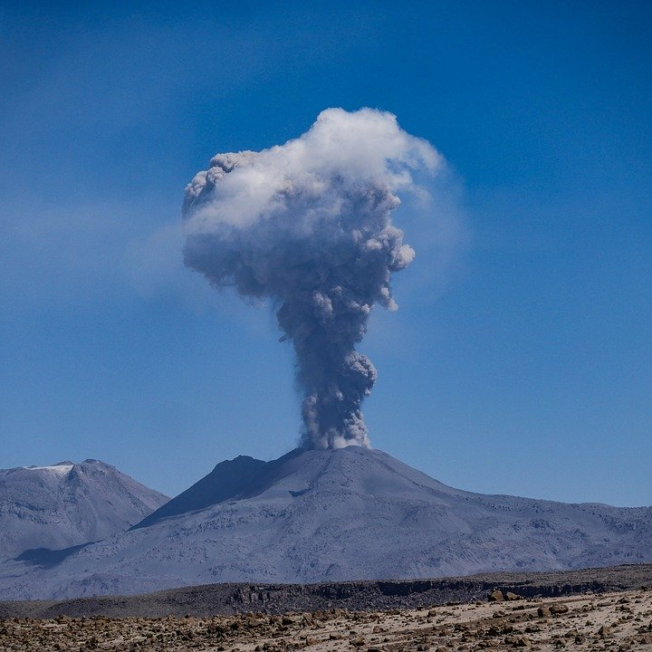
Volcanic Eruption
Volcanic eruption – when lava and gas erupt from a vent in a volcano.
back

Slide 11
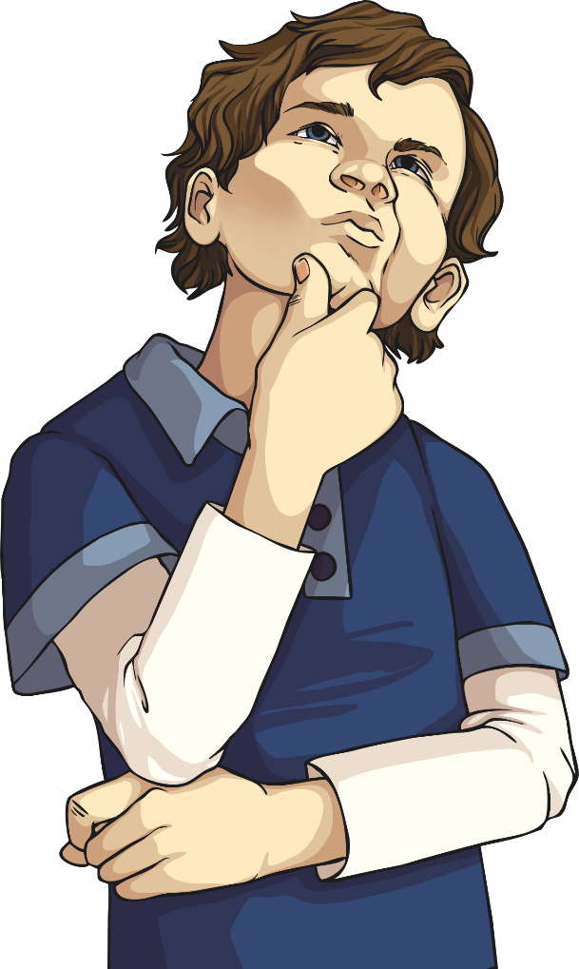
Human Disasters
Here are some examples of human disasters that have
happened to our planet:
The Minamata Poisonings – in April 1956, in Minamata, Japan, people began to exhibit symptoms such as being unable to walk or speak and were suffering convulsions. It soon transpired that a chemical factory had been dumping waste into the local ecosystem for years. The local water source, and therefore the fish living within it, became poisoned with mercury which subsequently caused thousands of deaths.
Deepwater Horizon oil spill – on 20th April 2010, the Deepwater Horizon oil rig exploded. It released 780,000,000 (780 million) litres of oil into the sea. The damage to marine wildlife and beaches is still being felt.
The Aral Sea – farmers started diverting water from the Aral Sea (a lake that was between Kazakhstan and Uzbekistan) to help their crops grow. This has caused the lake to almost completely dry up. The marine life has been lost and fisherman have lost their jobs.
Chernobyl – Chernobyl was a power plant in Ukraine which produced nuclear power. In 1986, an explosion caused one of the nuclear reactors to leak. Over thirty years later, the area is still unsafe to live in or near to.

Slide 12
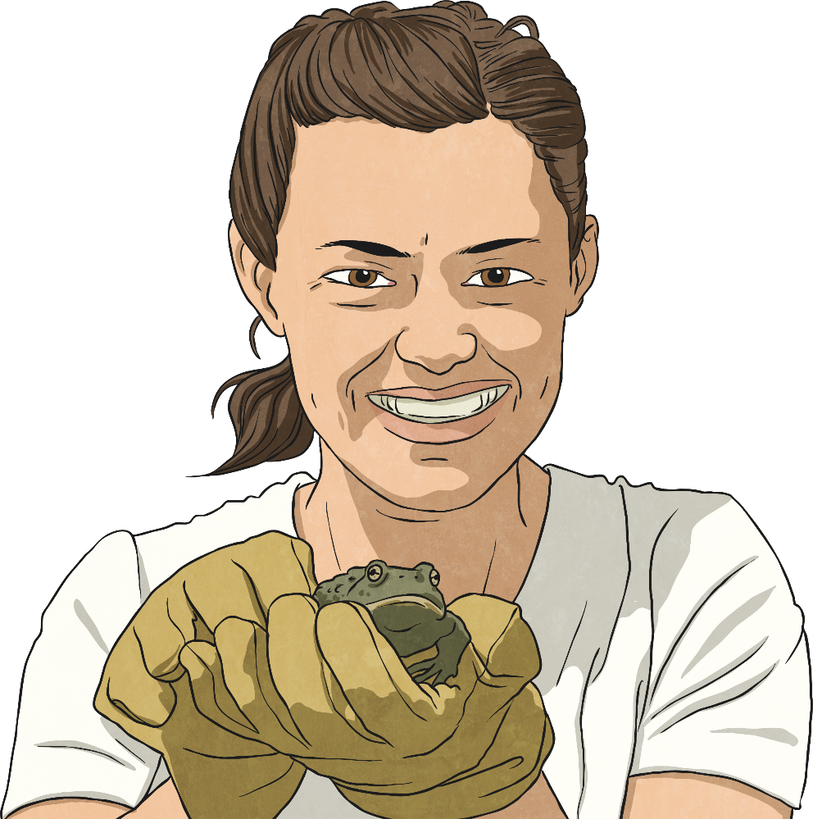
How Humans Cause Disasters
Over recent years, human activity has increased the numbers of apparent natural disasters. Scientists believe climate change has caused extreme conditions such as hurricanes and flooding.
Talk About It
How can humans lessen the possibility of
causing natural disasters?

