Slide 1
Simple Branched Keys
SCN 2-01a AR4

Slide 2
Learning Intention:
Success Criteria:

Slide 3
Scientists use Branched Keys to help them to identify unknown creatures.
The most simple way of doing this is by using their physical characteristics.
To help us understand this concept, we are going to use the Mister Men…

Slide 4
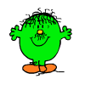
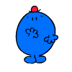
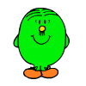
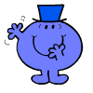
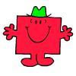
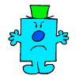
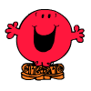
Meet the Mister Men
Lets start by splitting them in half…
What characteristic could we use to do this?

Slide 5
1) Does he have a hat?
Yes
No

Slide 6
Mr Men with Hats
2) Is he round?
Yes
No

Slide 7
Mr Men without Hats
2)Does he have hair?
Yes
No

Slide 8
Mr Men with Hats who are round
3)Is his hat red?
Yes
No

Slide 9
Mr Men with hats who aren’t round
3) Is he smiling?
Yes
No

Slide 10
Mr Men without hats who have hair
3) Is his hair neat and tidy?
Yes
No

Slide 11
Mr Men without hats and hair
3) Is he wearing shoes?
Yes
No

Slide 12
Mr Clumsy
His Characteristics
He doesn’t have a hat
He has hair
His hair isn’t neat and tidy
Back to the start

Slide 13
Mr Forgetful
His Characteristics
He does have a hat
He is round
His hat is red
Back to the start

Slide 14
Mr Fussy
His Characteristics
He doesn’t have a hat
He has hair
His hair is neat and tidy
Back to the start

Slide 15
Mr Grumpy
His Characteristics
He does have a hat
He isn’t round
He isn’t smiling
Back to the start

Slide 16
Mr Happy
His Characteristics
He doesn’t have a hat
He doesn’t have hair
He isn’t wearing shoes
Back to the start

Slide 17
Mr Impossible
His Characteristics
He does have a hat
He is round
His hat isn’t red
Back to the start

Slide 18
Mr Noisy
His Characteristics
He doesn’t have a hat
He doesn’t have hair
He is wearing shoes
Back to the start

Slide 19
Mr Strong
His Characteristics
He does have a hat
He isn’t round
He is smiling
Back to the start

Slide 20
Now we are going to try a similar activity, but using a branch key.
Each group will get a key and pictures of the Mister Men.
(Print Slides 21 and 22)
In your groups, match the Mister Man with the correct description.
Check to see if you have it correct.

Slide 22
Start
No Hat
Hat
Hair
No Hair
Not Round
Round
Hair not tidy
No Shoes
Not Smiling
Hair tidy
Shoes
Smiling
Red Hat
No Red Hat

Slide 23
Here are the Answers…
Start
No Hat
Hat
Hair
No Hair
Not Round
Round
Hair not tidy
Hair tidy
Not Smiling
No Red Hat
Shoes
No Shoes
Smiling
Red Hat
Mr Clumsy
Mr Fussy
Mr Noisy
Mr Happy
Mr Strong
Mr Grumpy
Mr Impossible
Mr Forgetful

Slide 24
Now let’s try a real life example…

Slide 25
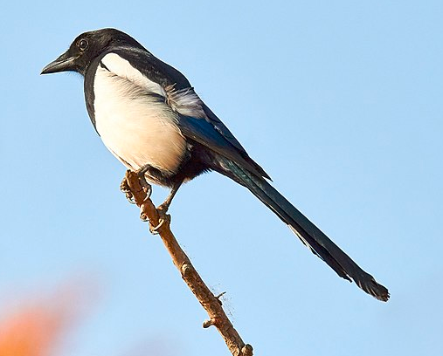
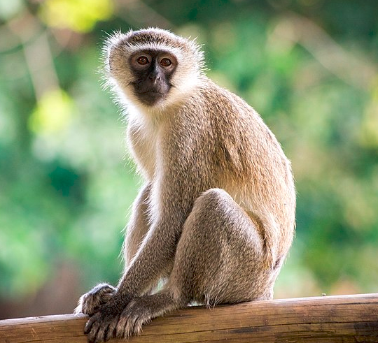
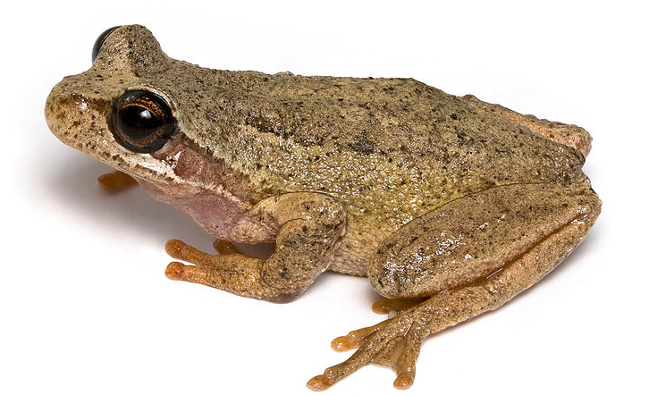
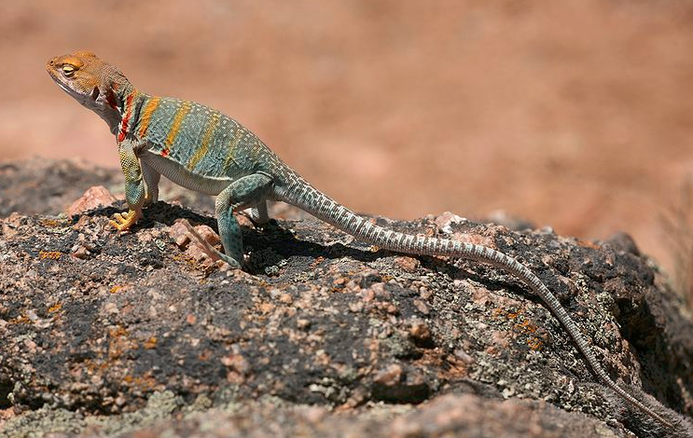
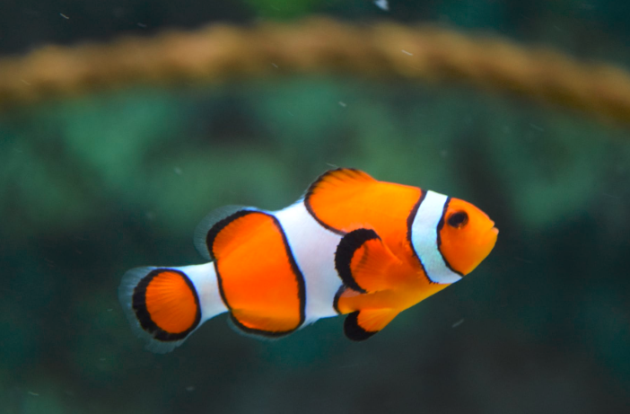
Start
Legs
No Legs
4 Legs
2 Legs
Tail
No Tail
Hair
Scales

Slide 26
Can you think of a different key using the same animals?

