Slide 1


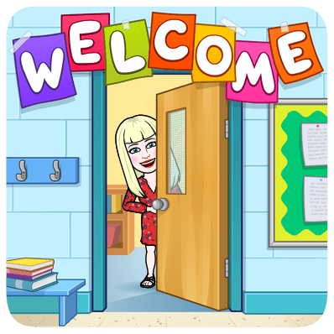

Primary 4’s
Virtual Curriculum Evening
Wednesday 22nd September 2021

Slide 2


Key points
Meet the teacher
What does the class look like?
Literacy
Numeracy and Mathematics
Health and Wellbeing
Religious Education
Feedback and Reporting
How can I support my child at home?
Keeping in touch

Slide 3
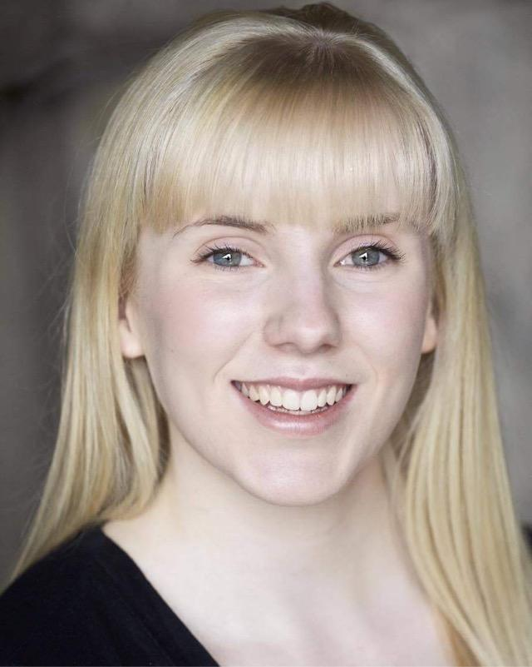
Meet the Teacher
My name is Miss Henery and I became a member of the St. Helen’s family last August. I am now into my second year of teaching at St. Helen’s and I love working with all the amazing pupils and staff every day!

Slide 4

What does the class look like?

Slide 5
What does the class look like?

Slide 6

Literacy
There are three components to Literacy:
Reading
Writing (Spelling and Taught Writing)
Listening and Talking
The following slides will go into more detail about each component.

Slide 7






Reading
This term pupils have been engaging in a modelling block where all pupils read the same book. In Primary 4, this was The Best Dog in the World which pupils have really enjoyed. The modelling block introduces pupils to the reading comprehension strategies which are:
Prior Knowledge, Metalinguistics, Visualisation, Inference, Main Theme and Summarisation.
These strategies will help pupils gain a deeper understanding of their book by equipping them with various skills they can use in Literacy and beyond. Upon completion of the modelling block, learners will work in their own reading groups with a text and written tasks best suited to their reading level. Below you can see some of the texts pupils will be reading this year.

Slide 8
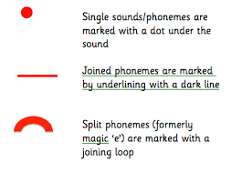
Writing
. Spelling
In Primary 4 pupils will develop their knowledge of different spelling strategies which will help them spell common and tricky words.
Pupils will also focus diacritical marking and the use of Elkonin boxes to assist the learning of their spelling words.
New phonemes and spelling rules will also be explored this year.
Taught Writing
Pupils have Taught writing once a week and will explore a range of genres throughout the year.
These genres include Narrative, Recount, Information Reports and Persuasion.
Pupils will develop their writing targets each week and enhance their ability to use different types of figurative language such as metaphors and similes.
As well as Taught Writing, pupils will have many opportunities to participate in free writing throughout the week.

Slide 9


Listening and Talking
Pupils will have many opportunities to engage in Listening and Talking exercises in class.
Recently, pupils planned and presented their own solo-talks based on their hobbies and interests. They did a fantastic job and we had an array of topics from basketball to boxing.
From discussing the latest headlines on Newsround to participating in circle time with their peers, pupils will have lots of practise to develop key Listening and Talking skills.
Skills that pupils will learn include listening and responding to others with respect; discussing the purpose and ideas of a text; waiting for their turn to speak; and forming their own opinions.

Slide 10

Numeracy and Mathematics
Maths lessons are split into three parts:
Mental starter
Number Talks
Main Maths Lesson
The next three slides will talk about each part in more detail.

Slide 11
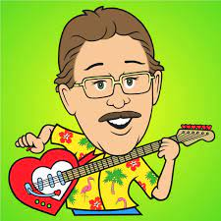
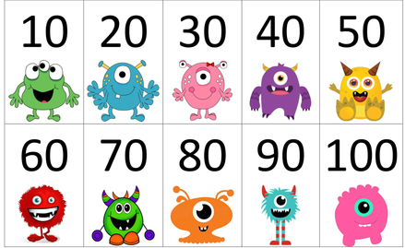
Mental Starters
Mental starters allow the children to be eased in gently to the maths lesson.
Starters we have used in class include counting forwards and backwards in various sequences such as 2s, 5s, 10s and 100s. We also practise our multiplication tables using Jack Hartmann music videos on Youtube. His videos can be found by clicking this link- https://www.youtube.com/c/JackHartmann/featured
Pupils love to sing along, so does Miss Henery!
We also play games such as 21, Buzz, Around the World and Bingo.

Slide 12



Number Talks
Number Talks is used to develop and strengthen pupils’ mental agility. It looks at strategies children can use with addition, subtraction, multiplication and division.
Once the children revise specific strategies with the class teacher, they are invited to take part in a Chilli Challenge. The Challenge involves three different sums (Mild, Hot, Extra Hot) and the children have the choice to do one, two or all three of the sums.
Afterwards we discuss the different strategies used to solve the problems and children are encouraged to share their thinking with their peers and teacher. Pupils are also encouraged to use hand signals in order to show that they have an answer, agree with someone else or have a different answer.

Slide 13
Main Maths Lessons
This year pupils will continue to develop their knowledge of different Maths topics.
These will include: Number Processes, Fractions, Money, Shape and Time.
Pupils will also have the chance to discuss when their Maths skills would be used in real life situations. There will be a range of opportunities to utilize their Maths skills in real life situations which will encourage the development of critical thinking and problem solving.
Practical materials will be used (when required) to facilitate learning and teaching. This includes materials such as: 100 squares, concrete materials (cubes, ten frames etc.) 3D shapes and clocks.
Below are examples of textbooks your child will use this year to consolidate their learning.

Slide 14
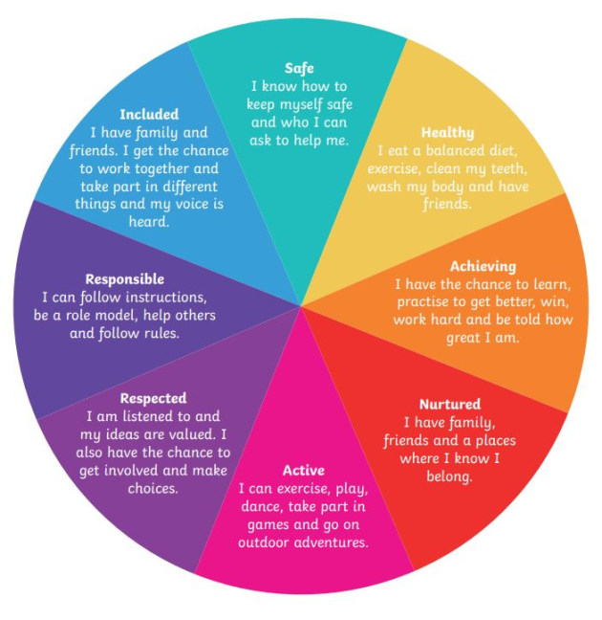
Health & Wellbeing
In Health and Wellbeing, we learn about the SHANARRI Indicators-
Safe, Healthy, Active, Nurtured, Achieving, Respected, Responsible and Included.
Each month, pupils will learn about each indicator in more depth. They will be able to give real life examples of each indicator and how they can incorporate it into their daily lives to help themselves and others. As well as the SHANARRI Indicators, pupils will be learning about the importance of adopting a growth mindset and keeping our minds and bodies calm through mindfulness exercises.

Slide 15

Health and Wellbeing- Physical Education
Pupils participate in P.E. lessons twice a week.
Our P.E. days this year are a Monday and Tuesday.
During these lessons pupils will have many opportunities to engage in a variety of sports and activities such as ball games, athletics and dance.
Most recently, pupils have been learning to keep fit through HIIT exercises and participating in team games in order to learn about working with others and keeping each other safe.
On these days pupils should come to school wearing their P.E. kits. They should also be dressed appropriately for the weather as at times P.E. will take place outside.

Slide 16

Religious Education
R.E. will continue to be a strong focus as we are proud of our Catholic identity.
So far in R.E. we have been looking at keeping our mind, body and soul healthy, the power of prayer and responding to God’s love through Bible stories.
Furthermore, some of our pupils will be making their First Holy Communion next year which is always an exciting and memorable experience for our pupils.
First Communion dates for next year have not been confirmed yet but as soon as they are, we will let you know as soon as possible.

Slide 17
Feedback and Reporting
Personal Learning Plans will be handed out to the pupils next month.
Pupils will have targets for Reading, Writing, Listening and Talking, Maths and Health and Wellbeing.
Personal Learning Plans are used to ensure children feel involved in their learning, are aware of their next steps and are active participants in learning.
We know parents and carers want to be part of the learning journey with children so the document helps to share information on your child's learning with you.
There are instructions included in the document to explain how to use the Personal Learning Plans to support discussions about learning at home.
Personal Learning Plans will be sent out on Monday 25th October and there will be no homework that week to ensure there is enough time to focus on creating targets.

Slide 18
Feedback and Reporting (continued)
Here is a list of important dates to remember:
Monday 25th October 2021 - Personal Learning Plans sent out (no homework this week).
Thursday 11th November 2021 – Interim Parent’s Evening, a chance for parents/carers to speak with Class Teachers (arrangements will be made for this in line with Government guidelines).
Monday 6th December 2021 - Personal Learning Plan Tracker sent home with feedback on how children are progressing with their targets.
Monday 24th January 2022- Updated Personal Learning Tracker sent home with new targets set.
Monday 28th March 2022 - Personal Learning Plans sent home with feedback on how pupils are progressing with their targets.
Monday 23rd May 2022 - Report cards sent out to Parents/Carers
Wednesday 25th May 2022 - Final Parents Evening

Slide 19
How can I support my child’s learning?
There are lots of things you can do to support your child’s learning at home.
Reading to children- bedtime stories are very beneficial. Talk about what has just been read and what details can be recalled.
Outdoors- play games such as eye spy or rhyming games to help with recall and memory. For example, on a trip to the supermarket you could test each other on what has been packed away and turn it into a little competition!
Singing songs and rhymes- as mentioned earlier, pupils love to learn new things through songs. These could be songs to help learn times tables or spelling words.
At the end of this presentation, there is a list of websites broken down into each curricular area that can be useful when learning from home.

Slide 20


Keeping in Touch
Although there are lots of opportunities across the year to hear about how your children are getting on, you can still get in touch with the school at any time if you have a concern or would like further information. This can be arranged by calling the office.
You can also keep in touch by visiting our website and by following us on Twitter.
https://blogs.glowscotland.org.uk/nl/sthelens/
@StHelnsNLC

Slide 21

Thank you for taking the time to watch and listen to our Virtual Curriculum Information Evening. I hope you found it informative and beneficial. If you have any questions, please do not hesitate to get in touch.
I am looking forward to working alongside all parents and carers this year to support the children through their learning journey.
Miss Henery ☺

Slide 22
Useful Learning Links
Maths-
https://play.ttrockstars.com/
http://www.primaryhomeworkhelp.co.uk/maths/timestable/interactive.htm
https://www.topmarks.co.uk/maths-games/hit-the-button
https://www.topmarks.co.uk/maths-games/daily10
http://www.oswego.org/ocsd-web/games/mathmagician/maths1.html
Reading
https://www.oxfordowl.co.uk/for-home/find-a-book/library-page/
Handwriting videos
https://appytherapy.com/handwriting-heroes/
Spelling
https://www.spellingcity.com/

Slide 23
Useful Learning Links
Science
https://mysteryscience.com/
Health and Wellbeing
Meditation at www.headspace.com
Mindfulness and Yoga at https://www.youtube.com/c/CosmicKidsYoga
Joe Wicks P.E. Lessons at https://www.youtube.com/playlist?list=PLyCLoPd4VxBuS4UeyHMccVAjpWaNbGomt
Social Studies
https://www.nationalgeographic.org/idea/fun-geography/
https://www.bbc.co.uk/newsround
Technologies
Computer Programming https://scratch.mit.edu/
Languages
Revise your knowledge of Italian and French here at https://www.duolingo.com/

