Slide 1



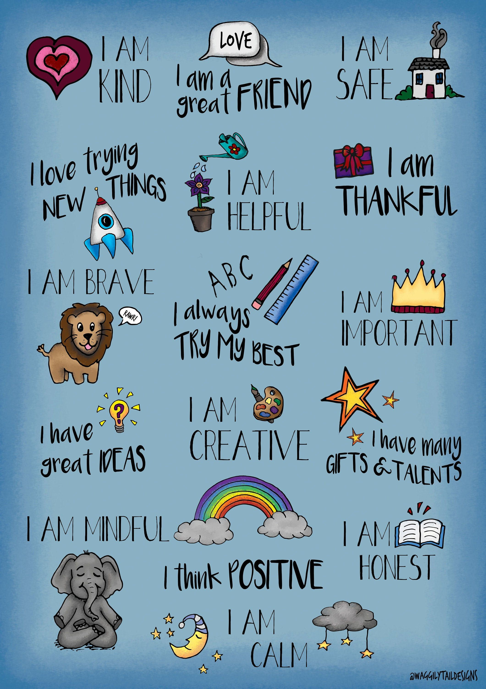


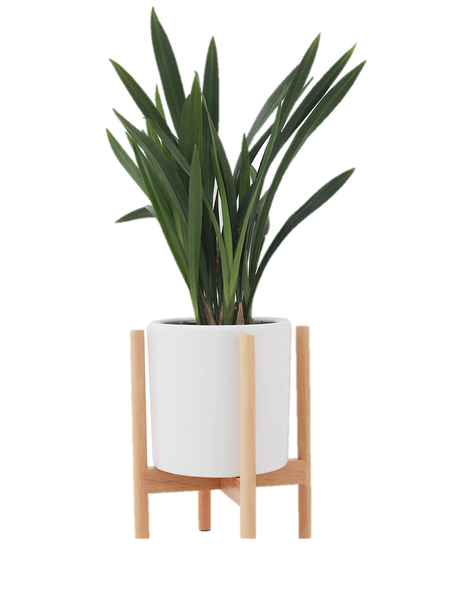
Primary 7/6 with Miss Williamson

Slide 2





Fact File:
Name: Miss Williamson
Class: Primary 7/6
Experience: 8 years
Favourite Subject(s) to teach: Literacy, number talks, Art and P.E.

Slide 3


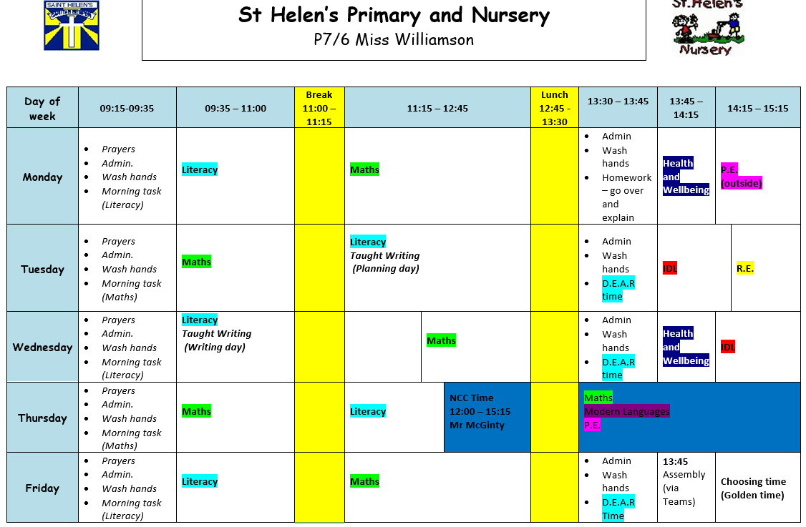

Our Classroom
There are 22 pupils in our class.
We have 11 Primary 7 children and 11 Primary 6 children.
Our class routine is the same each week and our timetable can be found on our class team in the class materials folder in files.

Slide 4






Literacy
Here are St. Helen's we follow the NLC Active Literacy Programme which divides literacy into 3 areas:
Reading
Writing
Talking and listening
LI: to use figurative language to enhance our writing

Slide 5



Reading
In our first term back at school, we focus on a class ‘Modelling block.’ This allows for revision and consolidation of the 6 Reading Comprehension strategies:
Prior Knowledge – making predictions about the text
Visualisation - quoting information about character/setting
Main Idea – finding the main events from a chapter(S)
Summarisation – writing a summary of the main points
Inference – interpreting the author’s message
Metalinguistics – finding the meaning of tricky words
LI: to use the reading comprehension strategies to explore the novel Carrie’s War.

Slide 6
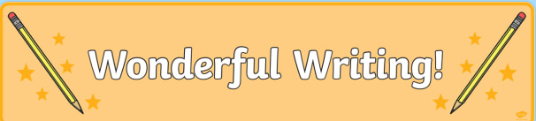

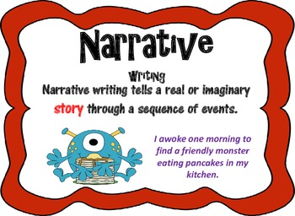
Writing
This year we focus on 7 writing genres:
Narrative
Information Report
Instruction
Recount
Explanation
Persuasive
Discursive
The children explore the genre initially by highlighting the genre features and then develop their writing over a block of 5 weeks, ending in assessment.
LI: to write a narrative story using the genre features.

Slide 7
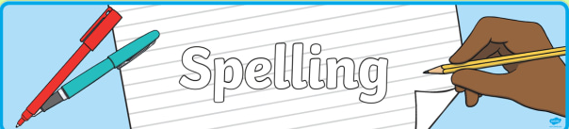
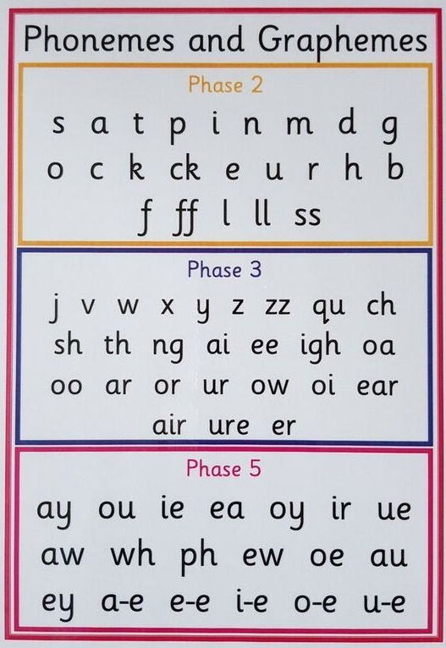

Spelling
Within in our classroom we have 3 spelling groups.
The red and blue group are focusing on Stage 6/7 words, which are a combination of common words, tricky words and ‘topic’ based words.
The green group are focusing on common words and phonemes using the Code Cracker programme.

Slide 8
Spelling
Each week we have a spell check and dictation on Friday to assess our progress.
Our spelling words are posted in the general channel in the class materials folder under files.

Slide 9

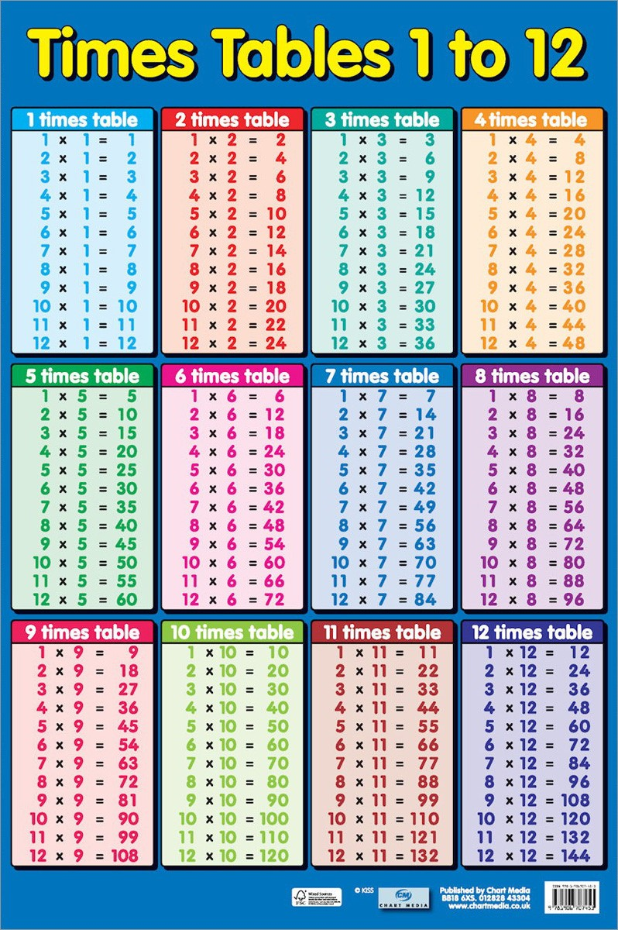

Numeracy
Follow the Numeracy Pathway.
This term we will focus on: number, addition, subtraction, multiplication and division before Christmas.
Number talks is used to teach the 4 number operations: addition, subtraction, multiplication and division.
Mr McGinty will cover additional maths concepts which are typically at the end of the pathway which may have been missed during lockdown.

Slide 10




Health and Wellbeing
This term we are focusing on health through the lens of the SHANARRI indicators.
Each week we will focus on a different indicator and a different aspect of that indicator.
At the beginning of this term we set learning goals (ask your child what their goals are for this term.)
Our P.E days are Monday and Thursday. This term we are focusing on ball games and skills.

Slide 11


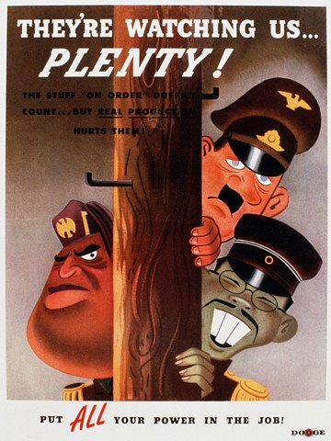
IDL (Interdisciplinary Learning)
This term our IDL focus is World War Two.
The children have enjoyed learning about the events leading up to the war and have been researching WWII leaders.
Last week we created symmetrical sketches of the leaders in class and this week we will be making fact files about them.
We hope to explore this theme until Christmas as the children came up with lots of ideas and questions during our K.W.L lesson (What we KNOW, What we WOULD like to find out, What we have LEARNED)

Slide 12
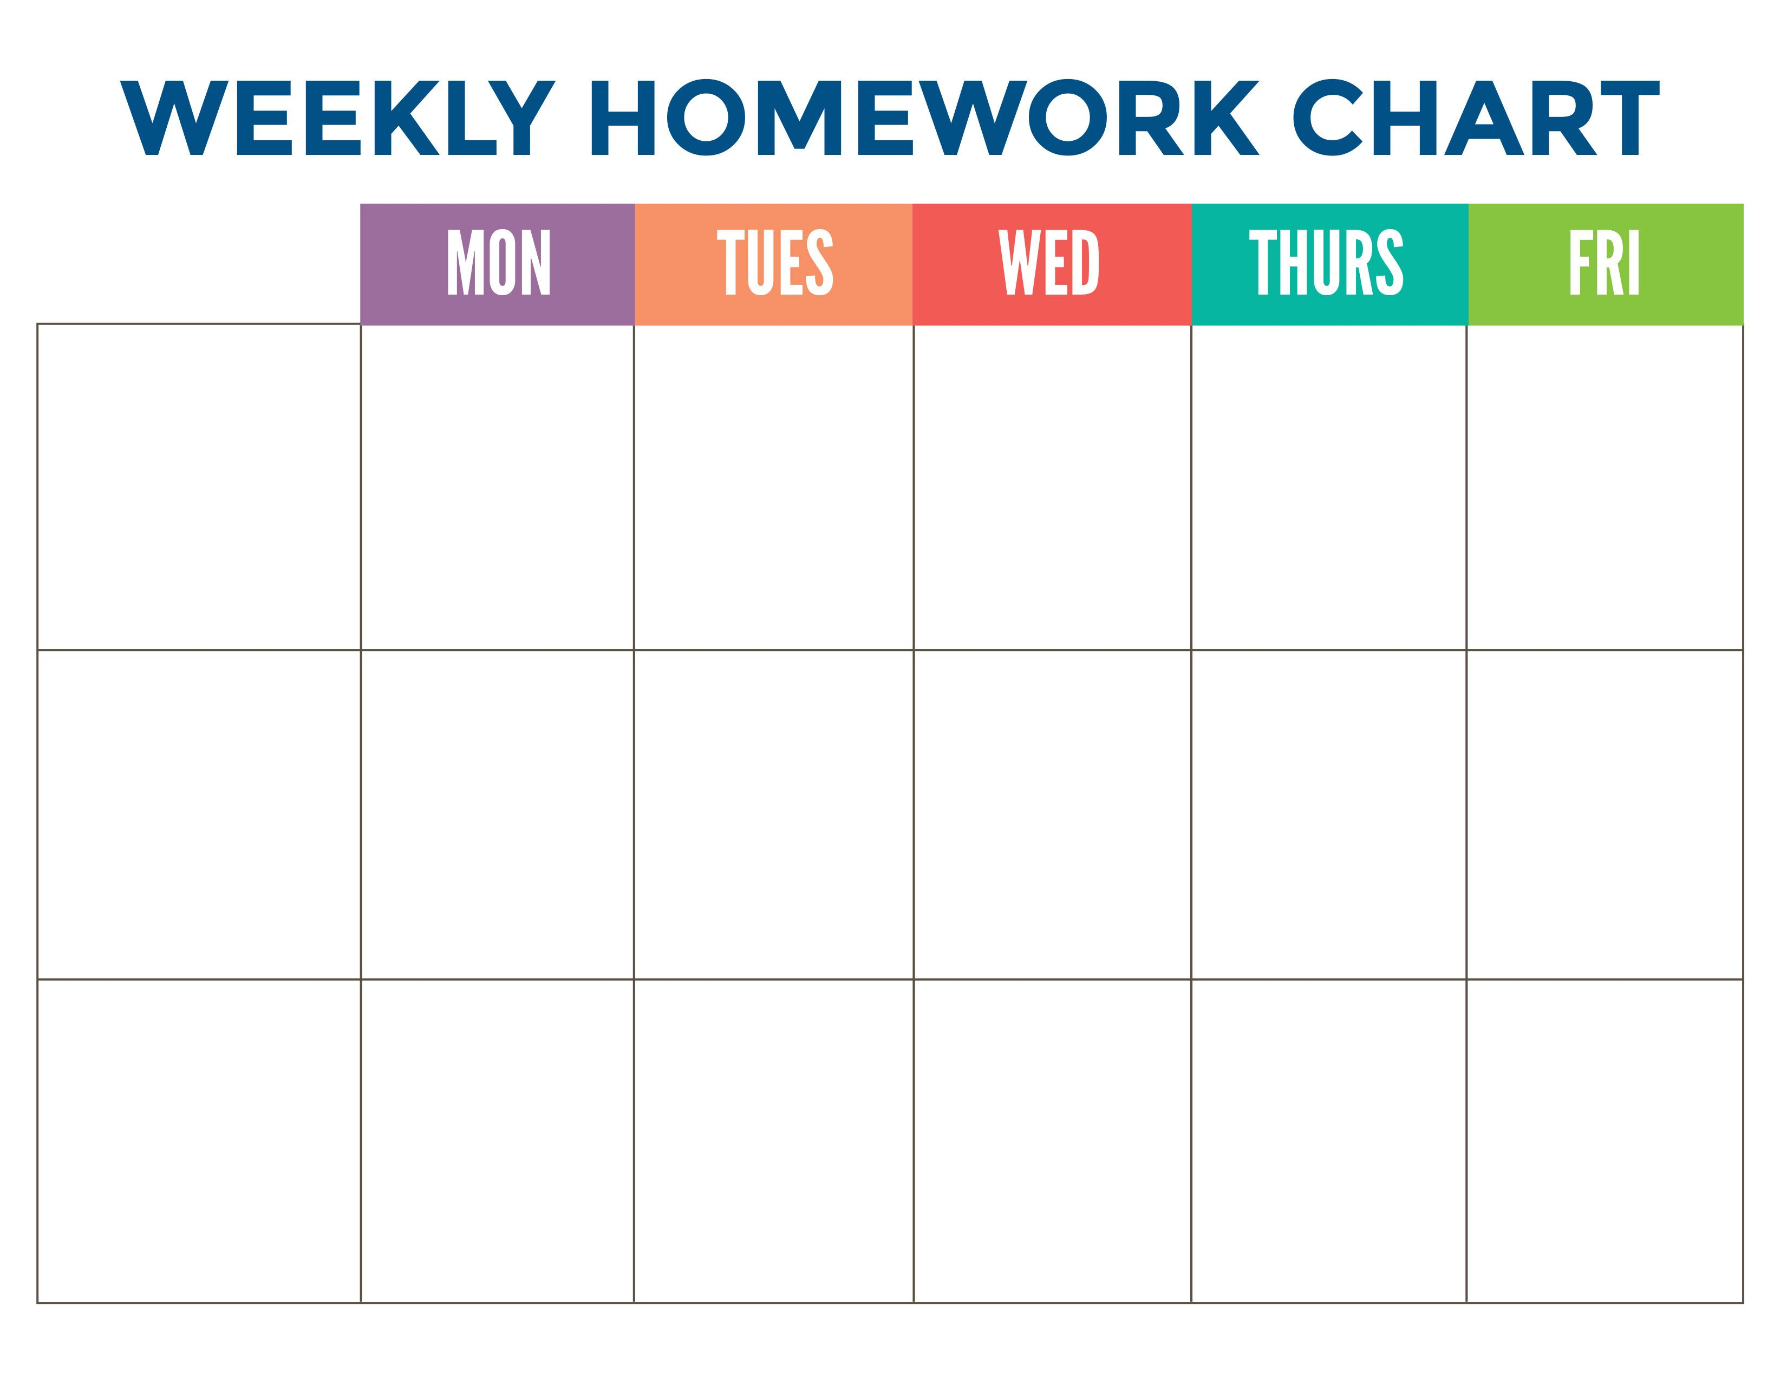



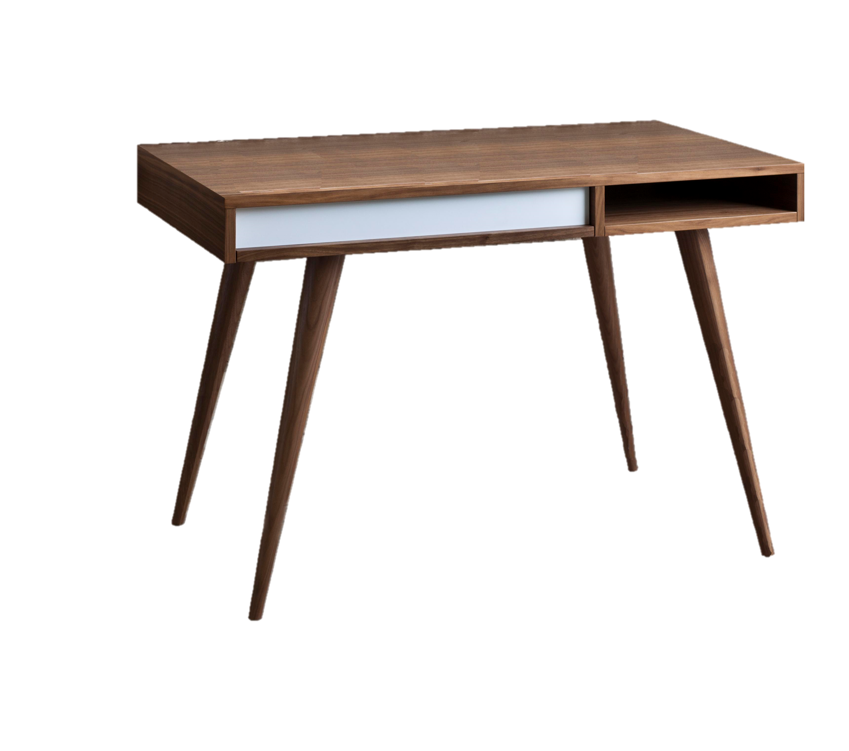
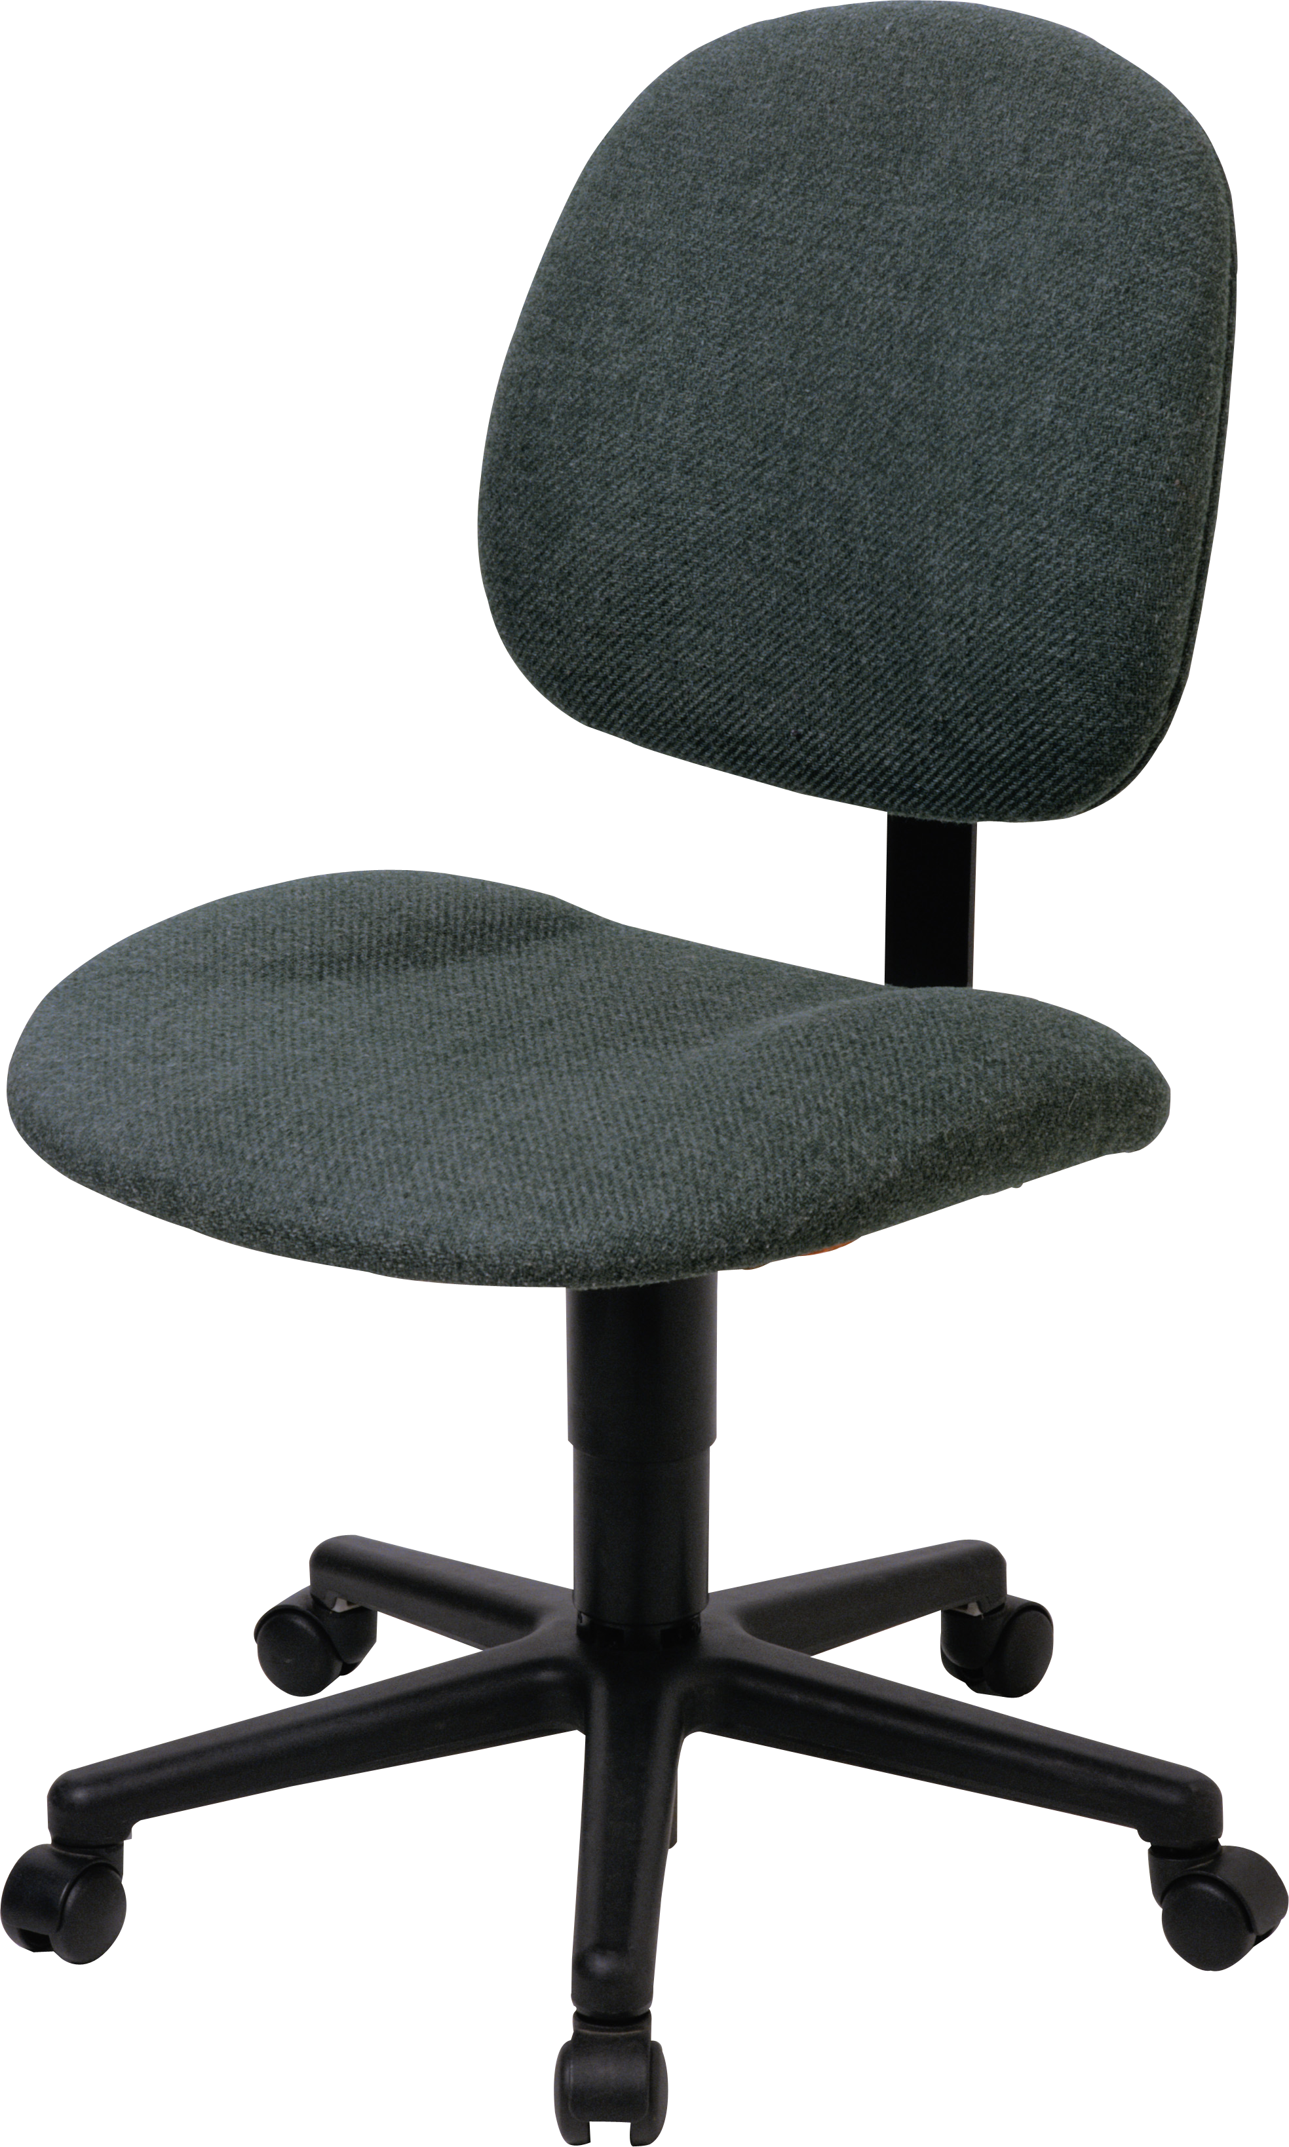
How to support your child at home?
Microsoft Teams
Links to class resources (on General channel)
Reading (Class novels/home reader)
Extra spelling practice
Times tables practice
Maths games
Digital School’s Virtual Classroom

Slide 13
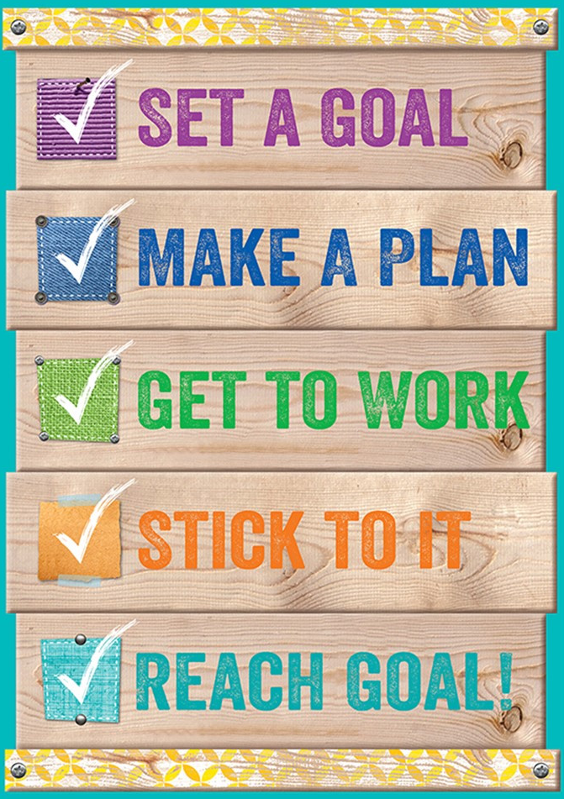
Feedback and Reporting
Personal Learning Plans (PLPs)
PLPs will be sent home on Monday 25th October. This will highlight your child’s targets for this term which have been set along with their class teacher.
PLPs trackers will be sent home again on Monday 6th December to provide feedback on the children’s progress with their targets for Reading, Writing, Talking and Listening and Maths. Please feel free to provide feedback on this.

Slide 14
Feedback and Reporting
Personal Learning Plans (PLPs)
Updated PLPs will be sent home again after Christmas, on the 24th January 2022, with new targets set.
This will be followed by PLP Tracker, on the 28th March 2022, to provide feedback on the children’s progress with their new targets.

Slide 15
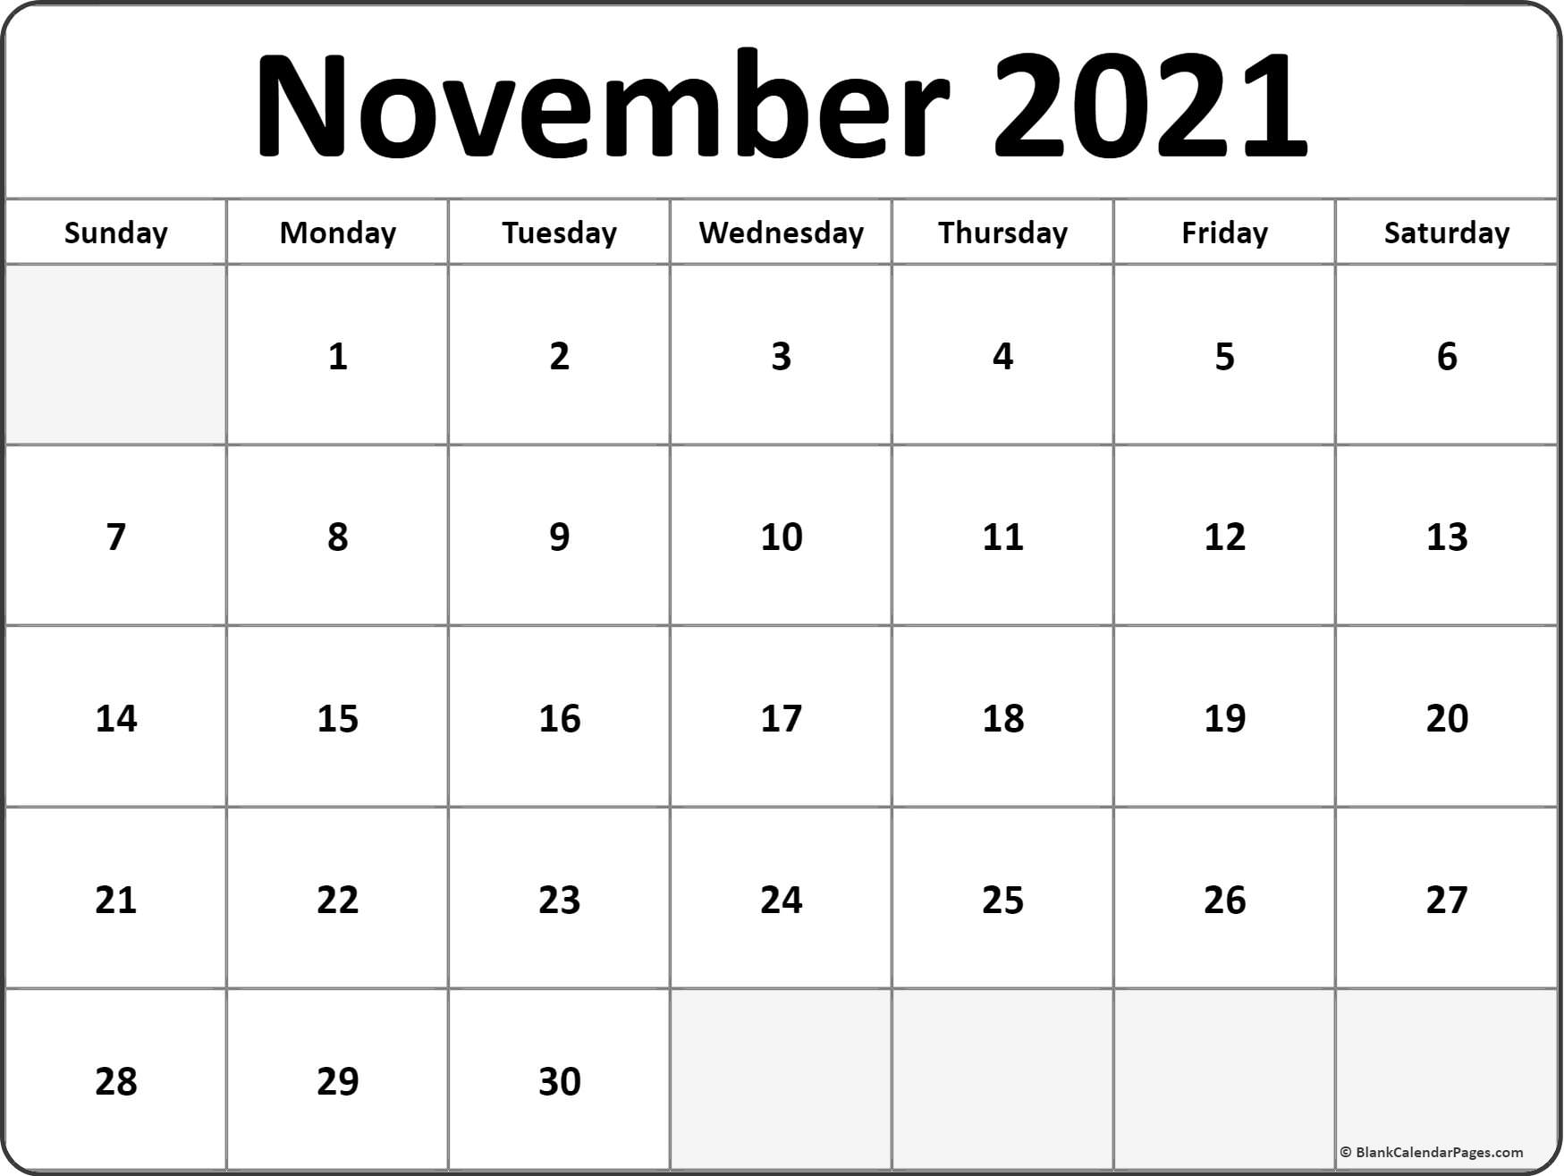
Feedback and Reporting
Parents’ Evening and Report Cards
Parents’ evening will take place on Thursday 11th November in line with Government guidelines. Arrangements to be confirmed.
Our final Parents’ evening will take place on Wednesday 25th May 2022.
Report cards will be sent home Monday 23rd May 2022.

Slide 16
Dates for your diary
Holidays
September weekend
Friday 24th September -Monday 27th September
October holiday
Monday 11th October – Friday 15th
Flu Vaccinations
Tuesday 2nd November
Christmas holiday
Wednesday 22nd December 2021 – school closes 2.30pm. Monday 10th January – return to school.

Slide 17


Keep in touch
If you have any questions, please contact me on nlwilliamsonl2@northlan.org.uk
Or call the school office at 01236 632068.
You can also keep up with us onTwitter @StHelensNLC or by checking out our school website at https://blogs.glowscotland.org.uk/nl/sthelens/

Slide 18

Thank you for taking part in our Curriculum Information session. I have had an great first term with the children and look forward to getting to know them more, and seeing their progress over this year.

Slide 19

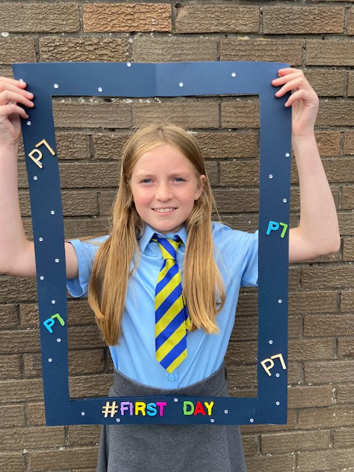
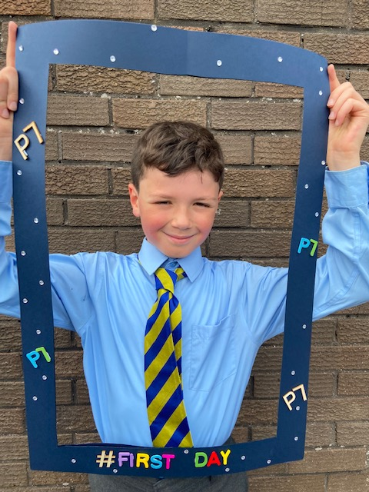

Slide 20
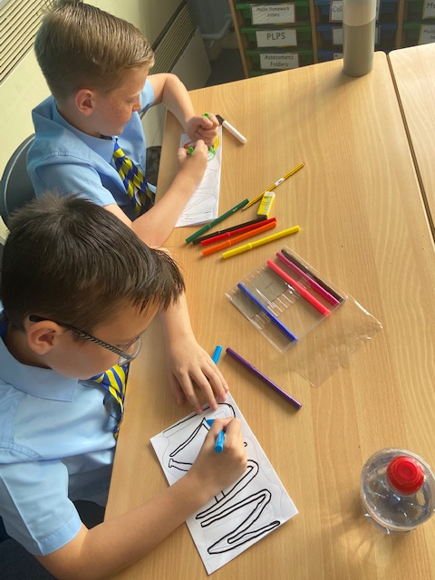
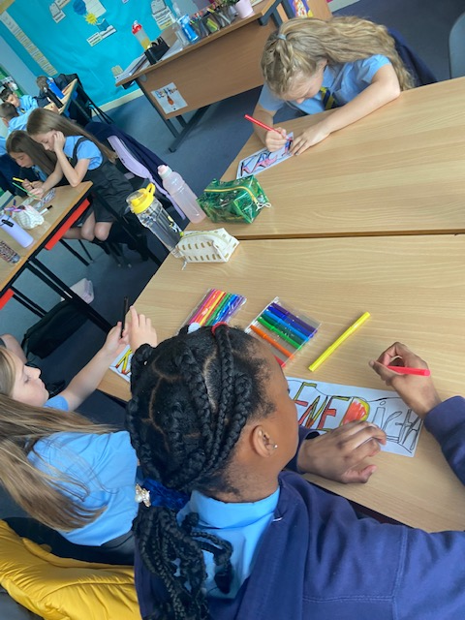

Slide 21
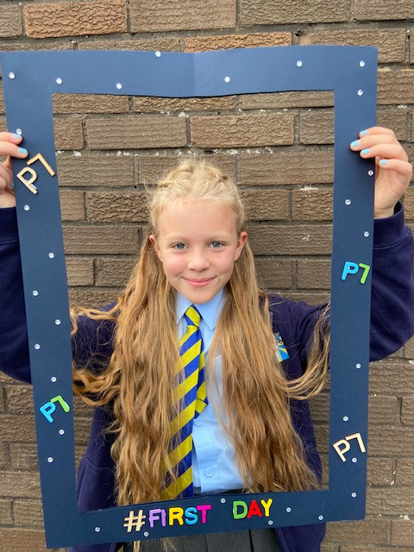
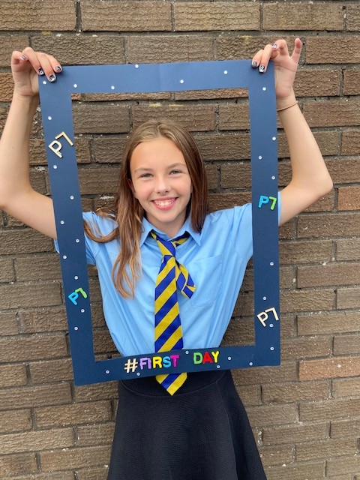

Slide 22
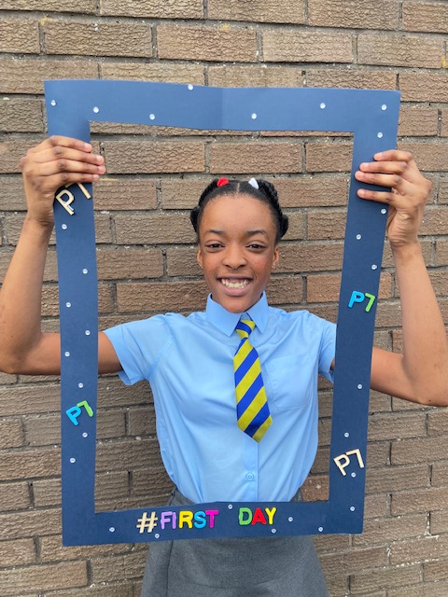
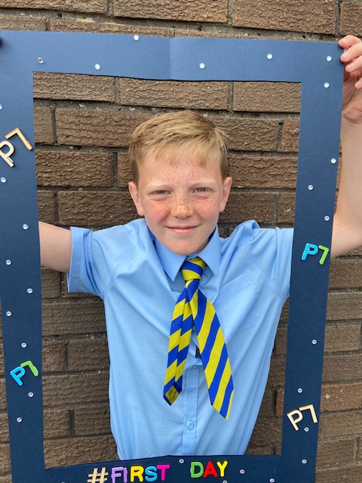
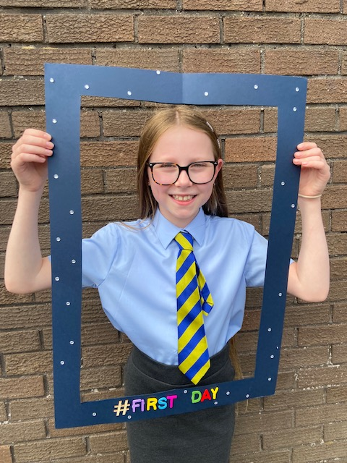

Slide 23
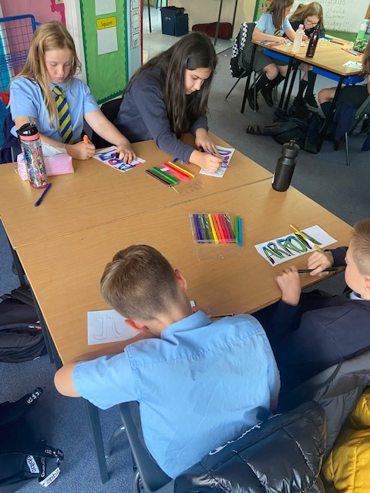
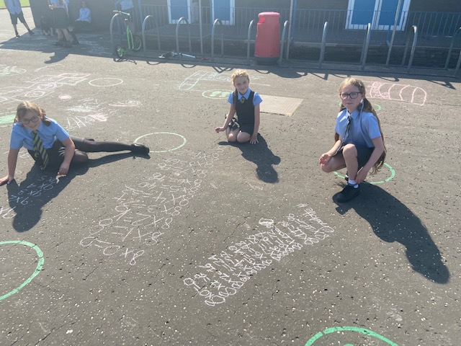

Slide 24
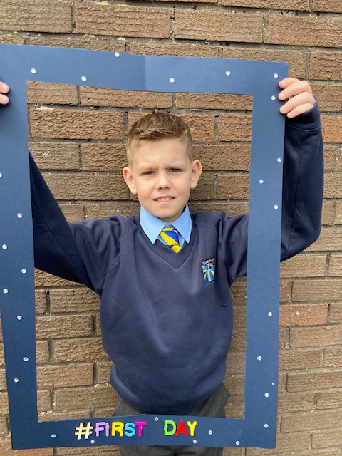
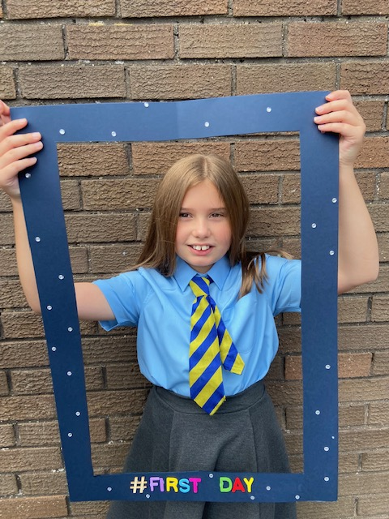

Slide 25
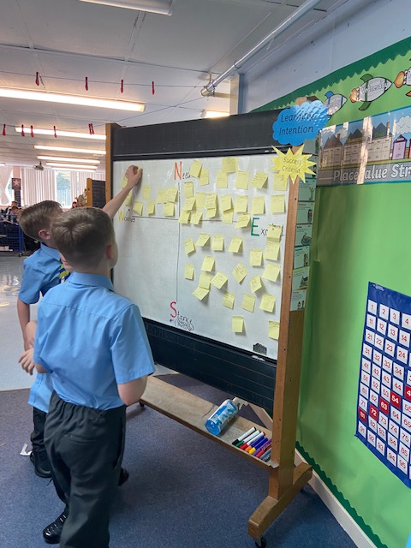
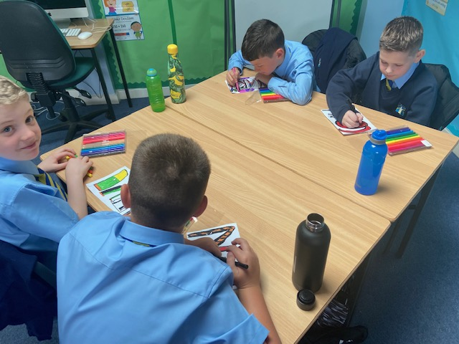

Slide 26
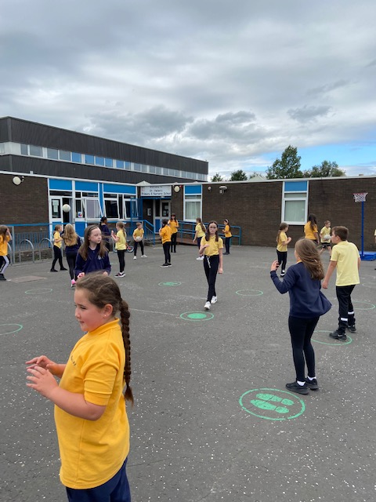
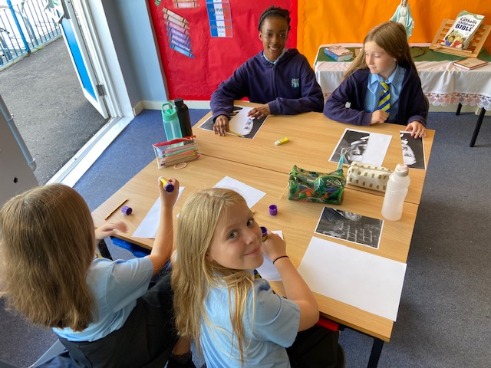

Slide 27
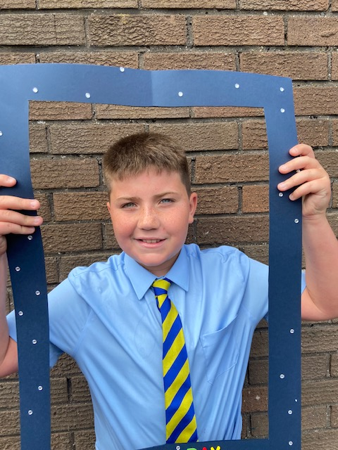
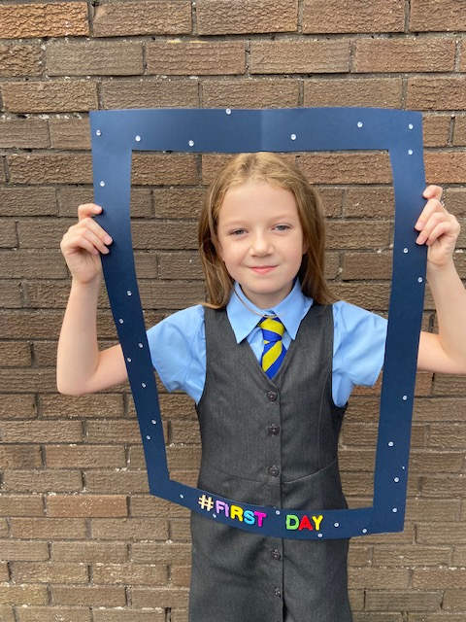

Slide 28
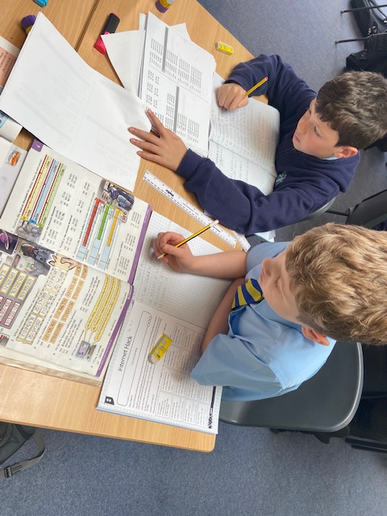
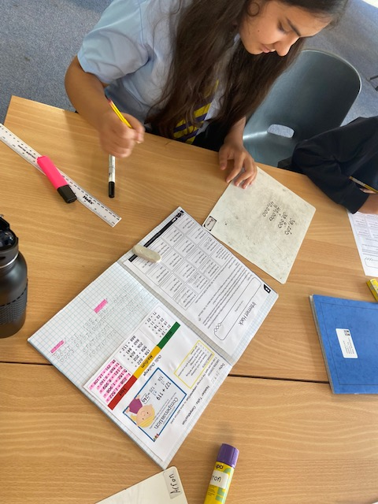

Slide 29
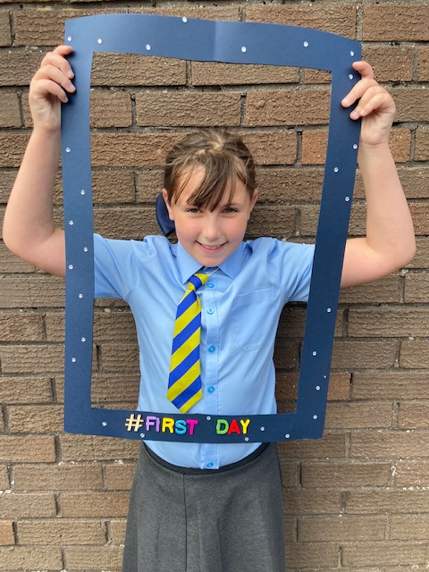
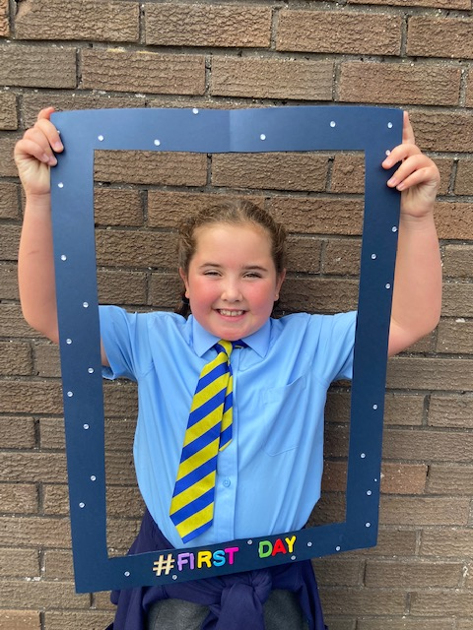

Slide 30
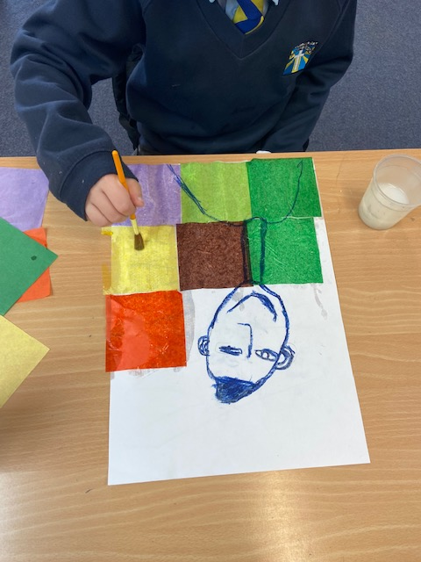
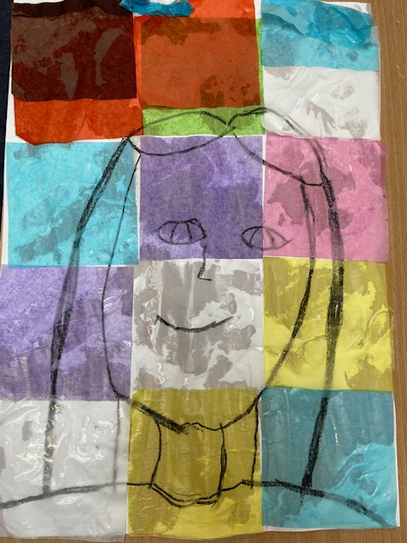
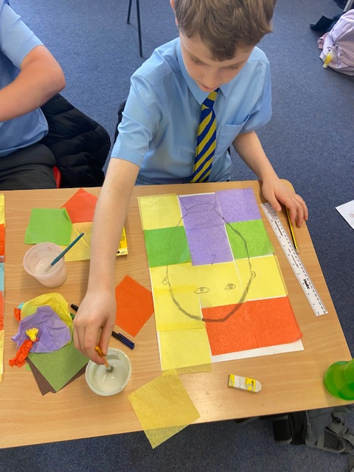

Slide 31
