Slide 1



Curricular Information
September 2021
Primary 6
St Helen’s Primary School and Nursery

Slide 2


St Helen’s Primary School and Nursery
  Introduction
  Our Classroom
  Curricular Areas:
    Literacy
    Numeracy
    Health and Wellbeing
    Interdisciplinary Learning
    This is Our Faith
  Supporting Your Child’s Learning
  Feedback and Reporting
  PLP key Dates

Slide 3
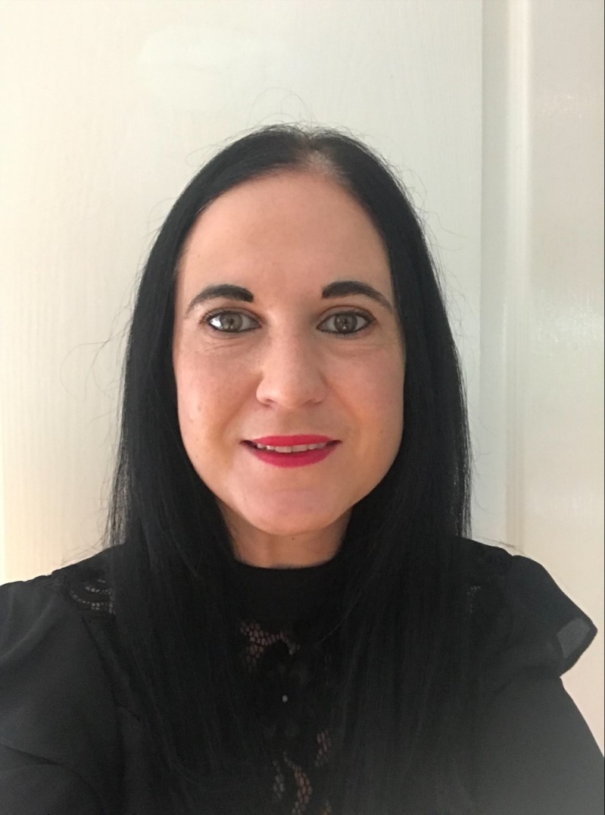
Introduction
Mrs Maclean

Slide 4
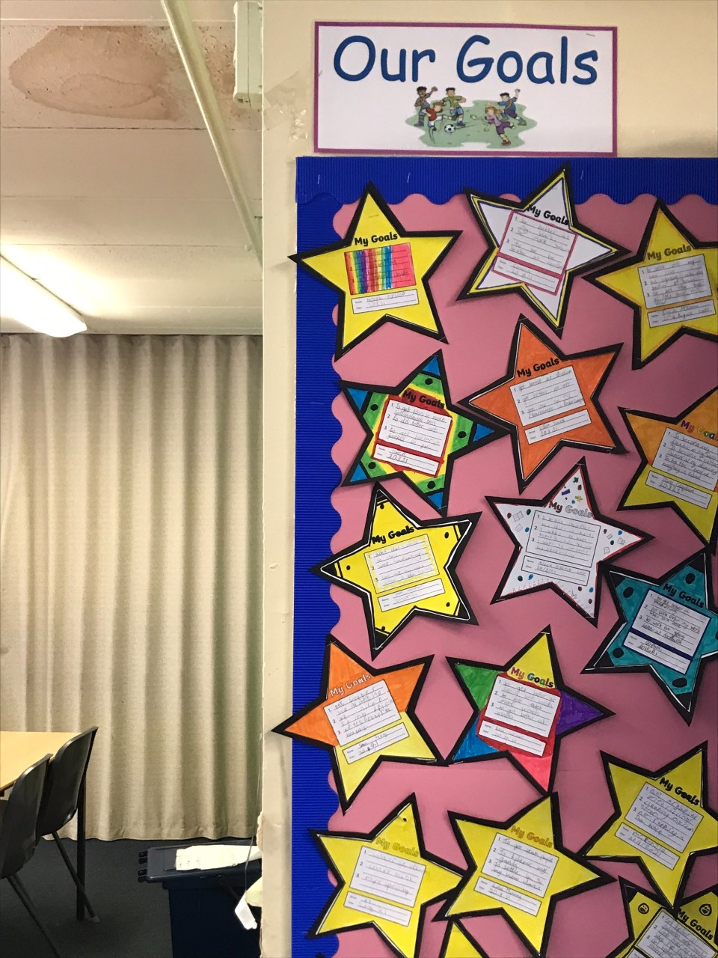
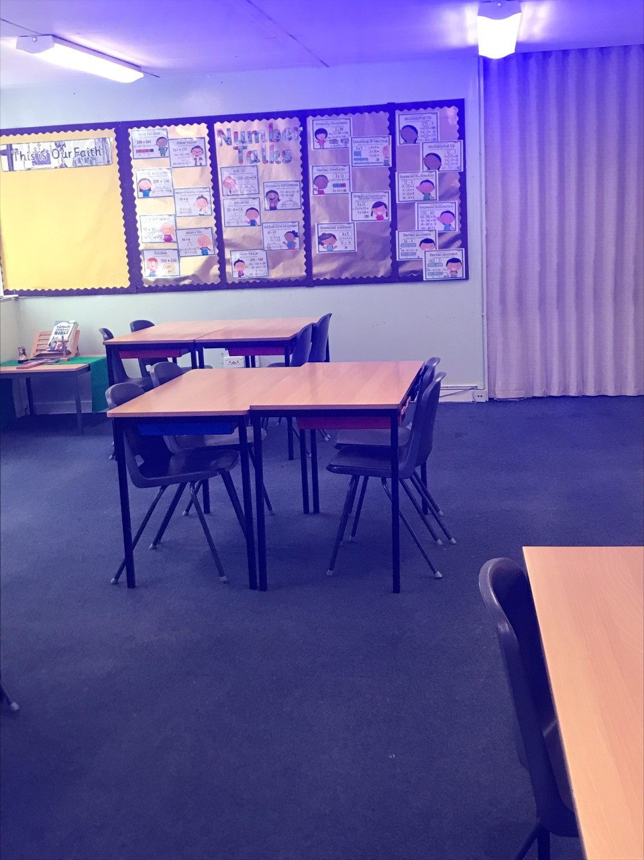
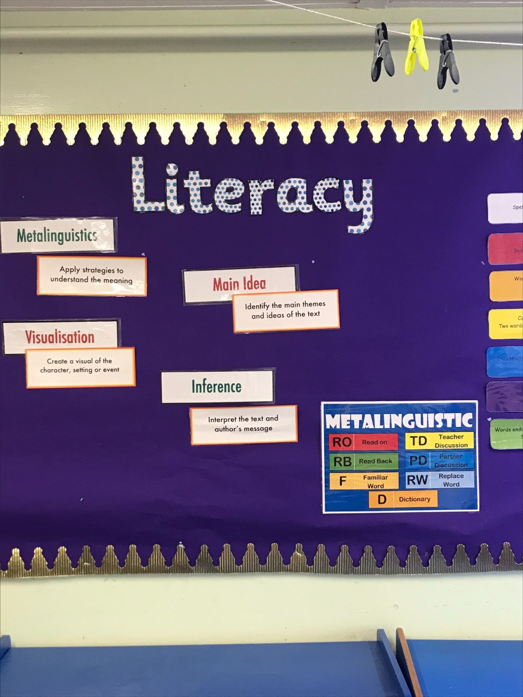
Our Classroom

Slide 5
Curricular Areas
    Literacy ​
    Numeracy ​
    Health and Wellbeing ​
    Interdisciplinary Learning
    This is Our Faith

Slide 6
Literacy
Reading:
Primary 6 are currently reading ‘The Butterfly Lion’. This is completed as a modelling block where all learners engage in the same book. This allows each of the comprehension strategies to be modelled accordingly.
Learners focus on ‘Visualisation’, ‘Metalinguistics’, ‘Prior Knowledge’, ‘Inference’, ‘Main Ideas’ and ‘Summary’ strategies which will be developed throughout the year.
Upon completion of the Modelling Block, learners will work in their own reading groups at a text best suited to their reading level.
Writing:
Learners will explore a range of genres throughout the year such as Narrative, Recount, Discursive, Information Reports and Persuasive writing.
Learners will develop their writing targets and enhance their ability to use figurative language.
Spelling:
Learners will develop their knowledge of different spelling strategies which will help to spell common/tricky words.
Some children will be revising a previous stage as we aim to avoid gaps in knowledge. Where this is the case, children will continue to revise the stage 4/5 Active Literacy program and will focus on phoneme units, Diacritical Marking and the use of Elkonin boxes to aid their learning.
Talking and Listening:
Talking and listening skills will be developed further through discussing opinions and ideas within a group setting.

Slide 7
Numeracy
So far this year, the children have revised addition, subtraction, division, multiplication. The have just recently completed a block on Place Value. These concepts will be developed throughout the year.
Learners will continue to develop their knowledge of different Maths topics (eg: Fractions, Decimals, Percentages, Money, Area and Shape). There will be a range of opportunities which allow learners to utilize their Maths skills in real life situations and encourage the development of critical thinking and problem solving.
Throughout each week pupils will learn new strategies for mental math through Number Talks lessons. It is here that they are given the chance to share their own strategies with their peers.

Slide 8
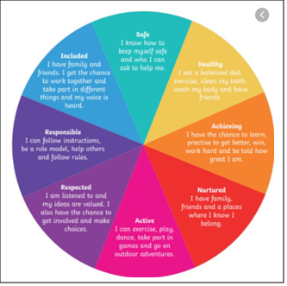
Health and Wellbeing
Health and Wellbeing continues to be a fundamental aspect of our learning. We have spent time sharing worries, developing a ‘Growth Mindset’ and explored the importance of building relationships. The children have discussed strategies that help them with problems and discussed in detail where they can find help as well as how they can help themselves.
Additionally, through fun group tasks, pupils have begun to develop good relationship within the class which has helped them settle into the new routines easier. All pupils have shown great kindness to one another and shown maturity by following the new rules around the school.
PE days = Wednesday and Thursday

Slide 9
Interdisciplinary Learning
Topics are discussed with learners in order to choose and plan topic-based learning.
Primary 6 and 7 children are learning about the Second World War as their topic this term.
Learners will explore several key areas within this topic:
  The Outbreak of the War
  Evacuation
  Rationing
  The Role of Women During the War
  Key Events During the War
This topic provides a plethora of learning experiences developing higher order thinking skills such as researching, designing, presenting, evaluating and creating.

Slide 10


Religious Education
R.E continues to be a strong focus throughout this year. Our classroom is embedded in a Catholic ethos which is enriched by how proud we are of our Catholic identity.
This year, we will explore key Bible stories and make references within our own lives. The Gospel Values will be explored in greater detail and ways in which we can promote these in our lives will be discussed. Learners will focus on key aspects of the Liturgical year such as Lent and Advent, building on their prior knowledge from Primary 5.

Slide 11
Supporting Your Child’s Learning
Examples of Activities:
Reading to children.
Outdoors - play games such as eye spy or rhyming games to help with recall and memory.
Singing songs/rhymes
Ask them their spelling words.
Times tables
Useful Websites:
http://www.primaryhomeworkhelp.co.uk/maths/timestable/interactive.htm
https://www.topmarks.co.uk/maths-games/hit-the-button
https://www.topmarks.co.uk/maths-games/daily10
http://www.studyladder.co.uk/
https://www.oxfordowl.co.uk/for-home/find-a-book/library-page/
https://appytherapy.com/handwriting-heroes/
https://www.spellingcity.com/

Slide 12
Feedback and Reporting
Personal Learning Plans are used to ensure children feel involved in their learning, are aware of their next steps and are active participants in learning.
We know parents want to be part of the learning journey with children so the document helps to share information on your child's learning with you.
There are instructions included in the document to explain how to use the PLP to support discussions about learning at home.

Slide 13
PLP Key Dates
  25th October 2021 - Personal Learning Plans sent home.
  11th November 2021 - Interim Parents' Evening.
  6th December 2021 - PLP Tracker sent home. Parents are invited to give feedback on this.
  24th January 2022 - Updated PLP sent home with new targets set.
  28th March 2022 - PLP Tracker sent home with feedback on how children are getting on.
  23rd May 2022 - formal report cards sent home to parents
  25th May 2022 - final parents' Evening.

Slide 14
I am always here to help!
Although there are lots of opportunities across the year to hear about how children are getting on - you can still get in touch with the school at any time if you have a concern or would like some information. This can be arranged by calling the school office.
The school website can be found on:
https://blogs.glowscotland.org.uk/nl/sthelens/

Slide 15


