Slide 1
Curricular Information September 2021 Primary 6a
St Helen’s Primary School and Nursery

Slide 2
St Helen’s Primary School and Nursery
Introduction
Our Classroom
Curricular Areas:
Literacy
Numeracy
Health and Wellbeing
Interdisciplinary Learning
This is Our Faith
Supporting Your Child’s Learning
Feedback and Reporting
PLP key Dates
Showcase of work

Slide 3
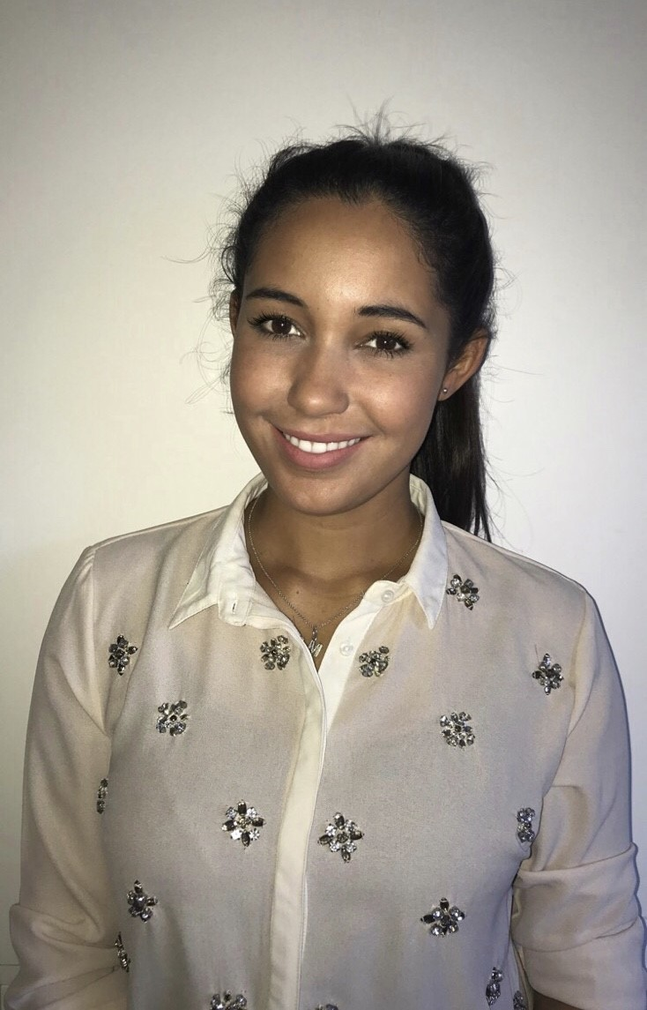
Introduction
Class Teacher: Miss Govan

Slide 4
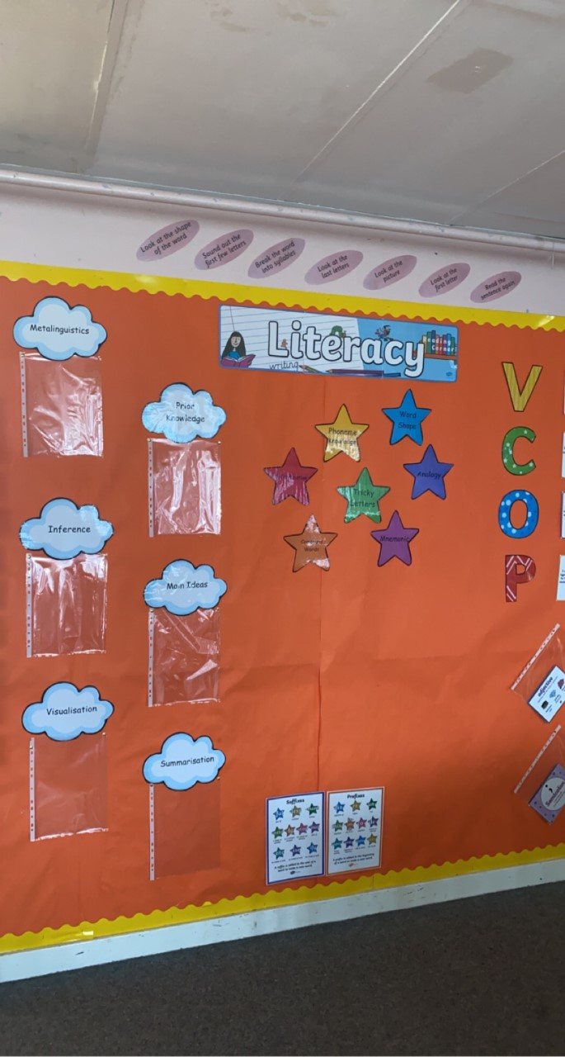
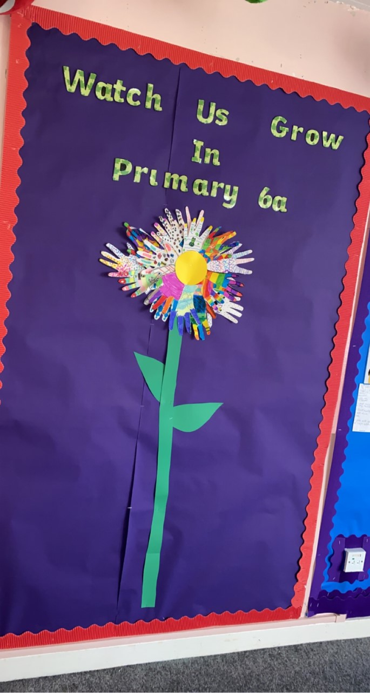
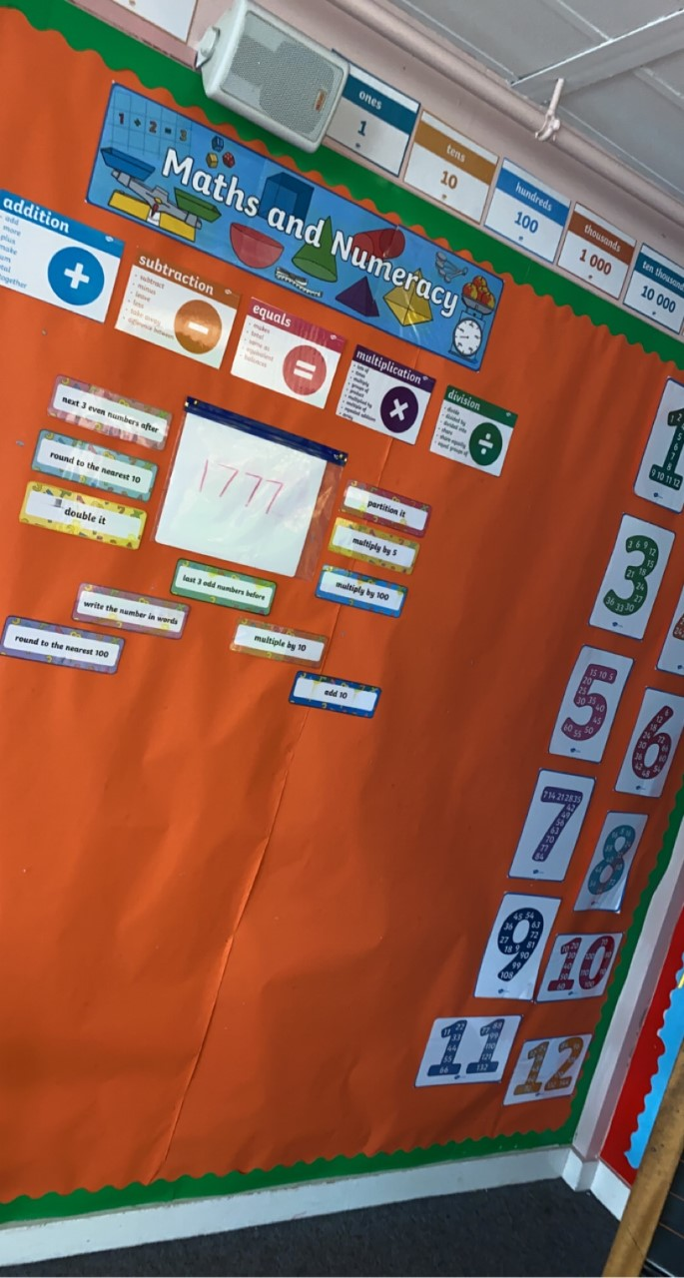
Our Classroom

Slide 5
Curricular Areas
Literacy
Numeracy ​
Health and Wellbeing ​
Interdisciplinary Learning
This is Our Faith

Slide 6
Literacy
Reading:
Primary 6 are currently reading ‘The Butterfly Lion’. This is being completed as a modelling block.
Reading comprehension strategies: ‘Visualisation’, ‘Metalinguistics’, ‘Prior Knowledge’, ‘Inference’, ‘Main Ideas’ and ‘Summary’.
Upon completion of the Modelling Block, learners will work in their own reading groups at a text best suited to their reading level.
Writing:
Learners will explore a range of genres throughout the year: Narrative, Recount, Discursive, Information Reports and Persuasive writing.
Learners will develop their writing target knowledge and ability.

Slide 7
Literacy
Spelling:
Learners will develop their knowledge of different spelling strategies which will help to spell common/tricky words.
Some children will be revising a previous stage as we aim to avoid gaps in knowledge. Where this is the case, children will continue to revise the stage 4/5 NLC Active Literacy program and will focus on phoneme units, Diacritical Marking and the use of Elkonin Boxes to aid their learning.
Talking and Listening:
Talking and listening skills will be developed further through discussing opinions and ideas within a group setting.

Slide 8
Numeracy
So far this year, the children have revised Addition, Subtraction, Multiplication and Division.
The children have also just recently competed a block on Place Value, Rounding and Estimation.
Learners will continue to develop their knowledge of different Maths topics (eg: Fractions, Decimals, Percentages, Money, Area and Shape).
Throughout each week pupils will learn new strategies for mental math through Number Talks lessons. It is here that they are given the chance to share their own strategies with their peers.

Slide 9
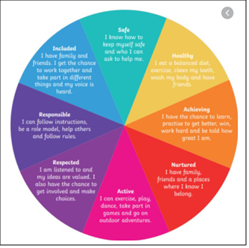
Health and Wellbeing
Primary 6a have spent time sharing worries, developing a ‘Growth Mindset’ and have explored the importance of building relationships.
The children have discussed strategies that help them with problems and discussed in detail where they can find help as well as how they can help themselves.
Pupils have begun to develop good relationship within the class which has helped them settle into the new routines easier. All pupils have shown great kindness to one another and shown maturity by following the new rules around the school.
PE days = Monday and Thursday.

Slide 10
Interdisciplinary Learning
Topics are discussed with learners in order to choose and plan topic-based learning.
Primary 6 and 7 children are learning about the Second World War as their topic this term.
Learners will explore several key areas within this topic:
The Outbreak of the War
Evacuation
Rationing
The Role of Women During the War
Key Events During the War
This topic provides a range of learning experiences developing higher order thinking skills such as researching, designing, presenting, evaluating and creating.

Slide 11
This is our Faith
R.E continues to be a strong focus throughout this year.
Our classroom is embedded in a Catholic ethos which is enriched by how proud we are of our Catholic identity.
This year, we will explore key Bible stories and make references within our own lives. The Gospel Values will be explored in greater detail and ways in which we can promote these in our lives will be discussed.
Learners will focus on key aspects of the Liturgical year such as Lent and Advent, building on their prior knowledge from Primary 5.

Slide 12
Supporting Your Child’s Learning
Examples of Activities:
Reading to children.
Outdoors - play games such as eye spy or rhyming games to help with recall and memory.
Singing songs/rhymes
Ask them their spelling words.
Times tables
Useful Websites:
http://www.primaryhomeworkhelp.co.uk/maths/timestable/interactive.htm
https://www.topmarks.co.uk/maths-games/hit-the-button
https://www.topmarks.co.uk/maths-games/daily10
http://www.studyladder.co.uk/
https://www.oxfordowl.co.uk/for-home/find-a-book/library-page/
https://www.spellingcity.com/

Slide 13
Feedback and Reporting
Personal Learning Plans are used to ensure children feel involved in their learning, are aware of their next steps and are active participants in learning.
We know parents want to be part of the child's learning journey so the document helps to share information on your child's learning with you.
There are instructions included in the document to explain how to use the PLP to support discussions about learning at home.

Slide 14
PLP Key Dates
25th October 2021 - Personal Learning Plans sent home.
11th November 2021 - Interim Parents' Evening.
6th December 2021 - PLP Tracker sent home. Parents are invited to give feedback on this.
24th January 2022 - Updated PLP sent home with new targets set.
28th March 2022 - PLP Tracker sent home with feedback on how children are getting on.
23rd May 2022 - formal report cards sent home to parents
25th May 2022 - final parents' Evening.

Slide 15
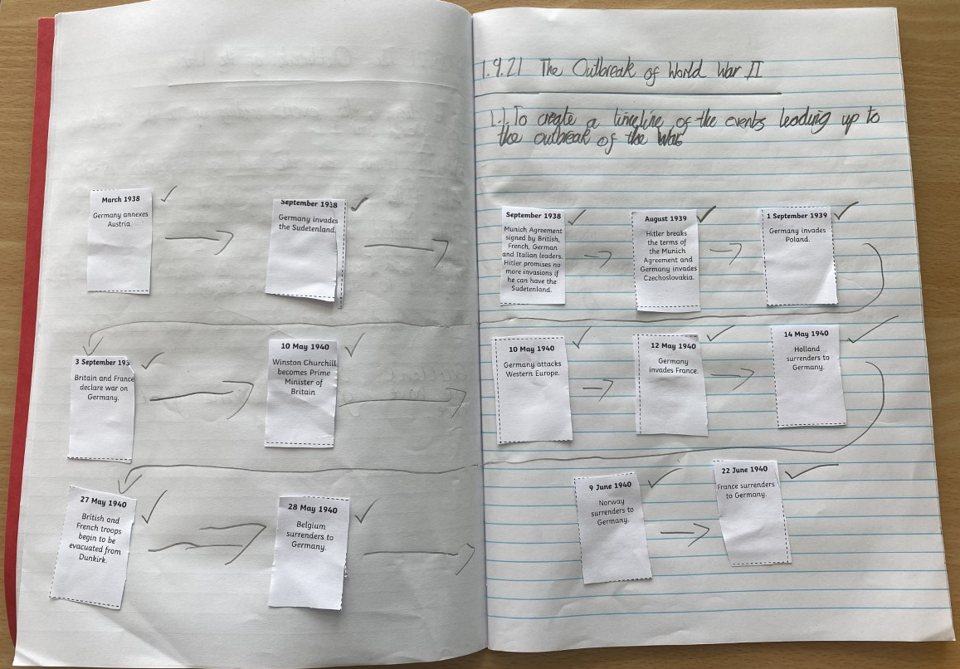
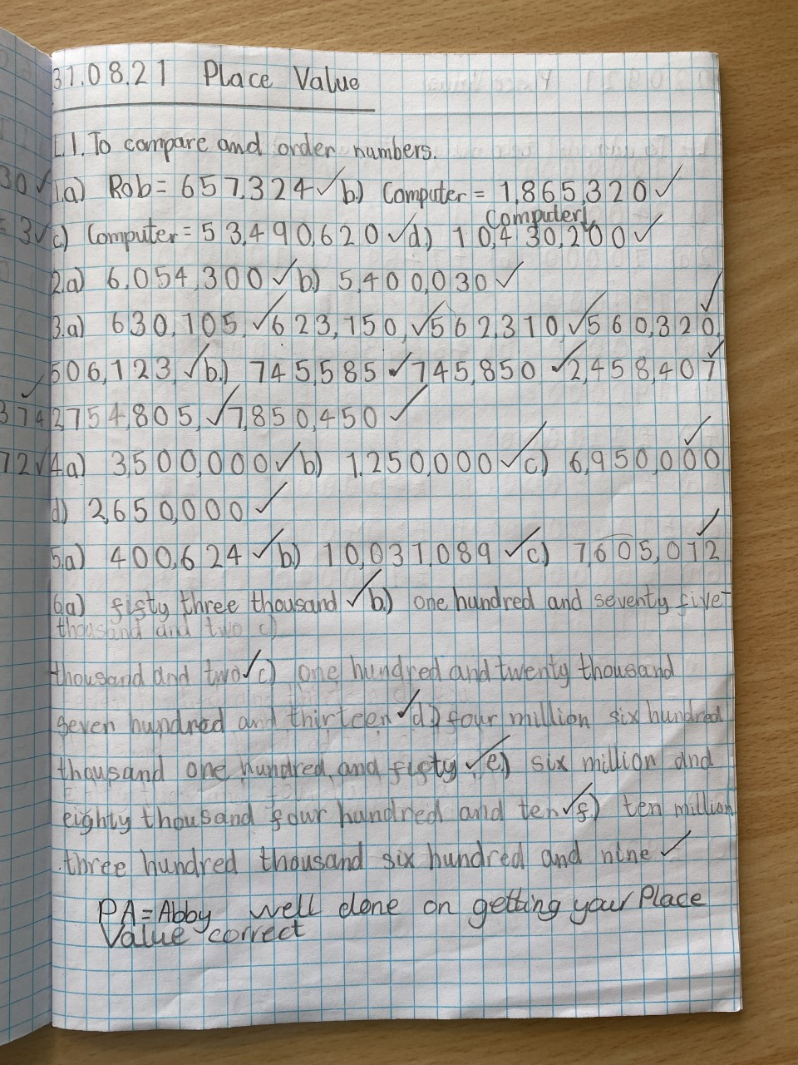
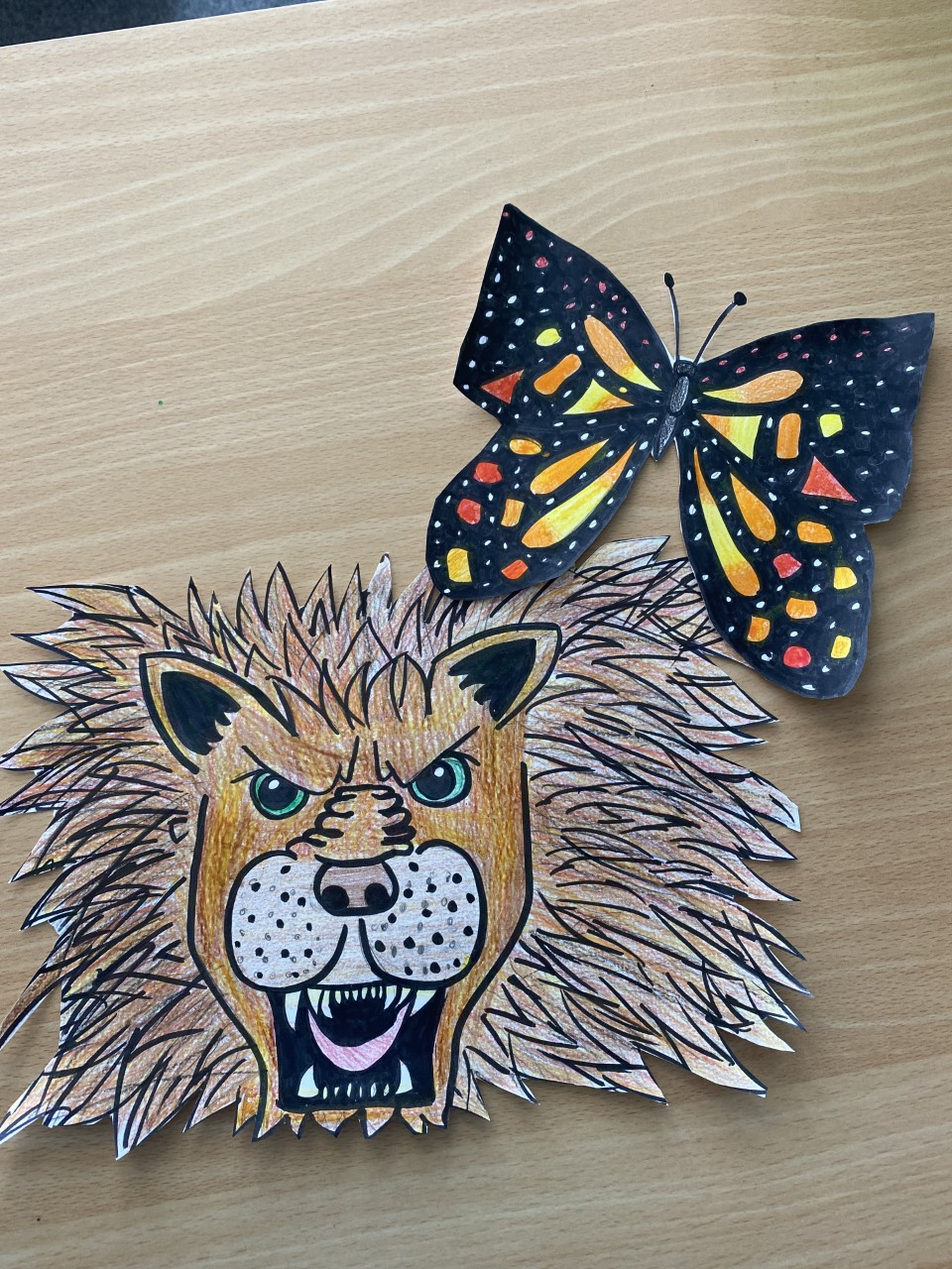
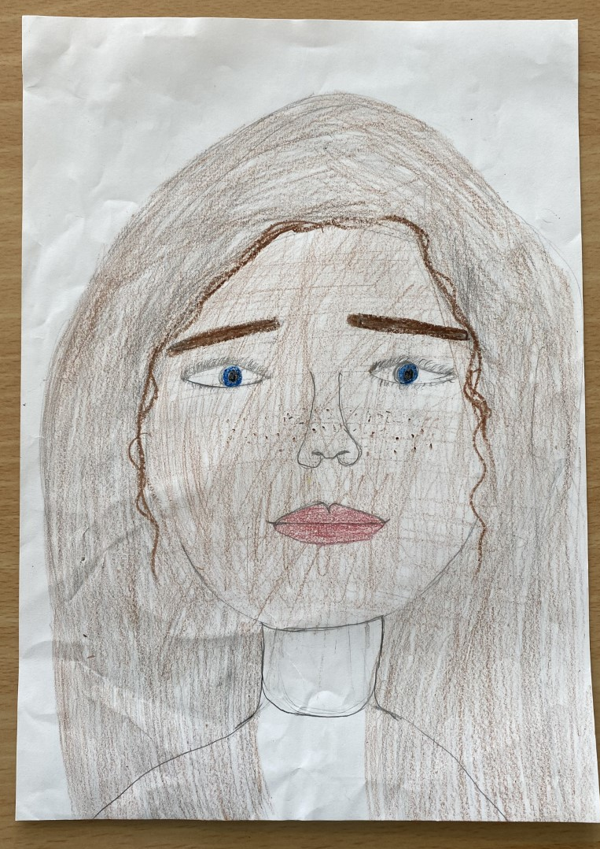
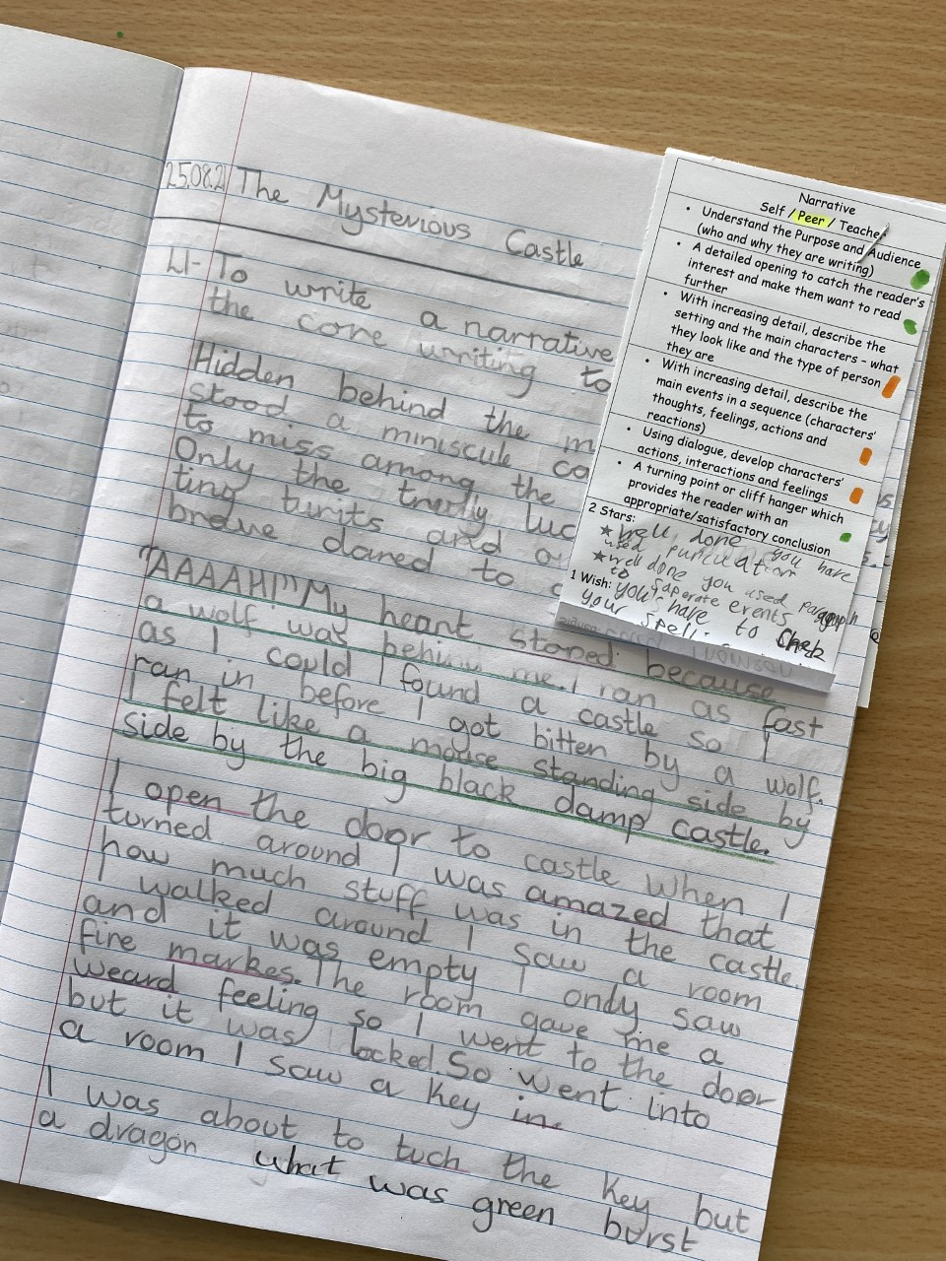
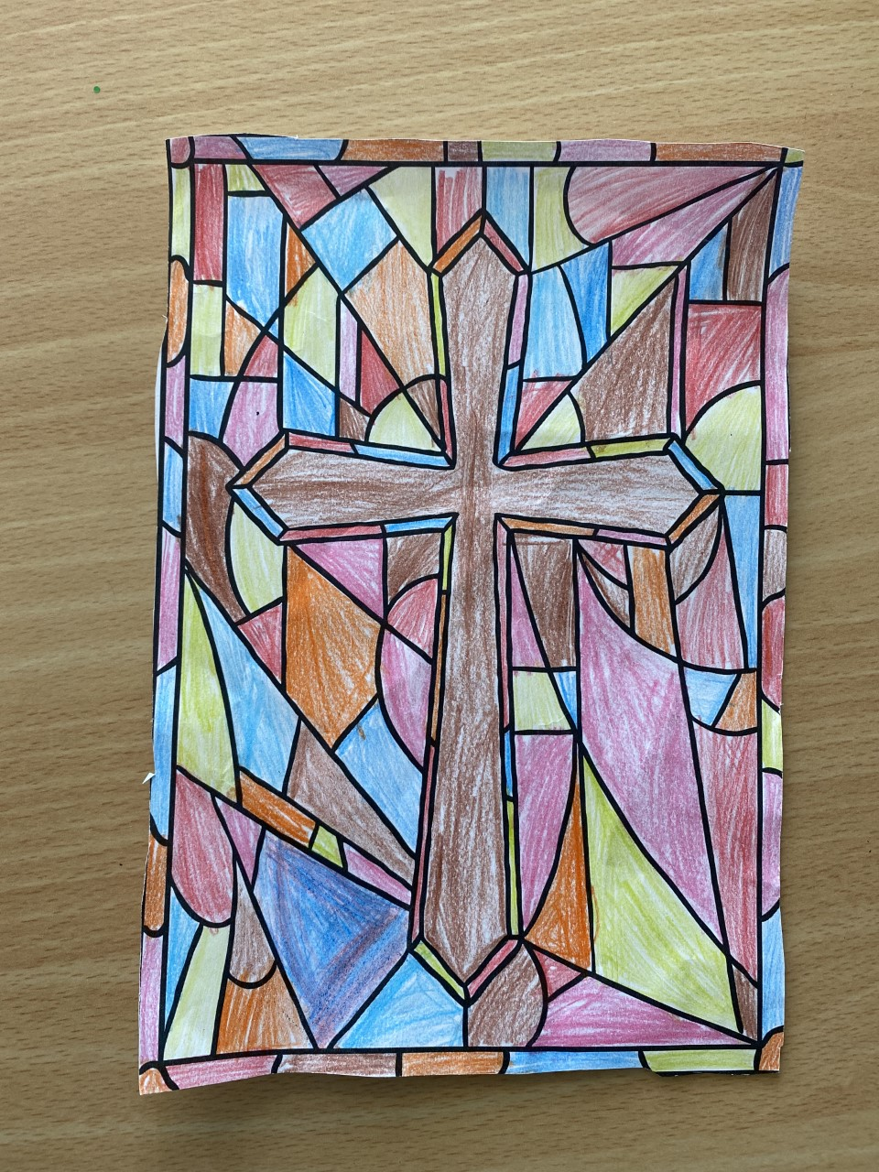
Showcase of Work
School Twitter: @StHelensNLC
The school website can be found on:
https://blogs.glowscotland.org.uk/nl/sthelens/

Slide 16
I am always here to help!
Please don't hesitate to contact the school at any time if you have a concern or would like some information. This can be arranged by calling the school office.

