Slide 1

Welcome to Primary 3/2
Mrs Hasselstrøm – Monday, Tuesday, Wednesday
Mrs McLaughlin - Wednesday, Thursday, Friday
Notes:
Hi everyone
And welcome to our Primary 3/2 virtual presentation.

Slide 2
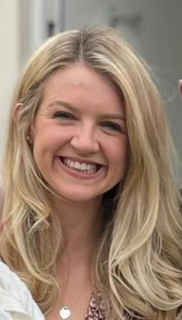
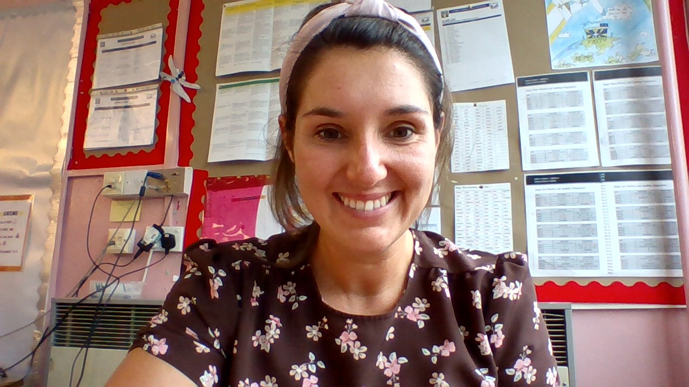
Mrs Hasselstrøm
Mrs McLaughlin

Slide 3
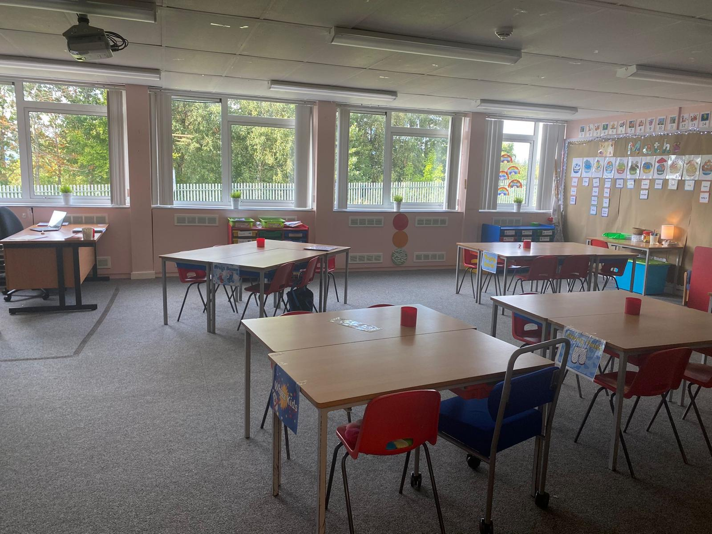
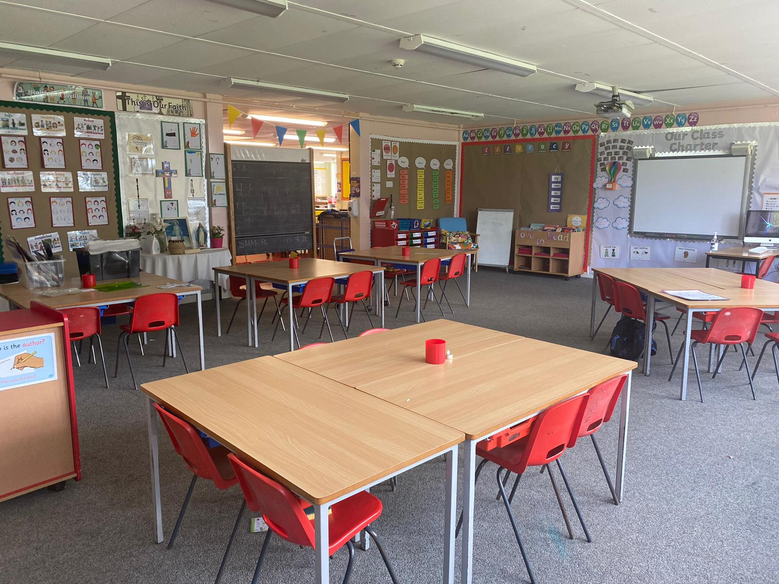
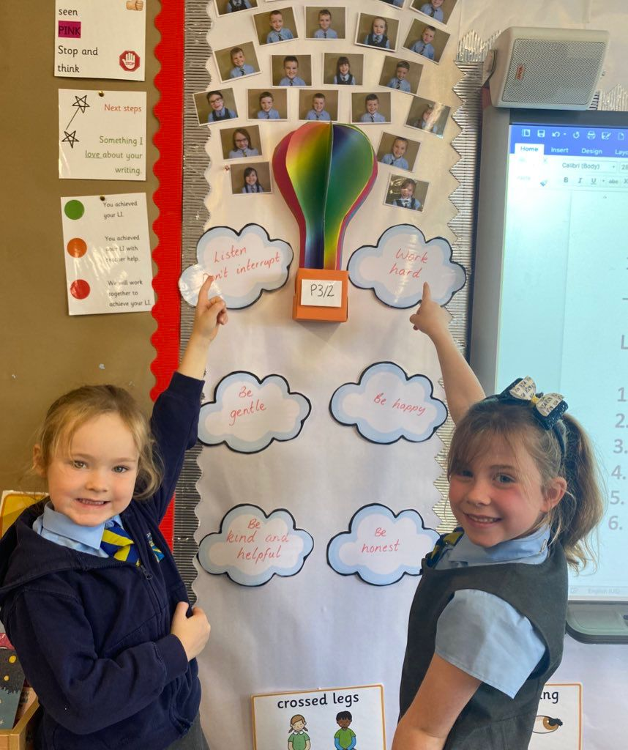
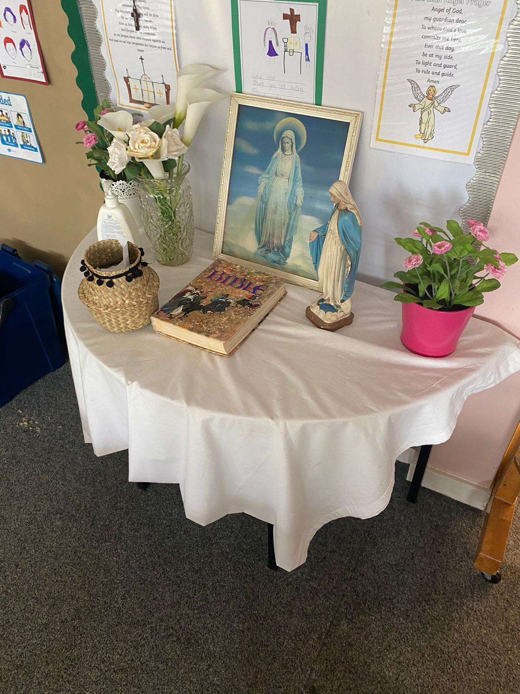
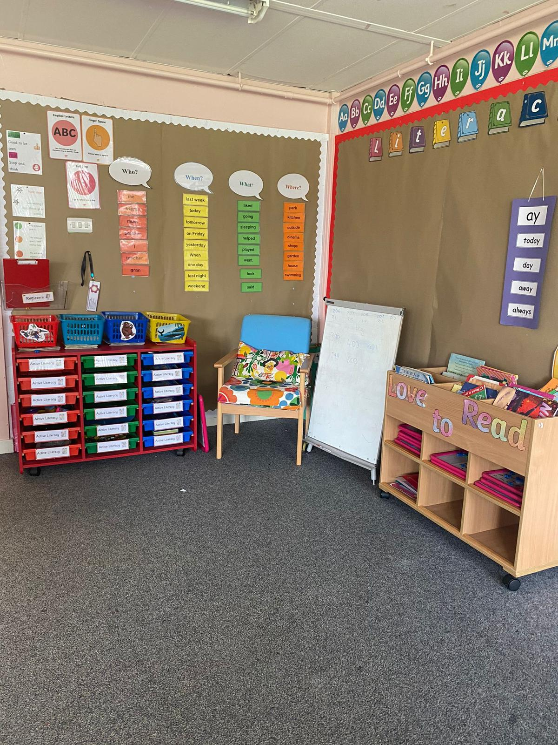
Photos of class

Slide 4
Literacy
Spelling
Common words
  Three per week
  Active tasks eg. spelling boards, partner dictation
  Phonemes
    One per week
    Magnetic board work
    Identifying phonemes words within a story or text.
Reading
Introduced by class teacher (walk through, modelling, unfamiliar vocabulary)
Partner reading, guided reading & independent reading
Read to write tasks – strip books, cut up sentences, simple sequencing.
Daily story time and personal choice books

Slide 5
Writing
Daily writing opportunities
- Handwriting, grammar and read to write tasks
One taught writing lesson per week
Links to class theme/topic
- Children use word mats, writing wall, knowledge of phonemes and common words to write
- Introduction to genres
Introduction to self and peer assessment strategies across writing opportunities

Slide 6
Numeracy
Mental maths
  Oral counting eg. forwards, backwards, counting in 2s, 3s, 5s, 10s and missing number sequences
  Developing addition and subtraction mental strategies
  Active games and written tasks to support learning
Topics – Term 1
  Estimating
  Counting
  Addition and Subtraction
  Resources
    Espresso
    Sumdog
    SMARTboard games
    Concrete materials eg. Numicon, counting objects

Slide 7
Health and Wellbeing
Class Charter at the beginning of the year
Learning about the SHANARRI indicators - Safe, Healthy, Achieving, Nurtured, Active, Respected, Responsible, Included (focus on one per month in more detail).
Circle time
Health and Wellbeing section of the Personal Learning Plans
Daily Mile

Slide 8
Resources used to Support Learning
Health & Wellbeing
sidandshanarri.co.uk
healthyschools.scot
educationscotlsnd.gov.scot
Literacy
doorwayonline.org.uk
starfall.com
Oxfordowl.co.uk
Discoveryeducation.co.uk
Numeray
Espresso
Sumdog.com
Smartboard Games
Topmarks.co.uk
ictgames.com

Slide 9
Timetable
P.E.
Monday and Thursdays
On these days full P.E. kit can be worn to school.
Homework
  Issued on a Monday
  Returned on a Thursday
    N.B. Reading books must be brought to school every day for classroom learning.

Slide 10
Reporting
Personal Learning Plans
Parents Nights
Formal Reports

Slide 11
Dates for the Diary
  October 25th 2021- Personal Learning Plans sent home
  November 11th 2021- Parents evening
  December 6th 2021 - PLP Tracker sent home
  January 24th 2022 - Updated PLP sent home with new targets set
  March 28th 2022 - PLP Tracker sent home with feedback on how children are getting on
  May 23rd - Formal report cards sent home to parents
  May 25th - Final parents' Evening

Slide 12
Keep in touch
Following us on Twitter @StHelensNLC
Have a look at our school website:
https://blogs.glowscotland.org.uk/nl/sthelens/

Slide 13

Final Message -

