Slide 1
Welcome to Primary 3!
Miss McColl
Twitter: @sthelensnlc

Slide 2
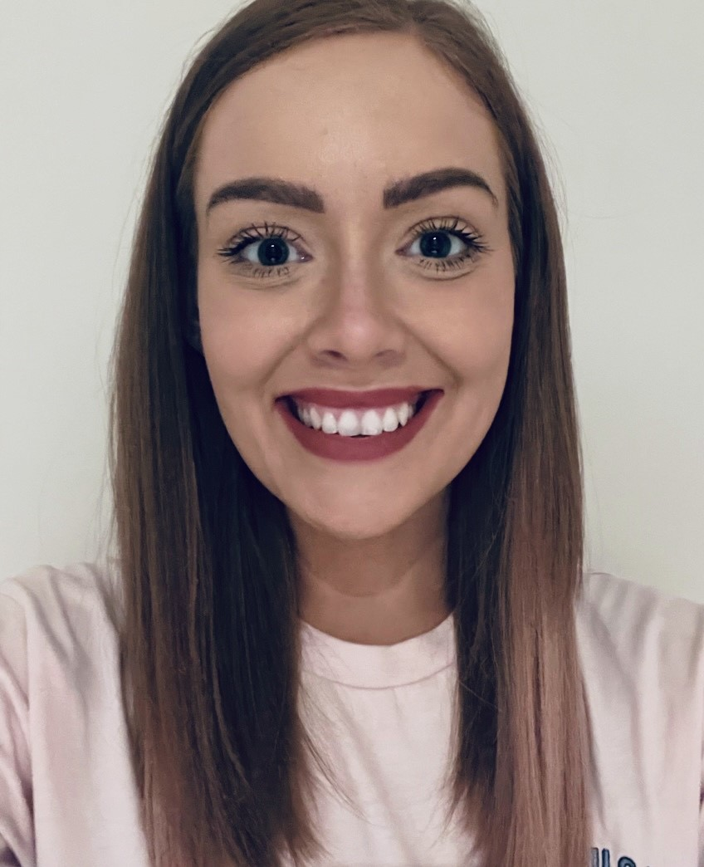
Hello my name is Miss McColl.

Slide 3
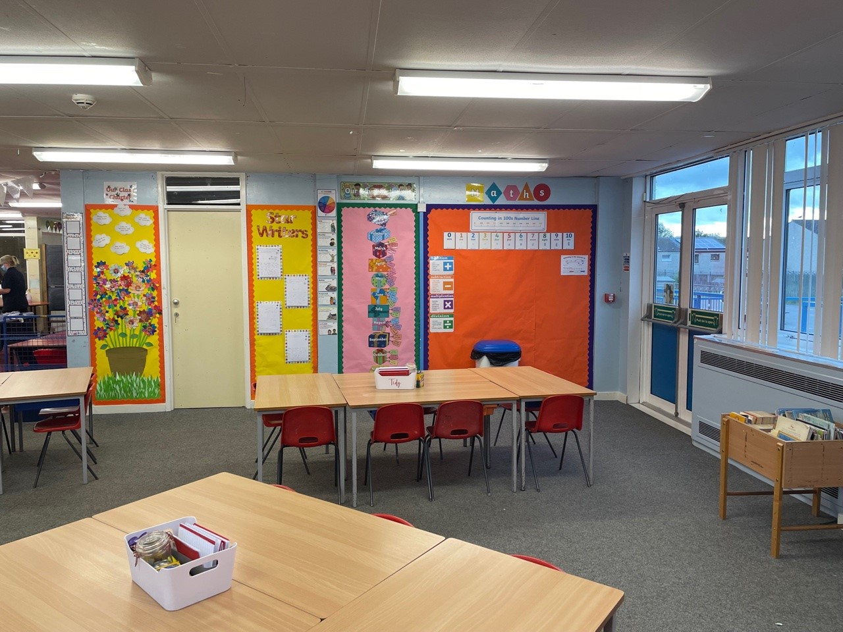
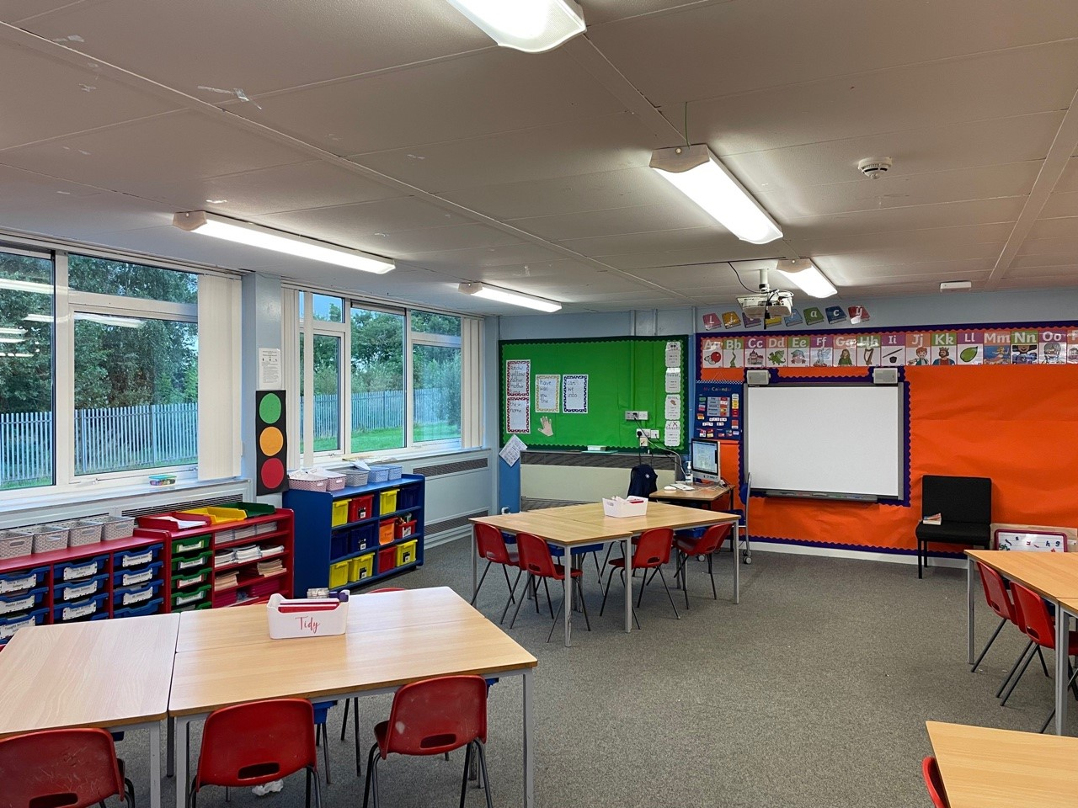
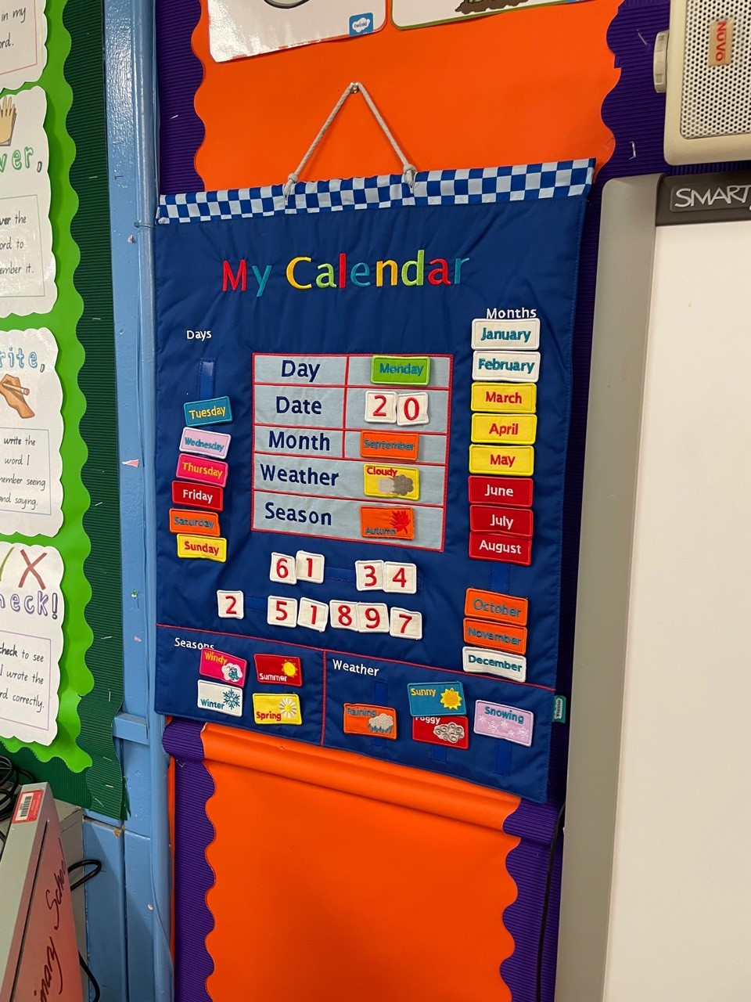
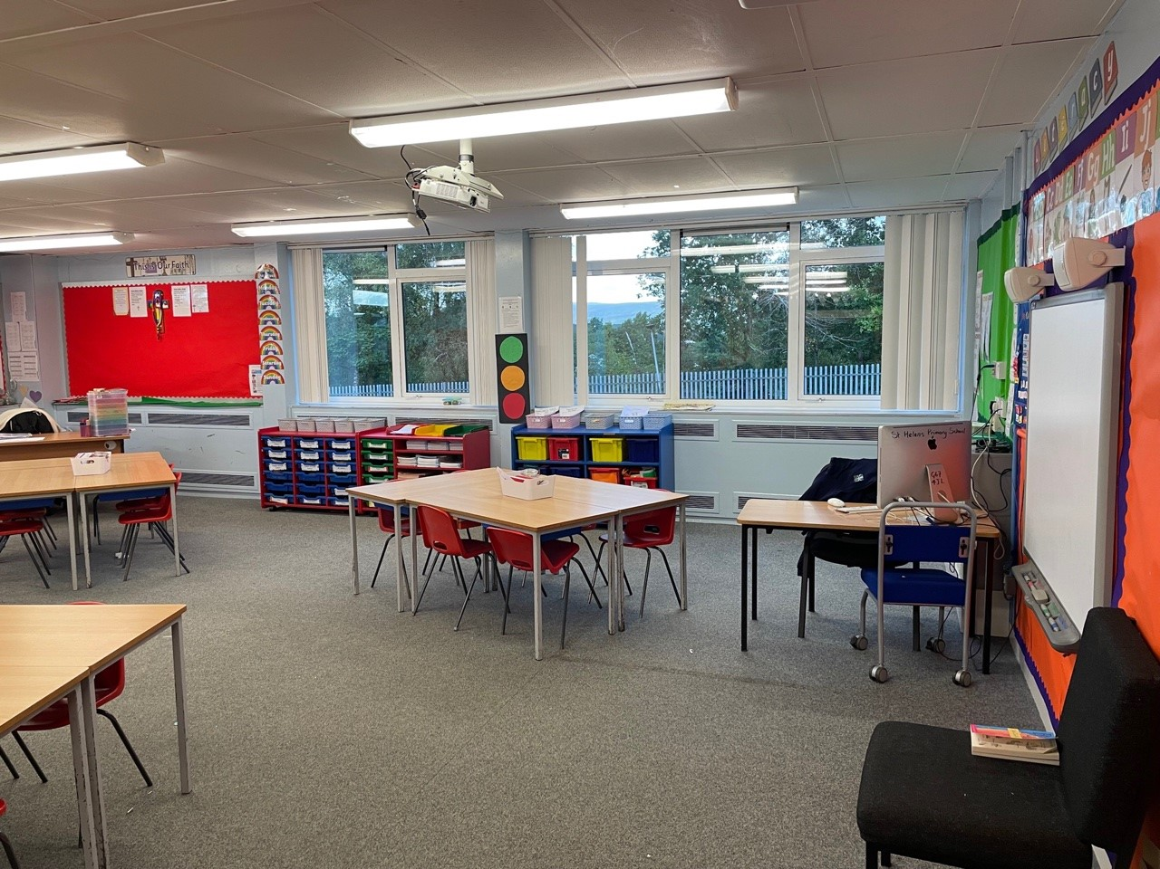
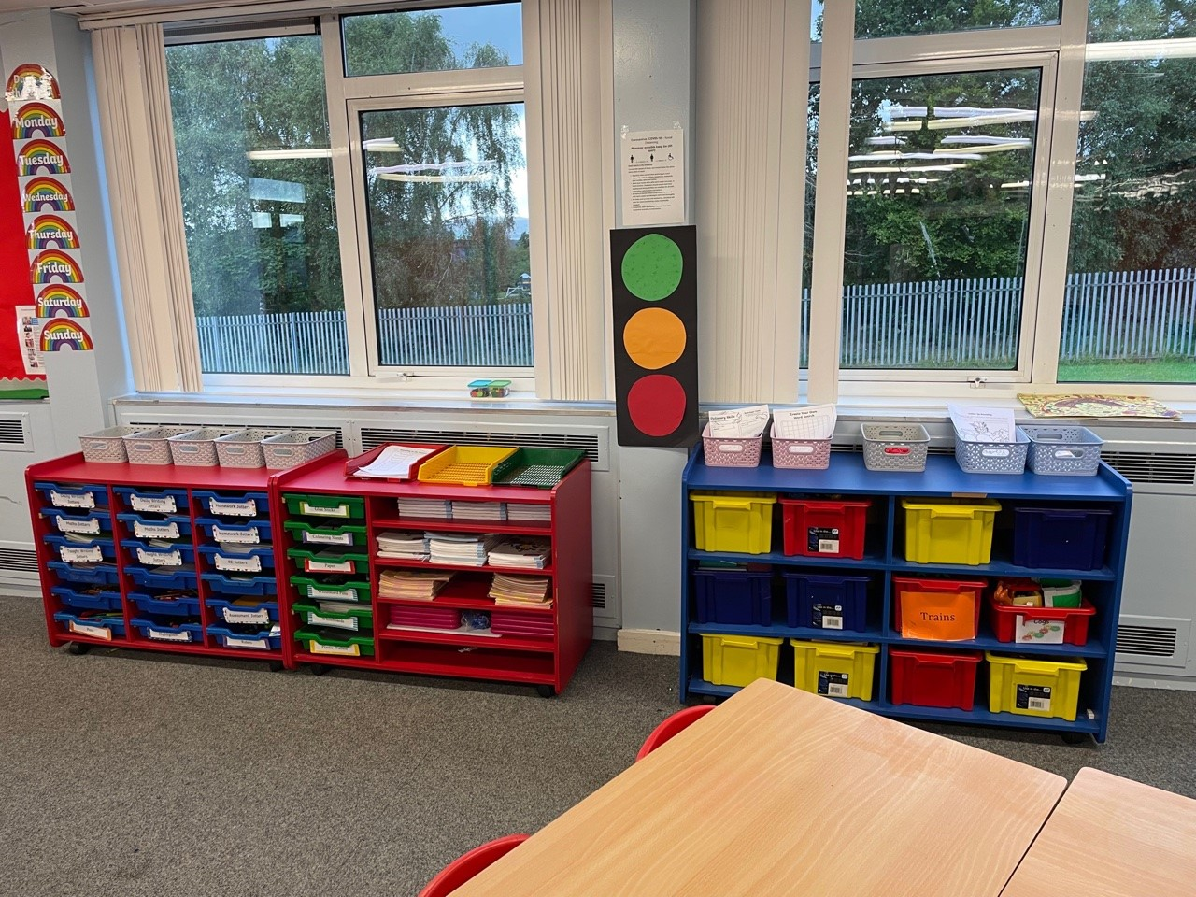
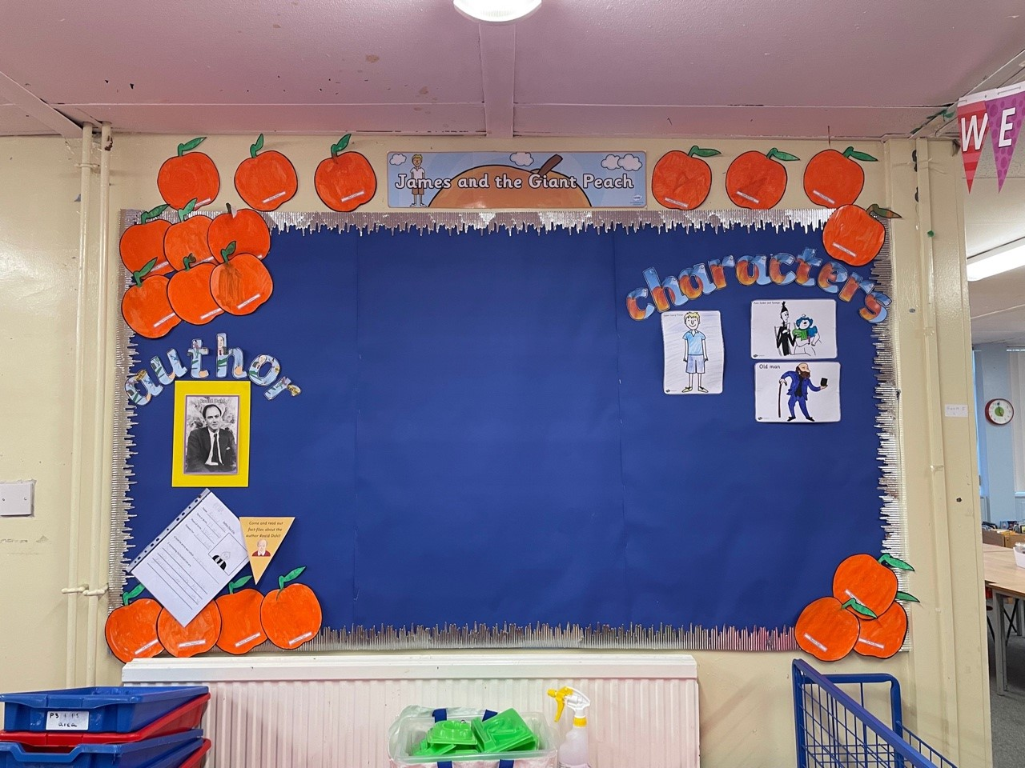
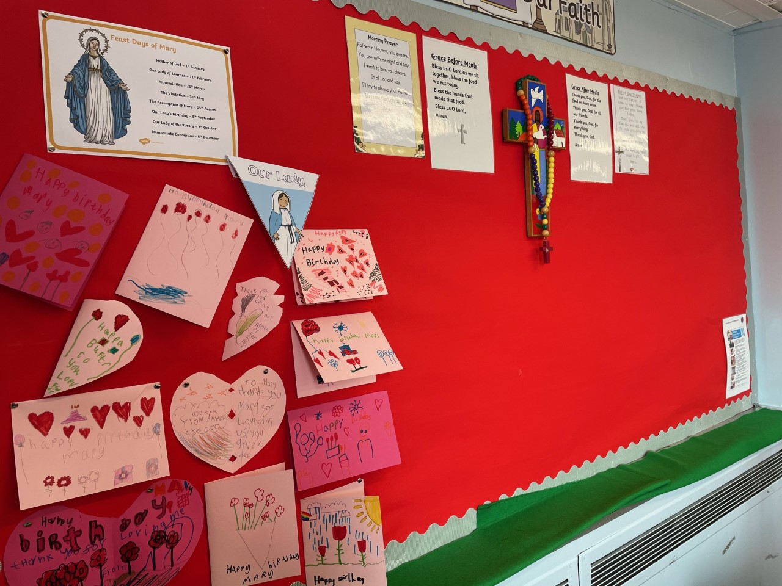
Photos of class

Slide 5
Literacy
Spelling
Common words
Four per week
Active tasks eg. spelling boards, partner dictation, sand spelling, plasticine
Sounds (phonemes)
Revising 3 per week at first
Introduce 1 new phoneme sound per week after this
Reading
Introduced by class teacher (walk through, modelling, unfamiliar vocabulary)
Partner reading, guided reading & independent reading
Read to write tasks – sequencing, comprehension tasks, prediction

Slide 6
Writing
One taught writing lesson per week
Links to class theme/topic
Encouraging the children to write as independently as possible
Use of common words and phoneme words
Introduction to genres
Introduction to self and peer assessment strategies

Slide 7
Literacy
Some useful websites are;
Starfall
ICT Games – Phonics Pop
BBC Bitesize
Literacy Shed
Oxford Owl

Slide 8
Numeracy
Mental maths
Oral counting eg. forwards, backwards, counting in 2s, 5’s, 10’s, missing number sequences
Addition and subtraction
Active and written tasks
Topics – Term 1
Estimating and Rounding
Number (Addition & Subtraction, developing Multiplication & Division)
Measurement
Resources
Sumdog
SMARTboard games
Concrete materials eg. Numicon, counting cubes etc

Slide 9
Numeracy
Some useful websites are;
Topmarks (Hit the Button, Number Bonds etc)
BBC Bitesize
Sumdog
Doorway Online
Primary Games Arena

Slide 10
HWB
Health and Wellbeing encompasses everything we do
Class Charter at the beginning of the year (Photo of this on next slide)
Learning about the SHANARRI indicators - Safe, Healthy, Achieving, Nurtured, Active, Respected, Responsible, Included. (focus on one per month in more detail).
SHANARRI plenaries
Circle time
Health and Wellbeing section of the Personal Learning Plans
Daily Mile/PE

Slide 12
Assembly
Whole school (Friday afternoon)
Golden Time
Friday afternoon (After assembly)

Slide 13
Topic
James and the Giant Peach
Christmas Fayre
Nativity

Slide 14
Timetable
P.E.
Wednesday & Thursday.
On these days full P.E. kit can be worn to school.
Homework
Issued on a Monday
Returned on a Thursday
N.B. Reading books must be brought to school every day for classroom learning.

Slide 15
Dates for diary
October 25th 2021- Personal Learning Plans sent home
November 11th 2021- Parents evening
December 6th 2021 - PLP Tracker sent home
January 24th 2022 - Updated PLP sent home with new targets set
March 28th 2022 - PLP Tracker sent home with feedback on how children are getting on
May 23rd - Formal report cards sent home to parents
May 25th - Final parents' Evening

Slide 16
Keep in touch
Following us on Twitter @StHelensNLC
Have a look at our school website:
https://blogs.glowscotland.org.uk/nl/sthelens/

Slide 17
Final Message

