Slide 1
Welcome to Primary 2
Mrs Cardigan
Twitter: @sthelensnlc

Slide 2
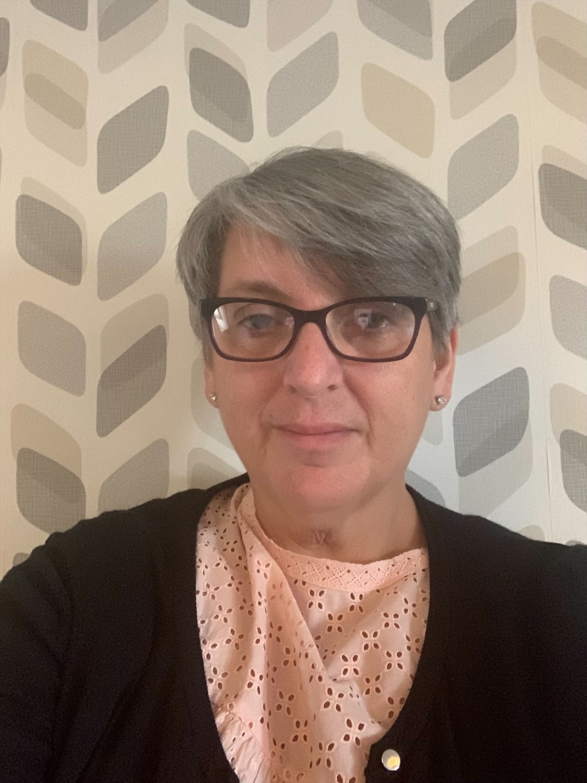
Hello My Name is Mrs Cardigan
I have worked with children for almost 40 years in a variety of early years setting. I have been a teacher in St Helen’s Primary for 20 years, 18 years of which I spent in our nursery class. I was lucky to have the opportunity to move from nursery to the infant department in August 2020. This will be my second year teaching in P2
I hope to involve the children, to lead their own learning, by providing stimulating learning experiences with a focus on active learning outdoors.

Slide 3
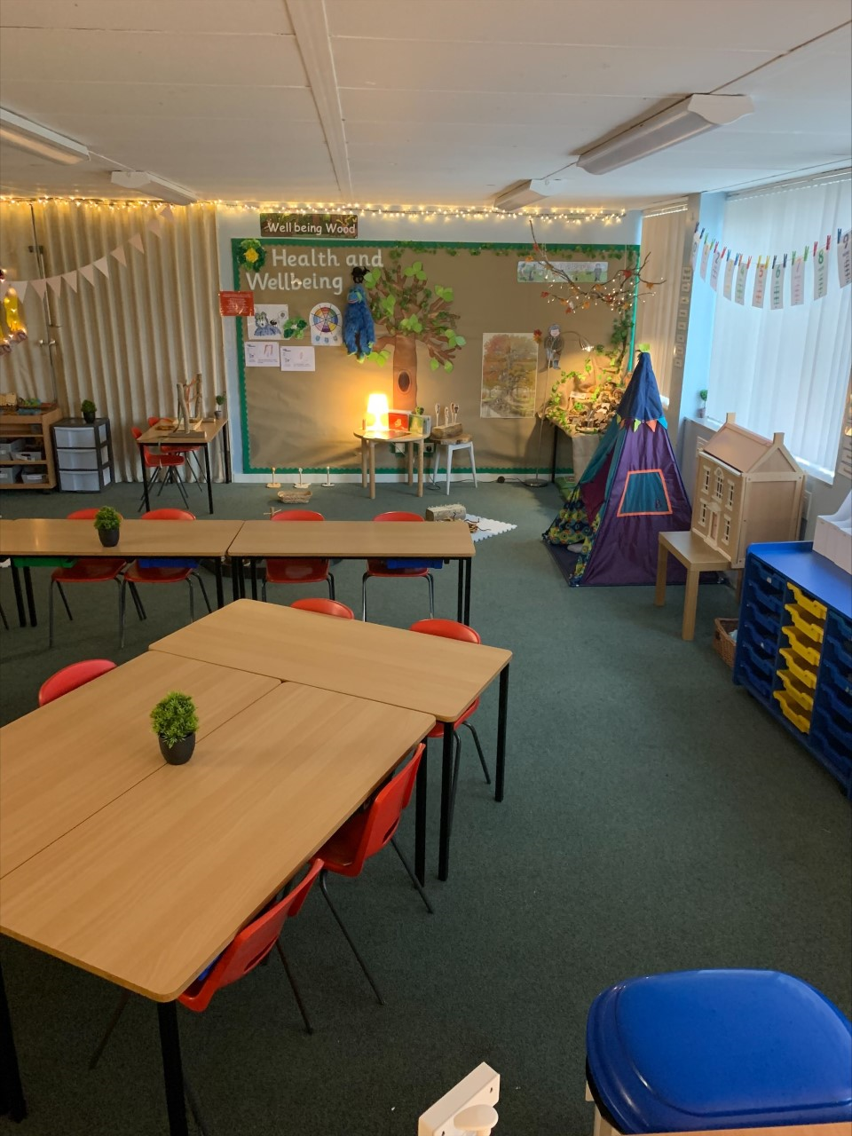
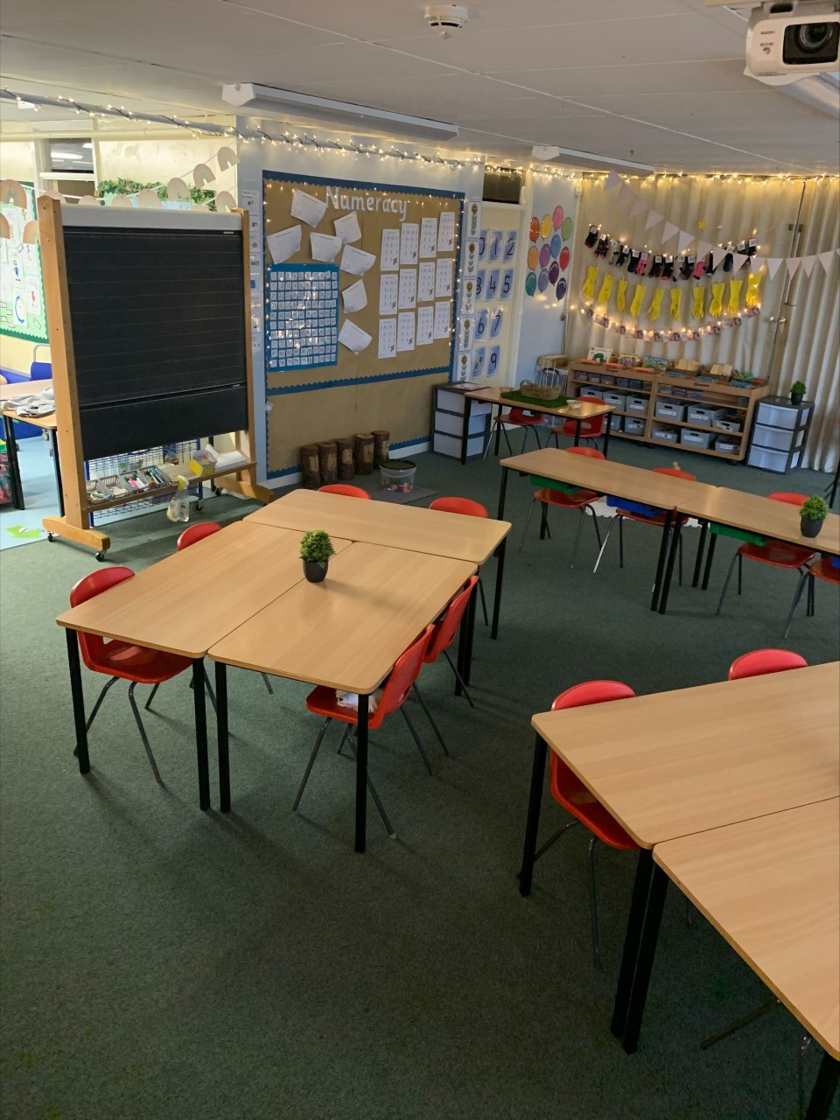
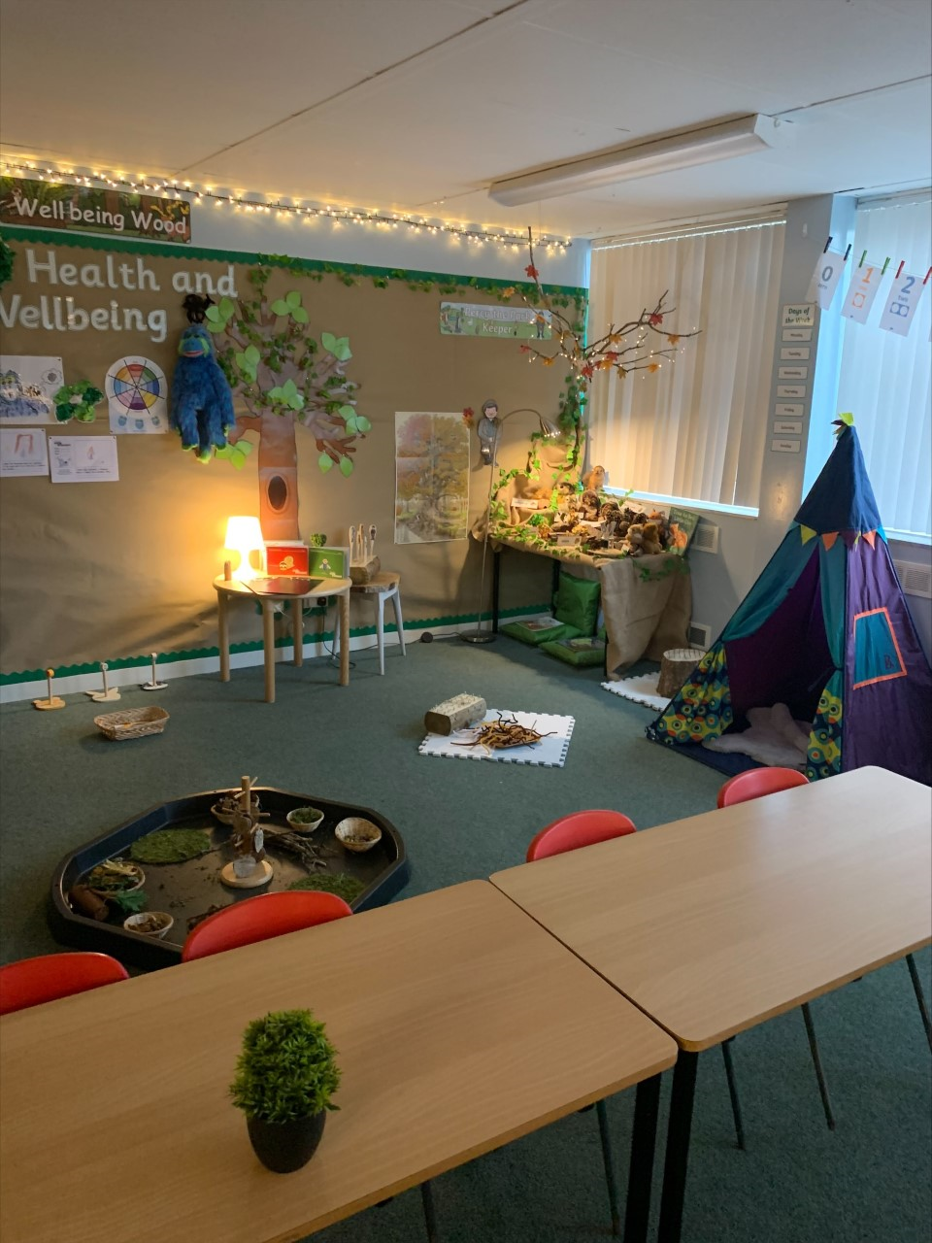
This is our classroom.

Slide 4
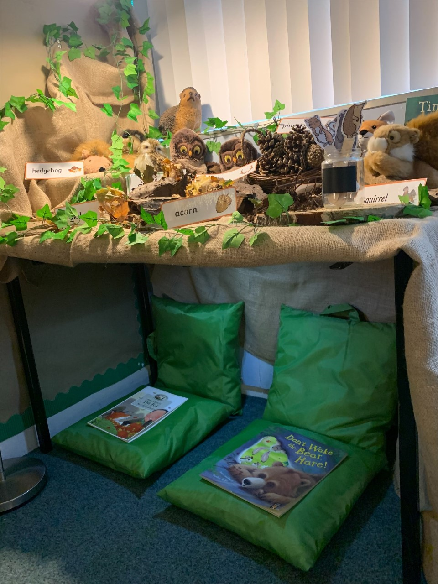
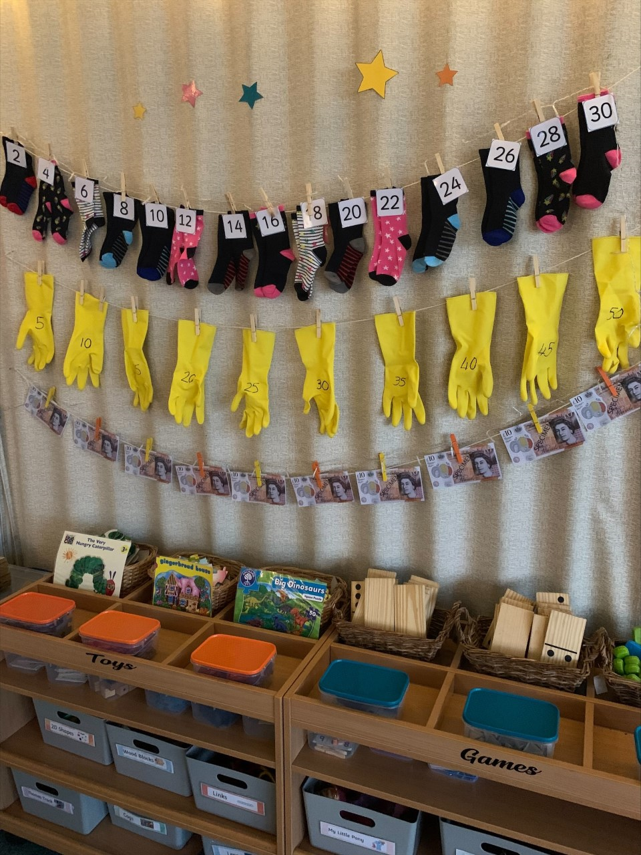
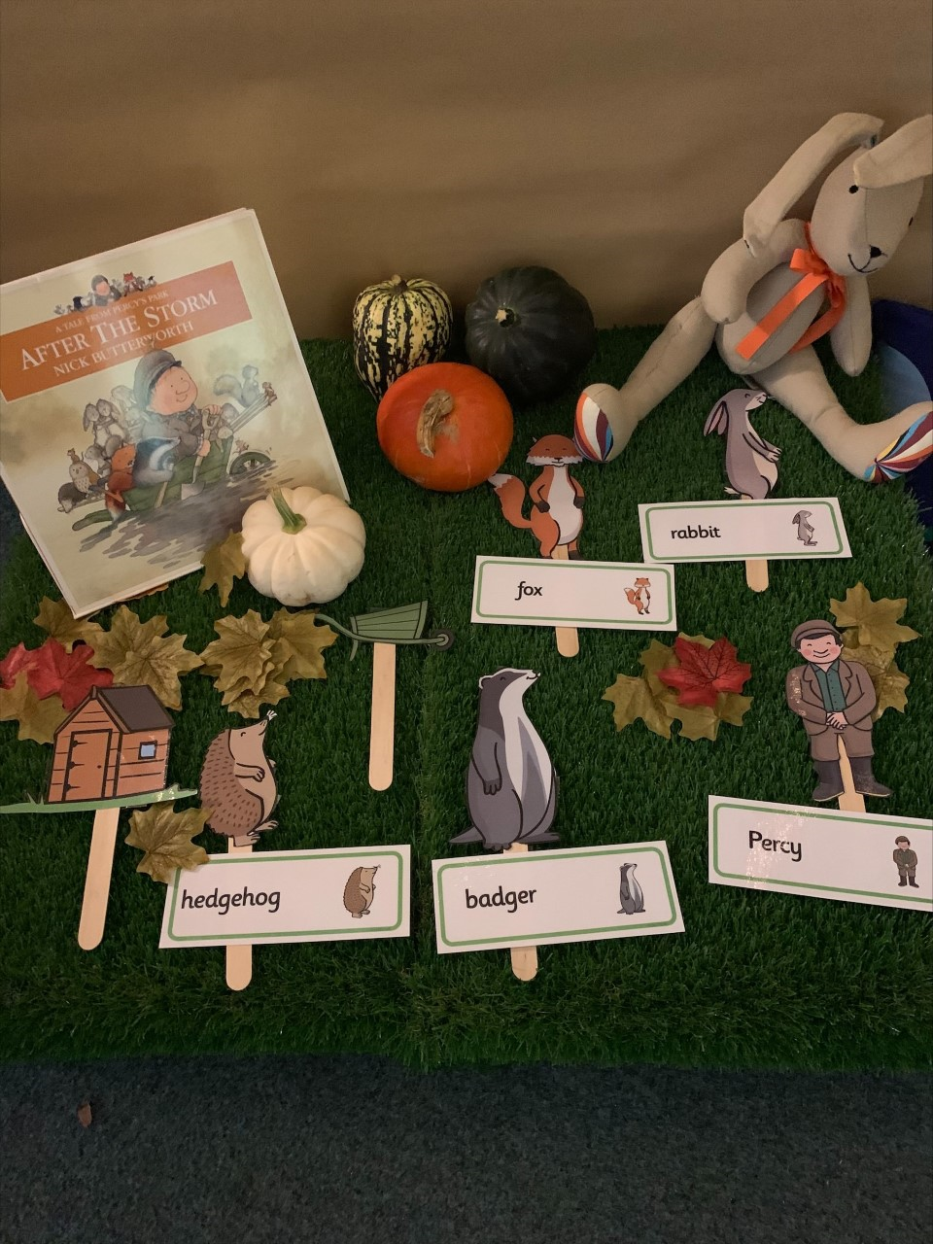
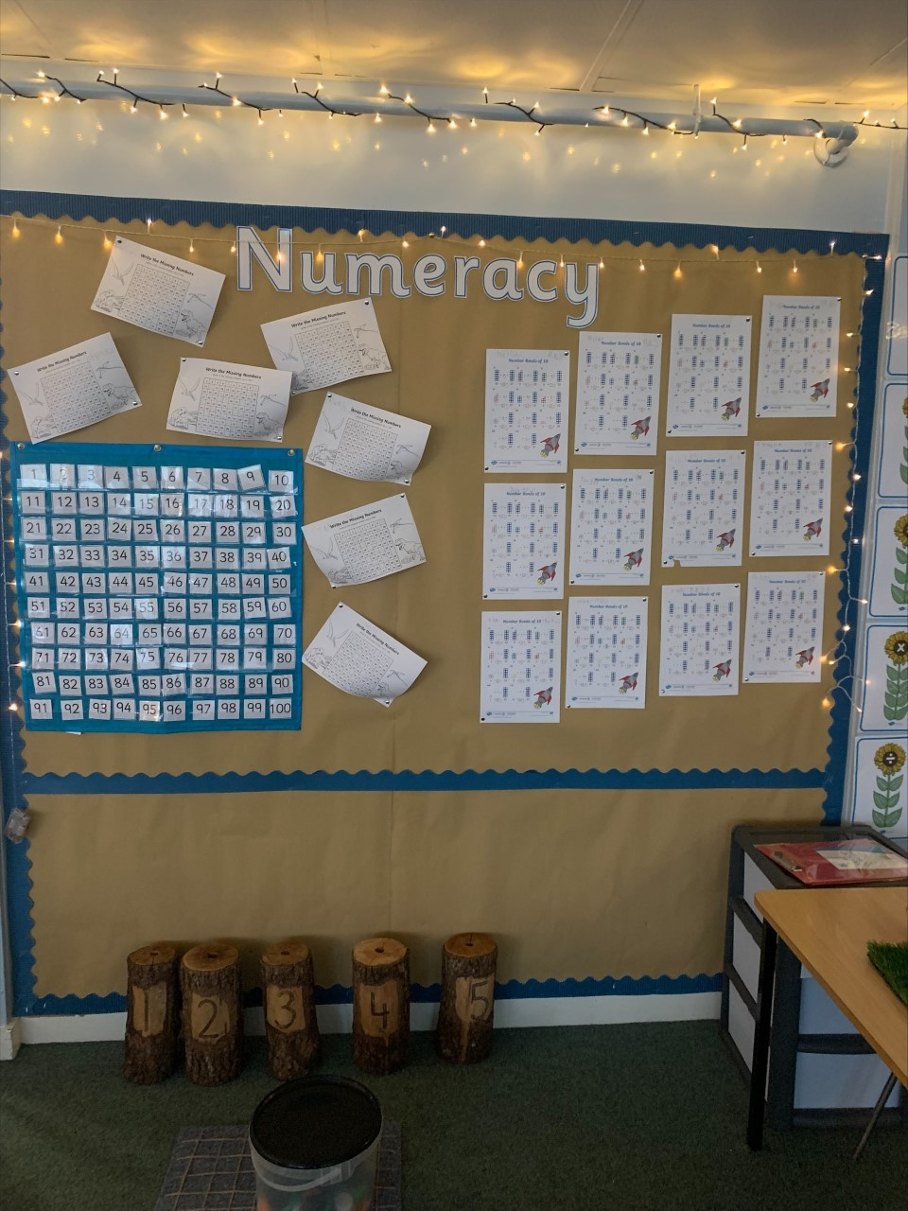
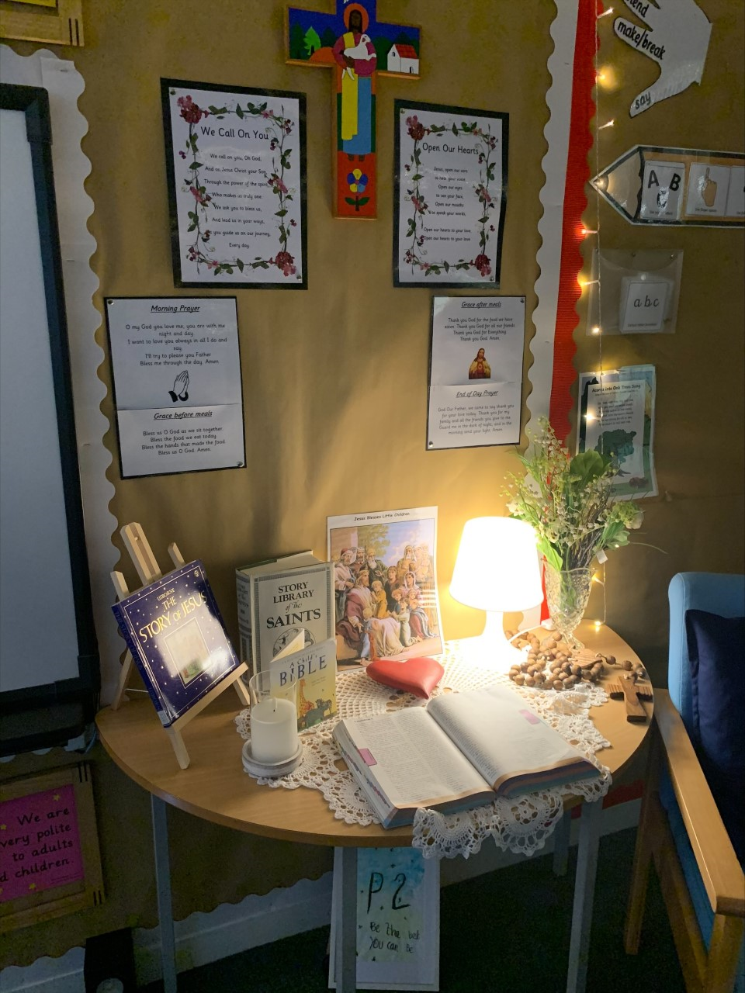
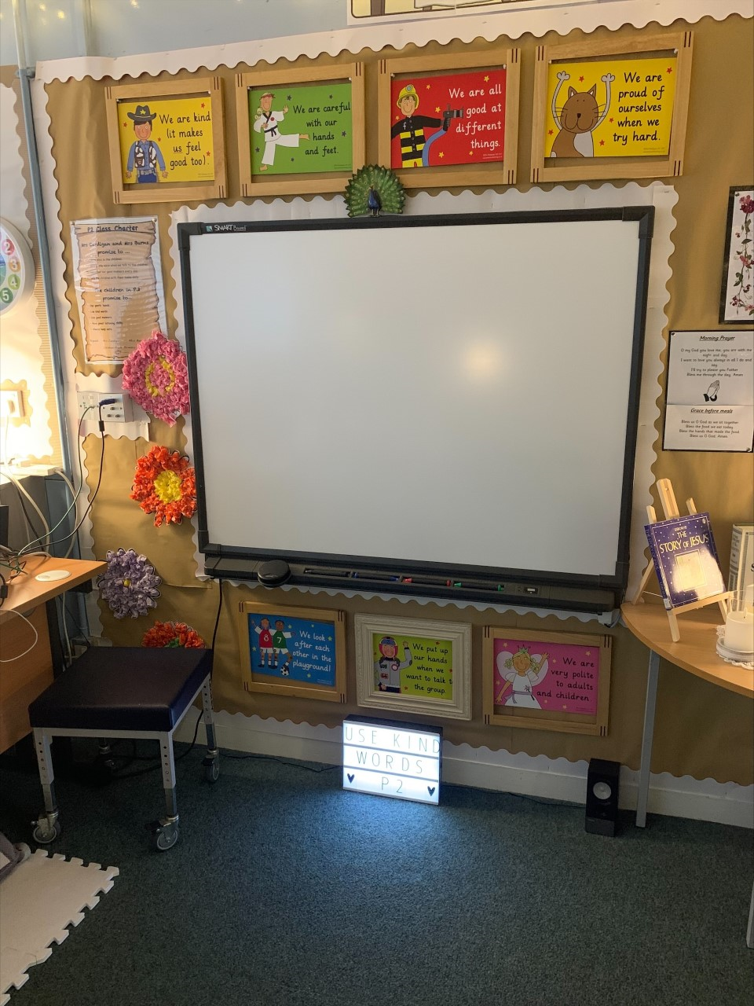
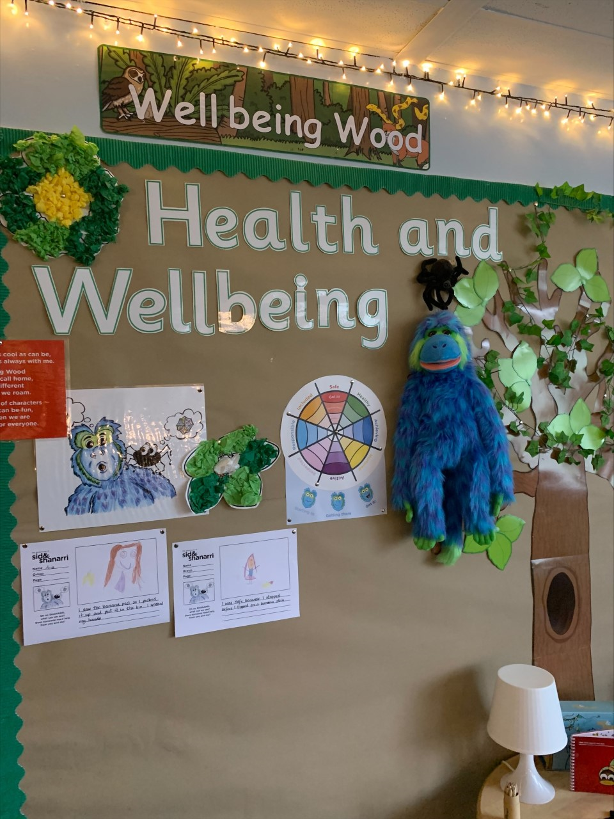
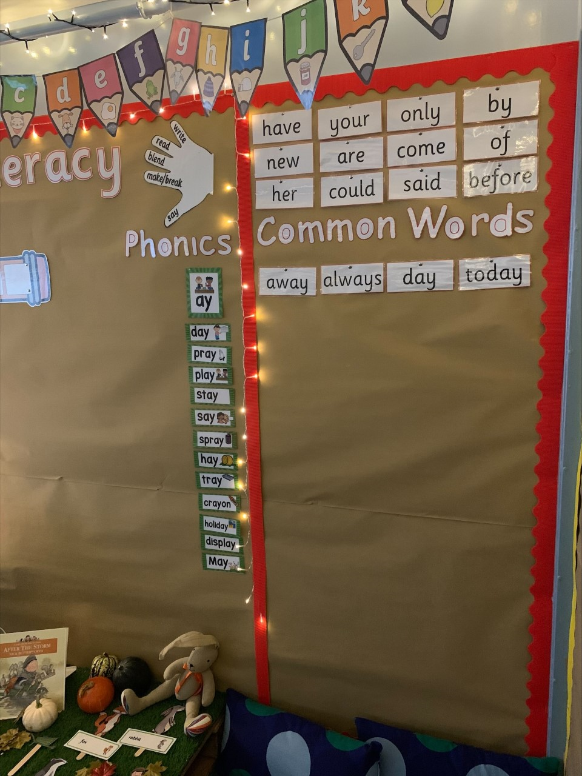

Slide 5
Curriculum for Excellence
Within the 8 curricular areas of the curriculum children’s learning will focus on 3 key aspects.
Literacy
Numeracy
Health and Wellbeing
The additional 5 areas are covered within Topic work and Interdisciplinary Learning.

Slide 6
Literacy
Spelling
Common words
Four per week
Active tasks eg. spelling boards, partner dictation, writing tasks.
Common word Tin
Sounds (phonemes)
One per week
Jolly Phonics, multi sensory stations, smartpals, smartboard tasks, letter formation & magnetic boards
Reading
Introduced by class teacher (walk through, modelling, unfamiliar vocabulary)
Partner reading, guided reading & independent reading
Read to write tasks – strip books, cut up sentences, story sequencing.
Independent reading and reading for fun.

Slide 7
Writing Listening & Talking
Daily writing activities, which include, taught writing, grammar, sharing news, common word sentences
Introduction to a variety of writing genres, for example Creating Instructional texts
Links to class theme/topic
Independent writing, Over writing and under writing
As children become more independent they will begin to use word mats, writing wall, knowledge of phonemes and common words
Introduction to self and peer assessment strategies
Can hear and say patterns in words, for example rhyming words.
Participates actively in songs, rhymes and stories.
Opportunities to take turns and contribute to class discussions.
Communicate clearly and audibly while engaging with others.
Opportunities to ask questions and respond relevantly to questions from others.
Can use new vocabulary and phrases to express ideas, thoughts ad feelings.

Slide 8
Numeracy
Topics covered in Term 1
Estimation and Rounding
Number and Number Processes
Measurement
Addition and Subtraction
Resources Used
Espresso
Sumdog
SMARTboard games
Concrete materials eg. Numicon, counting objects
Number formation
Mental Maths
Oral counting eg. forwards, backwards, counting in 2s, 5s,10s and missing number sequences
Addition and subtraction using concrete materials
Active and written tasks

Slide 9
Resources used to Support Learning
Maths
Sumdog.com
Smartboard Games
Topmarks.co.uk
ictgames.com
Literacy
doorwayonline.org.uk
starfall.com
Oxfordowl.co.uk
Discoveryeducation.co.uk
Health & Wellbeing
sidandshanarri.co.uk
healthyschools.scot
educationscotland.gov.scot
Esspresso Education: covers all aspect of the curriculum.
username: student 13896 password: sthelens

Slide 10
Health and Wellbeing
Learning about the SHANARRI indicators - Safe, Healthy, Achieving, Nurtured, Active, Respected, Responsible, Included. This also includes help from Sid the puppet and his friend Shanarri the spider.
Circle time - Talking circle
Health and Wellbeing section of the Personal Learning Plans
Daily Mile
Class Charter at the beginning of the year
Health and Wellbeing encompasses everything we do
UNCRC – The Rights of the Child

Slide 11
Timetable
P.E.
Monday (with Mr McGinty) and Wednesday.
On these days full P.E. kit can be worn to school.
Homework
Issued on a Monday
Returned on a Thursday
N.B. Reading books must be brought to school every day for classroom learing.

Slide 12
Feedback and Reporting
Personal Learning Plans (PLP’s) are used to ensure children feel involved in their learning, are aware of their next steps and are active participants in learning. We know parents want to be part of the learning journey with children so the document helps to share information on your child's learning with you. There are instructions included in the document to explain how to use the PLP to support discussions about learning at home. Learning Targets within the PLP’s are focused on Reading, Writing, Talking and Listening, Maths and Health and Wellbeing
Parents Evenings – There are two opportunity to discuss your child’s progress, in November and May. Arrangements will be made for this in line with Government restrictions.
Formal Reports will be sent to parents in May, prior to the Parents’ Evening
Although there are lots of opportunities across the year to hear about how children are getting on - you can still get in touch with the school at any time if you have a concern or would like some information. This can be arranged by calling the office.

Slide 13
Dates for diary
October 25th 2021- Personal Learning Plans sent home
November 11th 2021- Parents evening
December 6th 2021 - PLP Tracker sent home
January 24th 2022 - Updated PLP sent home with new targets set
March 28th 2022 - PLP Tracker sent home with feedback on how children are getting on
May 23rd - Formal report cards sent home to parents
May 25th - Final parents' Evening

Slide 14
Ways to keep in touch
Following us on Twitter @StHelnsNLC
Have a look at our school website:
Check out our TEAMS page.
https://blogs.glowscotland.org.uk/nl/sthelens/
You can also find important information in the newsletter that is emailed to all parents

Slide 15
A message from me
Thank you for taking the time to listen to this presentation. I am excited to be working with your children in Primary 2 and look forward to watching them learn, grow and develop new skills. With your support I will guide and encourage your child through their learning journey. I look forward to getting to know you all better over the next few months.
Kindest regards Tricia Cardigan

Slide 16
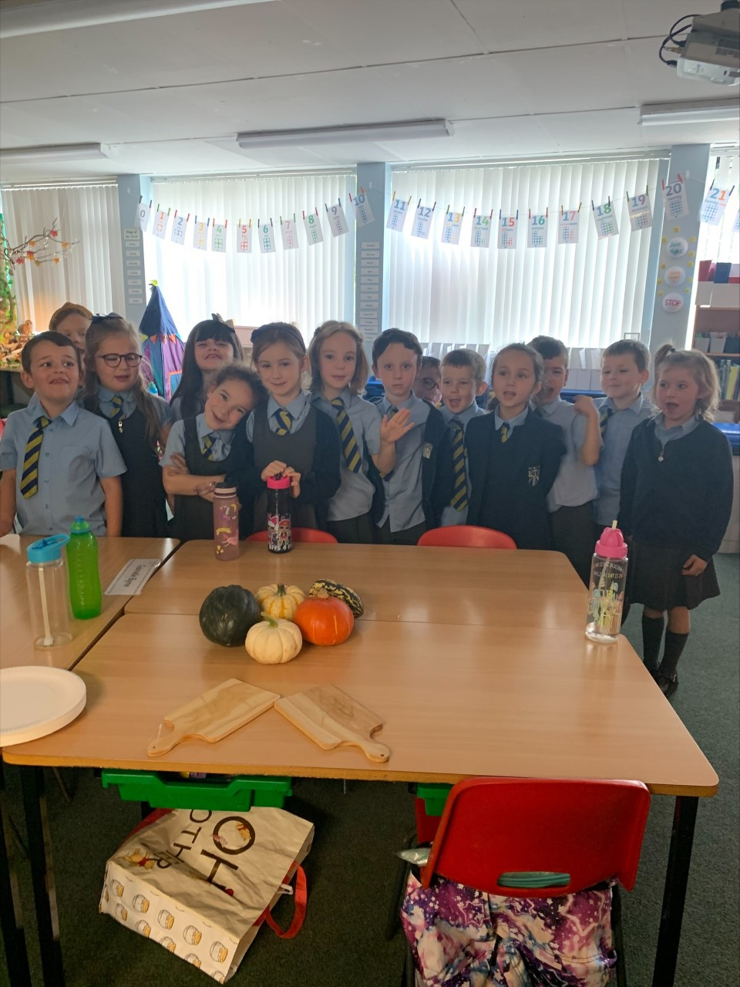
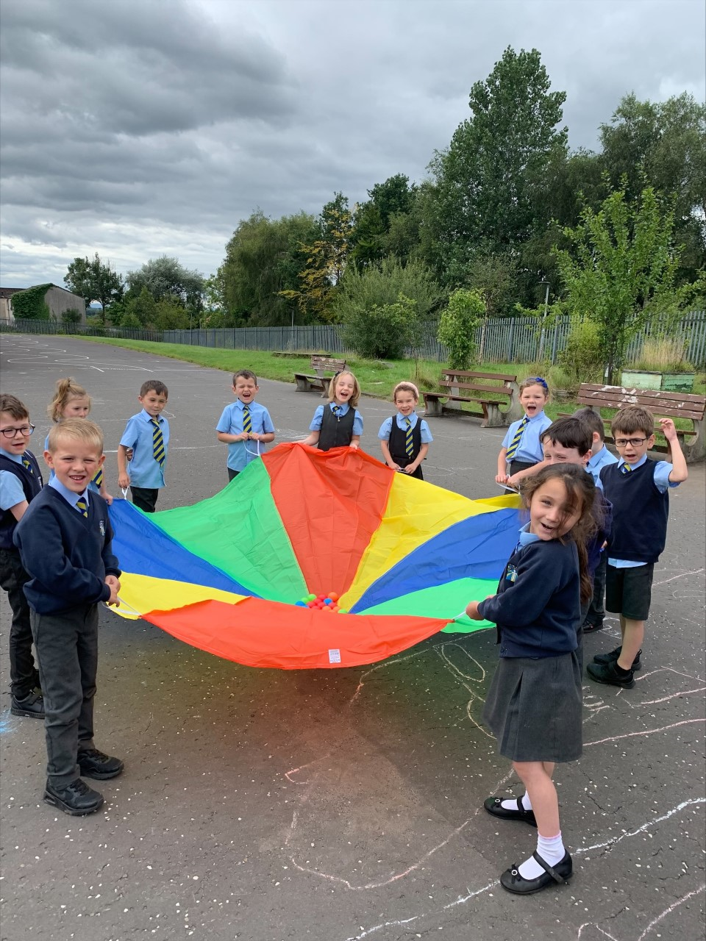
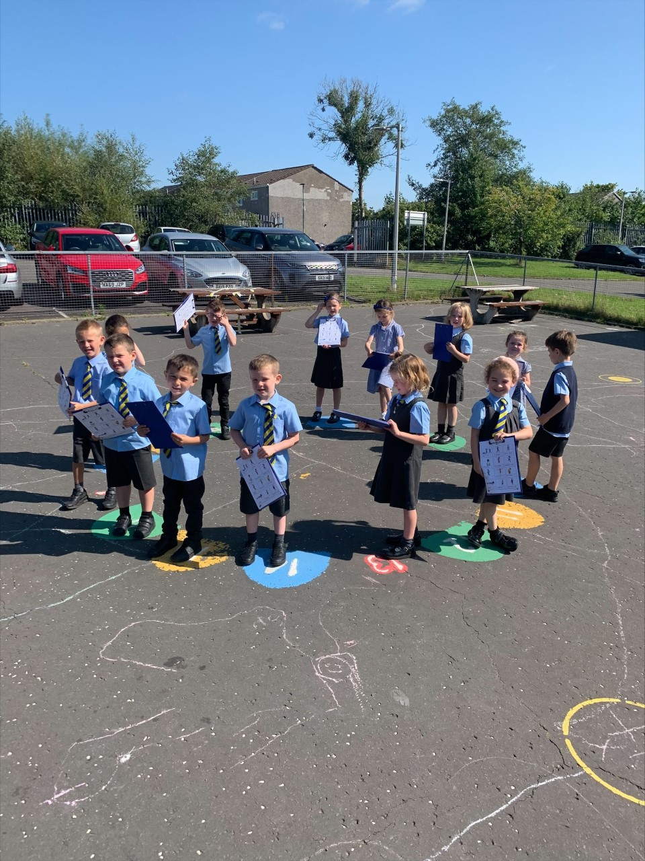
Learning is fun!
P2

