Slide 1
Welcome to Primary 1
Mrs Marshall
Twitter: @sthelensnlc

Slide 2
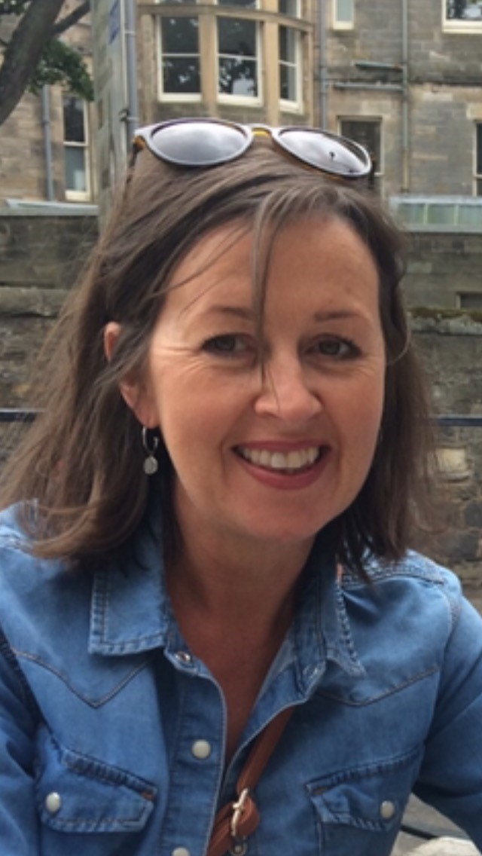

Hello My Name is Mrs Marshall

Slide 3
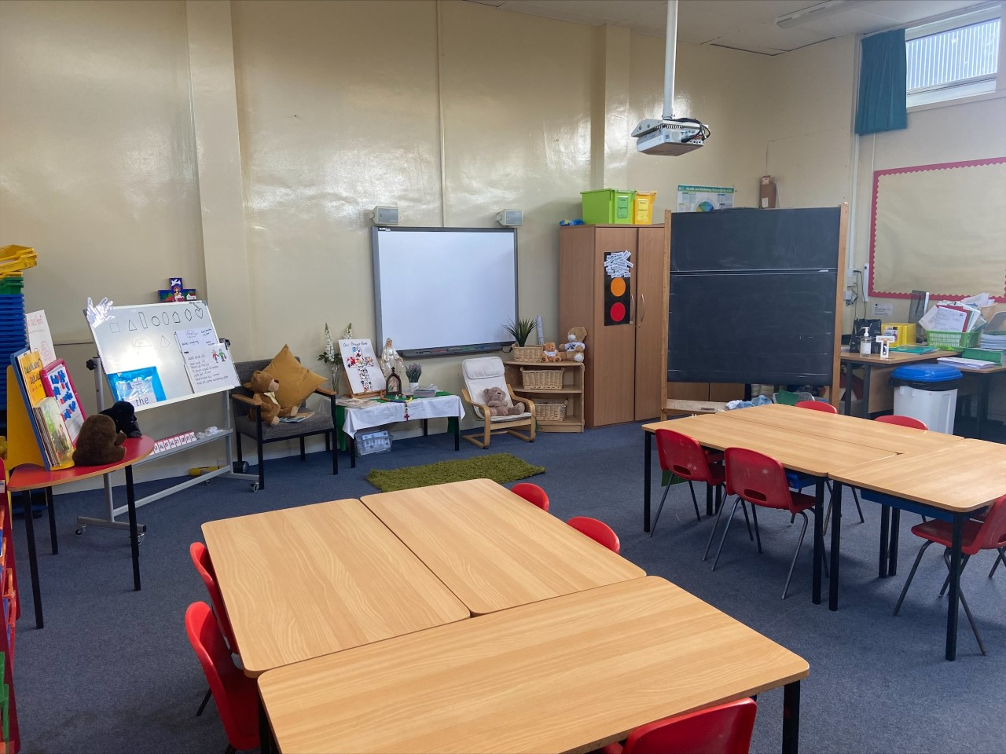
This is our classroom.

Slide 4
Curriculum for Excellence
Within the 8 curricular areas of the curriculum children’s learning will focus on 3 key aspects.
Literacy
Numeracy
Health and Wellbeing
The additional 5 areas are covered within Topic work and Interdisciplinary Learning.

Slide 5
Literacy
Spelling
Common words
  Three per week
  Active tasks eg. spelling boards, partner dictation
  Sounds (phonemes)
    Two per week
    Jolly Phonics, multi sensory stations, smartpals, letter formation & magnetic boards
Reading
Introduced by class teacher (walk through, modelling, unfamiliar vocabulary)
Partner reading, guided reading & independent reading
Read to write tasks – strip books, cut up sentences, story sequencing.
Independent reading and reading for fun.

Slide 6
Writing Listening & Talking
One taught writing lesson per week
Introduction to genres, for example Creating Instructional texts
Links to class theme/topic
Independent writing, Over writing and under writing
As children become more independent they will begin to use word mats, writing wall, knowledge of phonemes and common words
Introduction to self and peer assessment strategies
Can hear and say patterns in words, for example rhyming words.
Participates actively in songs, rhymes and stories.
Opportunities to take turns and contribute to class discussions.
Communicate clearly and audibly while engaging with others.
Opportunities to ask questions and respond relevantly to questions from others.
Can use new vocabulary and phrases to express ideas, thoughts ad feelings.

Slide 7
Numeracy
Topics covered in Term 1
Estimation and Rounding
Number and Number Processes
Measurement
Addition and Subtraction
  Resources Used
    Espresso
    Sumdog
    SMARTboard games
    Concrete materials eg. Numicon, counting objects
  Mental maths
  Number formation
  Oral counting eg. forwards, backwards, counting in 1s, 2s and 10s and missing number sequences
  Addition and subtraction using concrete materials
  Active and written tasks

Slide 8
Resources used to Support Learning
  Maths
  Espresso
  Sumdog.com
  Smartboard Games
  Topmarks.co.uk
  ictgames.com
  Literacy
  doorwayonline.org.uk
  starfall.com
  Oxfordowl.co.uk
  Discoveryeducation.co.uk
  Health & Wellbeing
  sidandshanarri.co.uk
  healthyschools.scot
  educationscotlsnd.gov.scot
Espresso Education
Username – student13896
password - sthelens

Slide 9
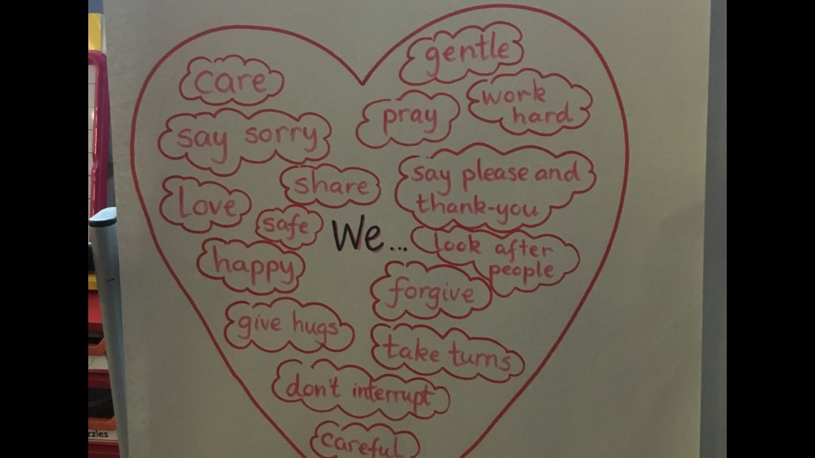
Health and Wellbeing
Health and Wellbeing encompasses everything we do
Class Charter at the beginning of the year
Learning about the SHANARRI indicators - Safe, Healthy, Achieving, Nurtured, Active, Respected, Responsible, Included.
Circle time
Health and Wellbeing section of the Personal Learning Plans
Daily Mile

Slide 10
Timetable
P.E.
Tuesday & Friday.
On these days full P.E. kit can be worn to school.
Homework
  Issued on a Monday
  Returned on a Thursday
    N.B. Reading books must be brought to school every day for classroom learning.

Slide 11
Feedback and Reporting
Personal Learning Plans (PLP’s) are used to ensure children feel involved in their learning, are aware of their next steps and are active participants in learning. We know parents want to be part of the learning journey with children so the document helps to share information on your child's learning with you. There are instructions included in the document to explain how to use the PLP to support discussions about learning at home. Learning Targets within the PLP’s are focused on Reading, Writing, Talking and Listening, Maths and Health and Wellbeing
Parents Evenings – There are two opportunity to discuss your child’s progress, in November and May. Arrangements will be made for this in line with Government restrictions.
Formal Reports will be sent to parents in May, prior to the Parents’ Evening
Although there are lots of opportunities across the year to hear about how children are getting on - you can still get in touch with the school at any time if you have a concern or would like some information. This can be arranged by calling the office.

Slide 12
Dates for diary
  October 25th 2021- Personal Learning Plans sent home
  November 11th 2021- Parents evening
  December 6th 2021 - PLP Tracker sent home
  January 24th 2022 - Updated PLP sent home with new targets set
  March 28th 2022 - PLP Tracker sent home with feedback on how children are getting on
  May 23rd - Formal report cards sent home to parents
  May 25th - Final parents' Evening

Slide 13
Ways to keep in touch
Following us on Twitter @StHelnsNLC
Have a look at our school website:
https://blogs.glowscotland.org.uk/nl/sthelens/
You can also find important information in the newsletter that is emailed to all parents

Slide 14
A message from me
I am enjoying working with the children I am looking forward to supporting them with their learning and working alongside all of their families.

