Slide 1
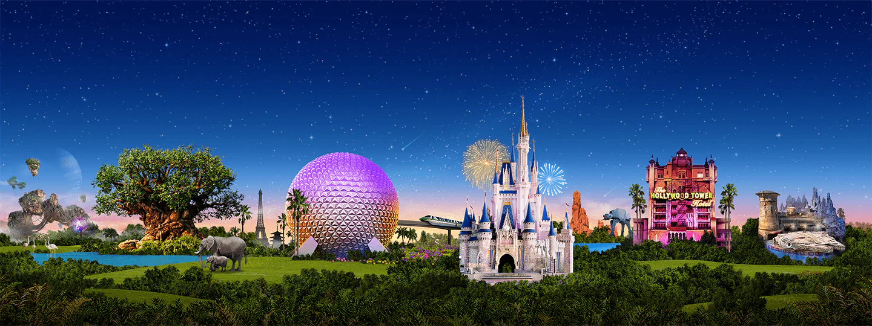
Virtual Disney Trip
Primary 6’s

Slide 2
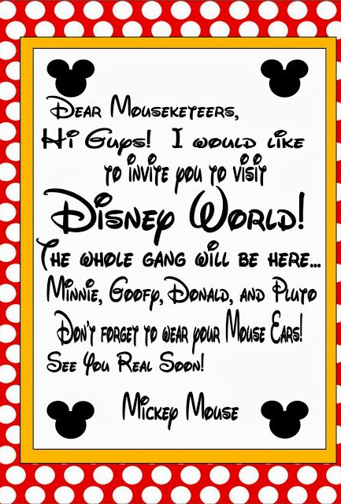
Attention P6!
To celebrate the end of term, our main tasks today are Disney themed. They will all revolve around a ‘virtual’ Disney trip to Disney Land. I can’t wait to see all of your fantastic responses!
Miss O’Toole x
Note: This PowerPoint works best when viewed in Slide Show mode. Click the ‘Slide Show’ tab and then click ‘From Beginning’ to view this correctly.

Slide 3
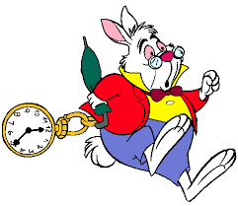
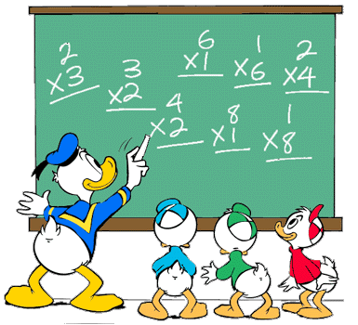
Task 1 –Maths Challenges
Complete the appropriate challenge for your given Maths group on
the next slides.

Slide 4
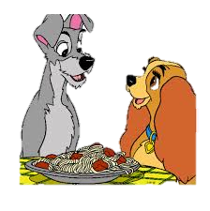
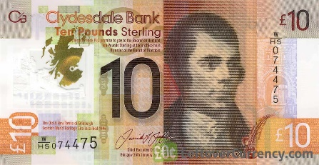
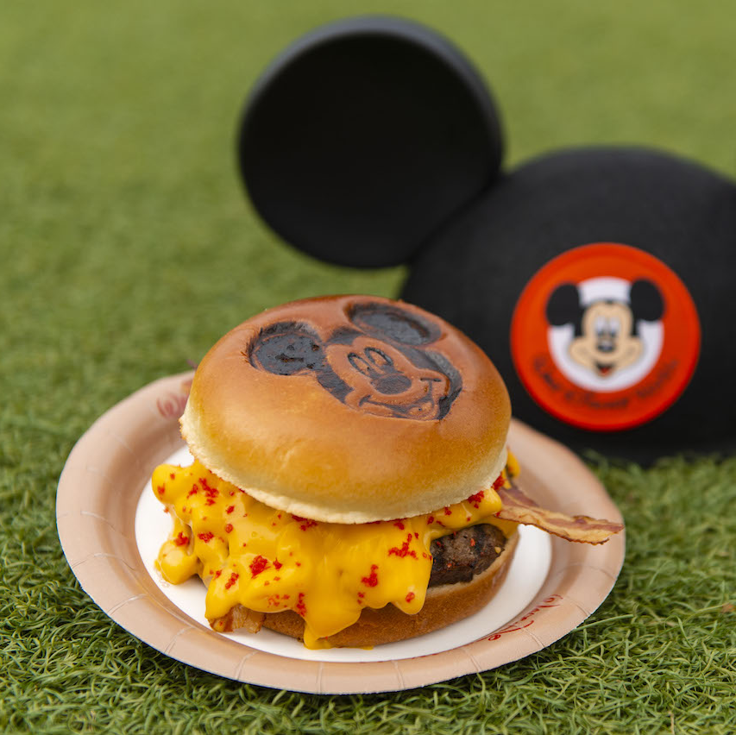
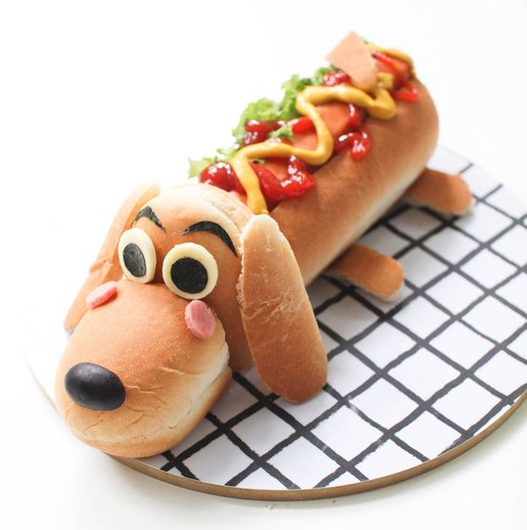
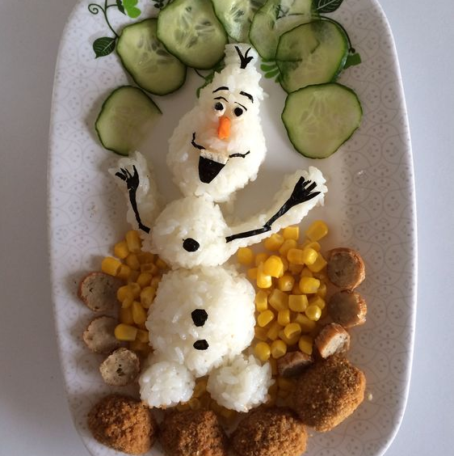
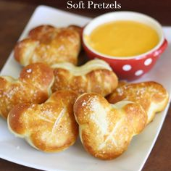
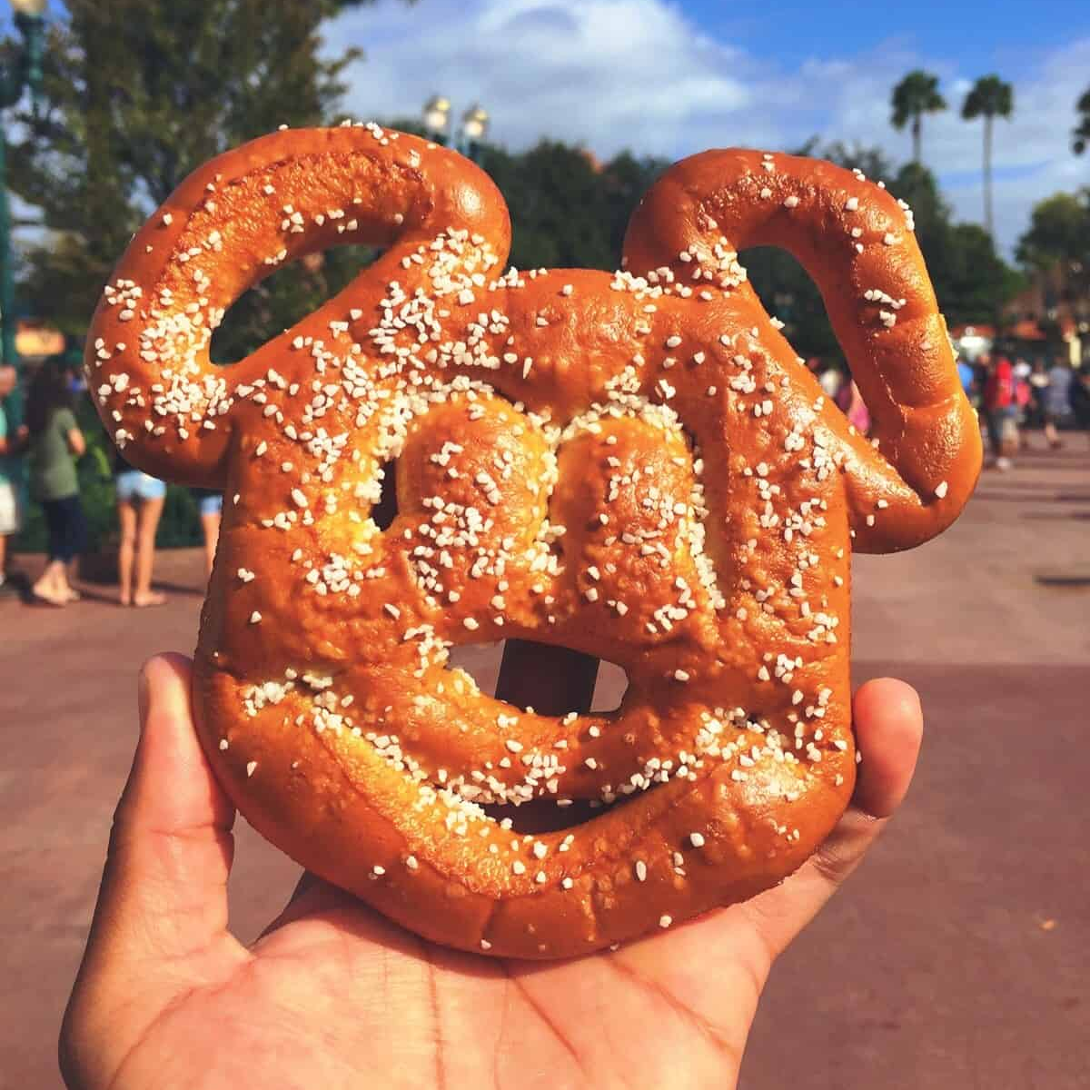
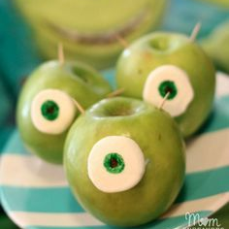
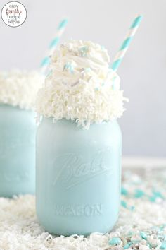
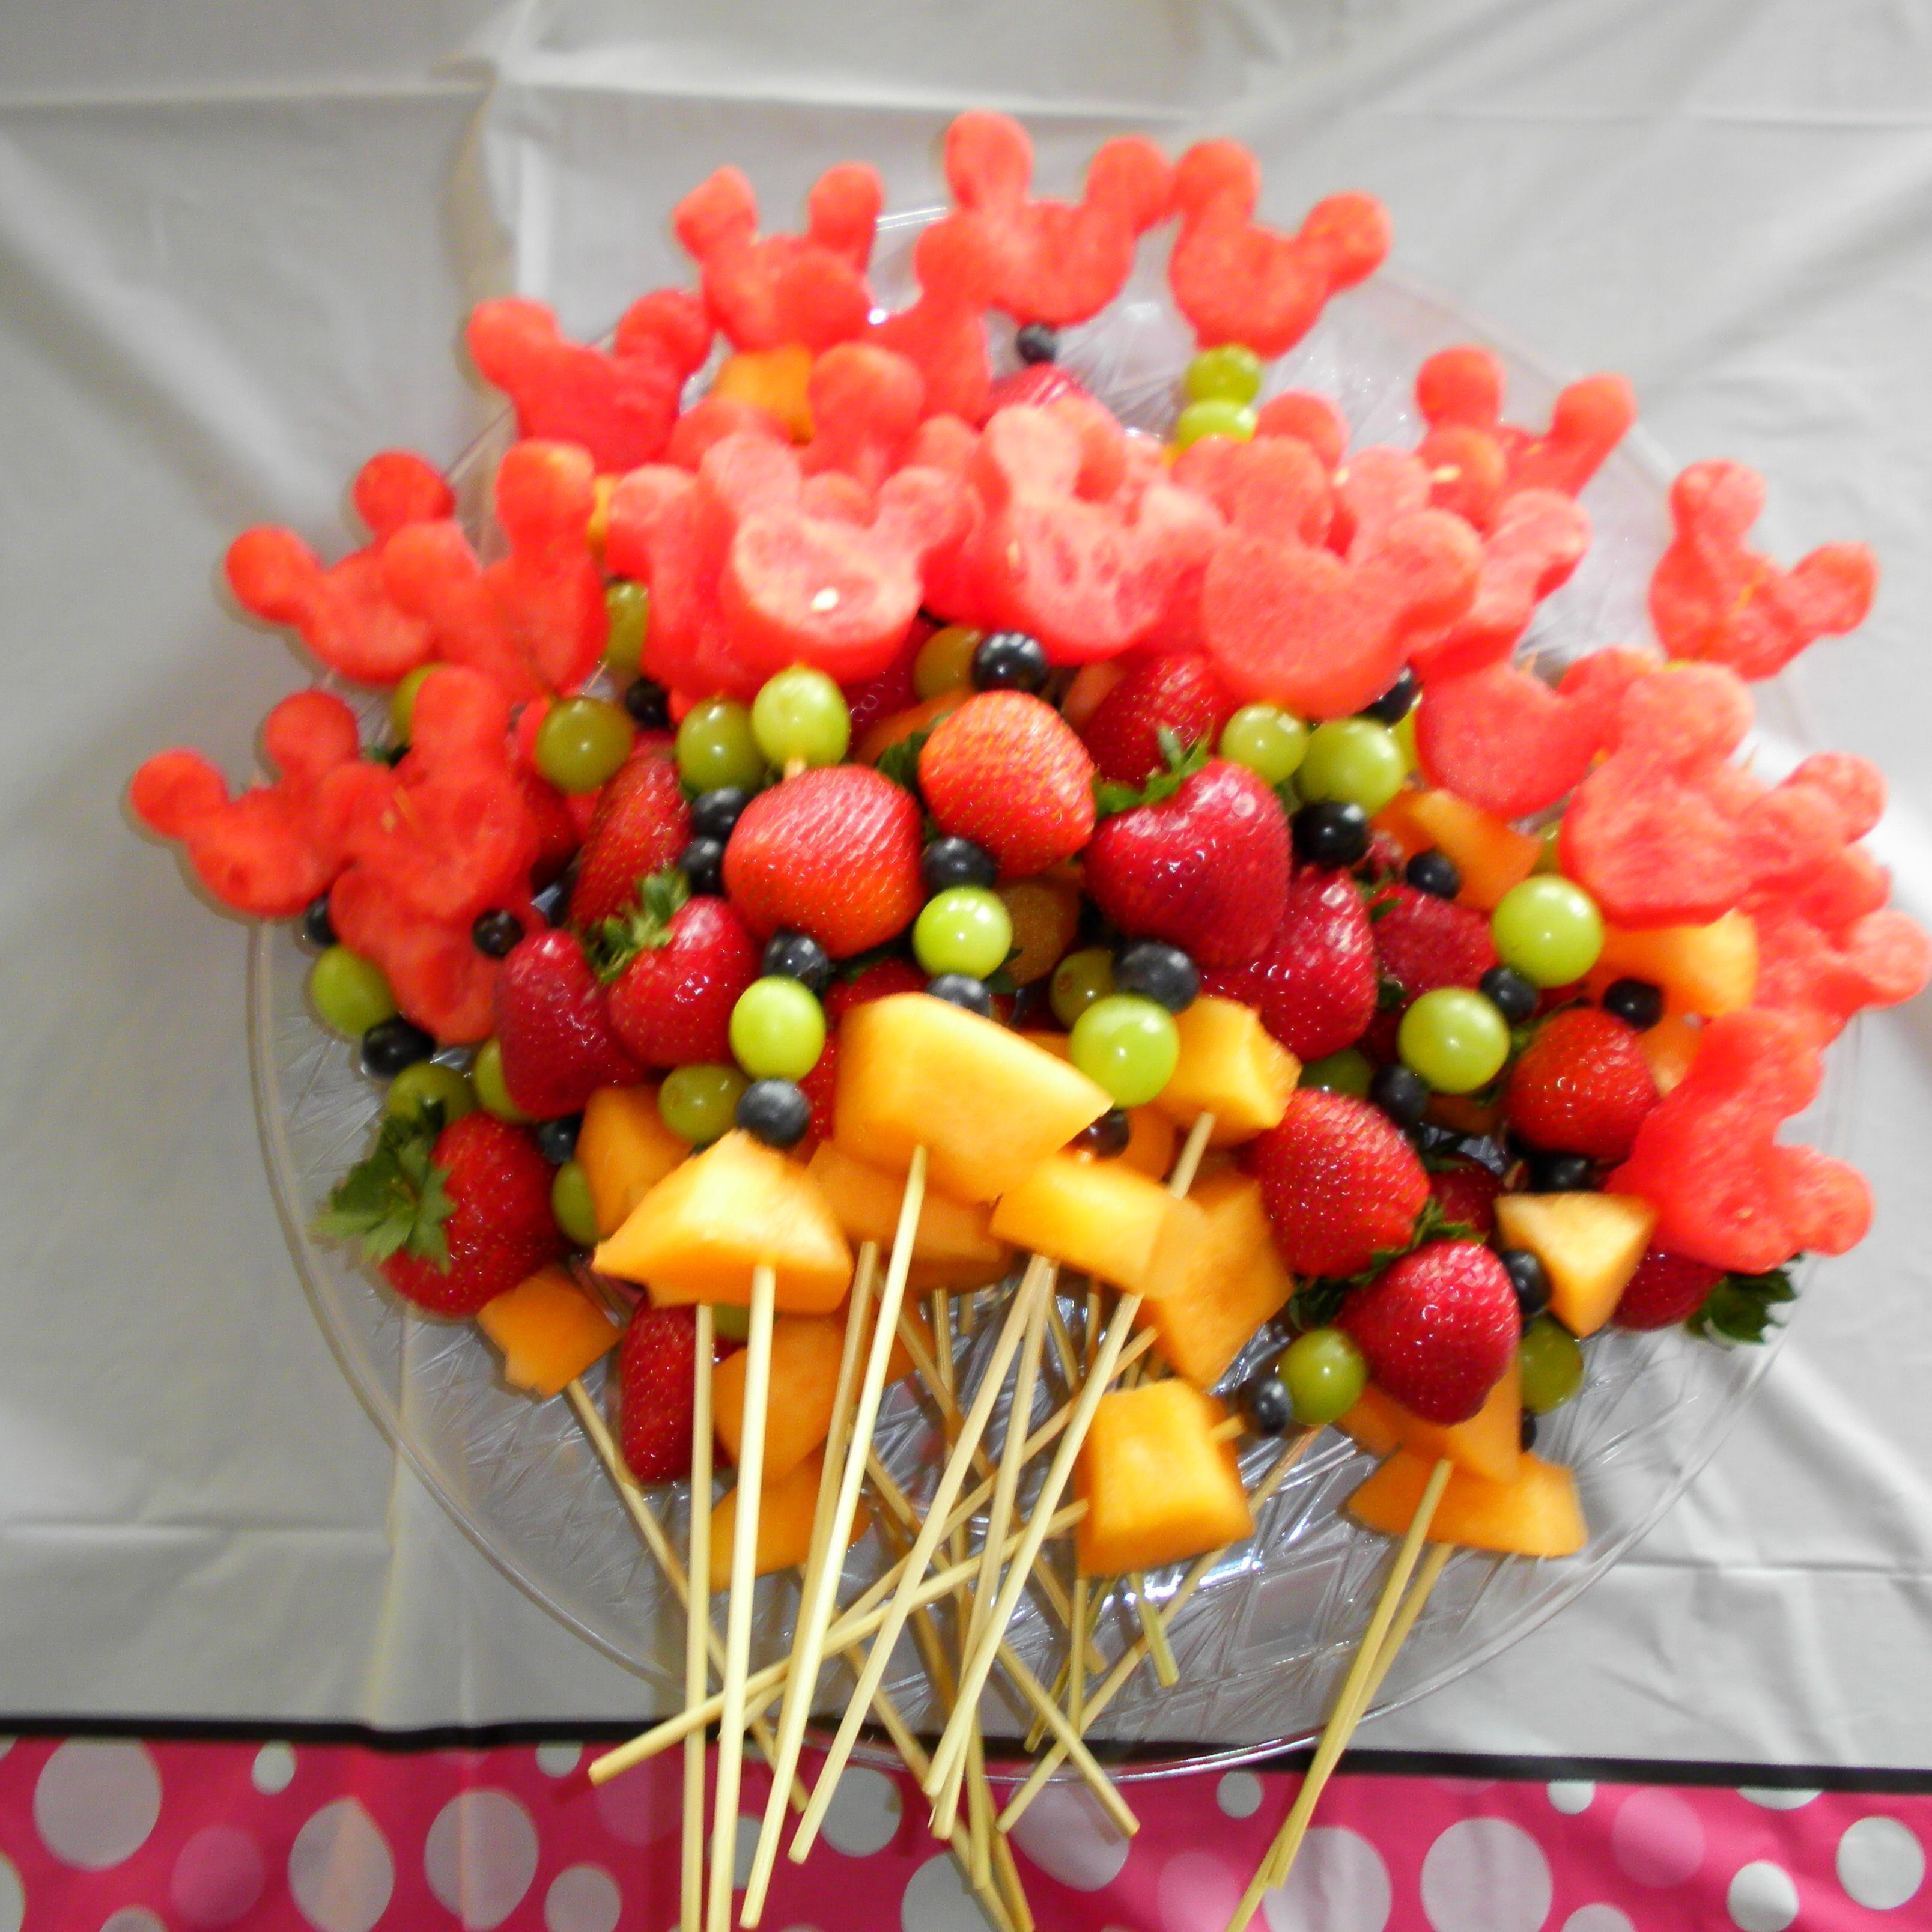
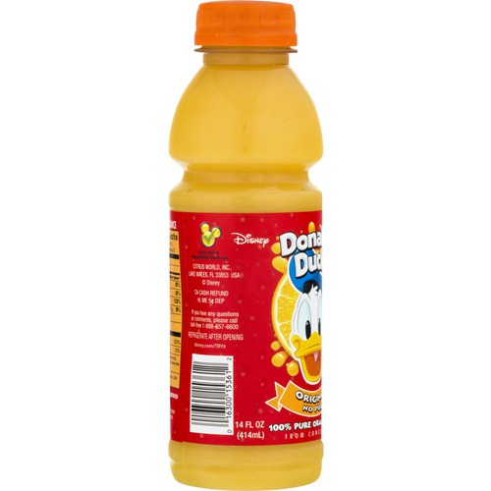
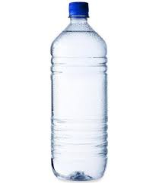
Numeracy: Snack Time! Red Group
You have £35.00 to spend on lunch for a family of 4 (2 adults and 2 children).
What will you buy? You must include at least 1 drink for each person. Snacks can be shared.
Do you have enough money?
How much change will you get?
Cheeseburger £6.00
Pizza
£5.50
Hotdog
£3.50
Chicken & Rice
£7.25
Soup & Bread
£3.50
Pretzel
£2.50
Fruit Kebab
£1.25
Apple
50p
Crisps
70p
Orange Juice
£1.50
Water
£1.00
Frozen Milkshake
£2.50

Slide 5
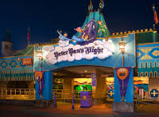
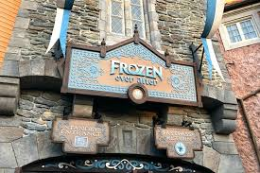
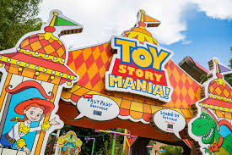
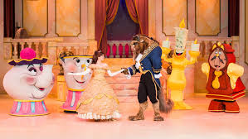
Numeracy: Ride Time! Blue Group
How long altogether would it take to ride Peter Pan’s Flight & Frozen Ever After?
You have 35 minutes left in the park. Which rides could you go on to make the most of your time left?
How much longer is the Beauty and the Beast show than Peter Pan’s Flight?
How much shorter is Frozen Ever After than Beauty & the Beast show?
You want to visit all 4 attractions. How long will it take altogether?
Peter Pan’s Flight
Duration: 11 minutes 19 seconds.
Frozen Ever After
Duration: 12 minutes 6 seconds.
Toy Story Mania!
Duration: 4 minutes 29 seconds.
Beauty & the Beast Show
Duration: 30 minutes

Slide 6
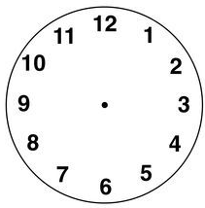
Numeracy: Green Group
Draw the hour and minute hands to show the time.
The park opens at quarter past 9.
You visit Mickey’s house at 11 o’clock.
You go on the log flumes at half past 1.
You visit the arcade at 10 past 4.
You eat dinner at 6:15pm.
The park closes at 25 minutes past 8.

Slide 7
Numeracy: Orange Group
Write the time shown on the clock.
The park opens at this time.
Mickey Mouse enters the park at this time.
The log flume queue normally gets busy at this time.
Most people attend the snack bar at this time.
Donald Duck meets visitors at this time.
The park closes at this time.

Slide 8
Task 2 - Weather Check
Disneyland is in Orlando in America.
Find out what the weather is like in Orlando this week.
Will it be rainy, cloudy or sunny?
What is the temperature?
Task: Create a weather report video to tell us about the weather at Disney World. What will we need to pack to be prepared?
Alternatively, you can write a brief summary of the weather. A video report is not essential – Don’t worry! ☺

Slide 9
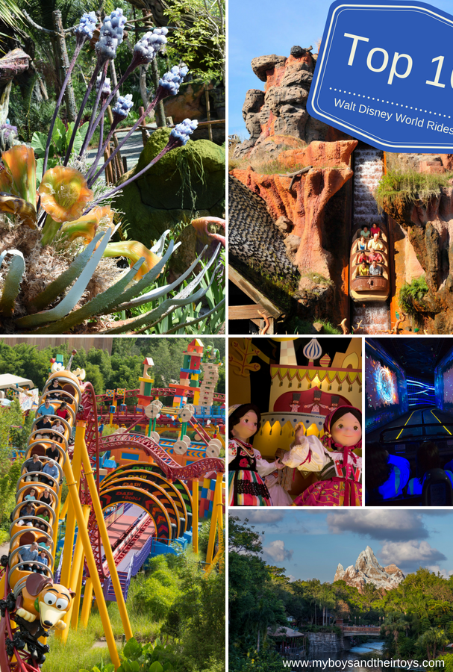
It’s time to explore the rides!

Slide 10
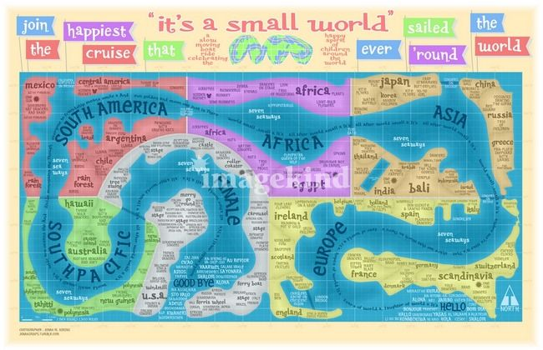
Task 3 - It’s a Small World
3. Compare Scotland to another country.
You may include:
Location
Weather
Food
Flags
Attractions/scenery
Anything else!
You can create a poster or record a video to showcase your information.
1. Set sail on the, ‘It’s a Small World’ Boat Ride to visit countries around the world. (Click the picture to go!)
2. Find out the names of the 7 different continents in the world.

Slide 11
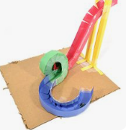
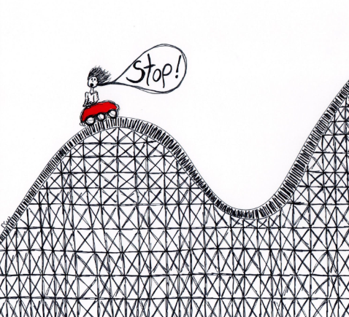
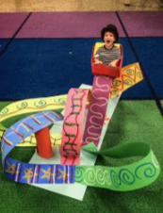
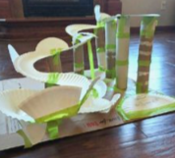
Task 4 - A New Ride: Part 1
The year 2021 is Disneyland’s 50th Anniversary!
We’ve been asked to help design a new ride.
Think about:
What will it be named?
What movie is it based on?
Who will it be for? Young children, teenagers, adults?
What will it look like?
Design your ride! You can draw or build this, you choose.

Slide 12
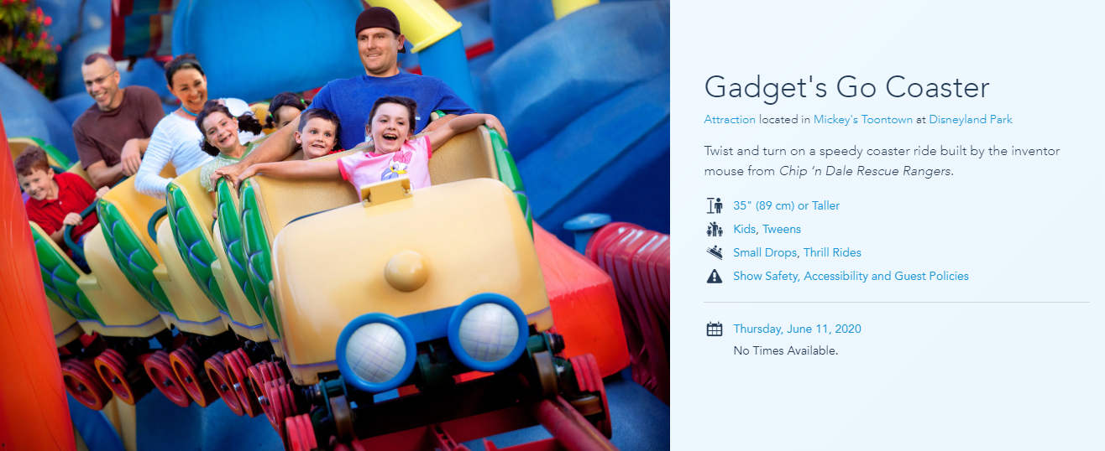
A New Ride: Part 2 (OPTIONAL)
Create a poster to advertise your new ride.
Remember to include: Price, height limits and any safety rules.

Slide 13
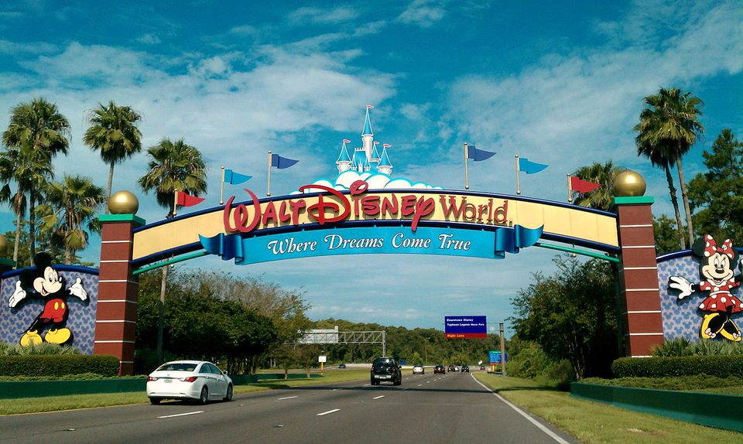
I hope you all enjoyed your trip to Disney World!
Big hugs, Miss O’Toole x

