Slide 2
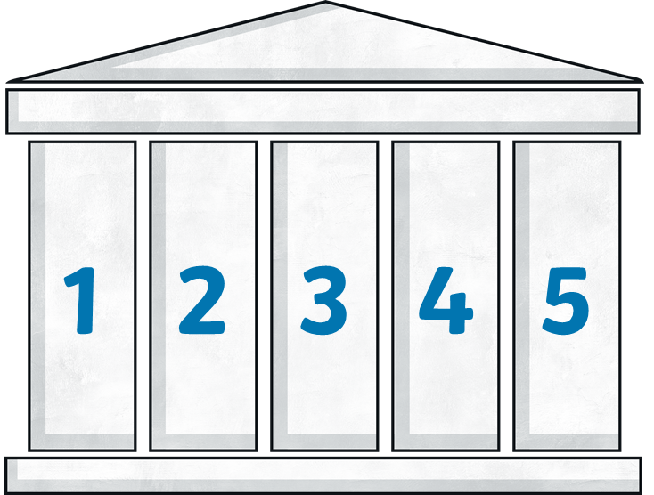
What are the Five Pillars of Islam?
The Five Pillars of Islam are five duties that Muslims try to carry out. It helps them to live a good and responsible life, and bring them closer to God (Allah) and their community.
Each pillar has a different name; Shahada, Salah, Zakat, Sawm, and Hajj.

Slide 3
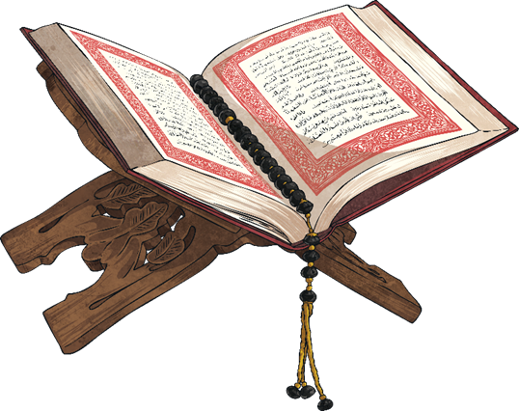
Shahada – Pillar One
This pillar is the main belief of all Muslim people and it is a declaration of their faith. The English words are:
“There is no god except Allah, Muhammad is the messenger of Allah.”
Muslims say this when they pray.

Slide 4
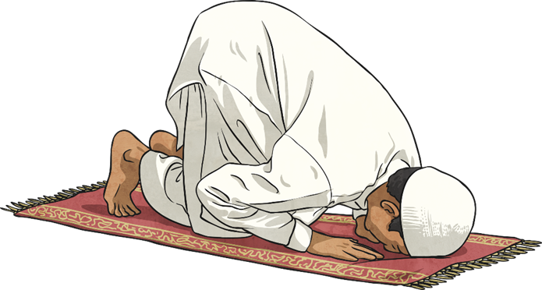
Salah – Pillar Two
This pillar is prayer. Muslims pray five times a day and follow a special ritual to do so. First they must wash in symbolically clean water.
All the prayers are said at the same time every day.
Fajr – Morning, between dawn and sunrise.
Zuhr – Mid-day or early afternoon.
Asr – Late afternoon.
Maghrib – Evening, around sunset.
Isah – Night, before going to bed.

Slide 5
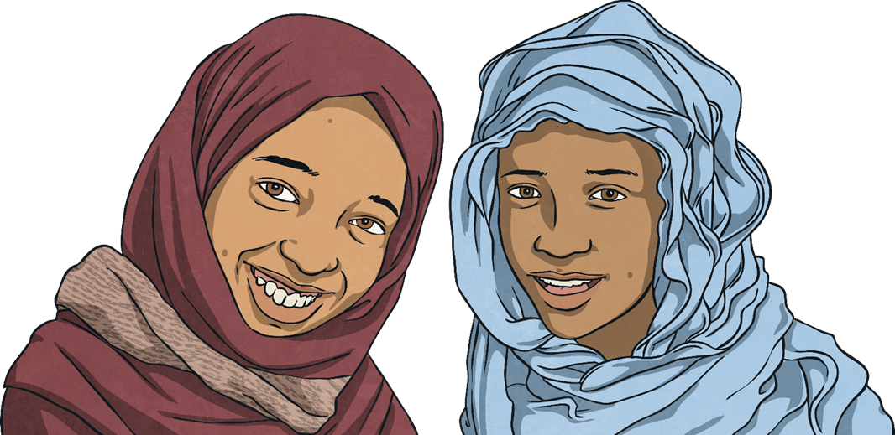
Zakat – Pillar Three
This pillar is about looking after other people. Each Muslim gives up a share of his wealth each year to provide for those less fortunate.
The word zakat means to purify or cleanse. As a person gives away a share of their wealth they become cleansed from selfishness and greed.

Slide 6
Sawm – Pillar Four
This pillar is all about Ramadan. The ninth month of the Islam calendar is when Muhammad began receiving messages from God.
For 30 days Muslims fast, they do not eat or drink during daylight hours.
The fast is to remind them how difficult it is to be poor, hungry and thirsty. It reminds them to thank God for the gift of the Qur’an and not be greedy.

Slide 7
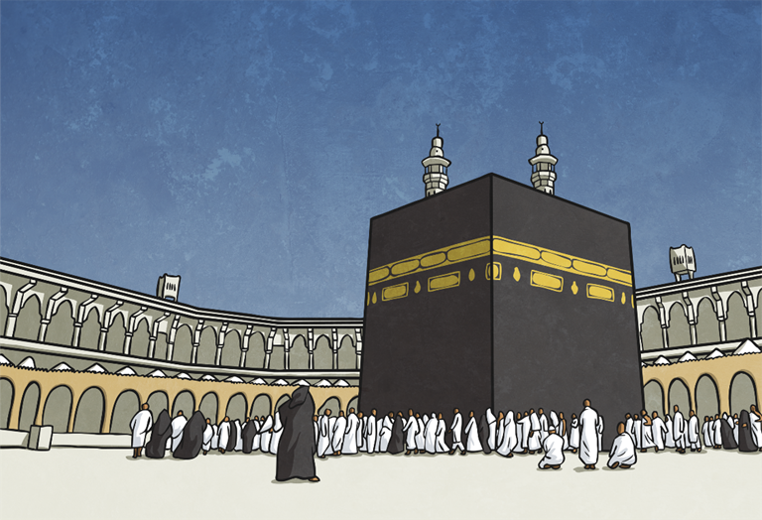
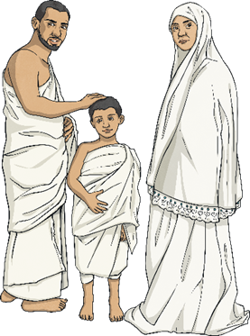
Hajj – Pillar Five
All Muslims have a duty to make a pilgrimage to Makkah at least once in their life. Very often whole families will save to send one person at a time.
Men who go must wear an ihram which is made up of two sheets which must not be sewn together.
Muslims go on the pilgrimage to bring together the community and strengthen it.

