Slide 2
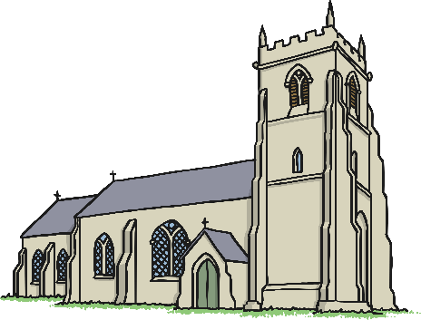
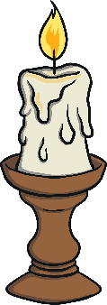
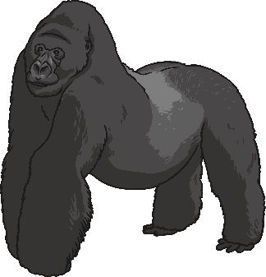
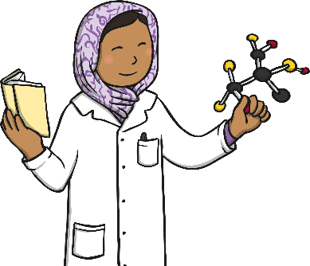
Getting Started
What is a noun?
A noun is a naming word. Nouns are used to identify people, places, objects, animals or ideas. There are several different types of nouns; we most commonly use ‘common nouns’.
So, what is a common noun?
Common nouns are the general names for people, places, objects or animals. For example:

Slide 3
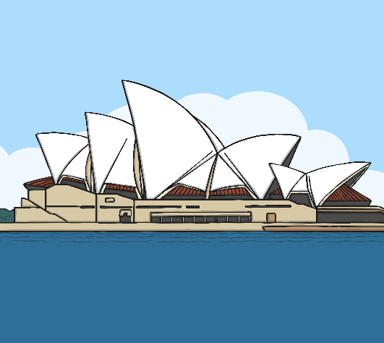
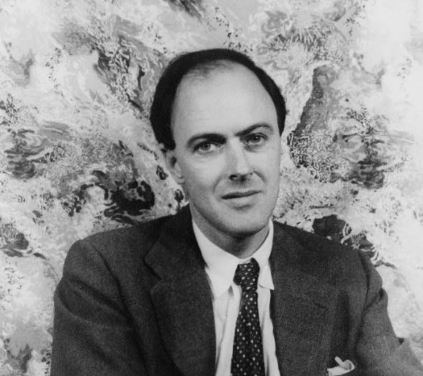
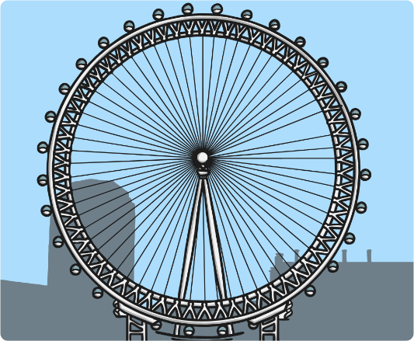
Getting Started
Proper nouns are different in that they name specific places, objects or people. A proper noun should always start with a capital letter.
Sydney
Roald Dahl
London Eye
Months of the year, days of the week, some religious events and brand names are also considered to be proper nouns.

Slide 4
Next Steps
Could you help me to fill in this common noun and proper noun chart? The first missing answer is completed for you:
Common Noun | Proper Noun
woman | J. K. Rowling
country
 | Africa
cartoon character
famous landmark
 | August
day of the week
city
restaurant

Slide 5
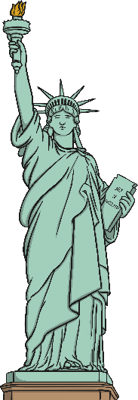
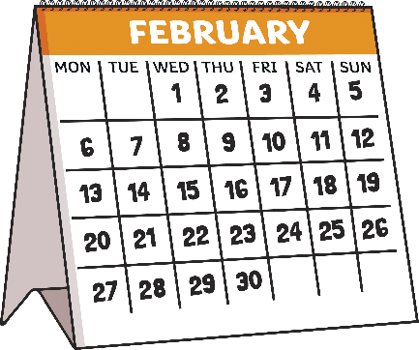
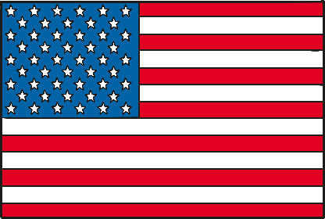
Practice Your Skills
Can you spot the three proper nouns hidden behind the numbered squares? When you think you’ve got them, write them carefully on your whiteboards with a capital letter.
1
2
3
America
Statue of Liberty
February
Could you use one of your proper nouns in a compound sentence?

Slide 6
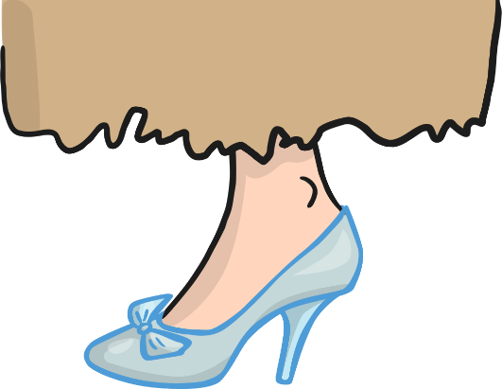
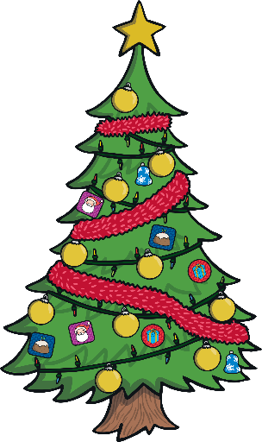
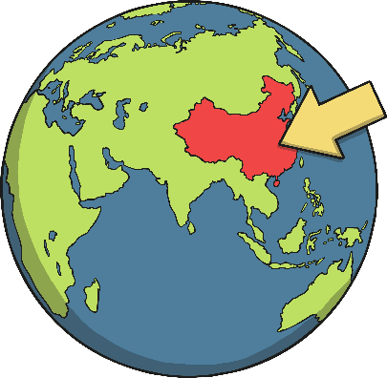
Practice Your Skills
Can you spot the three proper nouns hidden behind the numbered squares? When you think you’ve got them, write them carefully on your whiteboards with a capital letter.
Clue: They all begin with the same letter.
1
2
3
Christmas
Cinderella
China
Could you use one of your proper nouns in a complex sentence?

Slide 7
Let’s Play!
Do you think you could shout out a proper noun for each letter of the alphabet before you run out of time?
It might be a person’s name, a country, a landmark, a city or town, a month or day, an event or a brand name.
You must think quickly!
W
M
O
Q
G
D
H
N
U
K
V
A
X
B
C
R
P
Y
T
S
E
Z
F
J
L
I

Slide 8
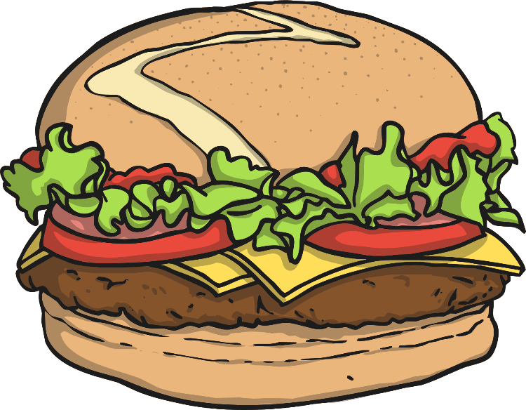
Quiz Question 1
Can you spot all the proper nouns that need capitalizing in this extract:
marie and mark are twins, who live at 132 rosemary road in madison. Their birthday is in september. They love to visit bernie’s burger bar in their hometown of middleton.
Marie and Mark are twins, who live at 132 Rosemary Road in Madison. Their birthday is in September. They love to visit Bernie’s Burger Bar in their hometown of Middleton.

Slide 9
Quiz Question 2
If I say a common noun, can you name a more specific proper noun?
e.g. cat - Garfield
dinosaur -→ ?
pop star →- ?
football team - ?→

Slide 10
Quiz Question 3
Which words are the proper nouns in the following sentences?
On friday, I went to see my grandmother at her house.
Last year, I celebrated thanksgiving at home.
Over the weekend, we went to the movies in town to see the new movie by pixar.

