Slide 1
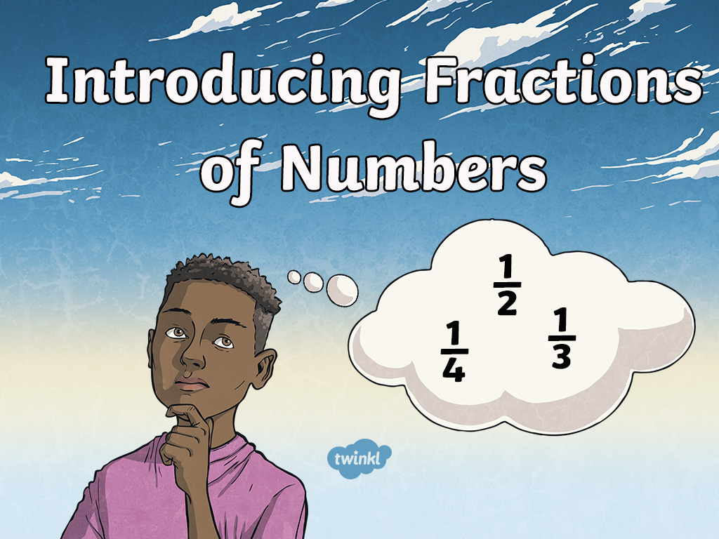

Slide 2

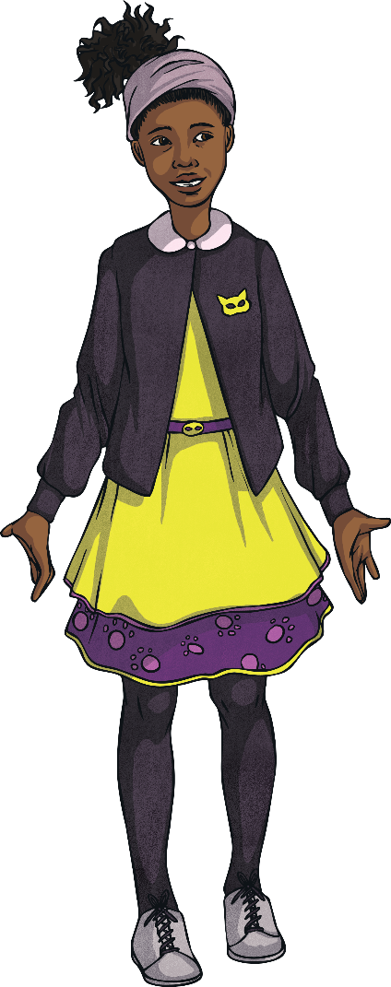



Contents
Finding half
Finding quarter
Finding one third
Finding three quarters
Finding two thirds

Slide 3
Finding Half (½)
To find half of a number, you need to divide the
number by two.
6 ÷ 2 = 3
so
½ of 6 = 3

Slide 4


Finding Half (½)
Can you find ½?
4
½ of 8 =
4
8 ÷ 2 =
So half of 8 is 4
Help

Slide 5

Finding Half (½)
Amina has 4 pencils, she wants to put half of them in her pencil case. How many pencils will she put in her pencil case?
2
½ of 4 =
2
4 ÷ 2 =
So half of 4 is 2
She will put 2 pencils in her pencil case.
Help

Slide 6
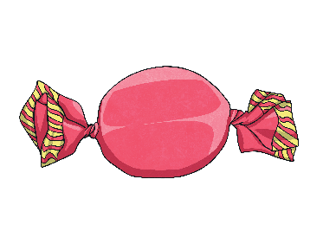
Finding Half (½)
Liam has ten sweets, he gives half to his sister. How many sweets will they each get?
5
½ of 10 =
5
10 ÷ 2 =
So half of 10 is 5
They will get 5 sweets each.
Help

Slide 7
Finding a Quarter (¼)
To find a quarter of a number, you need to divide the
number by four.
8 ÷ 4 = 2
so
¼ of 8 = 2

Slide 8

Finding a Quarter (¼)
Can you find ¼?
1
¼ of 4 =
1
4 ÷ 4 =
So a quarter of 4 is 1
Help

Slide 9

Finding a Quarter (¼)
A cat has 12 fish. It shares them between her four kittens. How many fish will each kitten get.
4
¼ of 12 =
3
12 ÷ 4 =
So a quarter of 12 is 3
They will get 3 fish each.
Help

Slide 10
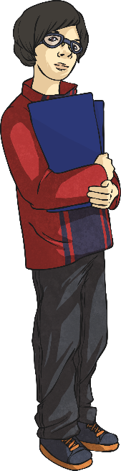
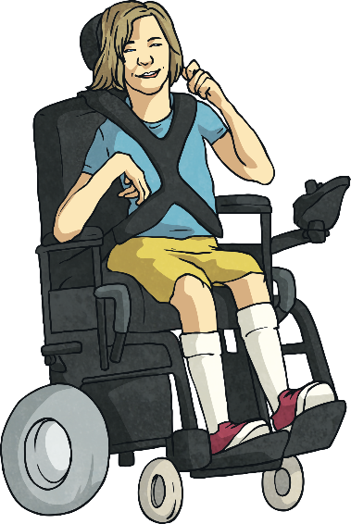
Finding One Third (⅓)
We divide by 2 to find half (½),
and 4 to find one quarter (¼).
What do you think we need to divide by to find one third? Have a look at the one third fraction…
⅓
You need to divide by 3
to find one third.

Slide 11
Finding One Third (⅓)
To find one third of a number, you need to
divide the number by three.
6 ÷ 3 = 2
so
⅓ of 6 = 2

Slide 12

Finding One Third (⅓)
Can you find ⅓?
3
⅓ of 9 =
3
9 ÷ 3 =
Help
So one third of 9 is 3

Slide 13

Finding One Third (⅓)
There are 12 dog biscuits in a packet. Daniel shares them between his three dogs. How many biscuits will each dog get?
4
4
12 ÷ 3 =
⅓ of 12 =
So one third of 12 is 4
They will get 4 biscuits each.
Help

Slide 14
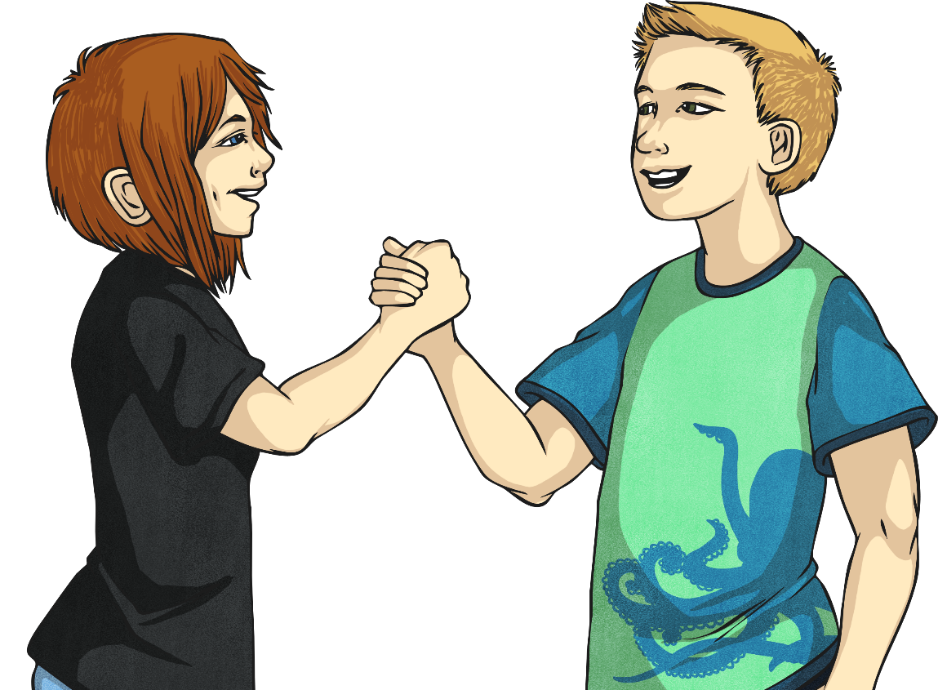
Challenge Section
If you have found it easy to find one half, one quarter and one third, try these next few challenges!

Slide 15
Finding Three Quarters (¾)
You know how to find one quarter, so now let’s look
at finding three quarters.
First find one quarter.
There are 8 eggs. If we divide these eggs between 4 baskets, how many eggs will be in each basket?
2
8 ÷ 4 =
2
¼ of 8 =

Slide 16
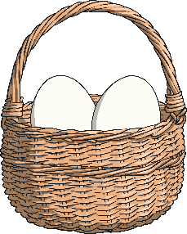
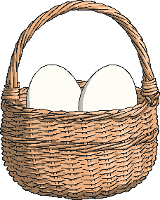

Finding Three Quarters (¾)
There will be 2 eggs in each basket.
To find three quarters, we want to find out how many eggs there are in three baskets, so we can do this:
Three baskets = 3 × 2 eggs
3 × 2 = 6
There are 6 eggs in the 3 baskets.
So three quarters of 8 is 6. ¾ of 8 = 6

Slide 17
Finding Two Thirds (⅔)
You know how to find one third, so now let’s look at finding
two thirds.
First find one third.
There are 6 paintbrushes. If we divide these brushes between 3 jars, how many brushes will be in each jar?
2
6 ÷ 3 =
2
⅓ of 6 =

Slide 18
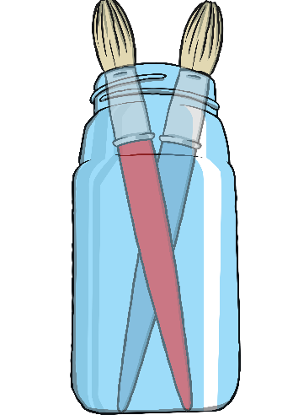
Finding Two Thirds (⅔)
There will be 2 brushes in each jar.
To find two thirds, we want to find out how many brushes there are in two jars, so we can do this:
Two jars = 2 × 2 brushes
2 × 2 = 4
There are 4 brushes in the 2 jars.
So two thirds of 6 is 4. ⅔ of 6 = 4

Slide 19


