Slide 2
Aim
To revise adjectives and similes
Success Criteria
To be able to explain and give examples of simile and adjectives
To be able to improve sentences using adjectives and similes
To be able to create similes and choose adjectives

Slide 3
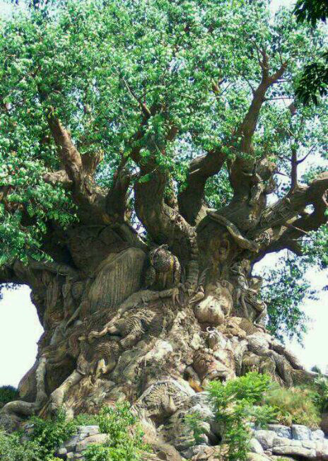
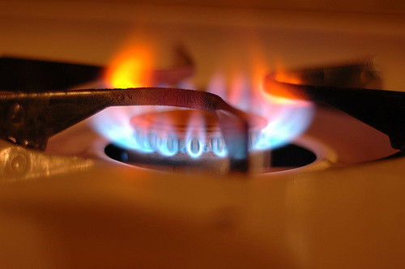
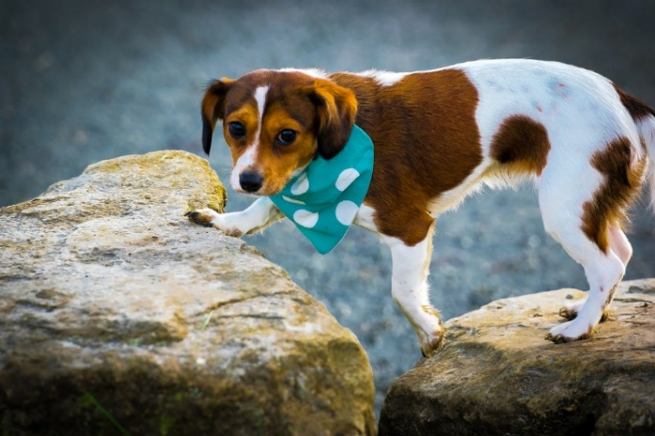
Starter
Can you think of any similes for the pictures?
Can you think of any adjectives to describe the pictures?

Slide 4
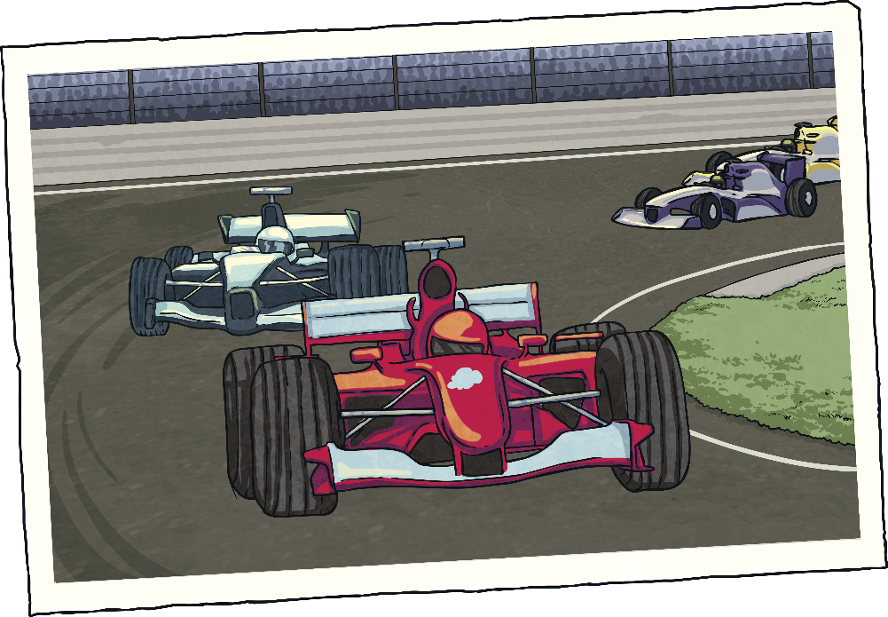
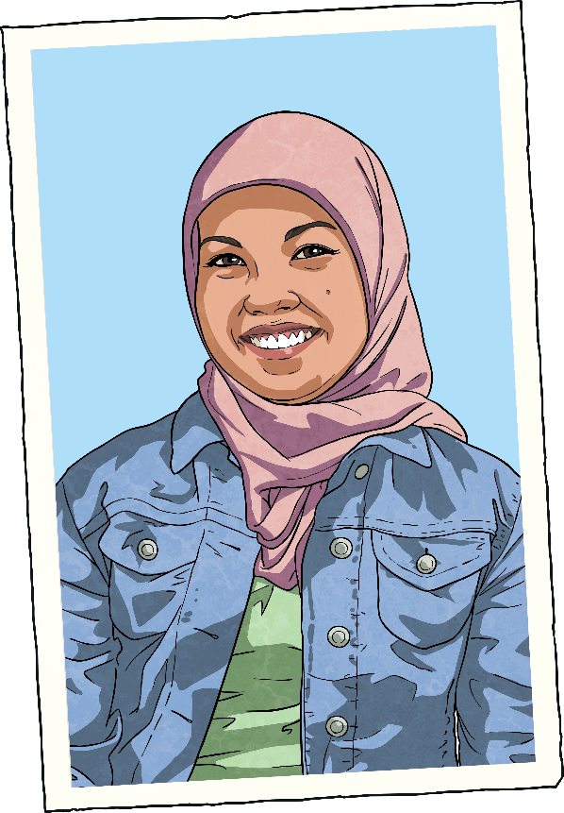
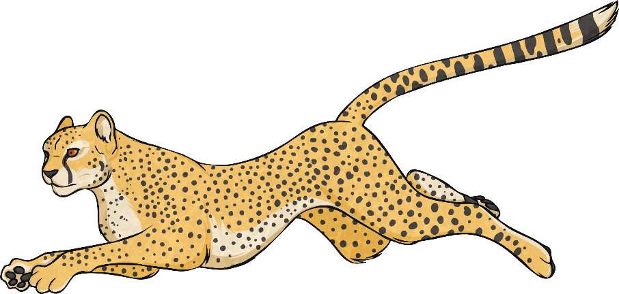
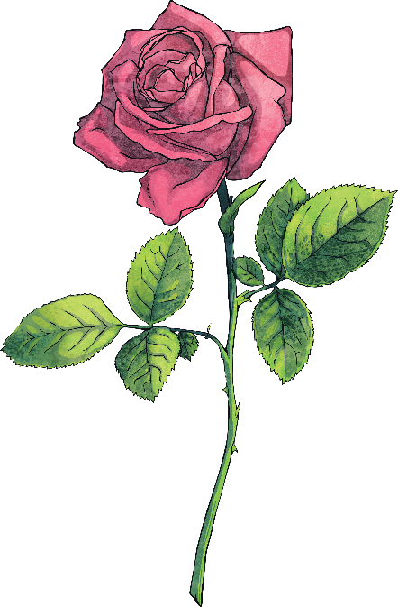
Simile Reminder
A simile is a way of describing something by comparing it to something else using ‘like’ or ‘as’.
Her eyes are like stars and her lips are like roses.
The car was as fast as a cheetah

Slide 5
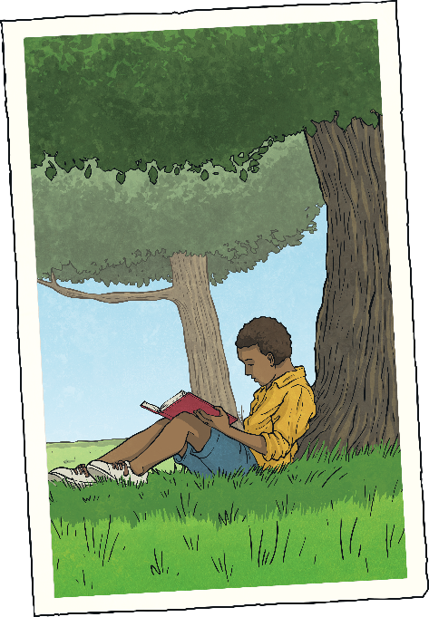
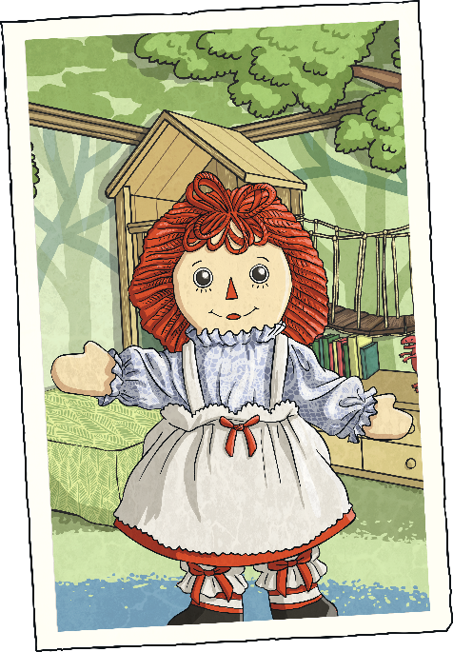
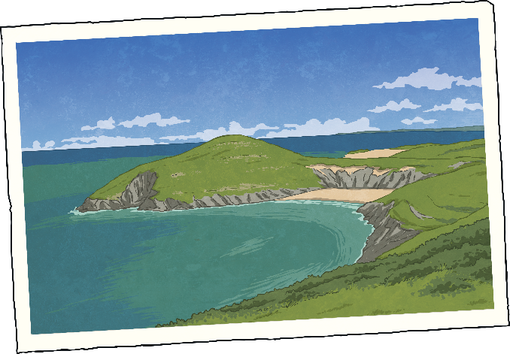
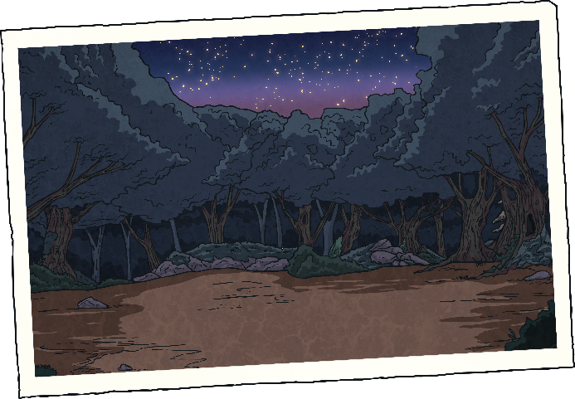
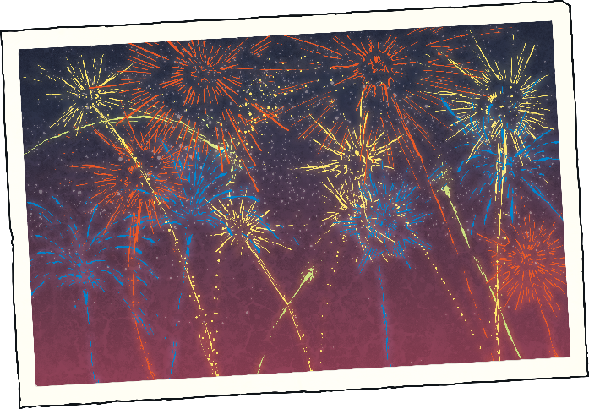
Now you try…
Finish the similes:
?
?
?
Greece was hot like…
The doll’s face was as smooth as…
The book was as exciting as…
?
?
The night was as black as…
The fireworks were colourful like…

Slide 6
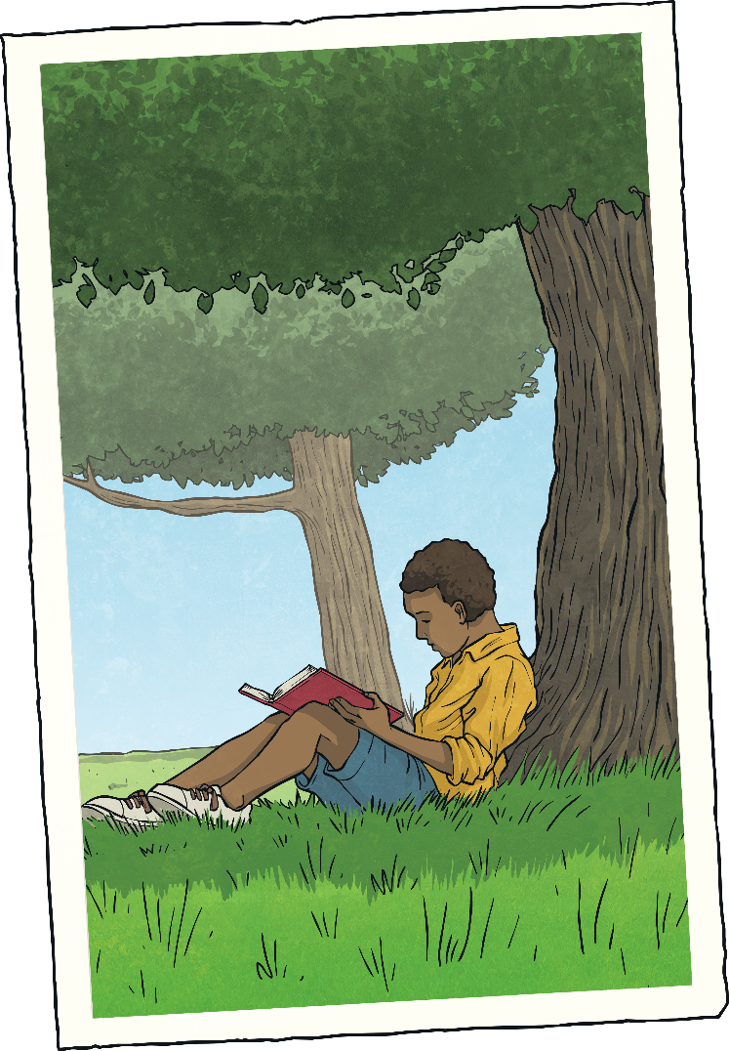
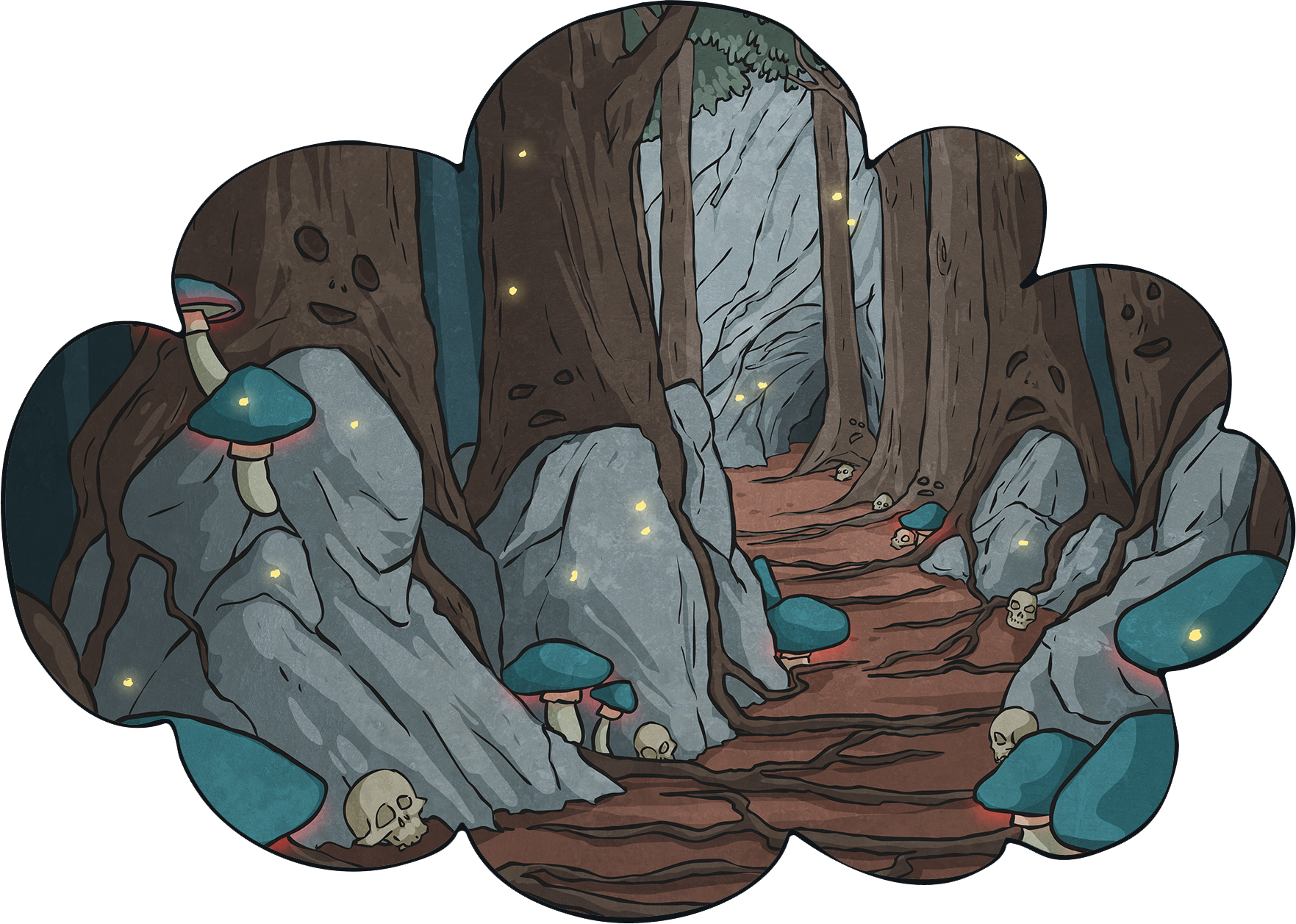
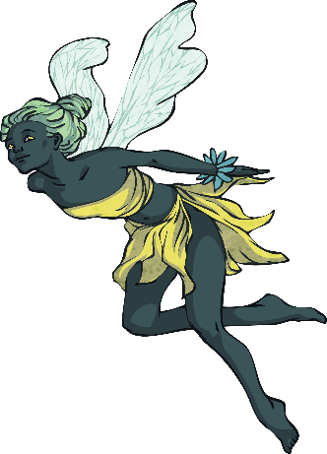
Why?
Why do we use similes and adjectives?
When you are describing something, you are trying to create a picture in the reader’s mind. Similes can help you to do this.
They are most often used in stories and poems.

Slide 7
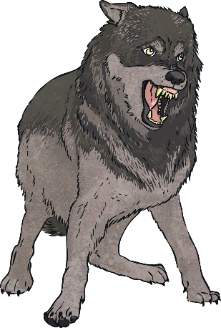
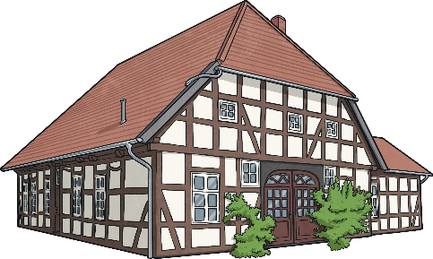
See How It Works
Why do we use similes and adjectives?
The dog was big and fierce.
Now if we add adjectives and similes…
The house was beautiful.
Now if we add adjectives and similes…
The black, scruffy dog was as big as a wolf and fierce like a very angry bear.
The ancient house was beautiful like an old fashioned painting.
Isn’t that better?

Slide 8
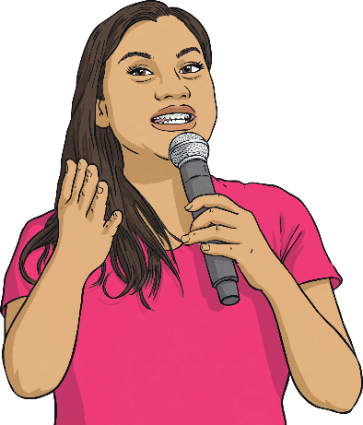
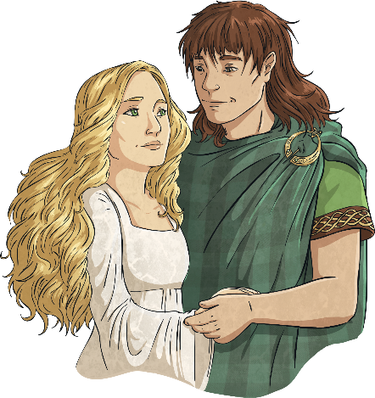
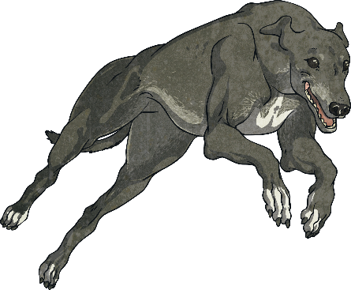
Improve These Sentences
Where you see * put in an adjective.
Where you see … put in a simile.
?
?
?
The dog was * and * and ran like a…
The * lady had a voice like a…
The * prince asked the * princess to marry him. She was as happy as a…

Slide 9
Sunflowers
On the next few slides you’ll see some pictures of real sunflowers. It’s your job to write at least three adjectives and at least three similes about the sunflowers. Remember to try to think of words that are exciting and unusual. Use a thesaurus to help.
Words to avoid:
yellow
tall
pretty
green
nice
good
bright

Slide 10
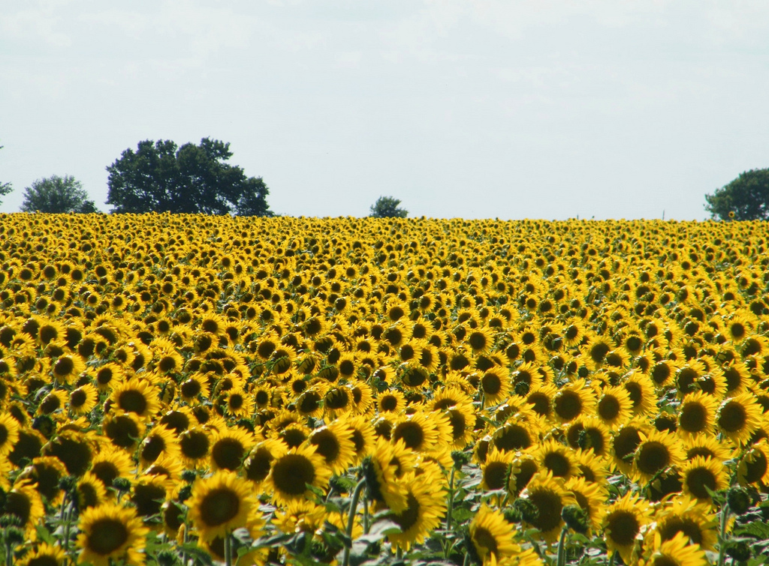
Photo courtesy of ted_M8@flikr.com - granted under creative commons licence - attribution

Slide 11
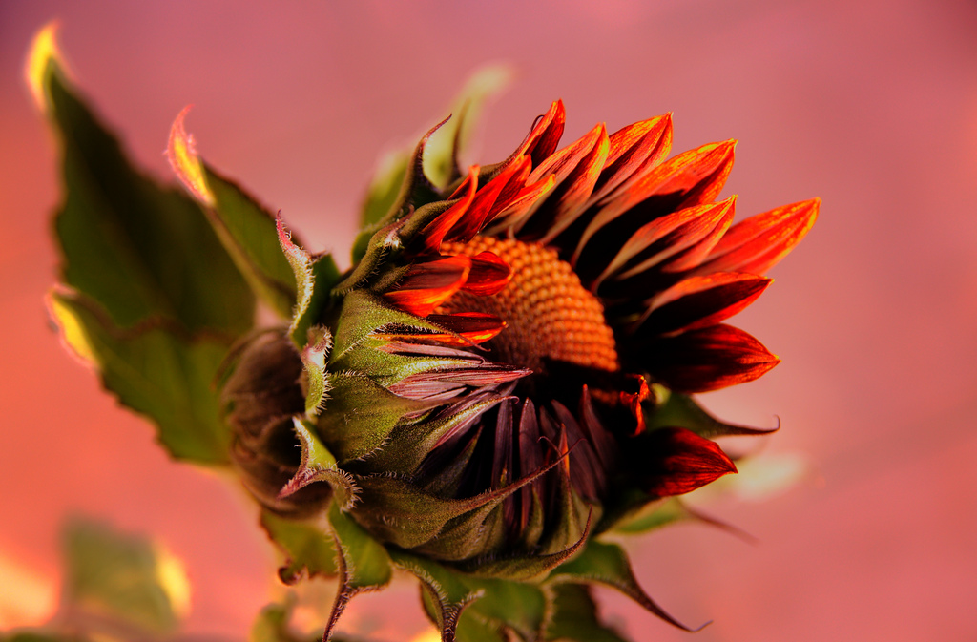
Photo courtesy of NAPARAZZI@flikr.com - granted under creative commons licence - attribution

Slide 12
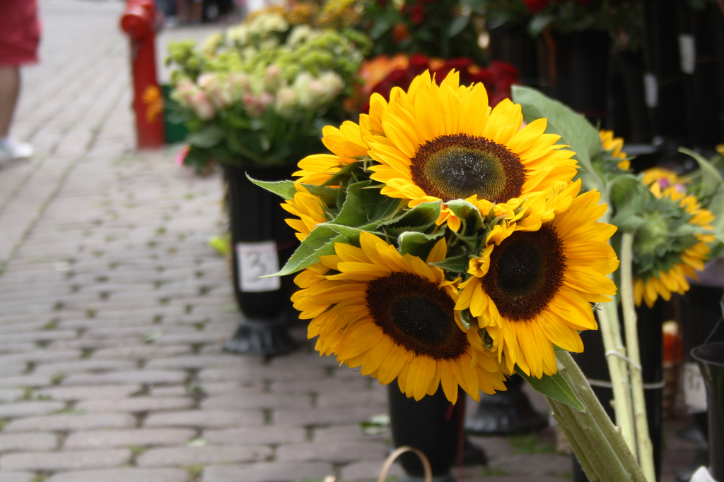
Photo courtesy of macieklew@flikr.com - granted under creative commons licence - attribution

Slide 13
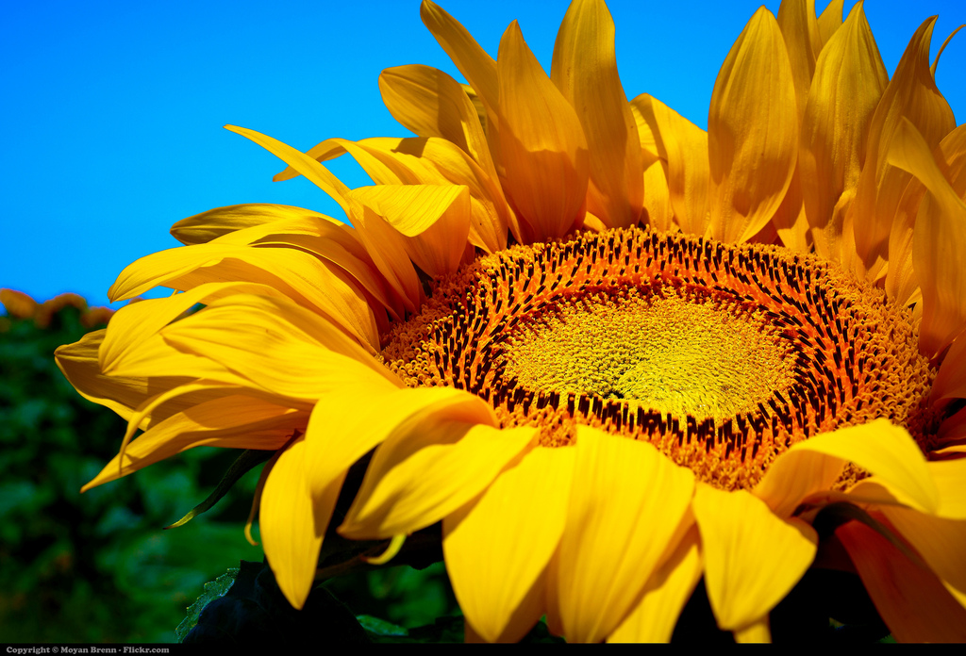
Photo courtesy of Moyan_Brenn@flikr.com - granted under creative commons licence - attribution

Slide 14
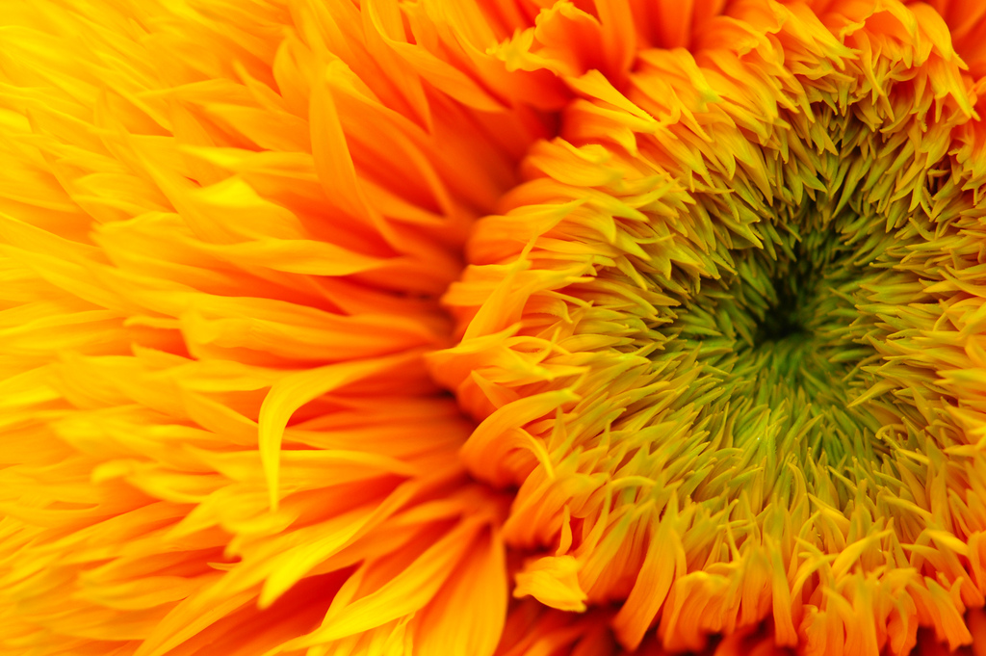
Photo courtesy of visualdensity@flikr.com - granted under creative commons licence - attribution

Slide 15
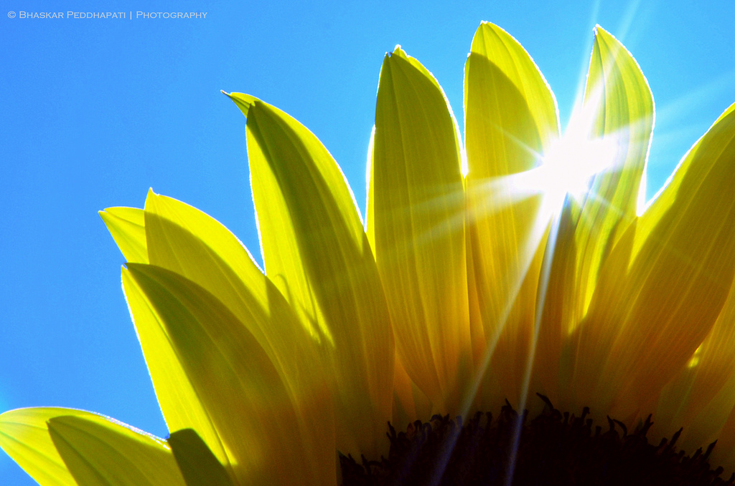
Photo courtesy of peddhapati@flikr.com - granted under creative commons licence - attribution

Slide 16
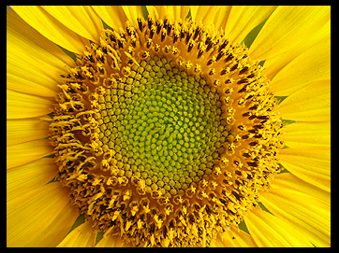
Photo courtesy of whitepebbles@flikr.com - granted under creative commons licence - attribution

Slide 17
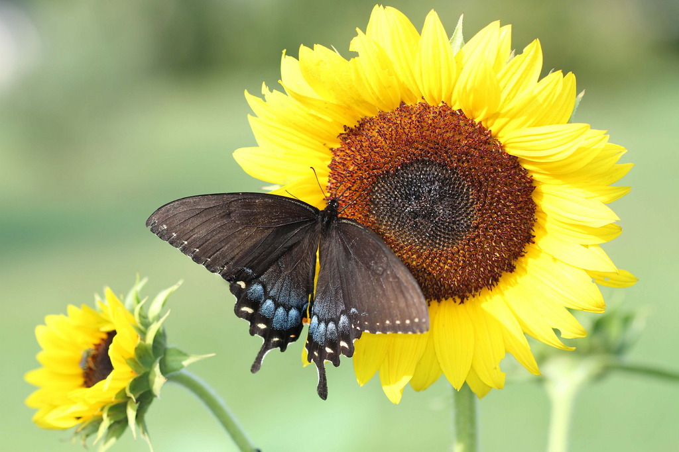
Photo courtesy of DrPhotoMoto@flikr.com - granted under creative commons licence - attribution

Slide 18
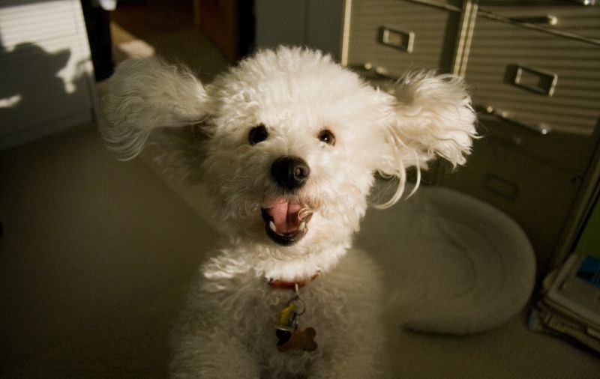
Share!
Volunteer to share your ideas!

Slide 19
Quiz!
Which of these words is an adjective?
A
B
jumping
palace
D
C
happily
amazing

Slide 20
Quiz!
Why do we use similes?
A
B
To make our writing sound good.
To create a picture for the reader.
C
D
Because our teacher wants to make our life difficult.
Because we get better marks for it.

Slide 21
Quiz!
Why do we use similes?
A
B
The moon was a pale, silver coin in the sky.
The sky was as blue as the sea
C
D
The angry waves climbed the sea wall.
The howling, wolf-like baby was driving me mad.

Slide 22
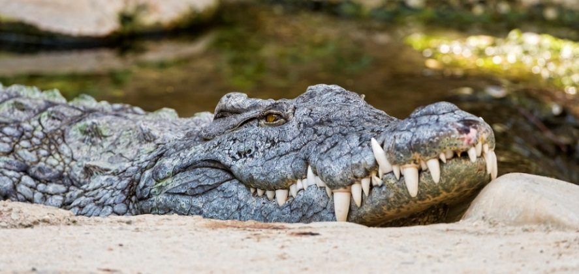
Quiz!
Pick the best adjective to describe the teeth in the picture. Give reasons.
A
B
nasty
razor-sharp
D
C
pointy
awful

Slide 23
Aim
To revise adjectives and similes
Success Criteria
To be able to explain and give examples of simile and adjectives
To be able to improve sentences using adjectives and similes
To be able to create similes and choose adjectives

