Slide 2
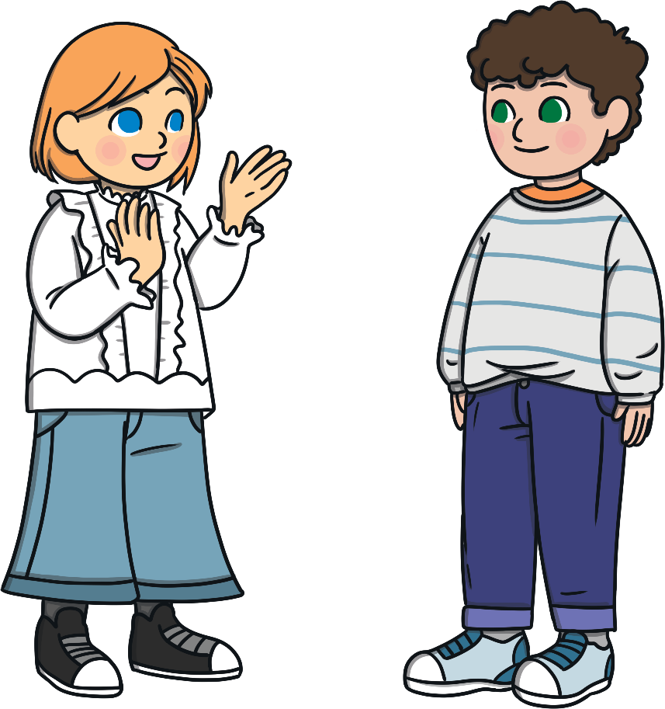
Who is Mary? Why is Mary important?
Discuss with a partner

Slide 3
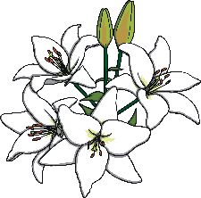
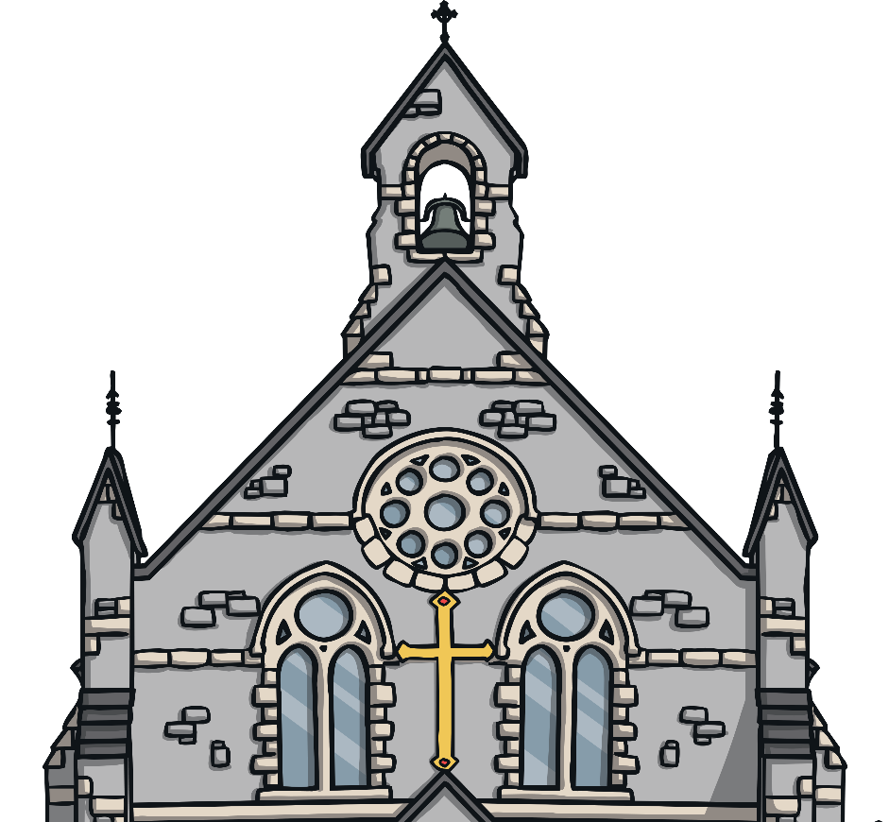
May Devotions
The Catholic Church celebrates Mary during Mass.
Special hymns are sung.
People lay out flowers to bring nature into the Church.
Many festivals are held during May to celebrate Mary’s life.

Slide 4
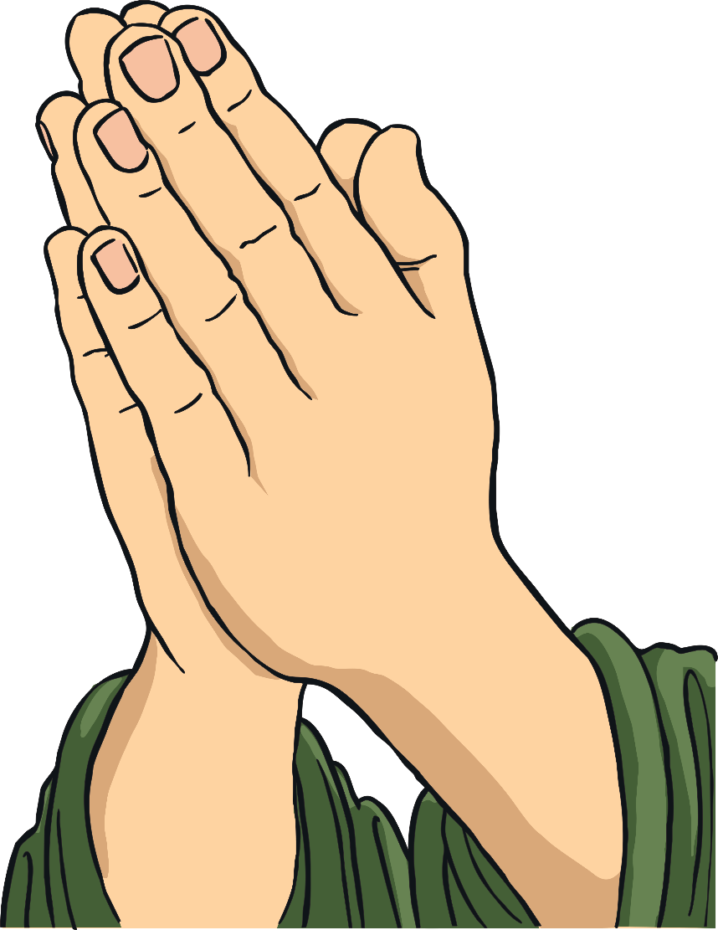
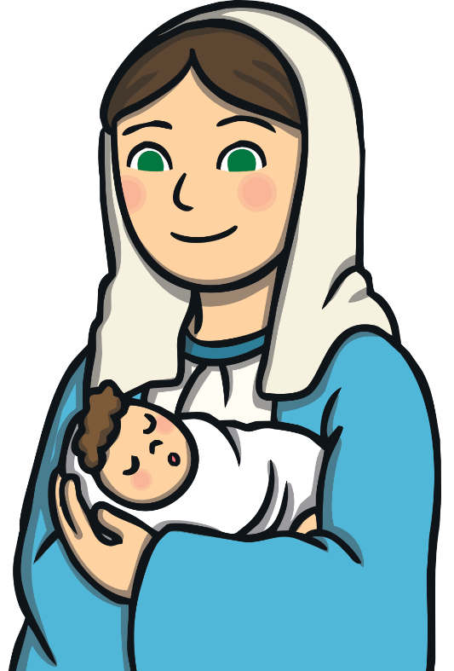

Did You Know…?
Some Catholic Christians have been celebrating Mary for about 700 years.

Slide 5

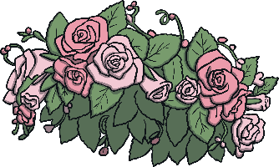
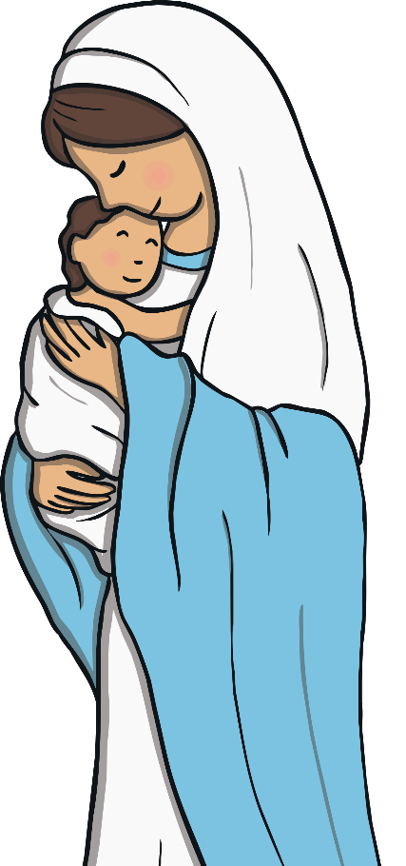
The May Crowning
Catholic Christians crown a statue of Mary with flowers.

Slide 6
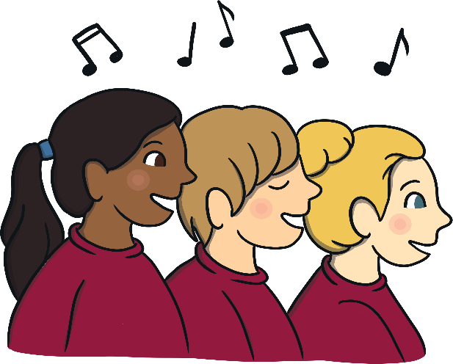

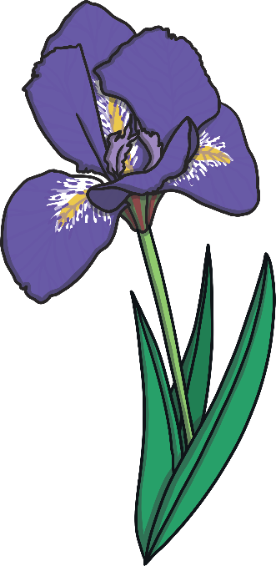

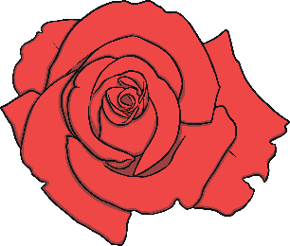

May Procession
Many years ago, May processions were very popular.
Boys and girls would walk through the streets carrying flowers.
People would sing hymns and say prayers.

Slide 7



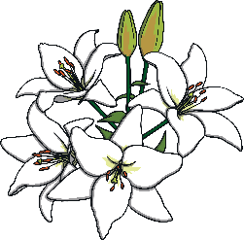
May Procession
When people reached the shrine or reached the Church, they would crown her.
After this, they lay their flowers at her feet.
Some Catholic Christians also decorated their homes with pictures or statues of Mary.

Slide 8

May Procession
Mary is honoured all over the world by some Catholic Christians.
We remember she is the mother of Jesus.
She is the mother of the Church and our mother too.

Slide 9



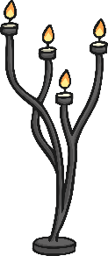
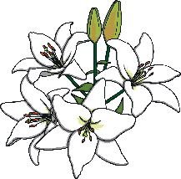
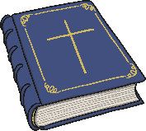





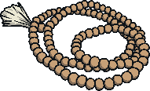

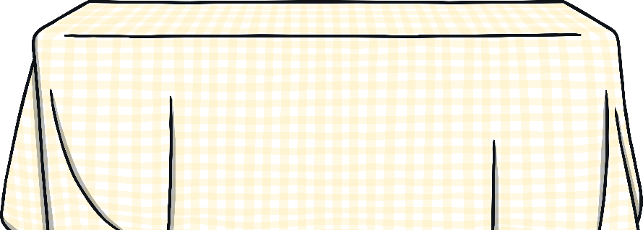
Create your own Altar to Mary
You will need:
A statue or image of Mary
Flowers
A Bible.
Rosary beads.
Green cloth to represent the liturgical calendar colour.

