Slide 1
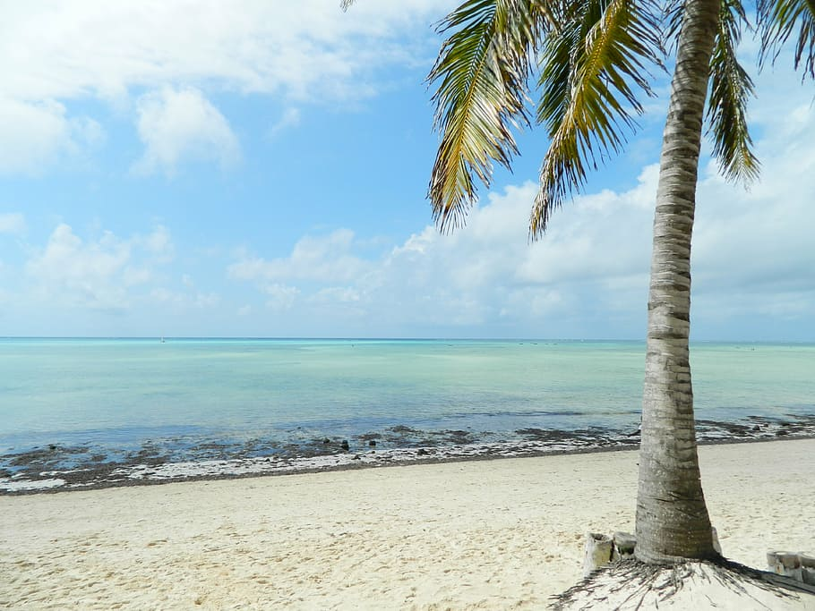
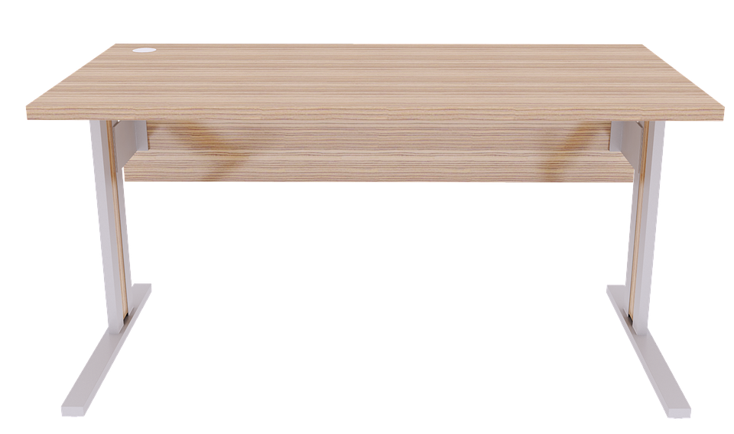
Good Morning
Click here for the End of term Booklet from last week.- Monday 22nd June.
Click on the camera, bucket, beach ball and balloons for some summer tasks. Click on the flip flops to join in with the NL sports day. Click on the Bible for a
Bible story.

