Slide 1


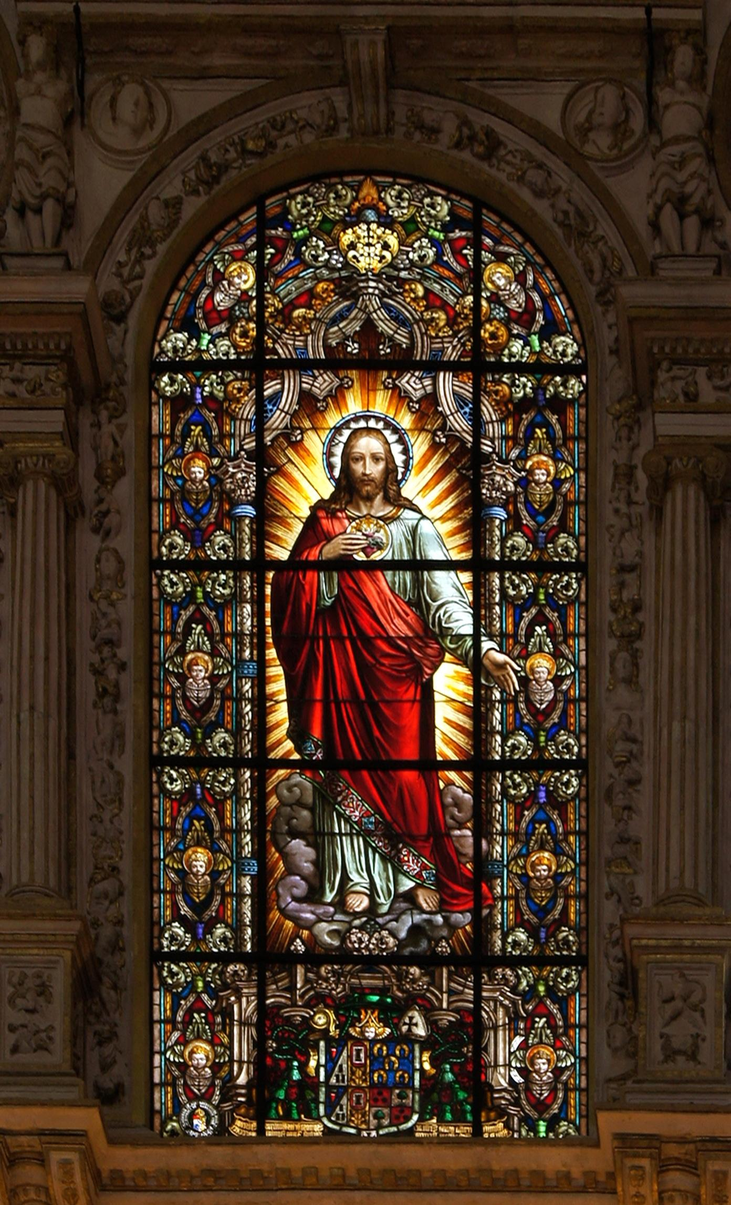



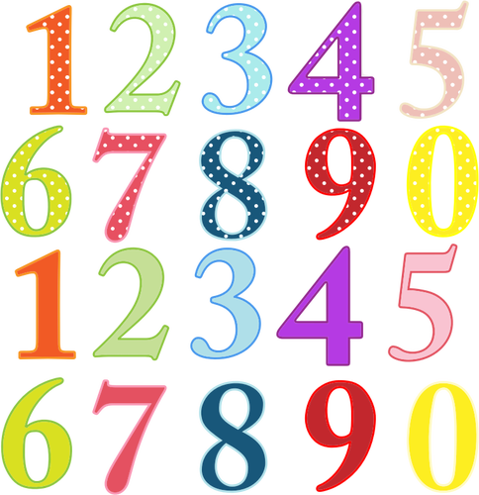














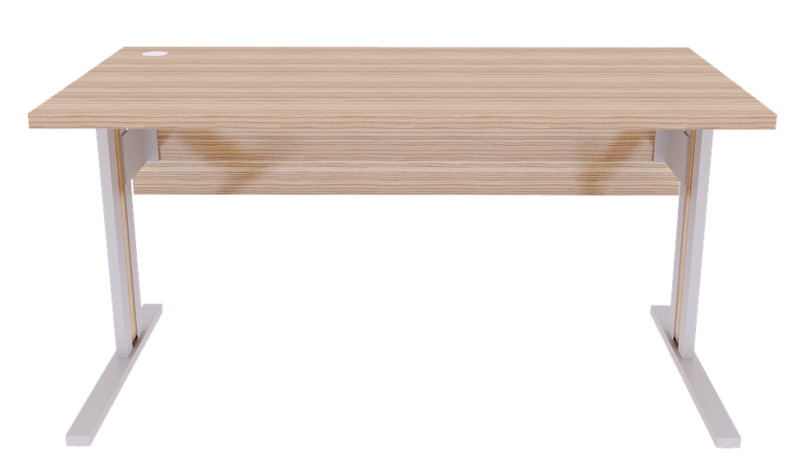













Good Morning
Daily Plan
Monday 15th June
Click on this link to open the End of Term Booklet.

