Slide 1
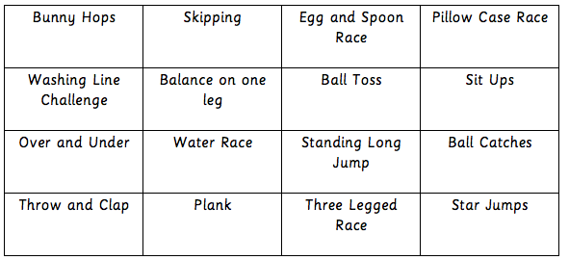

Slide 2
Sports Day at St Bart’s is always one of the great events at the end of our school year.
This year, we are going online with our virtual sports day!
On this power point you will see 16 activities!
For each activity that you photograph/video yourself doing and send to your teacher, you will be awarded 50 house points!
The more activities you do and send in, the more house points you will win for your house.
Please remember to stay safe!
We must observe all social distance rules.
Activities can only take place with your own family.

Slide 3
Skipping challenge!
How many skips can you do before you have to stop?

Slide 4
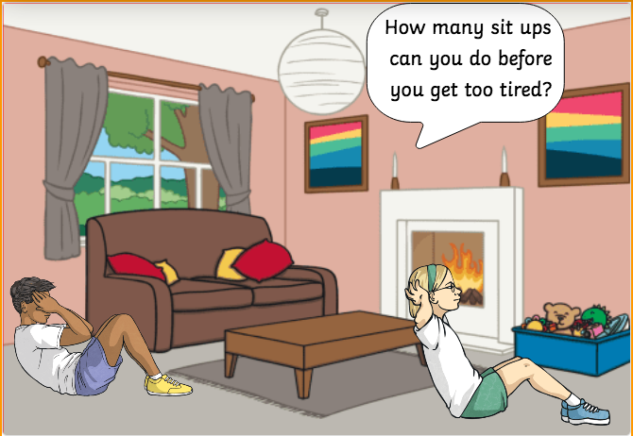
Sit ups!

Slide 6
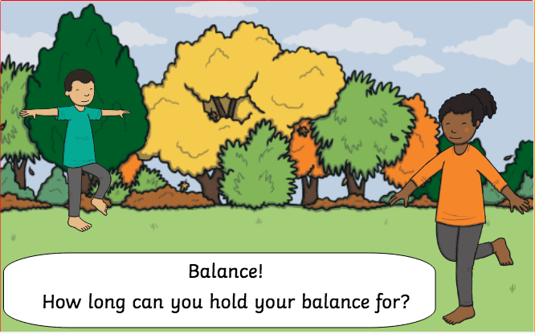

Slide 7
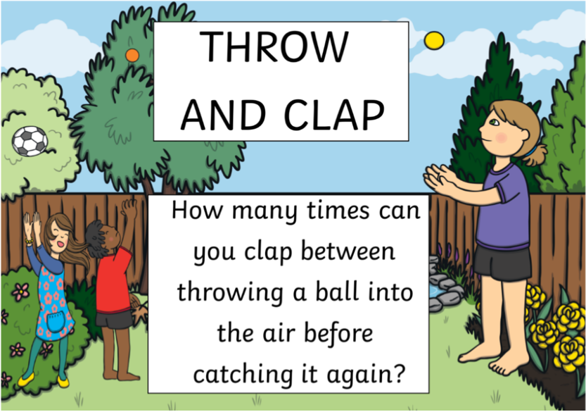

Slide 8
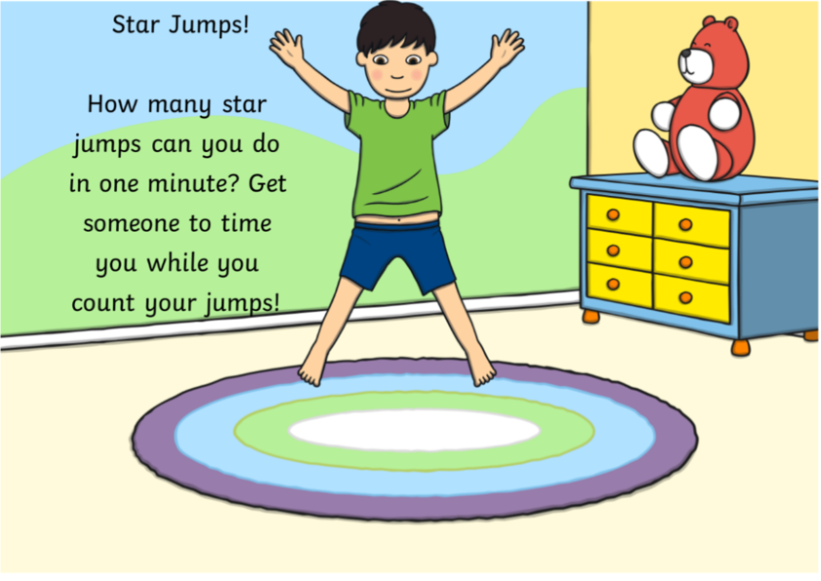

Slide 9
Find something in your home you can go over and under in one minute!

Slide 10
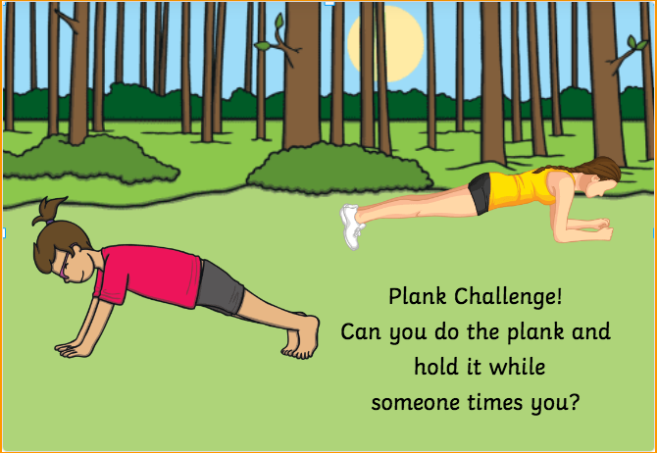

Slide 13
