Slide 1
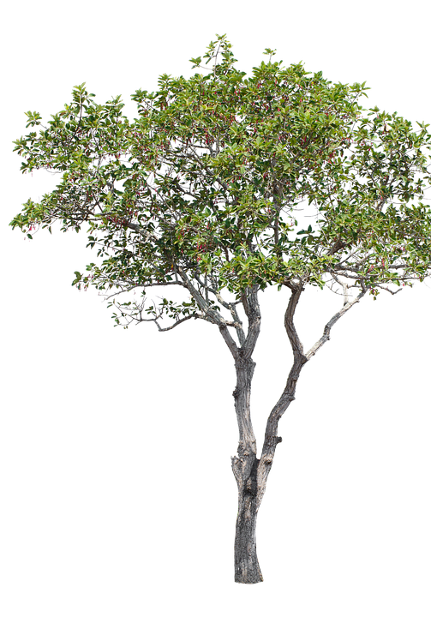
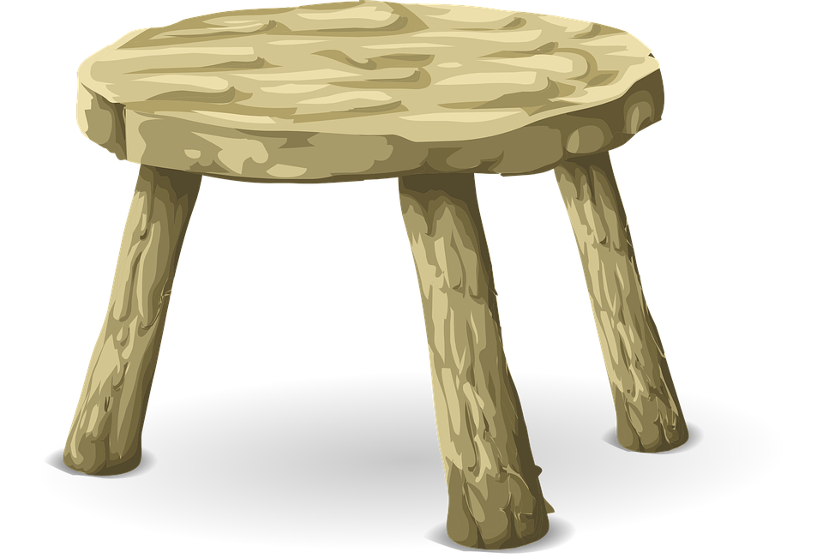
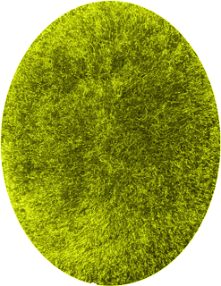
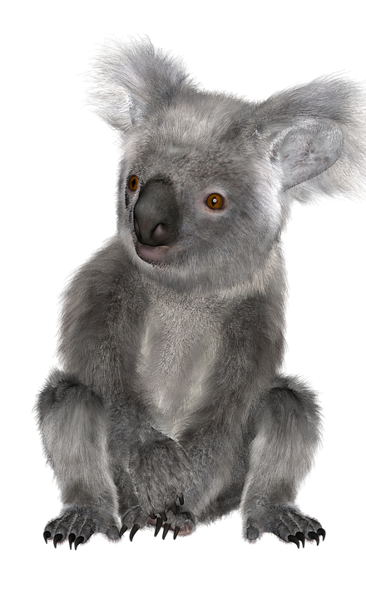
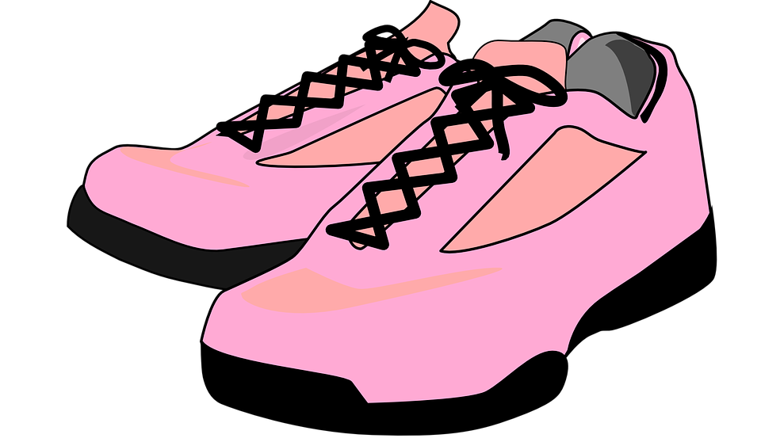
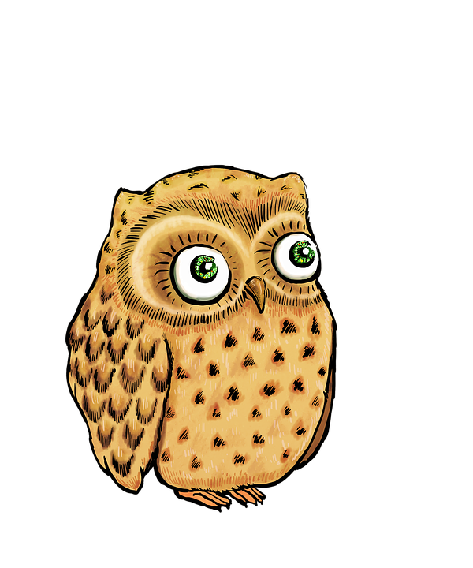
Happy Friday Everyone!
Click the trainers and do a 5 minute workout.
Click on the Koala Bear and go on a virtual tour of Australia Zoo! Answer the questions below in sentences.
Who built the zoo?
What animals do we meet?
What is Robert’s favourite animal?
What can a wombat do?
What do lemur’s like to eat?
What countries can you explore at the zoo?
Why is the koala at the hospital?
Spend 20 minutes on sumdog
Click the bible for Sunday’s liturgy.
Check in and say “Hello”.
Have a lovely weekend everyone!

