Slide 1
St. Barbara’s Primary School
Induction
May 2025

Slide 2
Overview: Week 1 Week 2
The Catholic School
Curriculum
Transition Journey
Class Configuration
Uniform
Welcome from Fr. O'Brien
Classes
Practical Information
Cafeteria and Breakfast Club
Aftercare Services
Buddies
Parent Council/PTA

Slide 3


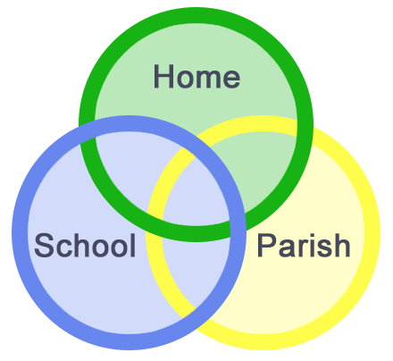

St. Barbara’s Primary School
FAITH: Friendly, Active, Inspiring, Teamwork, Helpful!
Faith in our education; educate in the Faith!

Slide 4

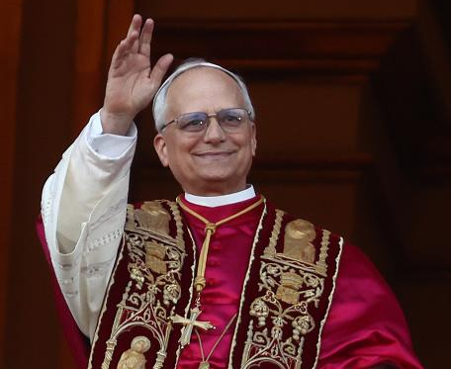

Catholic Education
The nature of the Catholic School
Aim/purpose of Catholic Schools
Knowledge
Skills
Beliefs, values and practices
Prayer Fasting Alms-giving
Inclusion
Our work is to enlarge the tent and to let everyone
Know that they are welcome inside the Church.
Pope Leo XIV
Faith in our education; educate in the faith!

Slide 5
Curriculum for Excellence
Early Level
First Level
Second Level
Confident Individuals
Successful Learners
Literacy Numeracy Health and Wellbeing
Sciences Social Studies
Technologies Expressive Arts
Relationships and Moral Education
Effective Contributors
Responsible Citizens

Slide 6


Literacy
Reading Writing Listening and Talking Phonics
Modern Languages
Digital Literacy

Slide 7
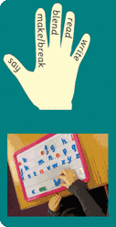
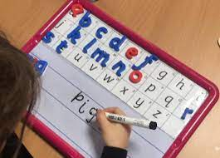
Methods
Synthetic Phonics approach –
breaking down words into smallest parts

Slide 8
NLC Literacy Programme
Reading Writing Listening and Talking Phonics
Once upon a time there were three bears…Mummy Bear, Daddy Bear and Baby Bear.
Once upon a time there were three bears… Mummy Bear, Daddy Bear and Baby Bear.

Slide 9
Supporting at Home
Reading stories to your child etc.
Looking at pictures and discussing settings, characters etc.
Looking at a variety of texts: books; signs in the environment etc.
Holding a pencil; making marks and patterns; colouring
Rhymes and songs
HOMEWORK

Slide 10
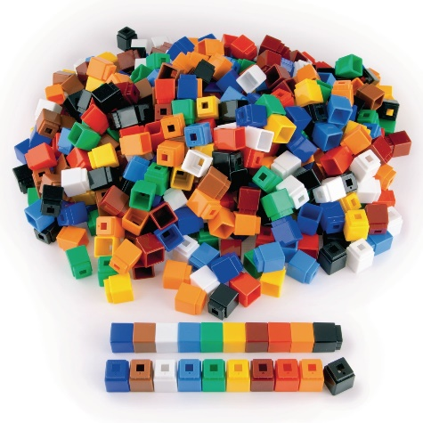
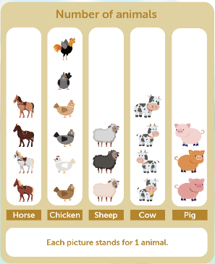
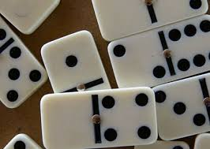
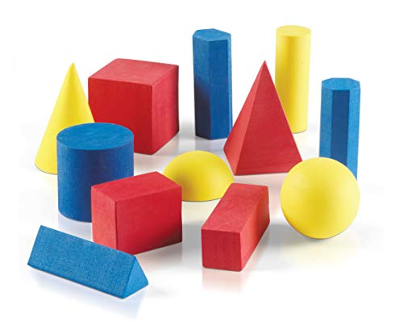
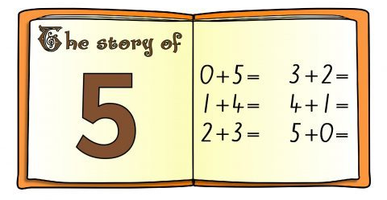
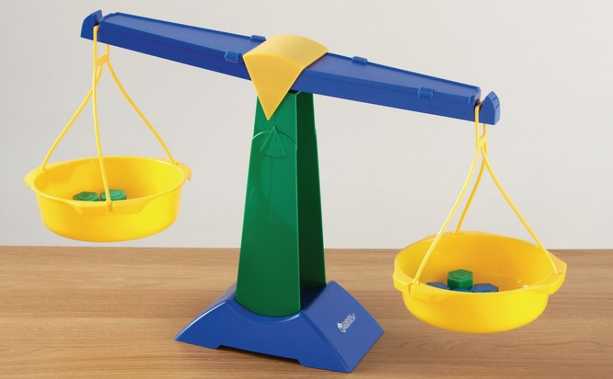
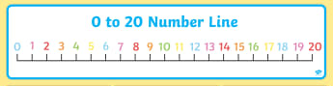
Numeracy

Slide 11
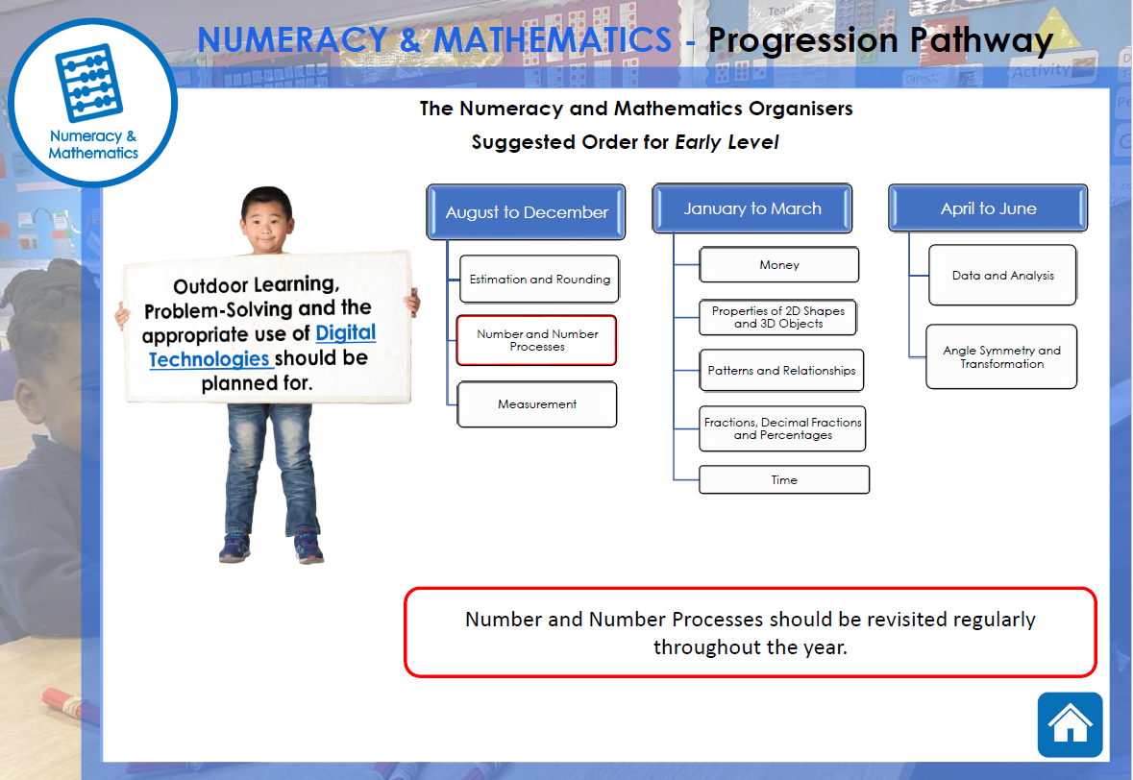

Slide 12
Supporting at Home
Rhymes and songs
Days of the week/months of the year
Counting
Sorting Games
Language – positional games
Turn-taking
Problem Solving and Enquiry… ‘why?’
Skills for Life: setting the table!

Slide 13

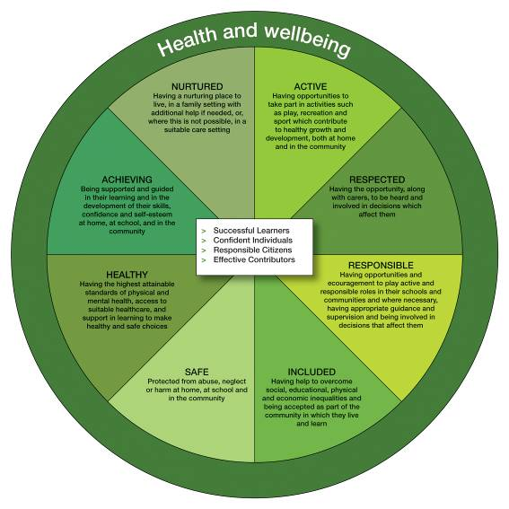
Health and Wellbeing
GIRFEC
UN RIGHTS OF THE CHILD

Slide 14
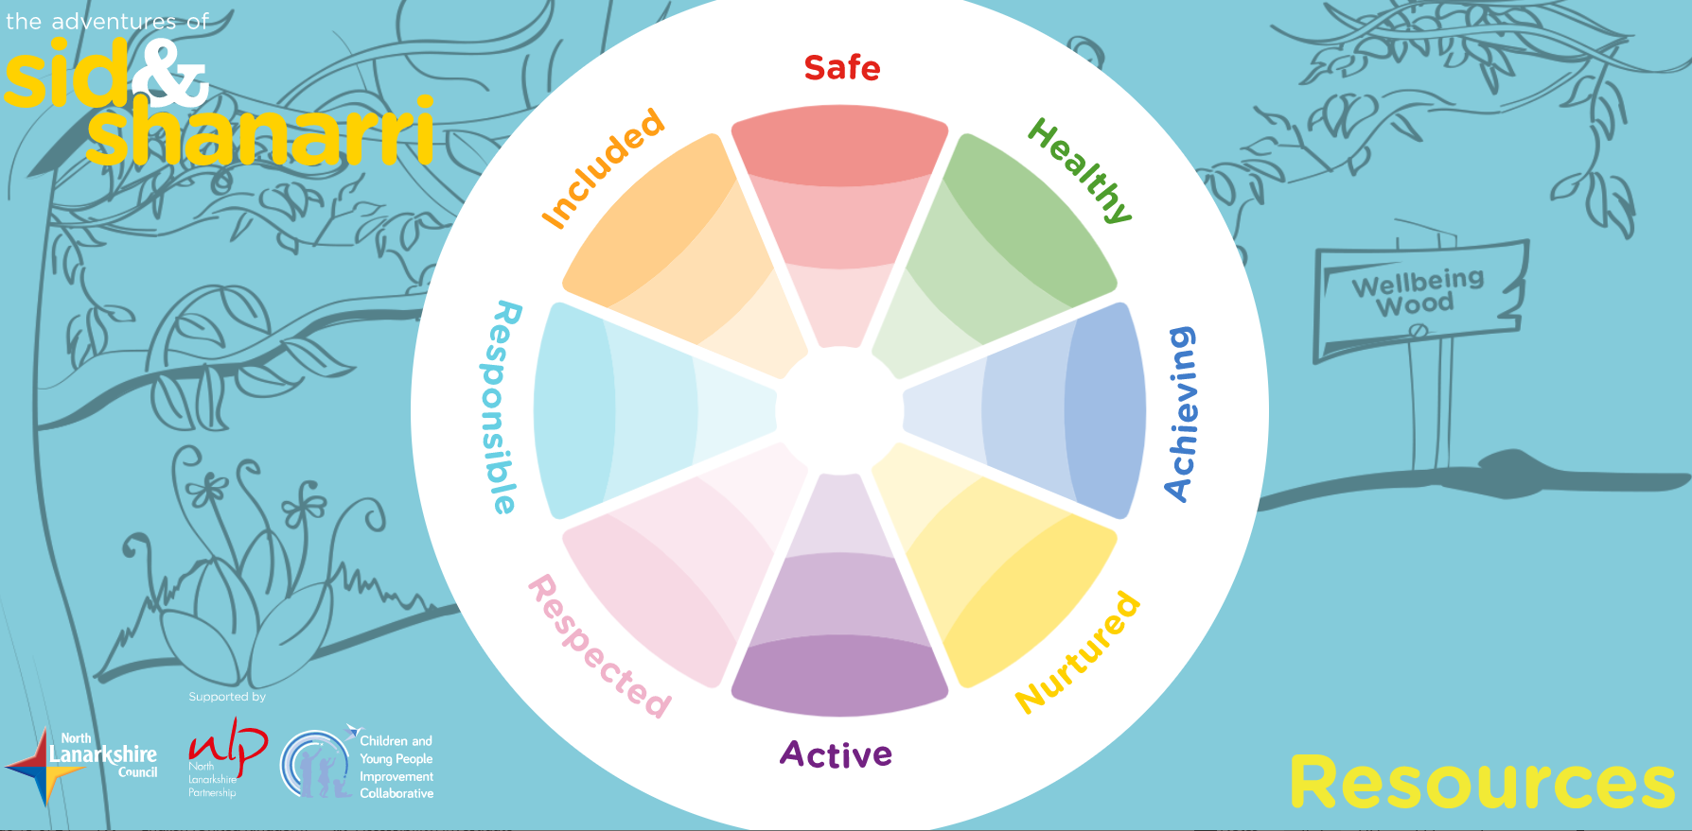
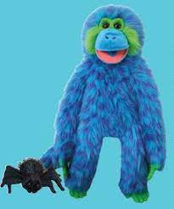
Sid and
SHANARRI

Slide 15
HWB: Six Organizers
Mental, emotional, social and physical wellbeing
Planning for choices and changes
Physical education, physical activity and sport
Food and health
Substance misuse
Relationships; relationships and parenthood.

Slide 16
Health and Wellbeing
HWB
UN Rights of the Child GIRFEC This is our Faith
Mental and Emotional
Social
Physical
Spiritual
Rights & responsibilities
Talents
Needs
Abilities
Contributing
Confidence
Interpersonal Skills
My body
Keeping healthy
Risk
Staying safe
Travelling safely
P.E.
My soul
Relationships
Sharing
Loving
Praying
Caring
Talents
Contributing
Including
Remembering
Friendship
Caring
Emotions
Listening
Talking
Resilience

Slide 17

Health and Wellbeing HWB
Planning for choices and changes
I can describe some of the kinds of work that people do and I am finding out about the wider world of work. HWB 0-20a / HWB 1-20a
Physical education, physical activity and sport
I am learning to move my body well, exploring how to manage and control it and finding out how to use and share space.
HWB 0-21a
I am developing my movement skills through practice and energetic play.
HWB 0-22a
I am aware of my own and others’ needs and feelings especially when taking turns and sharing resources. I recognise the need to follow rules.
HWB 0-23a

Slide 18
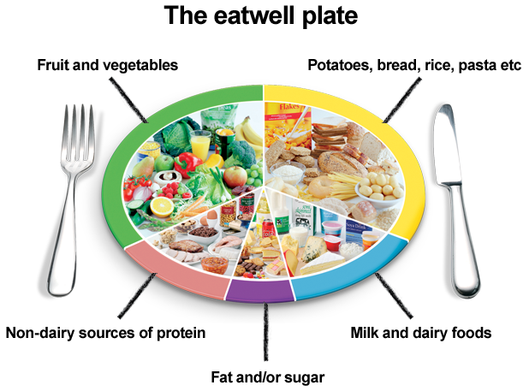
Food and Health
I know that people need different kinds of food to keep them healthy. HWB 0-32a
I explore and discover where foods come from as I choose, prepare and taste different foods. HWB 0-35a

Slide 19
Interdisciplinary Learning
Knowledge
Unfamiliar contexts
Understanding
Challenge
Skills
Making connections
across the
curriculum
Depth
Application

Slide 20
Jack and the Beanstalk: linking learning
Literacy
Listening to the story – predicting etc.
Talking about the story
Writing about the story
Reading to partners
Writing about planting
Science
Planting and growing
What do plants need to grow?
Why soil? Why not sand?
Why holes in our pots?
Digital
Counting games
Smartboard/iPads
Art and Design
Poster: Cow For Sale!
Pictures/collage of a beanstalk
Numeracy
Counting the seeds
How many shall I put in each pot?
Which stem is bigger; smaller?
How big am I?
Am I bigger/smaller than the beanstalk?
R.E.
Thank you God for the plants

Slide 21
Communication
Groupcall: email
X: @St_BarbarasPS
School Website
YouTube Channel

Slide 22
Current School Information: Classes
Classes: currently 28 children enrolled for P.1.
Primary 1 is capped at 25
Composite classes (any stage) are also capped at 25
There will be a Primary 1 class and a composite P.1/2 class in August
Staffing: to be confirmed; range of staff working with each class each week
Buddies
Slides will be available on the website following the second induction session

Slide 23
Transition: Next Steps
Visits to all linked Early Years establishments have been organized
Discussions with staff
See children in their learning environments
Chats with the children
Transition reports to school
Next Induction visit (Tuesday 20th May)

Slide 24
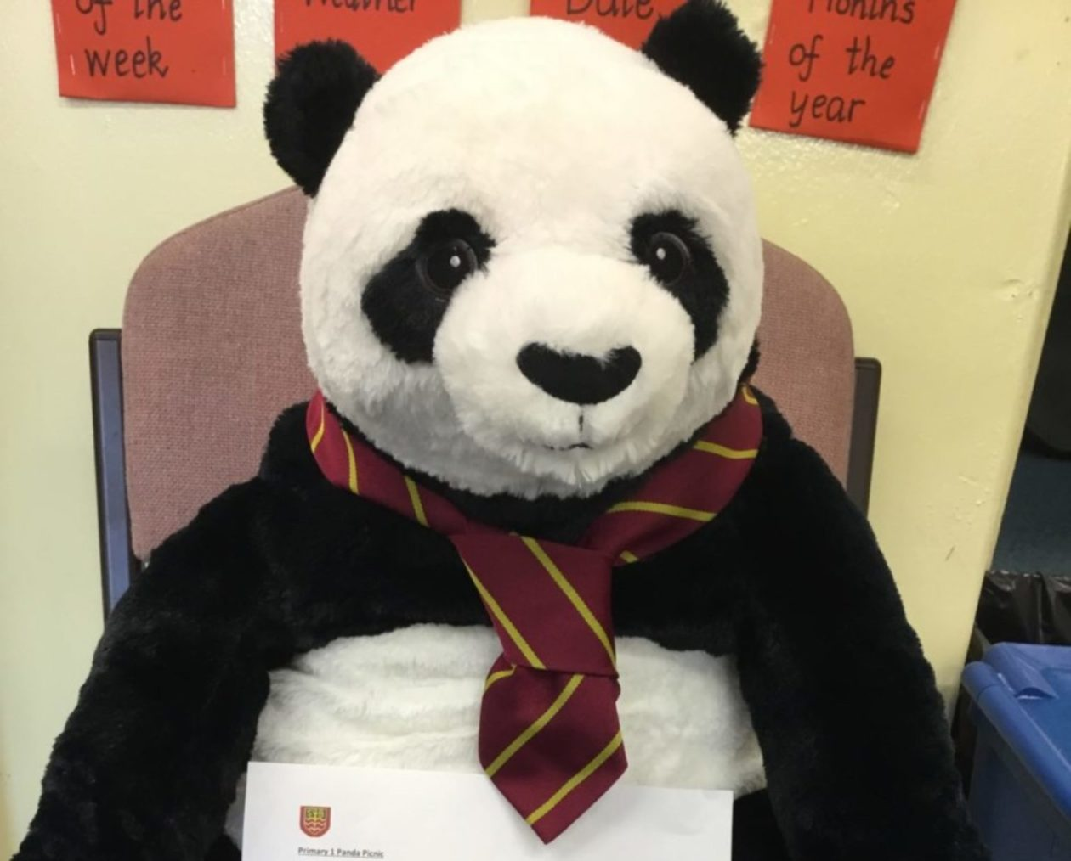
Any questions?
Uniform

