Slide 1
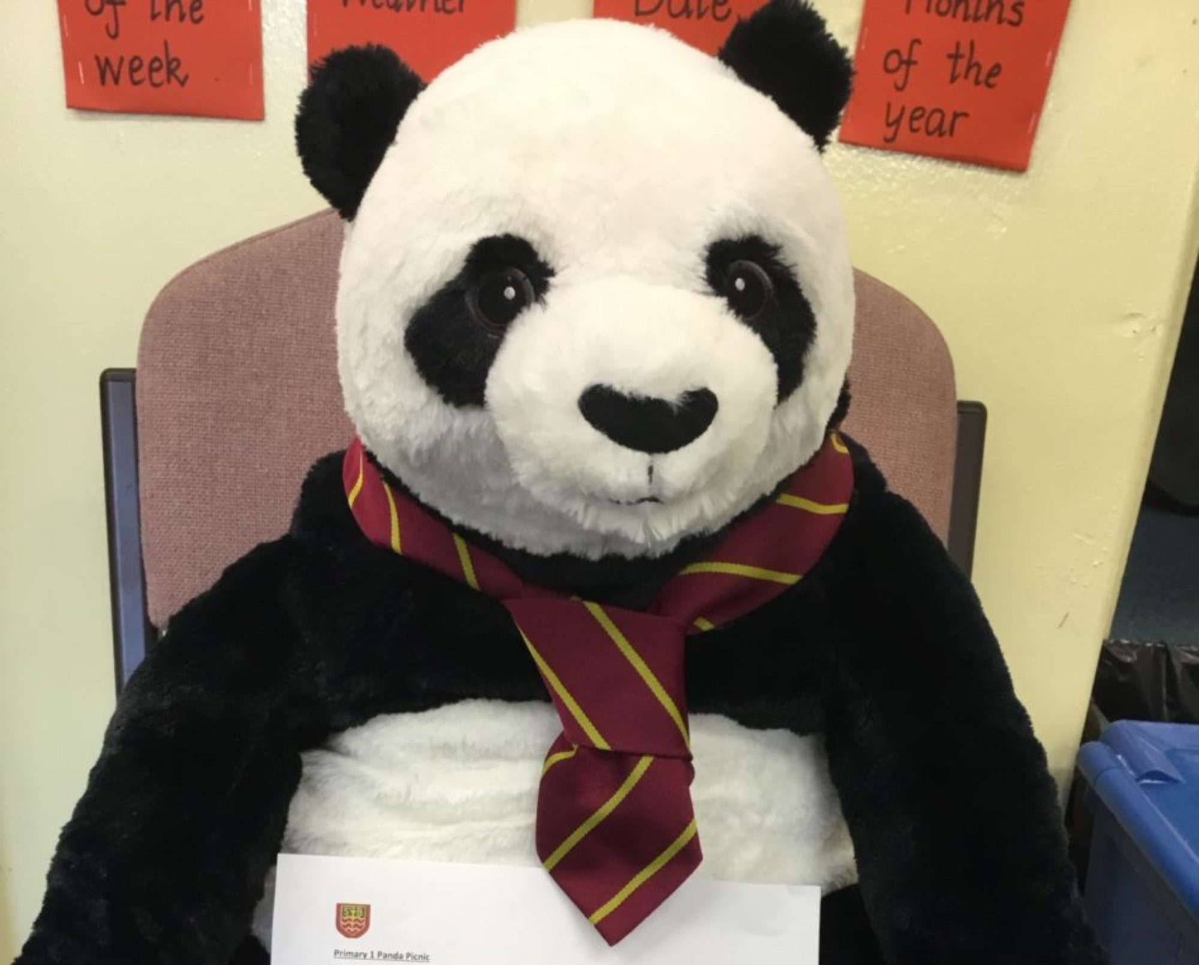
Parental Induction: Week 2
21st May 2024

Slide 2
Overview: Week 1 Week 2
Transition Journey
The Catholic School
Curriculum
Uniform: LogoXpres
Welcome from Fr. O’Brien
Welcome from David Kyle
Parent Council and PTA
School Information
Cafeteria: Snack to Go!

Slide 3
Overview
Cafeteria Staff and Information
Special Diets
Allergies
School Breakfast Club
Private Breakfast Clubs
Transition Update
Buddies
School Routines
Communication
Class Information
First Days
YouTube

Slide 4
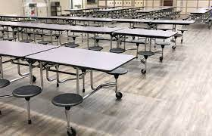
School Cafeteria…

Slide 5
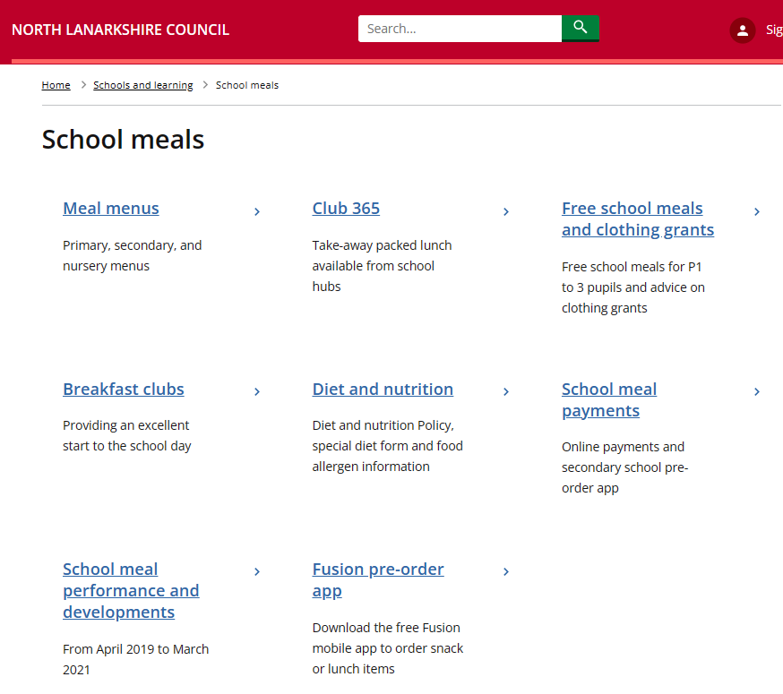
North Lanarkshire Council
Schools and Learning
School Meals

Slide 6
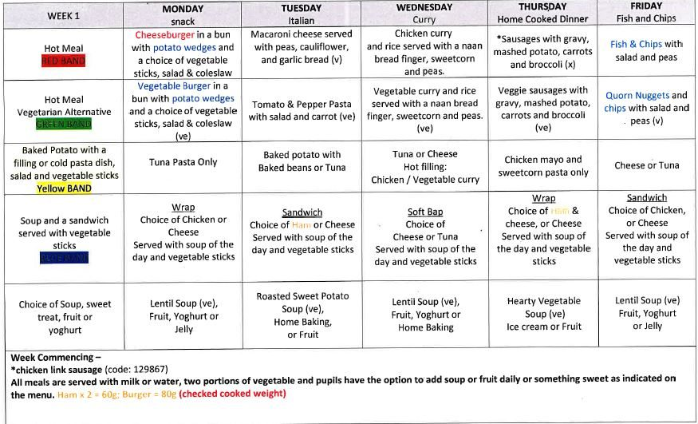

Slide 7
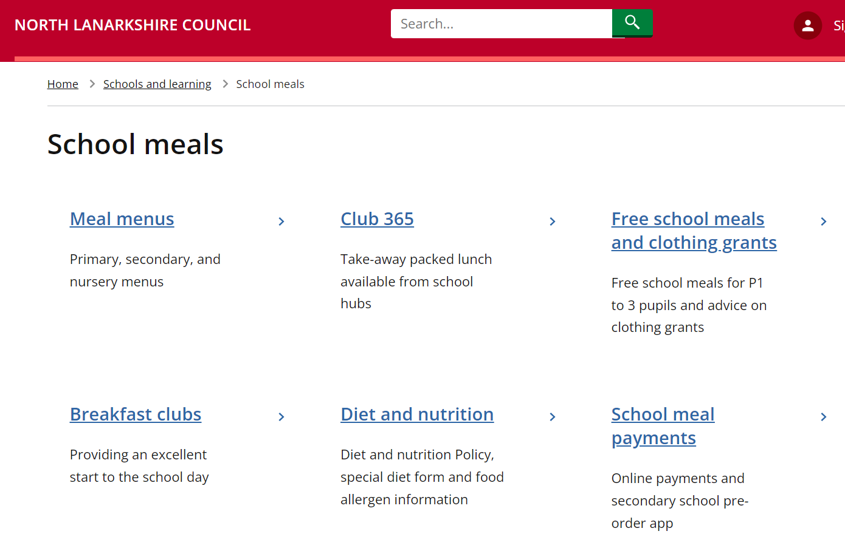
D
I
E
T
&
N
U
T
R
I
T
I
O
N

Slide 8
Please be aware…
Allergies: LATEX-free zone
Nut-free Zone
Food - Child’s Dietician
Birthdays etc.

Slide 9
Breakfast Club: School-based
8.15am
Please arrive before 8.30am
Free to children in P.1 – P.5
Playground at 8.45am

Slide 10
Breakfast Club: Private
FAST Aftercare/Breakfast Club
Kidz Out of School Care

Slide 11
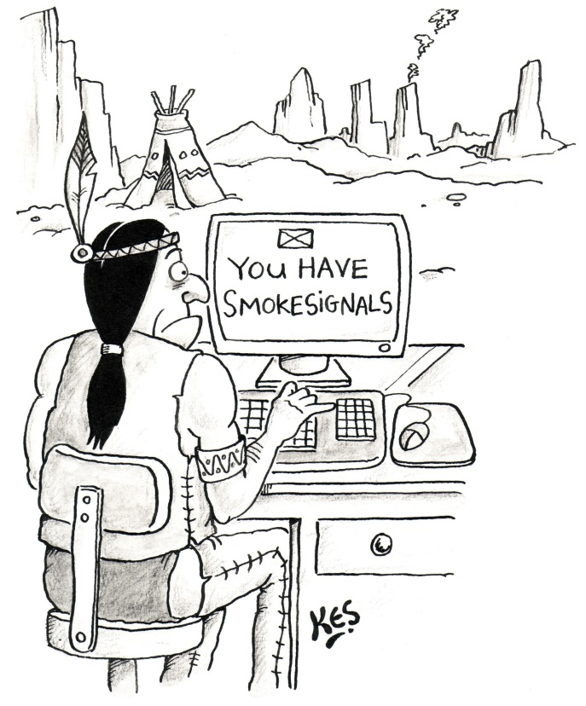
Communication
Groupcall
X
School Website
TEAMs
School correspondence – eldest child
Appointment via the school office
Telephone
Annual Data Check
NLC Website

Slide 12
School Routines
8.45am Playground opens - staff
9.00am Lines; water bottles
9.15am Bus and Aftercare Registers
10.30am Morning Interval – Playground/Pitch; Snacks
12.15pm Lunch
2.55pm Bus/Aftercare Bell & Registers
3.00pm Dismissal

Slide 13
Current School Information: Classes
Updated Classes: currently 36 children enrolled for P.1.
Primary 1 is capped at 25
Composite classes (any stage) are also capped at 25
Staffing: to be confirmed – unlikely to know the outcome before mid-June at the earliest
Range of staff working with each class
Primary 1 and Primary 2/1 - potentially
Once staffing is confirmed you will be informed of the final configuration and staff.

Slide 14
Current School Information: Classes
Updated Classes: currently 36 children enrolled for P.1.
Primary 1 is capped at 25
Composite classes (any stage) are also capped at 25
Staffing: to be confirmed – unlikely to know the outcome before mid-June at the earliest
Range of staff working with each class
Primary 1 and Primary 2/1 - potentially
Once staffing is confirmed you will be informed of the final configuration and staff.

Slide 15
Finally…
Wednesday 14th August – 9.30am
2pm onwards
Thursday 15th August: 9.00am school gates/Buddies
Home time: Playground – 3.00pm
Collection Information – gathered (am)
Bus/Aftercare/Change of plans…

Slide 16
Teddy at the beginning of the day…
Teddy in the classroom …
Teddy At The Beginning Of The Day - YouTube
Teddy In The Classroom - YouTube
St. Barbara’s YouTube Channel
Penny the Panda

