Slide 1
St. Barbara’s Primary School
COP26 CHALLENGING EVERYONE to make a difference…ARE YOU UP FOR IT?

Slide 2
10 Days to make a Difference… Wednesday 3rd – Friday 12th November 2021
Family Challenges
You don’t need to attempt ALL of the challenges…however please attempt some and let us know how you get on!
Upload your pictures onto GLOW or email:
enquiries-at-st-barbaras@northlan.org.uk
The time to save our planet is NOW…how will YOU respond?

Slide 3
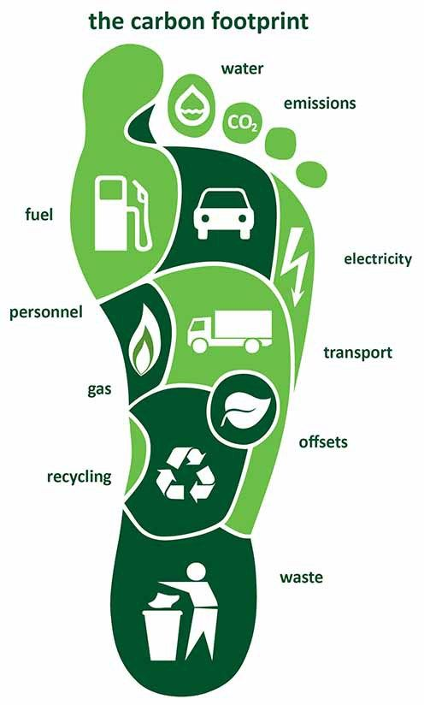
1. Re-wild an area of your Garden
Re-wild a corner of your lawn by cordoning off a small section (even a small area of 3 feet x 3 feet) and then watch the magic unfold. Get your child to take stock weekly of what seeds itself there, how high grass can actually grow, what insects visit and so on.
'Unkempt', 'overgrown', ‘neglected' gardens enable nature to thrive; they are a celebration of life. Much less work too. Use the link below for suggestions to see the magic unfold!
https://youtu.be/Y8_--YV4inE
2. The Air we Breathe
Copy the link to measure the air pollution YOUR family creates:
https://calculator.cleanairhub.org.uk/quiz
Create a family ACTION Plan to reduce the energy and pollution in your lives.
4. How BIG is YOUR Carbon Footprint?
Use the WWF link below to calculate your footprint and make a plan to reduce it!
https://footprint.wwf.org.uk/
3. Water, Water Everywhere!
Use the link to calculate your Water Footprint… how much water could you SAVE?
https://www.watercalculator.org/wfc2/q/household/

Slide 4
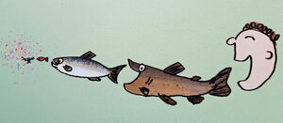
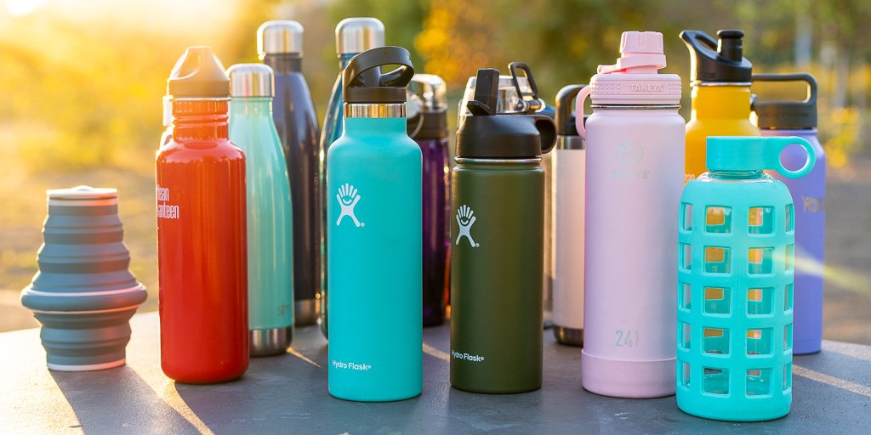
5. Single Use WASTE
Most of what we throw out is landfilled or incinerated (including some of what we put out for recycling), which pollutes our air, soil and our waterways. But some of our waste ends up in parks, rivers and the sea where it then kills and maims wildlife. It can injure people too. And because plastic in particular breaks down into ever smaller pieces, it is also getting into our food chain!
Watch the video…what could YOU do to reduce single use waste?
https://youtu.be/eg-E1FtjaxY
Fill the sink with water and tip in some of your (clean) plastic packaging waste. Blindfold your child and get them to guess what it is and then what it might feel like to a turtle, fish or sea bird. Prep your child beforehand, for example: bag = jellyfish, polystyrene pieces = shrimp, bottle top = small crab, snack wrapper = fish, cling film = seaweed.

Slide 5
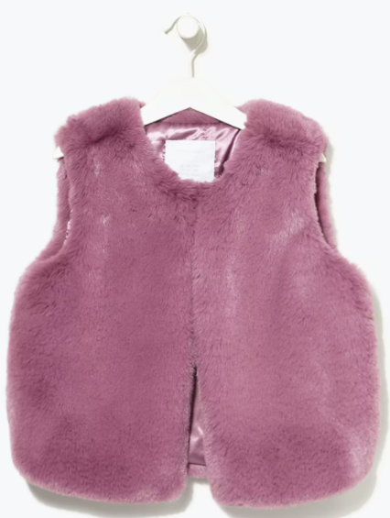
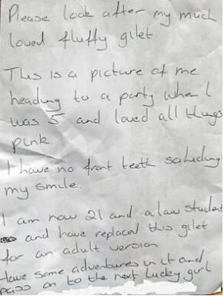
6. Gift a beloved item you no longer use!
We are have things which we love but no longer use…perhaps a teddy, a book, a game, Lego, a transformer, a piece of clothing etc.
Once you have decided to give your item away
think about all of the things that you have enjoyed with it.
Write a short description of what it means to you and ask the new owner to look after it for you and attach it to the item.
7. Upcycle an item instead of throwing it away.
Here are some ideas to try..
https://www.bbc.co.uk/bitesize/articles/zn4tnrd
8. Make your own Zero-Waste Christmas Decorations
Have a go at making some fun, beautiful Christmas
decorations. Use the link below for some plastic- free
ideas!
https://moralfibres.co.uk/zero-waste-christmas-decorations-to-diy/

Slide 6
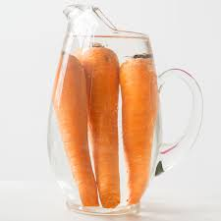
9. Cutting Food Waste
Over the course of a week, keep a chart and identify the food most
likely to be thrown away.
Rescue some limp vegetables:
Try a little experiment: find a limp carrot and cut the bottom off the tip and leave it in a glass of water overnight.
Pop the rejuvenated carrot next to a fresh one and get your child to do a taste test.
Can they tell the difference? No chance!
(b) Come up with a new recipe using something you sometimes/often waste - try sour milk scones, over-ripe banana pancakes, French toast with stale bread?

Slide 7
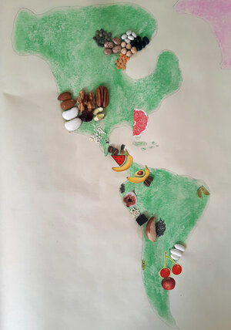
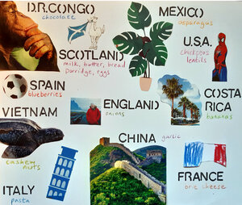
10. FOOD MILES AND SEASONALITY
From a really young age it's important to talk to our children about where food comes from - a really easy place to start when talking about our complex food system. And learning about food miles and seasonality is basically a fun geography lesson.
Activities: 1. Make a food map. Sketch out all the continents on a large sheet of paper and add food (magazine cuttings/stickers/non-perishable food) in its respective countries of production.
2. For a quicker project, you could make a 'Where we ate today' poster using pictures to represent the different countries. You could theme it by looking at flags, animals, landmarks, famous people, plants, sports…
3. For younger children, you can play a simple sorting game by selecting a range of different fresh produce that they have to separate into two categories: 'can grow in the UK'/ 'can only grow in hot countries'.
Talk about how smelly, dirty and noisy the ships, lorries and airplanes are that bring all this food to our shops and that this has an impact on air quality, marine life and our climate.
Action: As a family, why not choose 3-5 fruit or vegetables that you are only going to buy when grown in the UK in season.

Slide 8
10 Days to make a Difference… Wednesday 3rd – Friday 12th November 2021
Family Challenges Over to you!
You don’t need to attempt ALL of the challenges…however please attempt some and let us know how you get on!
Upload your pictures onto GLOW or email:
enquiries-at-st-barbaras@northlan.org.uk
The time to save our planet is NOW…how will YOU respond?

