Slide 1
St. Barbara’s Primary School
Induction
May 2021

Slide 2
Overview
Transition Journey
Curriculum
The Catholic School
School Information
Next Steps

Slide 3
Curriculum for Excellence
Early Level
First Level
Second Level
Confident Individuals
Successful Learners
Literacy Numeracy Health and Wellbeing
Sciences Social Studies
Technologies Expressive Arts
Relationships and Moral Education
Effective Contributors
Responsible Citizens

Slide 4



Catholic Education
The nature of the Catholic School
Aim of Catholic Schools
Community of Faith and Learning
Purpose
Knowledge
Skills
Beliefs, values and practices
Prayer
Fasting
Alms-giving
Inclusion
FAITH: Friendly, Active, Inspiring, Teamwork, Helpful!
Faith in our education; educate in the Faith!
Faith in our education; educate in the faith!

Slide 5
Primary 1: Core Curriculum (Recovery)
Literacy Numeracy Health and Wellbeing Religious and Moral Education
Interdisciplinary Learning

Slide 6
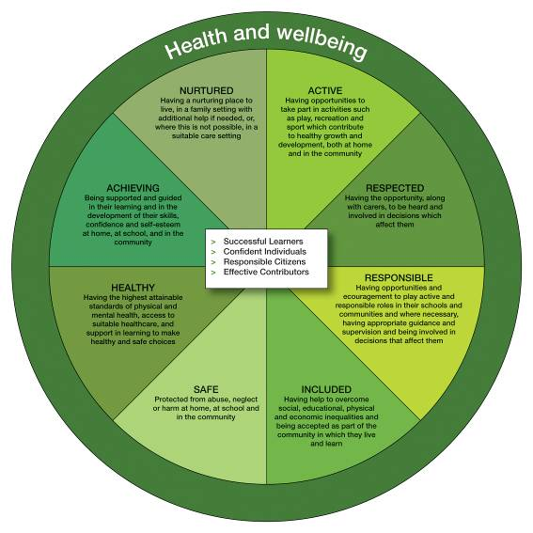
GIRFEC AGENDA
S
H
A
N
A
R
R
I
UN RIGHTS OF THE CHILD

Slide 7
Health and Wellbeing
HWB
UN Rights of the Child GIRFEC This is our Faith
Mental and Emotional
Social
Physical
Spiritual
Rights & responsibilities
Talents
Needs
Abilities
Contributing
Confidence
Interpersonal Skills
My body
Keeping healthy
Risk
Staying safe
Travelling safely
P.E.
My soul
Relationships
Sharing
Loving
Praying
Caring
Talents
Contributing
Including
Remembering
Friendship
Caring
Emotions
Listening
Talking
Resilience

Slide 8

Health and Wellbeing
HWB
Planning for choices and changes
I can describe some of the kinds of work that people do and I am finding out about the wider world of work. HWB 0-20a / HWB 1-20a
Physical education, physical activity and sport
I am learning to move my body well, exploring how to manage and control it and finding out how to use and share space.
HWB 0-21a
I am developing my movement skills through practice and energetic play.
HWB 0-22a
I am aware of my own and others’ needs and feelings especially when taking turns and sharing resources. I recognise the need to follow rules.
HWB 0-23a

Slide 9
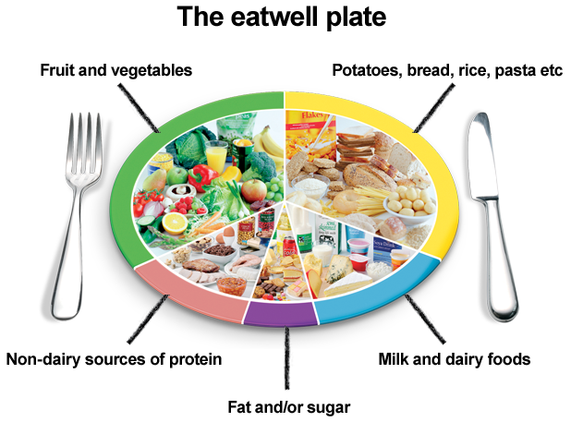
Food and Health
I know that people need different kinds of food to keep them healthy. HWB 0-32a
I explore and discover where foods come from as I choose, prepare and taste different foods. HWB 0-35a

Slide 10
Interdisciplinary Learning
Knowledge
Unfamiliar contexts
Understanding
Challenge
Skills
Making connections
across the
curriculum
Depth
Application

Slide 11
Current School Information: Classes
Classes: currently 33 children enrolled for P.1.
Primary 1 is capped at 25
Composite classes (any stage) are also capped at 25
Staffing: to be confirmed – unlikely to know the outcome before mid-June at the earliest
Range of staff working with each class
Buddies
Once staffing is confirmed you will be informed of the proposed configuration and staff.

Slide 12
Current School Information: Health and Safety
Children and classes are organized into ‘bubbles’ with the school building organized into zones
Outside, classes have outdoor zones in which to play and to line up in order to come into the building
Sanitizers are available across the school and children are directed to use them; they are also encouraged to wash their hands regularly
Classrooms are currently organized with desks in rows and seating plans are in use
Additional cleaning is in place during the day across the school

Slide 13
Current School Information: Routines
Travel by School Bus
You will be informed of pick-up/drop-off points once your bus place has been confirmed
Children are currently required to wear face coverings on all school transport
A register is taken each morning and cross-checked at the end of each day when children are escorted to the bus
Please inform us of any changes of plans in respect of bus travel
A seating plan is in place and is recorded each day
Children are escorted from the bus in the morning and to the bus at the end of the school day

Slide 14
Current School Information: Routines
Arrival at School
The playground opens at 8.45am each morning
Children can enter the playground from either gate and they will got to their allocated zone
Staff will be in the playground/at entrances
Children attending the breakfast club will be escorted to the playground
End of the Day
Children without siblings who are NOT travelling by bus/attending aftercare
The teacher will escort the children to the Elmira Road entrance in front of the annexe building. Please enter the outside area and stand on a cross while you wait for your child and observe the one-way system.
Children with older siblings: these children will exit via the Drumcavel Road exit

Slide 15
Current School Information: Meals
School-based breakfast club is open from 8.15am each morning and is free to children in Primaries 1-3.
Places do not need to be booked in advance
Lunch is served in the cafeteria and menus are available online to view (NLC website)
Staff will cater for special diets and forms are available to be completed as required from the cafeteria
Packed lunches can be brought to school
Snacks: we ask that nuts and/or fizzy drinks are NOT sent into school for snack or lunch, thank you!
Children have designated seating within the cafeteria which relates to their classroom zone

Slide 16
Current School Information: Routines
Aftercare
Many children attend privately-run aftercare business in the annexe building
Due to the numbers involved, we maintain a daily register of children attending
At the end of the school day, children attending aftercare have a designated area to meet with aftercare staff outside the main entrance
Please inform Aftercare staff of any changes to your arrangements. They will, in turn inform us, thank you.

Slide 17
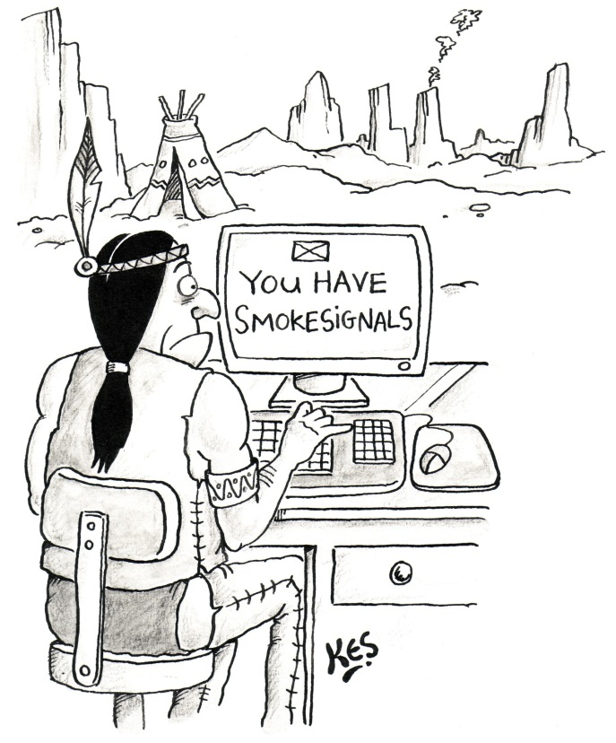
Communication
Email/texts to parents via Groupcall system
Twitter
School Website/Blogs
School correspondence – eldest child
Daily Diary
Office: by appointment only at present
Annual Data Check
NLC Website
Telephone: please inform the school of any absence/appointment by 9.30am each morning

Slide 18
Medicine/Forgotten Items
Forms MUST be completed for any medicine which has to be administered in school. Medicine should be brought to Reception by an adult where forms will be available.
Please contact us if your child has forgotten lunch/water bottle etc. We will provide a lunch and water for him/her.

Slide 19
Uniform
Grey school skirt/trousers
Grey school knitwear
White shirt/blouse and school tie
Summer dress – if desired
Grey, black, white socks/tights
Burgundy outdoor jacket – if desired
Gym days: joggers, shorts and tee-shirt (gifted)
No football colours/badges are permitted.
NAMES – PLEASE!!
Please note: uniform can be purchased from any retailer of your choice

Slide 20
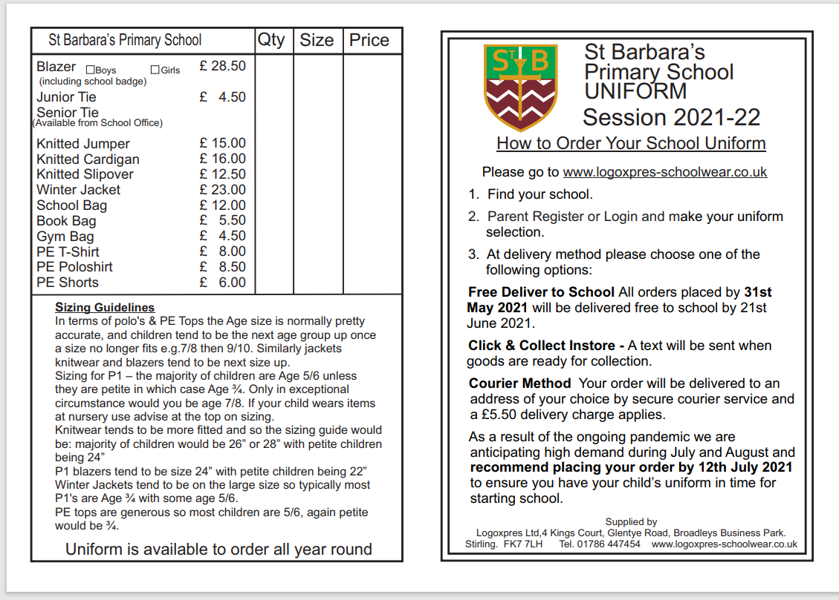
L
O
G
O
X
P
R
E
S

Slide 21
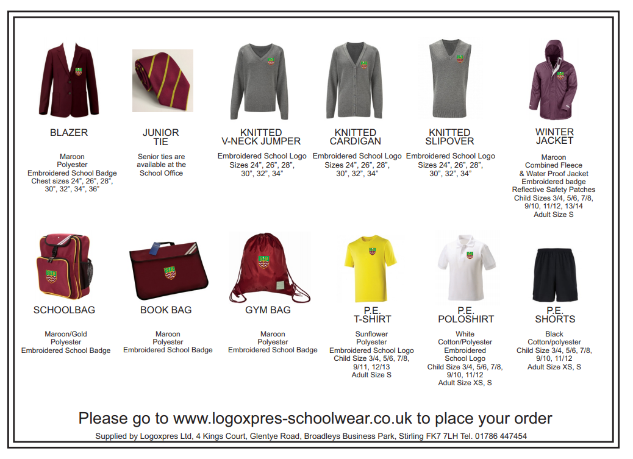
L
O
G
O
X
P
R
E
S

Slide 22
Coming to School: Week 1
Monday 16th August
Please bring your child into the main playground at 9.20am
Please come to the pick-up zone on Elmira Road at 2.30pm (in front of the annexe building)
Tuesday 17th August onwards
Drop-off at your chosen entrance from 8.45am
Pick-up from the designated exit at 3.00pm

Slide 23
Coming to School: Current Information
Warm, outdoor jacket and suitable school shoes as children are outdoors regularly – including the Daily Mile
Schoolbags and lunch boxes
No toys please!
Water bottle (filled)
P.E. Kit: Yellow t-shirt (gifted); joggers; outdoor jacket and suitable shoes should be worn to school in place of uniform on designated P.E. days – in line with current restrictions

Slide 24
Next Steps
Continuing visits to partner establishments
Visits to school: current restrictions
Monday 7th June and Tuesday 8th June
Times allocated from 3.30pm – 5pm (10 minute visit) – will be emailed to you
Currently accompanying adults are NOT permitted within the school
Further Transition Activities: coming weeks
Dedicated area on the school website for parents and children
Virtual tour of the school
P.7 Transition Ambassadors
Story time
Message from the Parent Council
Messages from Primary 1 children
Messages from Primary 6 Buddies

Slide 25


All salient information from today’s presentation will be uploaded onto the school website.

