Slide 1
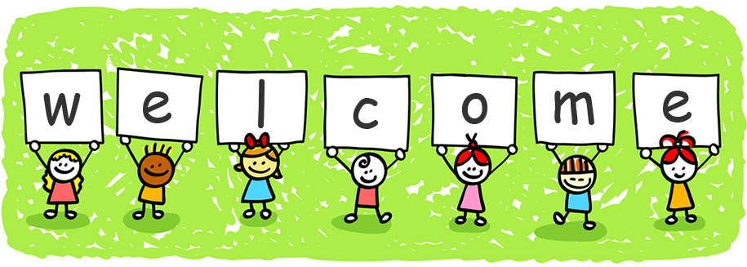
Welcome to all of our new Primary 1 children and your families!
We are your Buddies and we are so looking forward to seeing you in school.
Please run the slideshow to see us and to hear a little bit about us. We would love to have pictures of you and to learn something about you. If your mum or dad allows, please email your picture and story to:

Slide 3
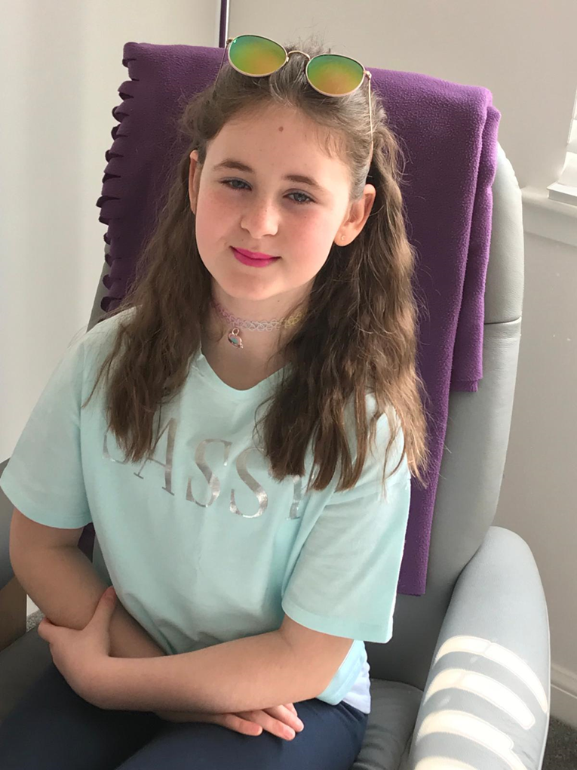

Slide 4
Hi, my name is Mhairi and I am 10 years old. I will be in Primary 7 when you join school. St. Barbara’s has a friendly environment and I really enjoy learning there.
These are some of the things I enjoy doing at school:
Silent reading in the class library
Fun learning with my friends
Playtime and Sports Day.
I have represented St. Barbara’s on many occasions. I am in the Eco Committee and am a Missio Ambassador. I have also taken part in a school dance competition called Dance Mania.
These are some things I like doing outside of school such as singing and dancing. I also go to a musical theatre group which puts on shows. I enjoy playing games with my friends and family too.
I am really looking forward to being in P7 and looking forward to meeting all the new P1s. I can’t wait to be a buddy, monitor classes and be a good example to the rest of the school.
I really hope you liked reading this letter and I can’t wait to see you when we go to school.
Mhairi

Slide 11
Hello!
My name is Nathan and I would like to welcome you to St. Barbara's Primary School!
I am 11 years old, I was born on Easter Sunday and I went to Jigsaw Nursery. My likes include lego, reading, swimming, broccoli pizza (it's delicious!), the Wii, maths, science and superheroes. My favourite is the Flash. My dislikes include eggs, fish and super villians.
I enjoy going to school because you can learn new things every day, you can make a lot of friends, there is golden time at the end of every week, and there are really nice staff members. My favourite subject is maths.
I look forward to meeting you and being your buddy and helping you settle in to Primary 1!
From Nathan

Slide 12
Howdy, P1
My name is Emilia; I am 10 years old and currently a P6 at St Barbara’s. I am very excited about becoming a P7 buddy and cant wait to meet all of you new P1s.
I am a member of a dance group called Revolution were I love to spend time with my dance partners. At dance, during the snack break, my friends and I dance around making funny dance moves. This makes us all laugh and helps us to become a happy group. My family and friends say that I am a funny character and often make them laugh too.
St Barbara’s is a happy place to be! Don’t be worried about starting school as the teachers and staff, are all caring, funny and kind. When I started school, I was worried but I quickly learned that school was going to be a good place to learn and play. As a P7 buddy, I will take care of you and make sure that your days in school are exciting.
Looking forward to meeting you in August.
Take care,
Emilia

Slide 13
Dear Buddy
My name is Finn and I am 10 years old. I live with my mum and dad. I also have two brothers. My brother Lucas is going into high school after the summer holidays and my wee brother Jude will be going into primary 3. I like playing on my Xbox, going outside with my friends on my bike and going on holiday with my family
I hope you are looking forward to starting school. I think you will love St. Barbara’s. I think the school dinners are tasty and I have made lots of friends whilst I have been at St. Barbara’s
I hope you have a good summer holiday and I can’t wait to meet you when school starts.
From
Finn

Slide 15
Hi buddy
My name is Matthew and I’m 11. I enjoy school, it’s a good school. I like the teachers and especially Mr Feeney because his high 5s waken me up in the morning. I’ve had some different teachers and they are all good. I enjoy English best. I like the shows and Christmas plays. I love sports and enjoy playing with my friends. The school has an ash football pitch we get to play on. Sports day is also a good day at school as well. Mrs McKinney is funny and is a good head teacher. Father Campbell is really funny and a good priest. You will like St Barbara’s. It’s a good school.
Matthew

Slide 16
Hi I’m Niamh, I’m starting primary 7.
Before I started school I went to snowdrop nursery, I know it was lots of fun. School is lots of fun too so you don’t need to be nervous.
All of the teachers are nice, you will make lots friends and you'll learn lots.
You will have playtime everyday and you can play after you have eaten your lunch. On Fridays after you have finished work you can even play in your classroom, we call this Golden Time.
All through the year there are fun activities like: sports day, discos and assemblies .
I cant wait to see you in August! You can come and talk to me any time!
Love Niamh x

Slide 18
Hi my name is Katie. In August I will be in Primary 7 and I will be your buddy. I like dancing, drawing, painting and playing with my friends. I remember how I felt before going into Primary 1. I was nervous and didn’t really know what to expect. But I really enjoyed it and I met lots of new friends. I am sure you will enjoy it too. There are lots of things to do. Some of the things I enjoy in school are art and P.E., going on school trips and taking part in Sports Day activities. You also get the chance to do projects on interesting topics like the Vikings and the Victorians. I am really looking forward to seeing you and helping you settle into Primary 1.
Katie

Slide 19
Hi!
My name is Sophie and whatever buddy you will make out to be I will still love you as a fellow person.
Some positive things about school is you will learn new things, make new friends and see new perspectives.
You can learn different areas of maths, learn how to read and write, have different topics like history or geography.
Another thing is you can experience various journeys with your class, like going to Dynamic Earth in Edinburgh and learning about space. You will go to Kelvingrove Museum or Zoo.
I can't wait to see you.
-Sophie

Slide 20
My name is Millie and I live in Muirhead with my Mum and Dad. I turned 11 years old in March and I have an older brother called Zak who is now at high school. My Dog is called Buddy. Pink is my favourite colour.
I have lots of hobbies such as gymnastics, dancing and swimming. I love going on holiday each year with my family and my Gran and Grandad always come along too.
Starting school is one of the best things that you will ever do, I have enjoyed school for so many reasons, it allowed me meet Cassiah who is now my best friend. As well as Cassiah I have made other friends who I play with outside school as well. I have learned so many things from school like reading and writing, as well as this you can join the after-school clubs like dancing and football. It’s great.
I have lots of good memories from to school since Primary 1 and I’m sure you will too. It’s not long now to you start school and I’m looking forward to meeting you.
Millie

Slide 21
Hello, my name is Liam, I am 10 years old and I am currently in p6 at St. Barbara’s. I hope you are looking forward to joining school in August. I am looking forward to meeting and you I will be taking care of you when you start primary 1. What do you like to do at home? When I am not at school, I like to meet my friends on our bikes, play my Xbox or play with my little brother Riley out in the garden, he is just 3 but he is nearly 4. I remember my first day at school and I was really excited to make new friends. When I am at school, I enjoy taking part in Art, PE, Maths and Golden time and I like seeing my friends every day. All the teachers are very friendly and if you ever need help with anything, they will help you out no problem. We do some fun sport events in school like sports day, we also have discos and parties and sometimes we perform shows that we learn with our classmates. I can’t wait to go back to school, I hope you feel the same. I will see you soon, stay safe.
From
Liam

Slide 22
Dear new Primary 1, welcome to St Barbara’s Primary School.
The first thing I want to tell you is you should not be scared about coming to St Barbara’s primary school, it is amazing and everyone will look after you.
My name is Michael: I will be in the new Primary 7 class and I will be your buddy, which means I will look after you and make sure you’re safe and having a fun time at St Barbara’s.
Let me tell you a little about myself: I like gaming and sports. I play for Garnkirk United. I have a younger sister called Sheena, who also goes to St Barbara’s and she is in the new Primary 5.
I live in Gartcosh and I take the bus to school. If you have to take the school bus too, that is fine because everyone on the bus will look after you.
Now, let me tell you about the school itself - you don’t have to be scared of going to the lunch hall because I will help you for the first couple of weeks. There are two different hot lunch options and every day there are sandwiches in case you don’t like the hot. If you can’t count money, please don’t worry because the lunches are free in Primary 1.
I will also look after you in the playground. Maybe you already know people from your nursery, and that’s great, but if you don’t I am sure you will make lots of friends in your class.
I hope to meet you soon and it’s nice to think that, even though we don’t know each other yet, we already have one thing in common: we both go to St. Barbara’s.
Looking forward to seeing you at school very soon.
From, Michael

Slide 23
Dear New Primary One,
My name is Aidan Harris. Right now, I am in Primary 6. When you go into Primary 1 in August, I will be your new buddy.
My favorite sport and hobby too is football. I play for Cumbernauld Colts. It is fantastic!
I am going to tell you a little about school. I am Vice House Captain for St Bernadette’s. When you start school, you will be put into a house. This is where you get together with the others in the house and decide things. It’s like a team.
My favourite thing to do in school is to draw and do P.E.
Unfortunately, we cannot meet just now but I can’t wait to meet you in August.
Yours sincerely,
Aidan Harris

Slide 25
Hello.
Welcome to St. Barbara’s. My name is Gio, and I will be your buddy soon. I really like to play video games but I can’t play all the time, because I need to study. I work hard!(most of the time). I told you something about me, so that you know me a bit, so maybe we can be friends! at school.
We study, play outside and eat snack and lunch. Normally, a new guy gets a lot of friends, so you can play with them! See you soon!
Gio

Slide 26
To my buddy
Hi, my name is Olivia and I can not wait to meet you, I hope you are looking forward to going to school because it will be the best time of your life. You will get to play with me and the other primary 1 and you will learn so much. I will be there to support you and help you get to know the school and the teachers. I can’t wait to see you and know what you are like but here is a bit about me.
My favourite colour is pink and I love to dance and play sports, my favourite animals are dogs and ponies ,I have blue eyes and brown hair and I am a little bit tall .I am so looking forward to seeing you so I hope you are safe and well, don’t worry I will get to see you soon.
love Olivia.

Slide 27
Hi I’m Olivia ♥
I will be in Primary 7 in August when you start school.
My biggest passion is horses. I take horse riding lessons and I am part of a group called The Pony Club. My favourite thing to do is to be at the stables looking after the horses. I also love hanging out with friends, going to the cinema and eating out.
St. Barbara’s is an amazing school. You will have a great time when you start school in August, just like I did. Throughout the year there are discos, parties and lots of special events. Every school day is different and filled with lots of things to do. You’ll enjoy meeting new friends and all the teachers and staff.
I am so excited to meet you all!
Olivia Devine

Slide 28
Hi, my name is Sophie.
I am 11 years old and in Primary 7. I am so excited to be your buddy this year, I cannot wait to meet you. St Barbara’s is such a great school I think you are going to love it. As your buddy I will be your friend and be there for you as well as helping you settle into school. My favorite thing about our school is the playground, it so much fun. I hope you are looking forward to school and I am pretty sure you are going to make a lot of new friends

Slide 30
Hi! My name is Anthony and I will be your buddy.
I hope you’re excited when you come and start school. Don’t be nervous when you first come in, soon you will make friends and get used to everything at St. Barbara’s. You’ll have a class to work with so I hope that you will have a good time.

Slide 31
Hi, my names Jayden,
I am nearly 11 years old. I like spending time with my mum and little brother Ollie. My favourite food is fish and chips but I love McDonald’s as well. My favourite colour is purple or green. I love school because I get to meet my friends every day and have lots of fun. You will love it to! See you soon. Jayden

Slide 32
Hi, I’m Harry. I’m 10m years old and when you start school I will be in Primary 7. My hobby is musical theatre – I have been in a big UK movie and I took part in the King’s Theatr e Christmas Panto, Jack and the Beanstalk.
I like to ride my bike, play with my friends and my three brothers and play Fortnite and Roblox on my Xbox. I feel a little like you just now because I am also new to St. Barbara’s primary.
I have found all the staff and pupils very friendly, welcoming and helpful. You will love our school.
Going to school you will meet lots of new friends and join some of the activity clubs within the community. My 6 years at school have made me feel smarter, more responsible and more confident.
Our teachers bring out the best in us. I cannot wait to meet you all and welcome you to St. Barbara’s.
You will be great!
Love Harry

Slide 33
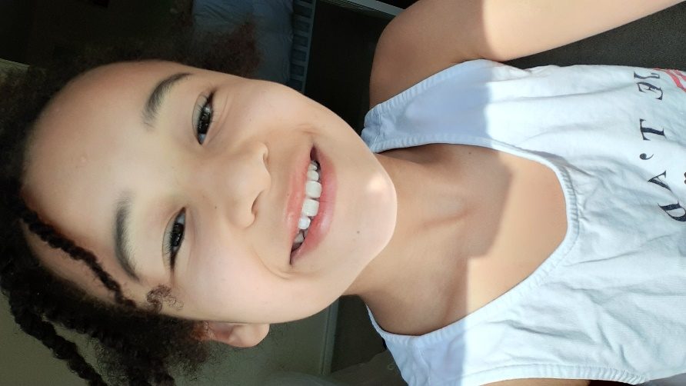
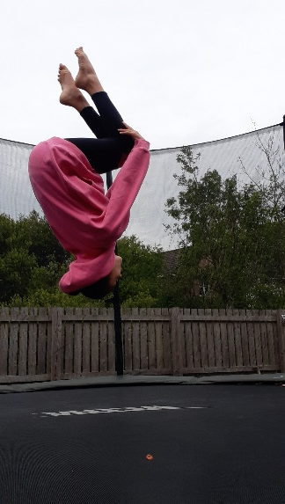
Welcome to St Barbara a fun, loving and secure primary school.
Hi, my name is Cassiah. I am 10 years old. I live in Muirhead.
My favourite colour is pink.
I love all kinds of food especially, lasagne.
I have one big sister.
.
Fun things at school
Art
Sports
Days out
Friends
Golden time
Discos
Dress downs
I like to sing
I like to dance
I like gymnastics
I like trampolining
I like acting
I like forest walks
I like drawing

Slide 34
We hope that you have enjoyed our letters.
Remember - if you are allowed, please tell us a little bit about you and email your story and picture to:

