Slide 1
P5/4 – Wednesday 3rd June
Good morning boys and girls!
It is lovely to be back with you today after the weekend. I hope you have been enjoying the sunshine and making the most of this time with your family.
As always please email me anytime.
Let’s get started!
Mrs McGill

Slide 2
Timetable for today
R.E. – Prayers, First Holy Communion Preparation, RME
Numeracy – Number Talks (Chilli Challenge), Sumdog
Literacy – Spelling & Solo Talk
HWB – Stay Active!
Grid – Maximum of 2 activities from the new grid

Slide 3
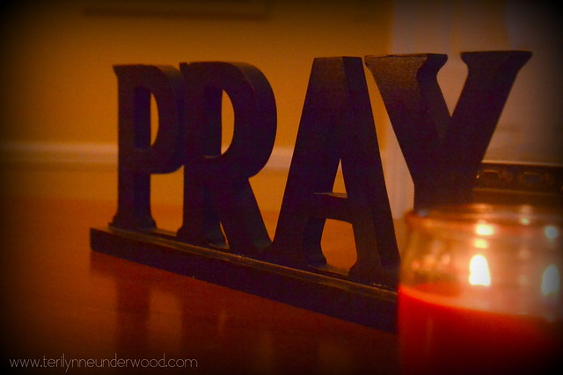
Morning Prayer
God our Father, as we prepare to begin our work, we ask you to help us use properly, the many gifts you have given us, so that we may fully benefit from our day together in school. St. Barbara – Pray for us.

Slide 4
R.E. – Sacrament of First Holy Communion
The Diocese of Motherwell has very kindly made available the First Holy Communion booklet we were working on in school and at home. Please click here to download a copy. Please be aware of copyright:
“Each Sacramental Workbook is copyright. Consent is granted to copy, distribute and share these Sacramental Workbooks up to the time that our Government have allowed pupils return to normal school activities. They will be removed from this website thereafter. In downloading the content you agree to these terms.”

Slide 5
R.E. – Sacrament of First Holy Communion
“This is my body, which will be given up for you: do this as a memorial of me” Luke 22:19”
Read the story of The Last Supper on the blog and complete page 30 in your workbook.

Slide 6
R.E.
Over the course of the last few days we have been learning about the importance of Pentecost. It has shown us how important the feast is in the church's year.
There are a few activities below which you can complete to reinforce what you have learned about The Feast of Pentecost and the Holy Spirit. You can choose to do one activity or why not complete it together with your siblings.
pentecost – story
pentecost - word search

Slide 7
R.E.
When you have finished your activities, take a few minutes to pray together with your family. I have attached a lovely hymn that you could sing together to finish off your Pentecost work for today.
https://youtu.be/dnt4ST8HGQA

Slide 8
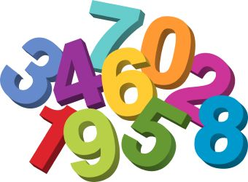
Numeracy
Please have a go at this chilli challenge. Remember to choose the chilli that you think will challenge you. Try to work out the answer in your head and think about all the strategies we have learned to work out the answer.
The answers are on the slide after the chilli challenge so make sure you don’t go too far ahead until you’re ready!
Good luck!

Slide 9
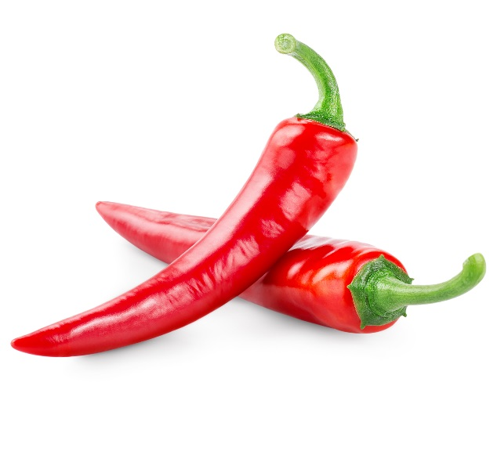
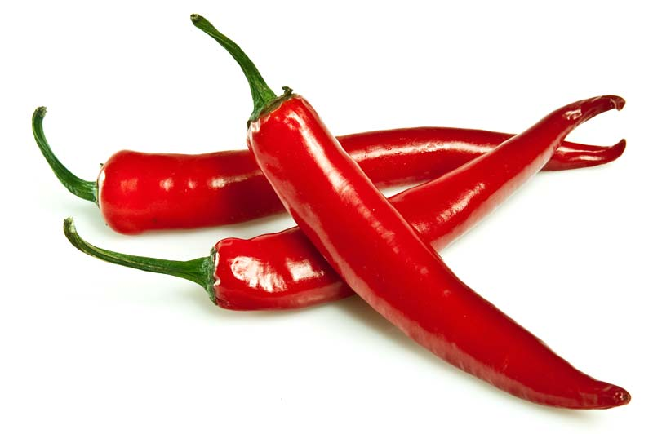
Number Talks
66+27
489+116
1506+2602

Slide 10
Number Talks - Answers
66+27
489+116
1506+2602
93
605
4108

Slide 11
Maths
Times Table Challenge – Well done to all the children who logged on and took part last week. If you would like to know your personal score please email me and I can let you know which times tables you should be working on now.
I have awarded everyone who took part 50 coins to spend in their house!

Slide 12
Maths
At the beginning of the week you were looking at adding and subtracting money with Mrs Grant.
We will continue with this through the rest of the week and I have set up some questions on Sumdog for you to work on. Enjoy!

Slide 13
Spelling
Red Group – Aberdeen, birthday, country, five, huge, aeroplane, biscuit, cousin, floor, idea.
Green group – lamb, comb, climb, thumb, crumb, knee, knew, knife, knit, knock.
Purple group –bank, sank, tank, ink, pink, sink, bunk, sunk.
Please write out each word in your jotter three times. You can choose pyramid spelling or rainbow spelling. Please write a sentence for each word too. ☺

Slide 14
Literacy
Solo Talk
Take some time today to continue to work on your solo talk.
You have until Friday 5th June to complete this. ☺

Slide 15
Health and Wellbeing
We are going to follow a little Yoga session that Mrs McFall (Daniel and Luke's mum) has kindly allowed us to share on the Blog.
Below is a great Yoga workout that you can do along with an adult or your siblings. You can also have your favourite ted join in too.
https://www.facebook.com/JulieAbsoluteWellness/videos/228083418312545/

Slide 16
Health and Wellbeing
Yoga is a great skill helping you learn the importance of how you breath which in turn helps us relax and sleep well. (Parents: Mrs McFall recommends that you allow your child to go with the flow and, if you are able to accompany them doing the video, ask them similar questions). Remember with any exercise we should remember to drink plenty to keep us hydrated, looking after our bodies!!

Slide 17
Grid Work
If you still feel up to it, why not try to do an activity from the new grid but no more than 2 activities per day.

Slide 18
Prayer at the End of the Day
God our Father, as we finish our day’s work, we thank all who have helped and supported us today, and we ask you to help us use your gifts so that we may relax and rest as you would wish. St. Barbara – Pray for us.

Slide 19
You’re Finished!!!
Well done boys and girls you are now officially finished for today!
Don’t worry if you didn’t manage to complete all the activities and well done if you did! I appreciate anything you are trying to do at home.
Have a good rest tonight and back to work tomorrow!

