Slide 1
P5/4 – Thursday 4th June
Good morning boys and girls! Ready for another fun filled day?
Please try to complete the activities for today but if you can’t please do not worry. You can adapt them to suit you and your family in any way you can.
If you need anything please email me anytime.
gw14waughmanda@glow.sch.uk
Mrs McGill

Slide 2
Timetable for today
R.E. – Prayers, RE, First Holy Communion preparation.
Numeracy – Number Talks (Chilli Challenge), Sumdog Challenge
Literacy – Fact and opinion
Health –Stay Active
ICT –Grid – Maximum of 2 activities from the new grid

Slide 3
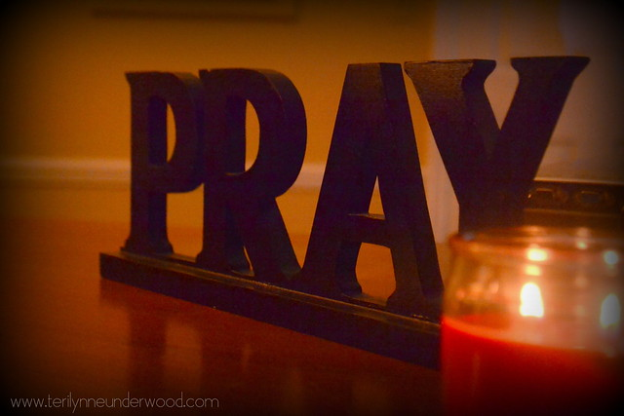
Morning Prayer
God our Father, as we prepare to begin our work, we ask you to help us use properly, the many gifts you have given us, so that we may fully benefit from our day together in school. St. Barbara – Pray for us.

Slide 4
R.E. – Sacrament of First Holy Communion
The Diocese of Motherwell has very kindly made available the First Holy Communion booklet we were working on in school and at home. Please click here to download a copy. Please be aware of copyright:
“Each Sacramental Workbook is copyright. Consent is granted to copy, distribute and share these Sacramental Workbooks up to the time that our Government have allowed pupils return to normal school activities. They will be removed from this website thereafter. In downloading the content you agree to these terms.”

Slide 5
R.E. – Sacrament of First Holy Communion
“This is my body, which will be given up for you: do this as a memorial of me” Luke 22:19
Today we are thinking about what Jesus sacrificed for us.
Please complete page 31 of your booklet.

Slide 6
R.E.
As we know things just now are very different from what we are used to. By now our new Primary 1 children would have been in to visit the school but, like you, they have not been able to come in for their visits. We are thinking that it would be a lovely idea for you to say a little prayer for them. In order to make them feel welcome to our school in August, I would like you to choose the word for your stage below, write/colour it on a sheet of paper, hold it up and ask an adult to take a picture of you holding your word with a big smile and if it is possible you could wear your uniform.

Slide 7
R.E.
Please email your picture to gw14waughamanda@glow.ch.uk We will use these to make our Primary 1's feel very welcome to our school.
Primary 1 - A;
Primary 5 - Great;
Primary 4 - Big;
Primary 6 - Welcome;
Primary 2 - To;
Primary 3 - St.
Primary 7 - Barbara's!

Slide 8


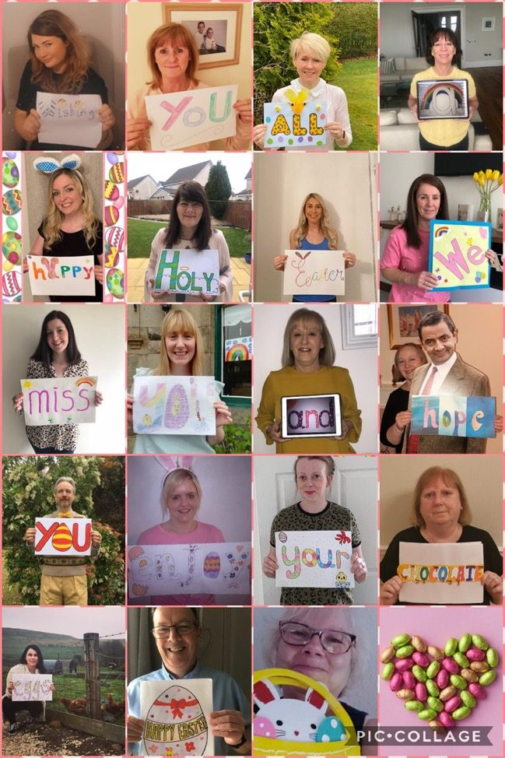

R.E.
Do you remember the Easter message? We still miss you lots!
I am not in the photo – did you notice?
When it was taken I had very sore eye and was wearing a patch (yes just like a pirate!) My little girl hit me with one of her toys by accident. All fine now though ☺

Slide 9

Numeracy
Please have a go at this chilli challenge. Remember to choose the chilli that you think will challenge you. Try to work out the answer in your head and think about all the strategies we have learned to work out the answer.
The answers are on the slide after the chilli challenge so make sure you don’t go too far ahead until you’re ready!
Good luck!

Slide 10

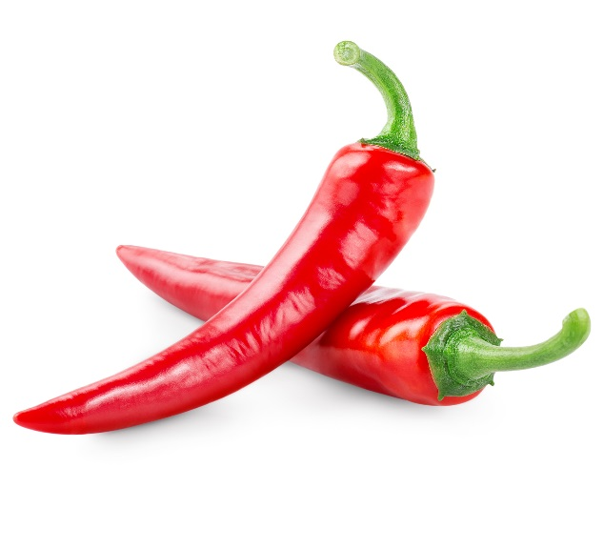
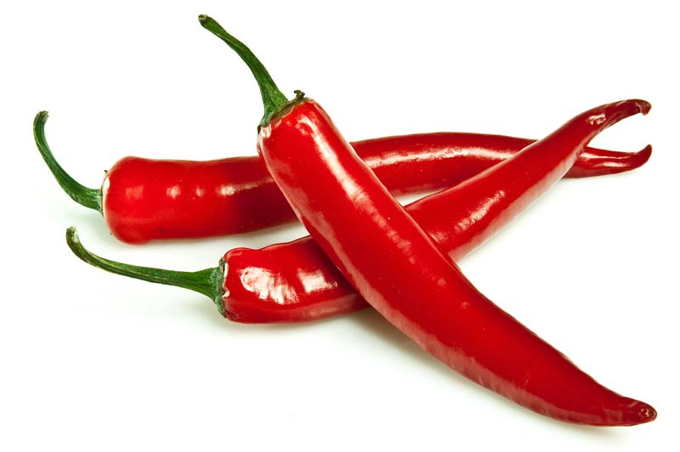

Number Talks
27-11
402-12
2781- 1621

Slide 11
Number Talks - Answers
27-11
406-12
2781- 1621
16
390
1160

Slide 12
Maths
Money
Please continue to complete the sums set for you on sumdog. If you want to try something different you could make your own money board game to play with someone at home.

Slide 13
Writing
Fact and Opinion
Using the website below, learn about the difference between fact and opinion and complete the writing tasks.
https://www.bbc.co.uk/bitesize/articles/zn4dqp3
If you can take a picture of your work and send it to me, you know I love to see how you are getting on.

Slide 14
Health
We were talking yesterday about how important it is to look after our bodies. Drinking plenty especially during exercise and warm weather to keep us hydrated. Our bodies are amazing things.
Here is a little activity to keep you busy and at the same time learn about all of the parts that make up ‘US’!!
Have you got a roll of wallpaper lying around or if you have been receiving lots of packages (did you know all our posties are busier than their busiest time of the year, Christmas!) during lockdown and have cardboard boxes around I want you to lie them flat on the ground and get someone in your house to draw round you. (The weather’s not looking that good today but should be dry so even do this task outside).

Slide 15
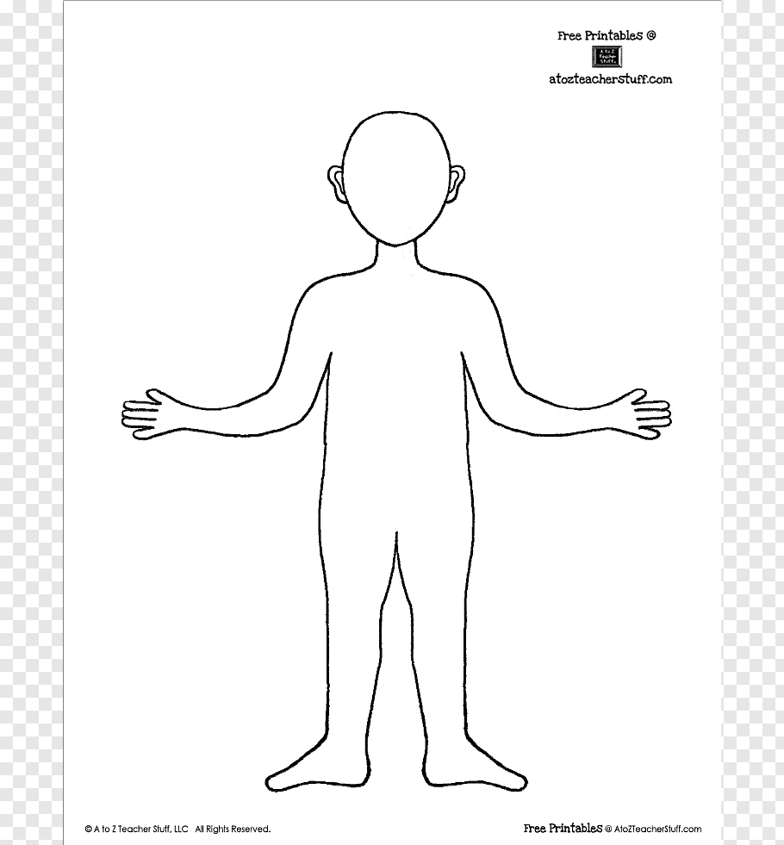
Health
Here we have our template!! Can you label and identify as many parts of the human body - all our organs? See if you can have a good guess at where they are located. Our heart 💓 should be easy, what about our lungs, liver etc. Try to see how many you can find. You could even put your artistic talents to good use and draw them in.
Remember to email your marvellous pictures to me or upload it onto Twitter with an adult's permission.

Slide 16
Grid Work
If you still feel up to it, why not try to do an activity from the new grid but no more than 2 activities per day.

Slide 17
Prayer at the End of the Day
God our Father, as we finish our day’s work, we thank all who have helped and supported us today, and we ask you to help us use your gifts so that we may relax and rest as you would wish. St. Barbara – Pray for us.

Slide 18

You’re Finished!!!
Well done boys and girls you are now officially finished for today!
If you ever need anything at all you know how to get in touch.
Have a good rest tonight and back to work tomorrow!

