Slide 1
P5/4 – Thursday 28th May
Good morning boys and girls! Ready for another fun filled day?
Please try to complete the activities for today but if you can’t please do not worry. You can adapt them to suit you and your family in any way you can.
If you need anything please email me anytime.
gw14waughmanda@glow.sch.uk
Mrs McGill

Slide 2
Timetable for today
R.E. – Prayers, Angelus Challenge, RE, First Holy Communion preparation.
Numeracy – Number Talks (Chilli Challenge), Sumdog Challenge
Literacy – Writing A Diary Entry
Health –Stay Active
ICT –Grid – Maximum of 2 activities from the new grid

Slide 3
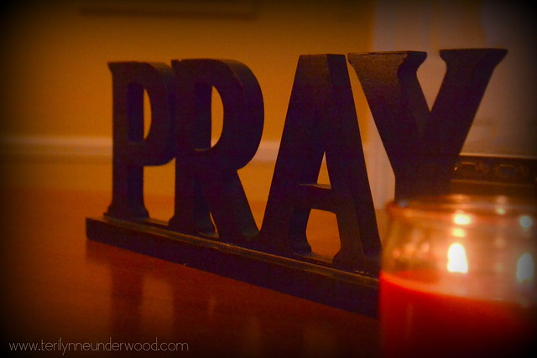
Morning Prayer
God our Father, as we prepare to begin our work, we ask you to help us use properly, the many gifts you have given us, so that we may fully benefit from our day together in school. St. Barbara – Pray for us.

Slide 4
Diocese of Motherwell
The Diocese of Motherwell are encouraging families to participate in the Angelus Challenge. They are releasing videos every weekday on YouTube to help children with their participation. Please find day 18 below:
https://www.youtube.com/watch?v=wk8EMm3CNOQ
When you have completed this why not colour in a flower on the Angelus Prayer Card. Please find this uploaded onto the blog on the website.

Slide 5
R.E. – Sacrament of First Holy Communion
The Diocese of Motherwell has very kindly made available the First Holy Communion booklet we were working on in school and at home. Please click here to download a copy. Please be aware of copyright:
“Each Sacramental Workbook is copyright. Consent is granted to copy, distribute and share these Sacramental Workbooks up to the time that our Government have allowed pupils return to normal school activities. They will be removed from this website thereafter. In downloading the content you agree to these terms.”

Slide 6
R.E. – Sacrament of First Holy Communion
“I am the bread of life, anyone who comes to me will not be hungry, and the man who believes in me will never be thirsty” John 6:35
We have learned that Jesus nourishes us on our faith journey towards our First Holy Communion.
Please complete page 26 of the Holy Communion Booklet.

Slide 7
R.E.
When we pray it is important to remember a few simple things. Prayers can be simple thoughts and words coming straight from the heart. Sometimes God doesn't seem to give us what we pray for. Do not give up praying - keep on talking to God and listening for he knows what is best for you, even if it is not what you expected. It is also important to remember that we don't just ask God for things we want. Remember to praise God and thank him for his goodness, to tell him about ourselves and others and say sorry if we have done wrong.

Slide 8
R.E.
Why not join in with this hymn Alleluia Alleluia Give Thanks to the Risen Lord below to praise God:
https://www.youtube.com/watch?v=2U1MuOCHon4

Slide 9
R.E.
I would like you to write out a short prayer thanking God for all the wonderful things you have in your life. I have included a template below for you to use or you can design your own.
https://blogs.glowscotland.org.uk/nl/public/stbarbaras/uploads/sites/26624/2020/05/23140945/prayer.pdf
Please send us a copy of your picture at gw14waughamanda@glow.sch.uk or Tweet us @St_BarbarasPS.
Also as it is Thursday again let's remember to praise (thank) all NHS workers tonight at 8pm by clapping and making as much noise as you can for them.

Slide 10
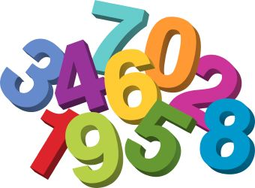
Numeracy
Please have a go at this chilli challenge. Remember to choose the chilli that you think will challenge you. Try to work out the answer in your head and think about all the strategies we have learned to work out the answer.
The answers are on the slide after the chilli challenge so make sure you don’t go too far ahead until you’re ready!
Good luck!

Slide 11
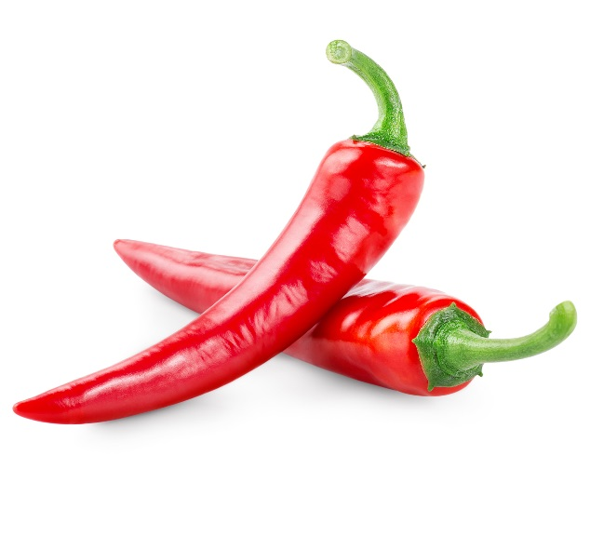
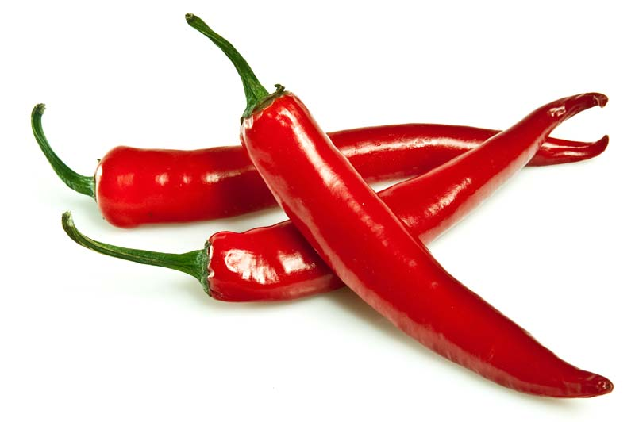
Number Talks
19-11
306-12
2081- 1031

Slide 12
Number Talks - Answers
19-11
306-12
2081- 1031
8
294
1050

Slide 13
Maths
Times Table Challenge!
As you have all been working hard on your table of the week I am keen to see how you are getting on.
Please complete the times table challenge I have set on Sumdog. It will end on Friday – good luck!

Slide 14
Writing
To write a diary entry based on a classic tale.
Please use the BBC Bitesize resources below to help you with the writing task today.
https://www.bbc.co.uk/bitesize/articles/z6yxt39

Slide 15
Health
We have all been enjoying the lovely sunny weather recently and it has been great to be able to get outside and play. Even though it is important for everyone to enjoy the sun we have got to remember that it can burn your skin. There are three important steps to stop sunburn:
• Cover up with clothing and a hat • Spend time in the shade • Wear suitable sunscreen and apply it often

Slide 16
Health
In the attached sheet the character in it is out in the sun with no hat!!! I would like you to design a hat for the character and make sure it offers suitable protection against the sun.

Slide 17
Health
Or if you want to make a more detailed design on your sun hat why not click on the link below.
https://blogs.glowscotland.org.uk/nl/public/stbarbaras/uploads/sites/26624/2020/05/23195241/Design-Your-Own-Sun-Hat.pdf
Please send us your pictures to gw14waughamanda@glow.sch.uk or Tweet @St_BarbarasPS

Slide 18
Grid Work
If you still feel up to it, why not try to do an activity from the new grid but no more than 2 activities per day.

Slide 19
Prayer at the End of the Day
God our Father, as we finish our day’s work, we thank all who have helped and supported us today, and we ask you to help us use your gifts so that we may relax and rest as you would wish. St. Barbara – Pray for us.

Slide 20
You’re Finished!!!
Well done boys and girls you are now officially finished for today!
Don’t worry if you didn’t manage to complete all the activities and well done if you did!
Have a good rest tonight and back to work tomorrow!

