Slide 1
P5/4 – Wednesday 26th May
Good morning boys and girls!
It is lovely to be back with you today after the holiday weekend. I hope you enjoyed the virtual sports day. Please email me any pictures you have and I can add them onto our blog. Some amazing work was sent through last week so I have included it in our slides today too. ☺
Mrs McGill

Slide 2
Timetable for today
R.E. – Prayers, Angelus Challenge, First Holy Communion Preparation, RME
Numeracy – Number Talks (Chilli Challenge), Sumdog
Literacy – Spelling & Solo Talk
HWB – Stay Active!
Grid – Maximum of 2 activities from the new grid

Slide 3
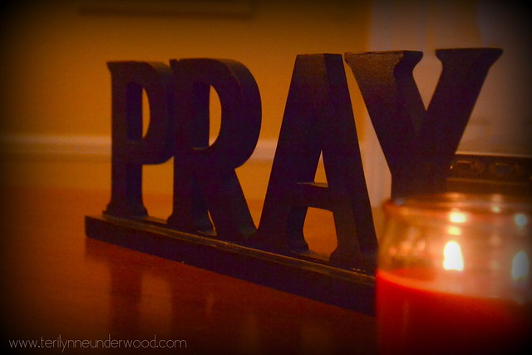
Morning Prayer
God our Father, as we prepare to begin our work, we ask you to help us use properly, the many gifts you have given us, so that we may fully benefit from our day together in school. St. Barbara – Pray for us.

Slide 4
Diocese of Motherwell
The Diocese of Motherwell are encouraging families to participate in the Angelus Challenge. They are releasing videos every weekday on YouTube to help children with their participation. Please find day 17 below:
https://www.youtube.com/watch?v=qmXiiQgpR6Q
When you have completed this why not colour in a flower on the Angelus Prayer Card. Please find this uploaded onto the blog on the website.

Slide 5
R.E. – Sacrament of First Holy Communion
The Diocese of Motherwell has very kindly made available the First Holy Communion booklet we were working on in school and at home. Please click here to download a copy. Please be aware of copyright:
“Each Sacramental Workbook is copyright. Consent is granted to copy, distribute and share these Sacramental Workbooks up to the time that our Government have allowed pupils return to normal school activities. They will be removed from this website thereafter. In downloading the content you agree to these terms.”

Slide 6
R.E. – Sacrament of First Holy Communion
“I am the bread of life, anyone who comes to me will not be hungry, and the man who believes in me will never be thirsty” John 6:35
We have learned that Jesus nourishes us on our faith journey towards our First Holy Communion.
Please complete page 25 of the Holy Communion Booklet.

Slide 7
R.E.
When Jesus needed to feel very close to his Father, what did he do? - He would pray. Jesus prayed in the Garden of Gethsemane, before he was betrayed by Judas. He prayed before he raised Lazarus from the dead and Jesus prayed during the Last Supper, before he broke the bread. Like us Jesus needed to share his worries and problems with his heavenly Father; he knew that he was never alone. Just as we are never alone. God is always with us.
When we pray we are having a conversation with God. When we talk to God, he listens. We don't have to have special times for saying prayers. Often we say them at bedtime but we can talk to God at any time. Do you ever feel unsure about what to say to God? Don't worry as God our Father likes to hear about everything we have to tell him and he is always ready to listen.

Slide 8
R.E.
The apostles knew how important it was to pray to God but like us they often felt uncertain about how to pray. One day they asked Jesus to teach them how to pray. What was the prayer that Jesus taught them? - The Our Father.
Watch this short video about how Jesus taught his disciples the Our Father:
https://www.youtube.com/watch?v=3B0d1_GRH7s

Slide 9
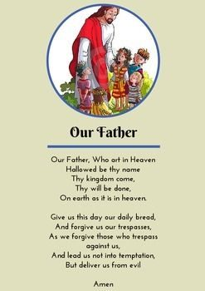
R.E.
Let's say the Our Father now. I have copied the words to help you if you need it.

Slide 10
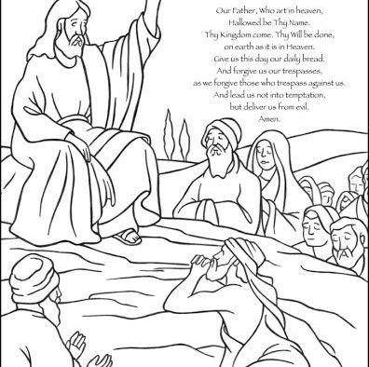
R.E.
I would like you to download the picture below if you can and colour it in. If you can't download it why not draw a picture like this one.
Please send me a copy of your picture g14waughamanda@glow.sch.uk

Slide 11
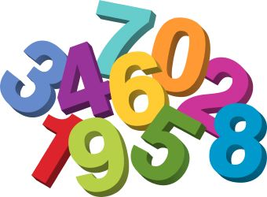
Numeracy
Please have a go at this chilli challenge. Remember to choose the chilli that you think will challenge you. Try to work out the answer in your head and think about all the strategies we have learned to work out the answer.
The answers are on the slide after the chilli challenge so make sure you don’t go too far ahead until you’re ready!
Good luck!

Slide 12
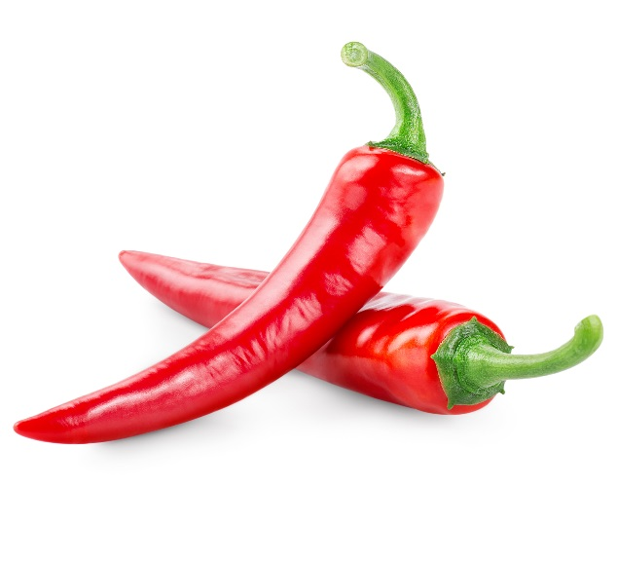
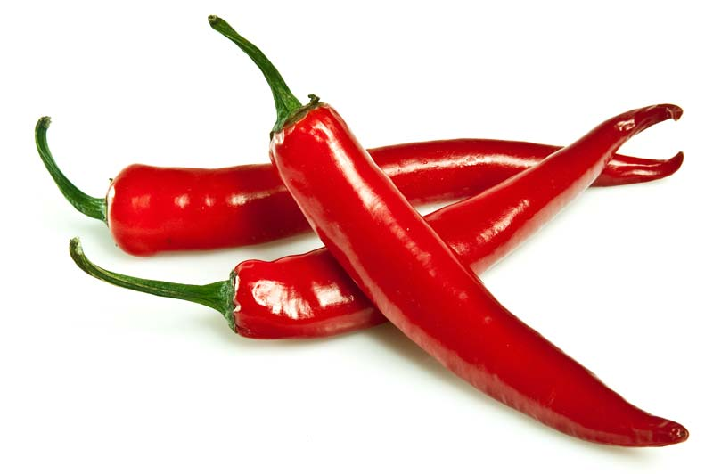
Number Talks
56+17
481+220
1505+2101

Slide 13
Number Talks - Answers
56+17
481+220
1505+2101
73
701
3606

Slide 14
Maths
Times Table Challenge!
As you have all been working hard on your table of the week I am keen to see how you are getting on.
Please complete the times table challenge I have set on Sumdog. It will end on Friday – good luck!

Slide 15
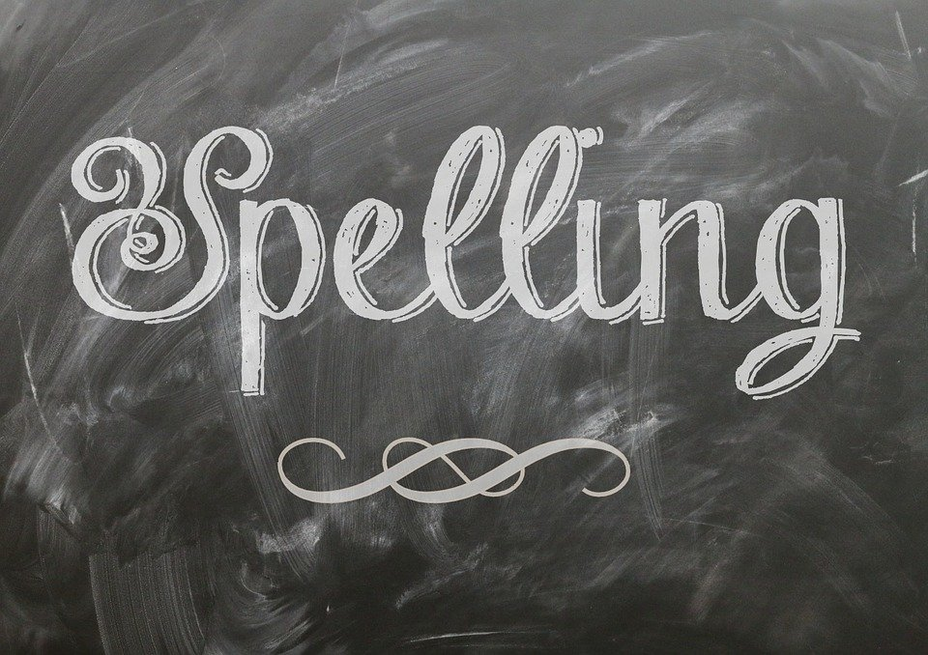
Literacy
Consolidation Week
This week you will not have any new spelling words.
Please look back over the words set for your group for past three weeks and see if there is any you still need to learn.

Slide 16
Literacy
Solo Talk
Take some time today to continue to prepare your solo talk.
The next few slides give you some top tips and remember you have until Friday 5th June to complete this.

Slide 17
Literacy
Solo Talk – Top Tips
Your Purpose: what do you want to achieve in your talk?
Will you:
Try to persuade the audience about an issue?
Reflect on something you have achieved?
Put forward a point of view?
Give information?

Slide 18
Literacy
Solo Talk – Top Tips
Choosing Your Subject
Choose a topic you already have an interest in
Know your audience – is this something they might enjoy hearing about?
Research your topic: were, when and how?
Know the purpose: are you describing something or trying to persuade your audience about something?
Be entertaining and engaging: speak clearly, use humour/props if you can.

Slide 19
Health and Wellbeing
I hope you enjoyed sport's day yesterday and had plenty of fun! I would like you to keep having fun whilst exercising. Research shows that regular exercise has lots of benefits including:
improving fitness
increasing concentration
building a stronger heart, bones and healthier muscles
encouraging healthy growth and development
improving posture and balance
lowering stress
encouraging a better night's sleep

Slide 20
Health and Wellbeing
Today we are going to have a Wild Workout with Andy. Andy is off to the Arctic to see what he can find. Let's join him and exercise on the way!
https://www.bbc.co.uk/iplayer/episode/p06tmrxh/andys-wild-workouts-series-1-10-arctic
Now let's do a fun dance video with GoNoodle:
https://youtu.be/Pwn4beja1QE

Slide 21
Grid Work
If you still feel up to it, why not try to do an activity from the new grid but no more than 2 activities per day.

Slide 22
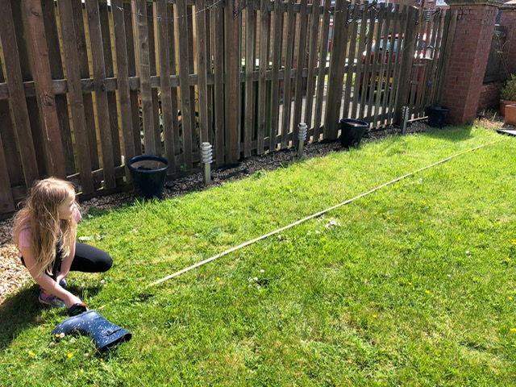
Good Work!
By Amelia
Ascension Video
Sports Day

Slide 23
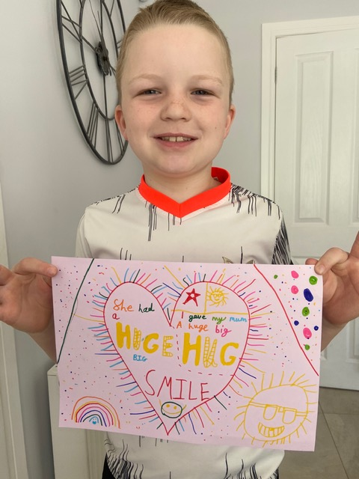
Good Work!
By Noah
By Rory
Learning Log
This week I have learned how to
make super healthy cupcakes.
This week I have enjoyed PE.
This week I want to learn Physics.
This week my target is to make decisions
for myself.
RE

Slide 24
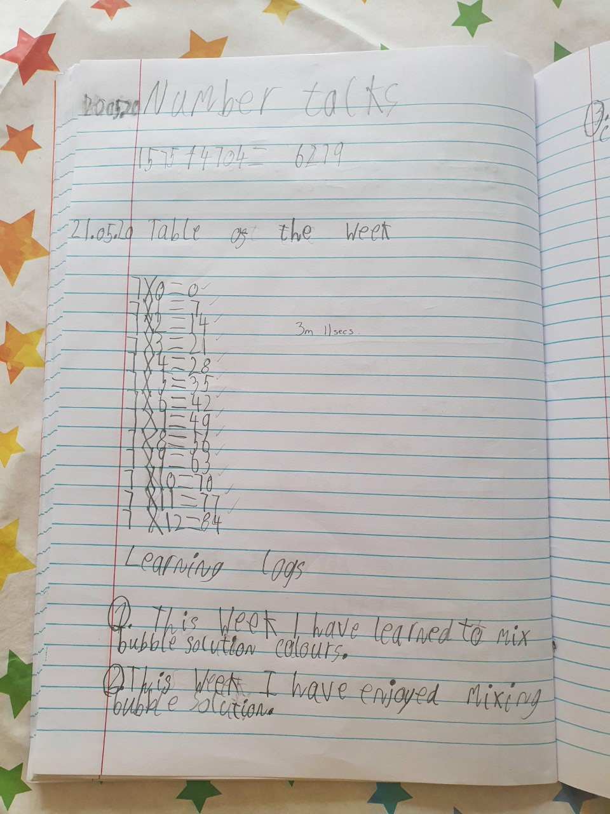
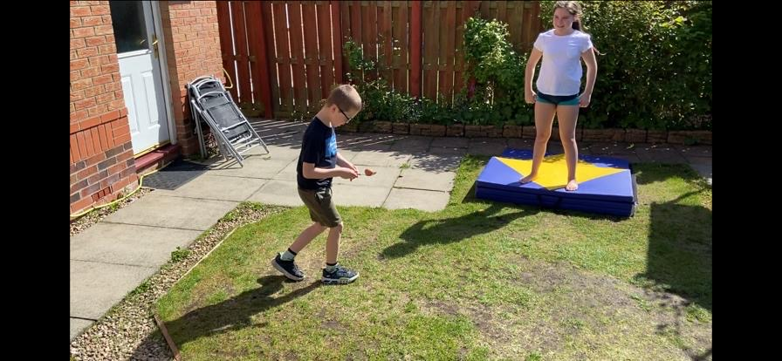
Good Work!
Charlie
Sports Day
Learning Log

Slide 25
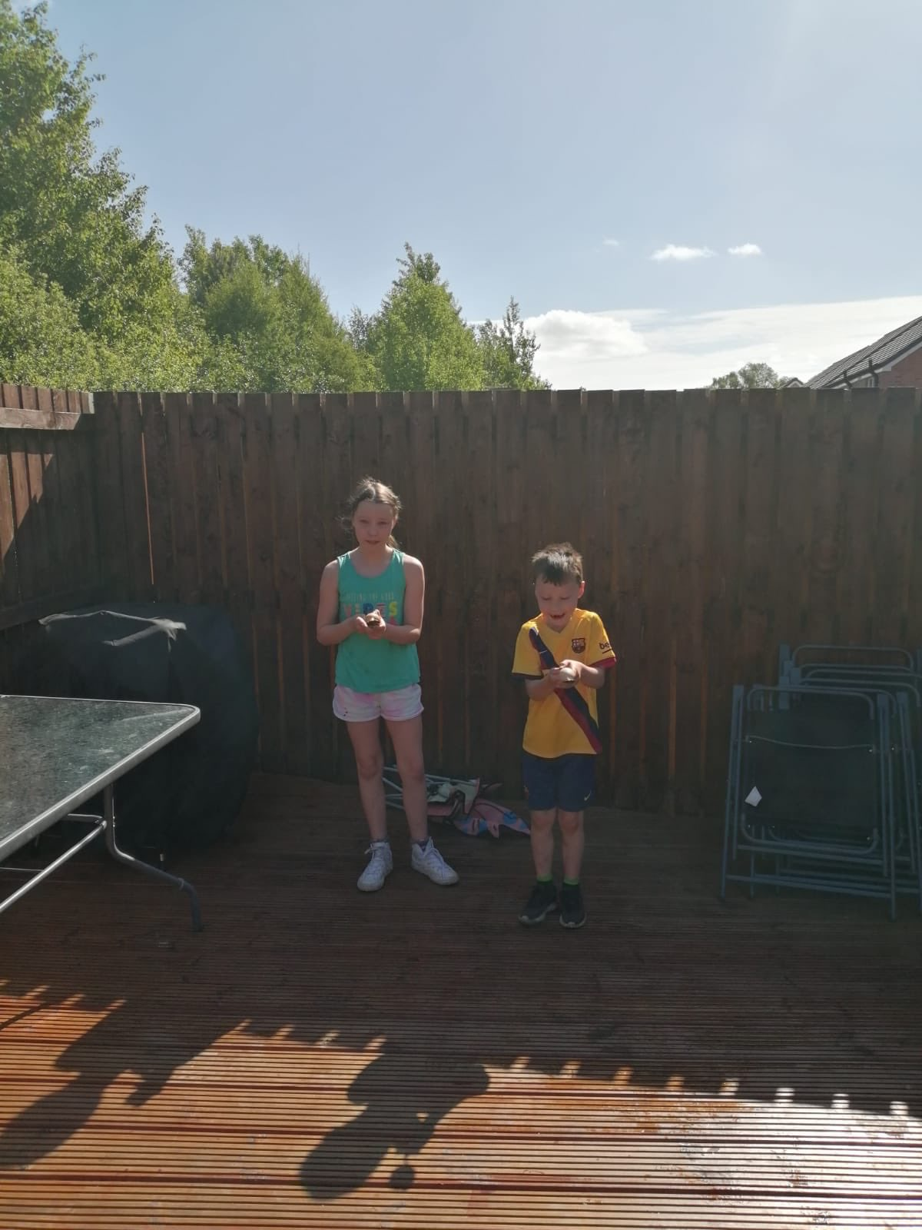
Good Work!
Chloe
Sports Day

Slide 26
Prayer at the End of the Day
God our Father, as we finish our day’s work, we thank all who have helped and supported us today, and we ask you to help us use your gifts so that we may relax and rest as you would wish. St. Barbara – Pray for us.

Slide 27
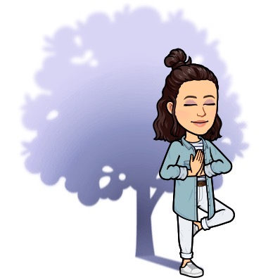
You’re Finished!!!
Well done boys and girls you are now officially finished for today!
Don’t worry if you didn’t manage to complete all the activities and well done if you did! I appreciate anything you are trying to do at home.
Have a good rest tonight and back to work tomorrow!

