Slide 1
P5/4 – Thursday 21st May
Good morning boys and girls!
Please try to complete the activities for today but if you can’t please do not worry. You can adapt them to suit you and your family in any way you can.
If you need anything please email me anytime. gw14waughmanda@glow.sch.uk
Mrs McGill

Slide 2
Timetable for today
R.E. – Prayers, Angelus Challenge, First Holy Communion Preparation, R.E
Literacy & Maths – Assessment
IDL – Yellow!
HWB – Stay Active!
Grid – Maximum of 2 activities from the new grid

Slide 3
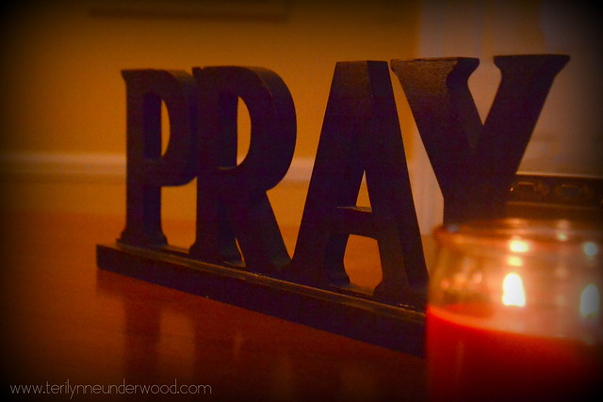
Morning Prayer
God our Father, as we prepare to begin our work, we ask you to help us use properly, the many gifts you have given us, so that we may fully benefit from our day together in school. St. Barbara – Pray for us.

Slide 4
Diocese of Motherwell
The Diocese of Motherwell are encouraging families to participate in the Angelus Challenge. They are releasing videos every weekday on YouTube to help children with their participation. Please find day 15 below:
https://www.youtube.com/watch?v=l0md69k5kVQ
When you have completed this why not colour in a flower on the Angelus Prayer Card. Please find this uploaded onto the blog on the website.

Slide 5
R.E. – Sacrament of First Holy Communion
The Diocese of Motherwell has very kindly made available the First Holy Communion booklet we were working on in school and at home. Please click here to download a copy. Please be aware of copyright:
“Each Sacramental Workbook is copyright. Consent is granted to copy, distribute and share these Sacramental Workbooks up to the time that our Government have allowed pupils return to normal school activities. They will be removed from this website thereafter. In downloading the content you agree to these terms.”

Slide 6
R.E. – Sacrament of First Holy Communion
“I am the bread of life, anyone who comes to me will not be hungry, and the man who believes in me will never be thirsty” John 6:35
Please complete page 24 of the First Holy Communion Booklet.
We are learning about the Word of God.
The stories I have reflected on are The Journey of Elijah, The Miracle of the Loaves and Fishes & The Road to Emmaus.

Slide 7
R.E.
Today is Ascension Thursday!
We have been thinking about loving and caring for others all week and we have tried to follow Jesus' commandment to, 'Love one another as I have loved you.'
You have created a Caring Wreath to show that you care and you have learned about how Jesus ascended into heaven forty days after his resurrection on Easter Sunday.

Slide 8
R.E.
Normally on Ascension Thursday we would all be going to Mass. Although we can't actually go to church today, Bishop Toal is celebrating Mass for all of the children of the Diocese of Motherwell at 11am.
Father Campbell is also celebrating Mass on St. Barbara's Parish website at 10am.
With an adult's permission, please select a Mass to follow.
You might also like to watch the clip below. You can join in if you like.
https://www.youtube.com/watch?v=jT0ygUgPvP0

Slide 9
Assessment – Spelling Test
Please complete a spelling test for the words you have been asked to learn this week.
If possible ask an adult to read them out to you. You can self assess them by looking at the next slide.
If you got any wrong please continue to work on these at home- good luck!

Slide 10
Assessment – Spelling Test
Red group - after, faint, faithful, family, traffic, daffodil, difficult, graph, telephone, elephant
Green group –high, sigh, night, fright, sight, bright, might, light.
Purple group – bang, gang, hang, king, ring, sing, long, sung.
How did you do?

Slide 11
Assessment – Learning Logs
Please copy and complete the sentences below in your jotter.
This week I have learned….
This week I have enjoyed…
Next week I want to learn…
Next week my target is…
Ask an adult to email me your answers if you can.

Slide 12
Numeracy – Table of the Week
Set a timer and write the multiplication table you have been working on.
Remember to take a note of how long it took you to complete it and try to beat that time next week.
Good luck!

Slide 13
Numeracy – Mental Maths Test
Please answer the below questions in your jotter -
Write the number two thousand, six hundred and ten in figures.
What is half of 46?
Write an odd number between 89 and 99.
What is 80 minus 63?
What is one quarter of 32?

Slide 14
Numeracy – Mental Maths Test
Please answer the below questions in your jotter -
6. What is 605 rounded to the nearest 10?
7. How many 2p coins make £1?
8. Multiply 16 by 100.
9. Roughly how long is your door? 2m, 4m or 6m?
10. Mrs McGill bakes 18 cakes. She shares them equally between herself, her daughter and husband. How many does each person get?

Slide 15
Numeracy – Mental Maths Test
Answers
Write the number two thousand, six hundred and ten in figures. 2610
What is half of 46? 23
Write an odd number between 89 and 99. 91, 93, 95 or 97
What is 80 minus 63? 17
What is one quarter of 32? 8

Slide 16
Numeracy – Mental Maths Test
Answers
6. What is 605 rounded to the nearest 10? 610
7. How many 2p coins make £1? 50
8. Multiply 16 by 100. 1600
9. Roughly how long is your door? 2m, 4m or 6m? 2m
10. Mrs McGill bakes 18 cakes. She shares them equally between herself, daughter and husband. How many would each person get? 6

Slide 17
IDL
Recap on the rainbows of hope and the different colours of the rainbow. This week we are going to focus on yellow. (My favourite colour!)
Scavenger hunt - set a challenge to find as many things as they can which are yellow throughout the day – this might even be when the child is outside or going for a walk (always making sure that the child only picks up items which are clean and suitable given the current restrictions). As part of the challenge you might like to recap on the sunflowers they drew last week. Can they spot any different yellow flowers or even some bees?

Slide 18
IDL
Invite the children to think about how the colour yellow makes them feel? If the children had to link the colour to a feeling, what would that feeling be? Usually, yellow makes us feel happy. At this time, we want to spread happiness to others. Ask the children to think about someone they would like to make happy and what they could do to achieve this. This might be helping out around the house, telling the person a joke or even singing them a song!
Perhaps the children could make their own daffodils or paper flowers for that special someone. Here are some links to activities of different complexity which might help – https://www.activityvillage.co.uk/bunch-of-daffodils or https://www.youtube.com/watch?v=kpsna9A7WdI or https://stillnomore.org/paper-flowers-for-kids/

Slide 19
IDL
Introduce the book, ‘If I Was a Banana’ by Alexandra Tylee . They can listen to the story being read here - https://www.youtube.com/watch?v=_QZDwlQMNh8.
Encourage the children to think about what they would be if they could be anything in the world and why. Invite the children to write about this and illustrate their story with colourful drawings.

Slide 20
IDL
As an extension activity, ask the children to think about what two/three things they like best about themselves and to capture this in their drawing too.
Time for the Yellow Food Challenge. Can the children create a menu for breakfast, lunch and dinner of only yellow foods – remember it has to be healthy (well, custard lovers and vanilla ice cream fans could sneak in a little treat!). And they have to eat it too! Maybe they could record their day on video or take pictures of the food they are eating. Then, send them in for everyone to see! Here’s how one family who only ate yellow for 24 hours got on - https://www.youtube.com/watch?v=FqwDcAhDsjc

Slide 21
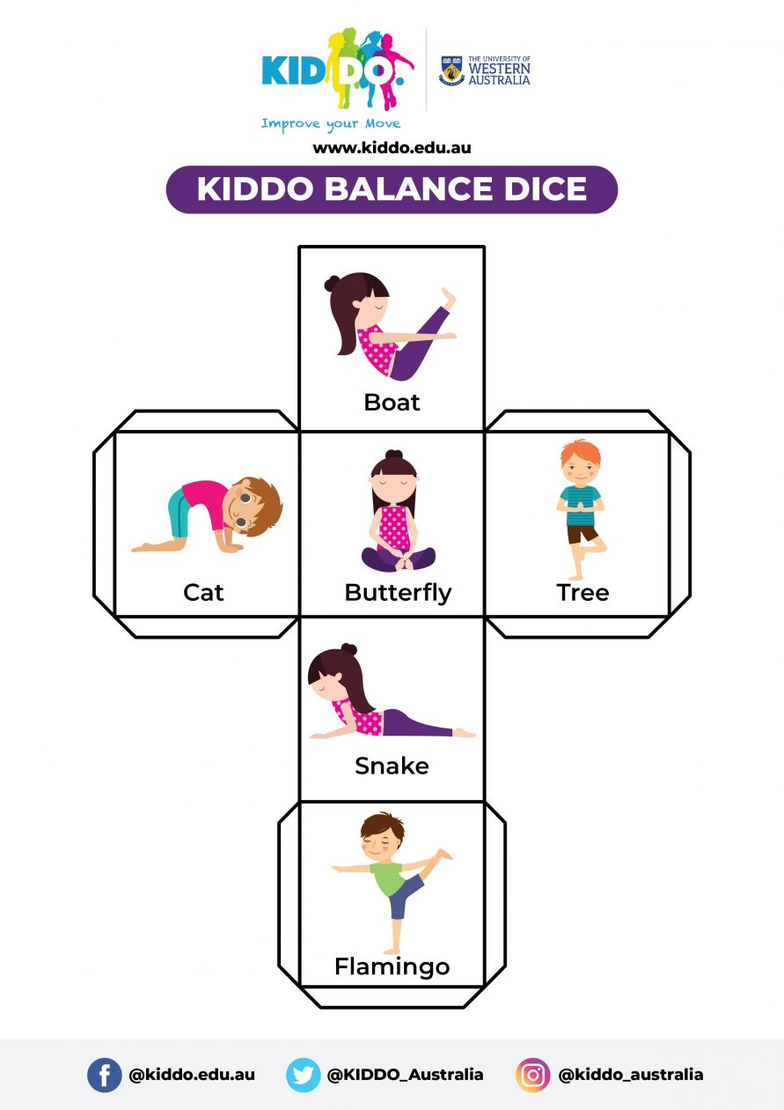
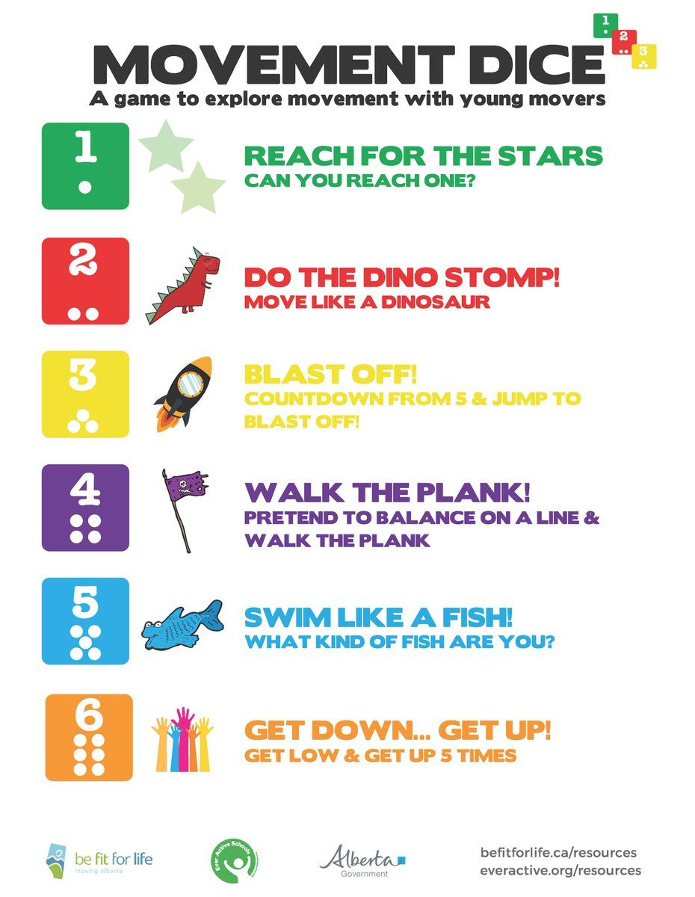
Health and Wellbeing
It's the last day before the holiday weekend and before Sports' Day on Tuesday!!! For some of today's activities you need dice or you can make some (see below).

Slide 22
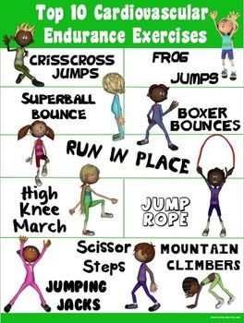
Health and Wellbeing
Select one or more of the following to do today:

Slide 23
Prayer at the End of the Day
God our Father, as we finish our day’s work, we thank all who have helped and supported us today, and we ask you to help us use your gifts so that we may relax and rest as you would wish. St. Barbara – Pray for us.

Slide 24
You’re Finished!!!
Well done boys and girls you are now officially finished for today!
Don’t worry if you didn’t manage to complete all the activities and well done if you did! I appreciate anything you are trying to do at home.
Enjoy the time you are having with your family and I will be back with you next Wednesday.

