Slide 1
P5/4 – Wednesday 20th May
Good morning boys and girls!
It is lovely to be back with you today. I really enjoyed watching the First Communion video. A BIG well done to Mrs Grant for making it.
I have included some pictures of the great work you have been sending me over the past few weeks. Please keep it up as I love seeing what you are doing and would be great to keep posting about our talented class on the blog and twitter ☺
Mrs McGill

Slide 2
Timetable for today
R.E. – Prayers, Angelus Challenge, First Holy Communion Preparation, RME
Numeracy – Number Talks (Chilli Challenge), Sumdog
Literacy – Spelling, Reading, Solo Talk
HWB – Stay Active!
Grid – Maximum of 2 activities from the new grid

Slide 3
Morning Prayer
God our Father, as we prepare to begin our work, we ask you to help us use properly, the many gifts you have given us, so that we may fully benefit from our day together in school. St. Barbara – Pray for us.

Slide 4
Diocese of Motherwell
The Diocese of Motherwell are encouraging families to participate in the Angelus Challenge. They are releasing videos every weekday on YouTube to help children with their participation. Please find day 14 below:
https://www.youtube.com/watch?v=4wPzy6Wsmhw
When you have completed this why not colour in a flower on the Angelus Prayer Card. Please find this uploaded onto the blog on the website.

Slide 5
R.E. – Sacrament of First Holy Communion
The Diocese of Motherwell has very kindly made available the First Holy Communion booklet we were working on in school and at home. Please click here to download a copy. Please be aware of copyright:
“Each Sacramental Workbook is copyright. Consent is granted to copy, distribute and share these Sacramental Workbooks up to the time that our Government have allowed pupils return to normal school activities. They will be removed from this website thereafter. In downloading the content you agree to these terms.”

Slide 6
R.E. – Sacrament of First Holy Communion
I would like you to look at three particular narratives which tell us how God nourished people on their faith journeys. If you have a Bible in your home, you could look at these with your child. If not you can find Bible pages online.
Take time to read and reflect together.
1 Kings 19: 4-8 (The Journey of Elijah)
Mark 6: 30-44 (The Miracle of the Loaves and Fishes)
Luke 24: 13-45 (The Road to Emmaus)

Slide 7
R.E.
This week we have been looking at Jesus' commandment to:
'Love one another as I have loved you.'
Jesus showed his love for all of us on Good Friday when he died on the cross. Tomorrow we are going to celebrate the Feast of the Ascension. On this day, forty days after his resurrection on Easter Sunday, Jesus ascended into Heaven leaving the disciples behind to carry on with his work and to be witnesses for him. They were a little scared to be left without Jesus but they believed in him and they knew that he would not leave them alone. They were quite right of course; the Holy Spirit came to help them on the Feast of Pentecost and we'll explore that later.

Slide 8
R.E.
Below you will see two very different video clips about the Ascension. Please watch both of them.
https://www.youtube.com/watch?v=7wLrw60bY5w
https://youtu.be/nnRJa4cZQIE

Slide 9
R.E.
Now what I would like you to do is to draw or make your own reminder of what happened on the Feast of the Ascension.
You could think about making the figures of Jesus, his disciples and the two people dressed in white - you could even create your own video clip.
Or you could draw them and write a sentence or a paragraph below; you might want to make a picture using other media - e.g. cotton wool for the clouds.

Slide 10
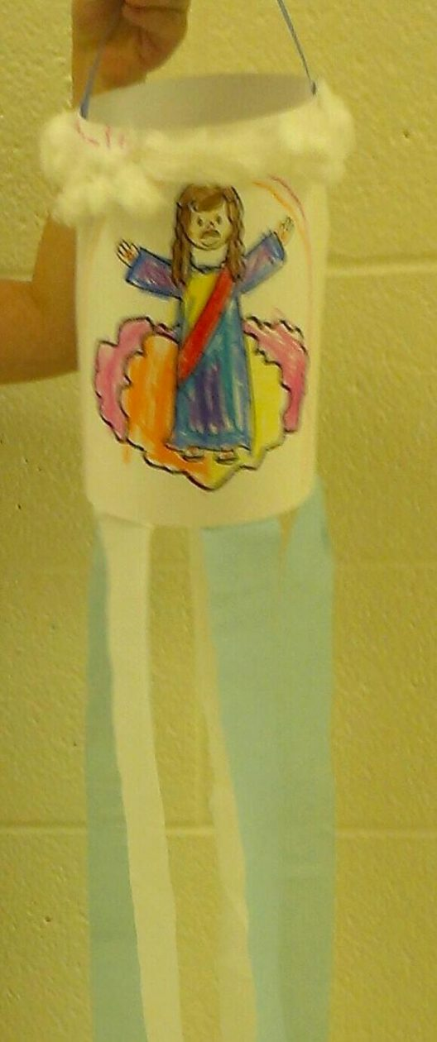
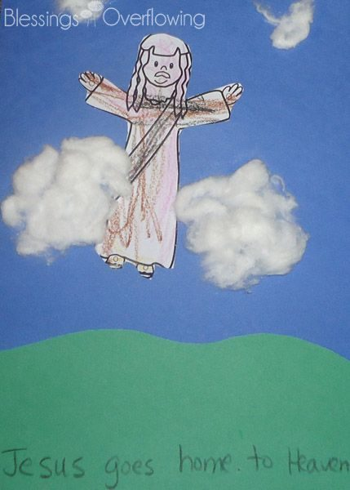
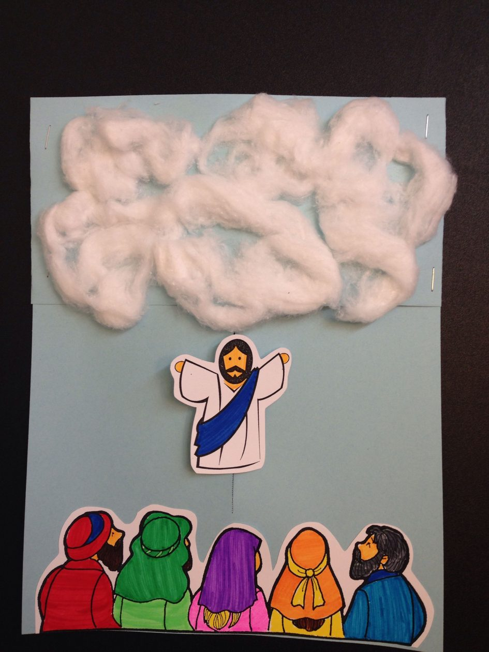
R.E.
Here are some examples.
Whatever activity you choose to do, please email it to me gw14waughamanda@glow.sch.uk or, with an adult's permission, upload it on to Twitter @St_BarbarasPS

Slide 11
Numeracy
Please have a go at this chilli challenge. Remember to choose the chilli that you think will challenge you. Try to work out the answer in your head and think about all the strategies we have learned to work out the answer.
The answers are on the slide after the chilli challenge so make sure you don’t go too far ahead until you’re ready!
Good luck!

Slide 12
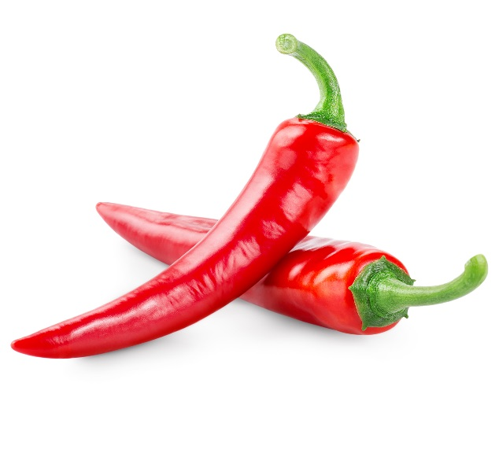
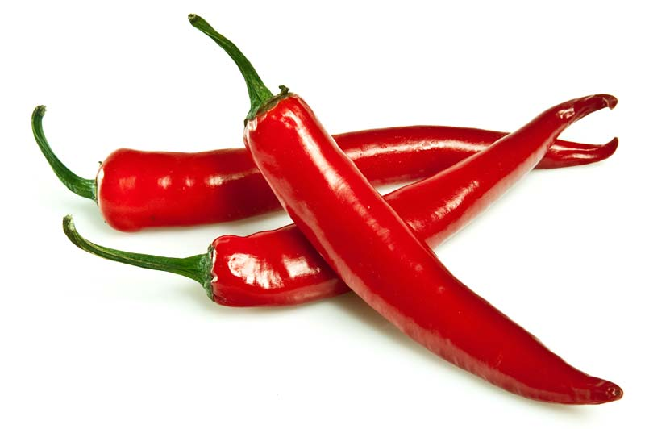
Number Talks
48+12
382+120
1575+4704

Slide 13
Number Talks - Answers
48+12
382+120
1575+4704
60
502
5270

Slide 14
Maths
As there’s a Sumdog competition on at the moment, I thought that you should use your maths time to play Sumdog. Get playing!!!

Slide 15
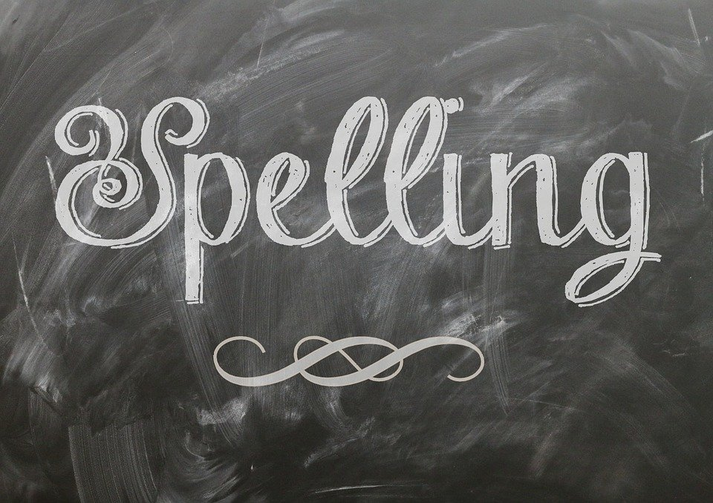
Literacy
Please find your spelling words below for each group:
Red group - after, faint, faithful, family, traffic, daffodil, difficult, graph, telephone, elephant
Green group –high, sigh, night, fright, sight, bright, might, light.
Purple group – bang, gang, hang, king, ring, sing, long, sung.
It is a lovely day – get outside if you can! Use anything you have to write your words. Use chalk, a water bottle/ water gun or washing up liquid bottle and try writing the words outside somewhere! !

Slide 16
Literacy
Reading
Please login to Scholastic using the link: https://educator-slz03.scholasticlearningzone.com/slz-portal/#/login3/GBRWY9D
Please continue to read the book assigned to you. Alternatively if you have a book at home, choose one and read a few chapters.
Write a short summary of what has happened in the story so far.

Slide 17
Literacy
Solo Talk
I would like you to use this time at home to learn more about what interests you and put together a solo talk. You can make it about anything you like but I would ask for it to be no longer than two minutes.
If you can, ask someone at home to record you saying it and send it to me by Friday 5th June ☺

Slide 18
Literacy
Solo Talk – Top Tips
Your Purpose: what do you want to achive in your talk?
Will you:
Try to persuade the audience about an issue?
Reflect on something you have achieved?
Put forward a point of view?
Give information?

Slide 19
Literacy
Solo Talk – Top Tips
Choosing Your Subject
Choose a topic you already have an interest in
Know your audience – is this something they might enjoy hearing about?
Research your topic: were, when and how?
Know the purpose: are you describing something or trying to persuade your audience about something?
Be entertaining and engaging: speak clearly, use humour/props if you can.

Slide 20
Health and Wellbeing
Time to waken up and put your best foot forward!
We're getting closer to Sports' Day - so time for a little movement. There are two video clips to get you moving and some tasks below. Enjoy!
https://www.youtube.com/watch?v=lJPvEs8qpQc
https://www.youtube.com/watch?v=KhfkYzUwYFk

Slide 21
Health and Wellbeing
Now for those tasks:
Play some music lasting about ten/fifteen minutes and do these:
Jumping Jacks/Star Jumps
On the Spot running
Plank
Squats
Add your own and have fun!
Remember to have your water bottle handy and to take a few breaks!

Slide 22
Grid Work
If you still feel up to it, why not try to do an activity from the new grid but no more than 2 activities per day.

Slide 23
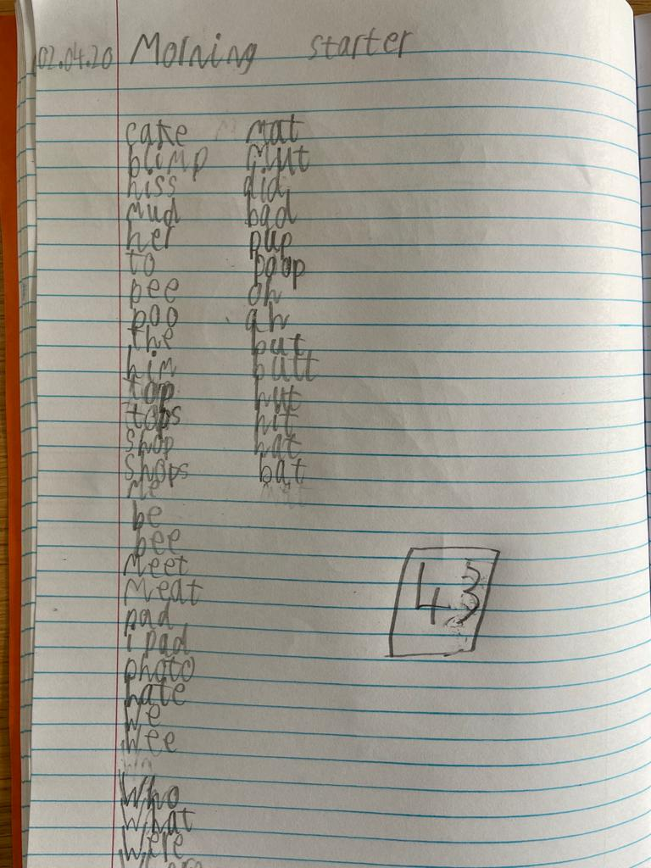
Good Work!
By Finn
By Charlie
A Stop Motion Lego Video
https://onedrive.live.com/?authkey=%21AEuvpfHJ04MHlIg&cid=16BFD0A4E3FC08FE&id=16BFD0A4E3FC08FE%211135092&parId=16BFD0A4E3FC08FE%211126519&o=OneUp
Morning starter

Slide 24
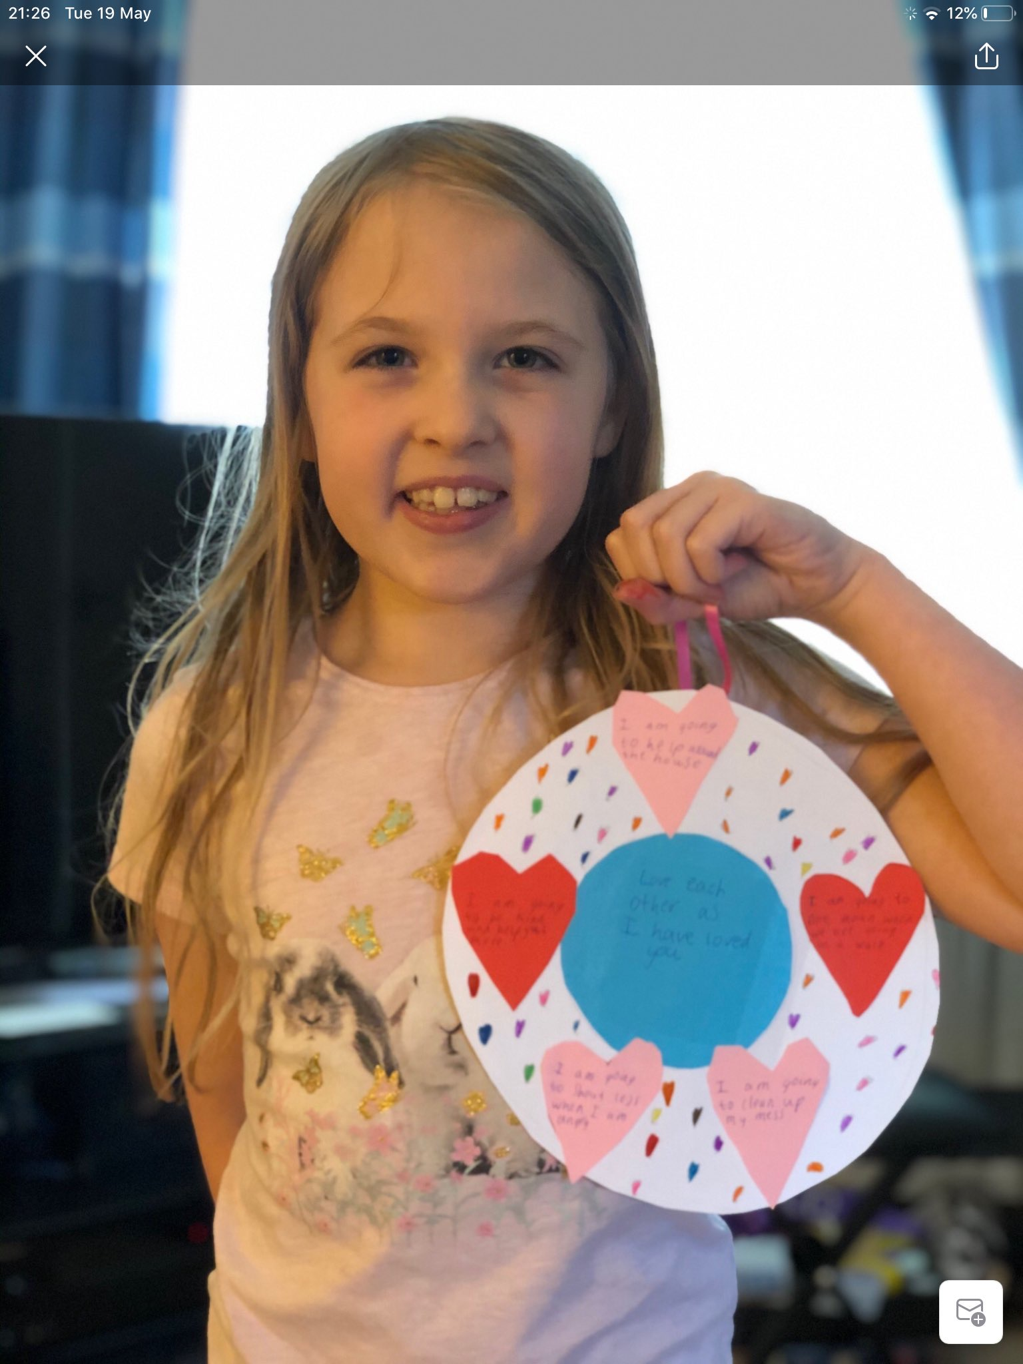
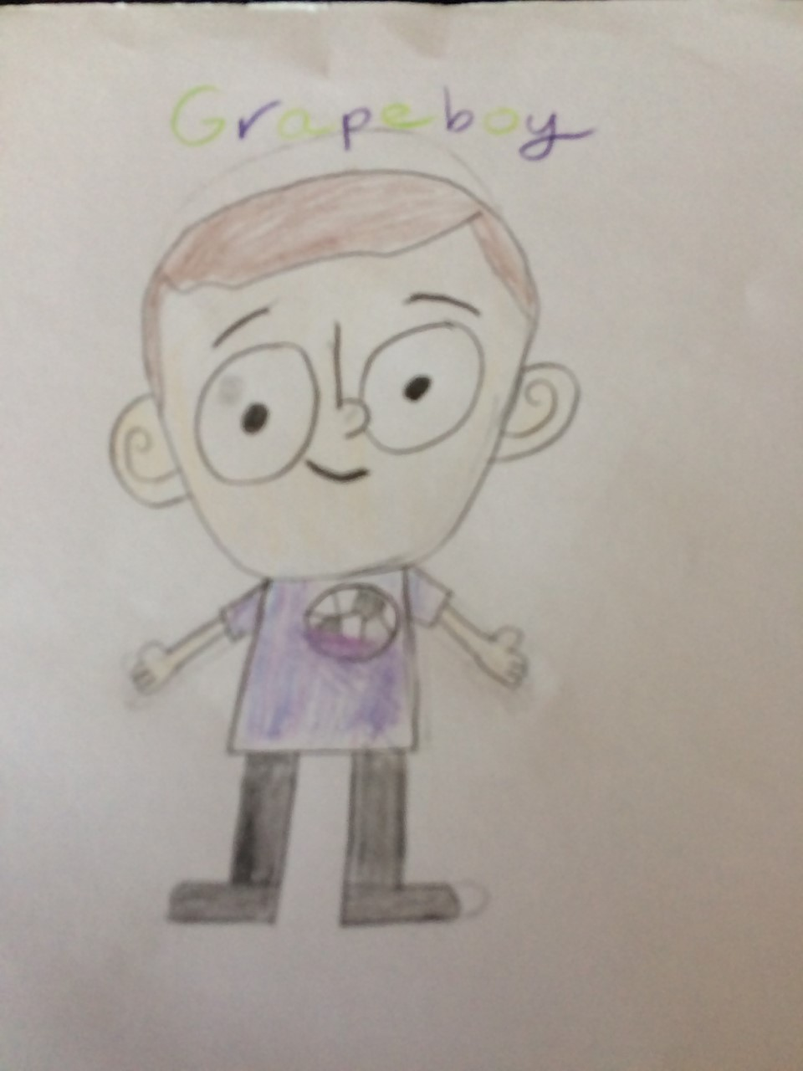
Good Work!
By Amelia
By Noah
RE
Self Portrait

Slide 25
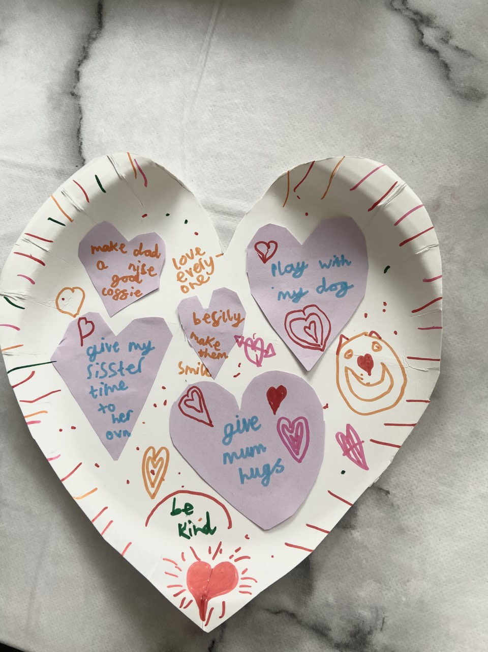
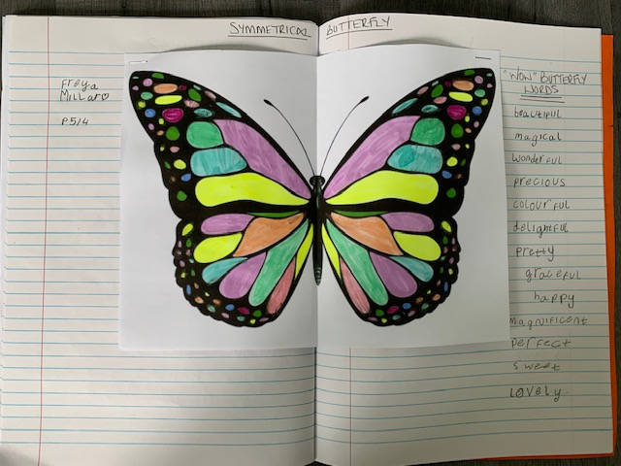
Good Work!
By Freya
By Rory
Symmetrical Butterfly
RE

Slide 26
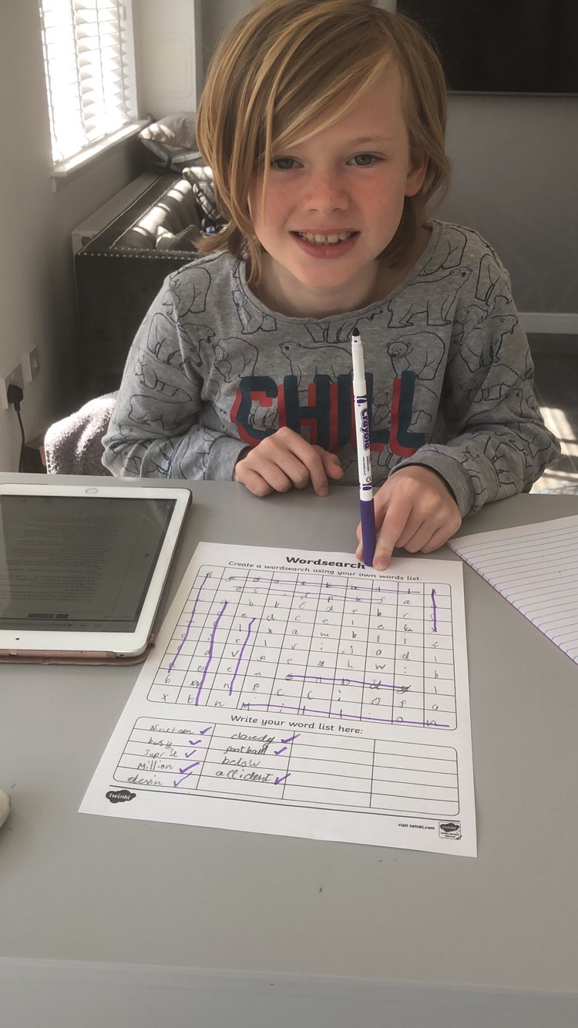
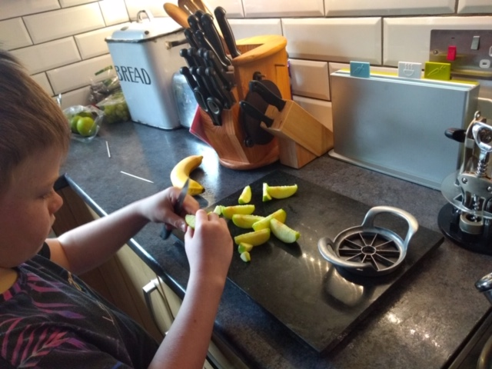
Good Work!
By Cole
By Alexander
Literacy
Health

Slide 27
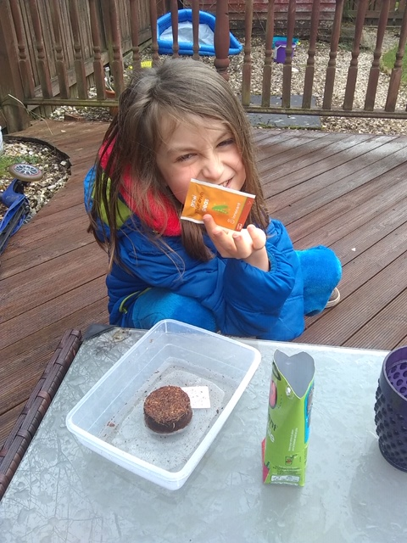
Good Work!
By Dexter
Planting Seeds

Slide 28
Prayer at the End of the Day
God our Father, as we finish our day’s work, we thank all who have helped and supported us today, and we ask you to help us use your gifts so that we may relax and rest as you would wish. St. Barbara – Pray for us.

Slide 29
You’re Finished!!!
Well done boys and girls you are now officially finished for today!
Don’t worry if you didn’t manage to complete all the activities and well done if you did! I appreciate anything you are trying to do at home.
Have a good rest tonight and back to work tomorrow!

