Slide 1
P5/4 – Tuesday 19th May
Good morning boys and girls!
I hope you had a wonderful day yesterday.
Thank you for all your wonderful pictures! Some of you managed to upload onto Twitter and the others I uploaded yesterday. If you’ve not managed to see them have a look. I have also uploaded onto the blog page some work that was sent to me too. Well done – I love seeing your fabulous work!
I’ve attached some more activities for you to try today. Remember do only what you can.
Mrs Grant ☺

Slide 2
Timetable for today
R.E. – Prayers, Angelus Challenge, Ten Commandments, Task
Numeracy – Number Talks (Chilli Challenge), Multiplication and Division, Sumdog
Literacy – Spelling, Reading
HWB – Dancing, Yoga
Spanish – Video 5 – Counting in Spanish, Activities
Grid – Maximum of 2 activities from the new grid

Slide 3
Morning Prayer
God our Father, as we prepare to begin our work, we ask you to help us use properly, the many gifts you have given us, so that we may fully benefit from our day together. St. Barbara – Pray for us.

Slide 4
Diocese of Motherwell
The Diocese of Motherwell are encouraging families to participate in the Angelus Challenge. They are releasing videos every weekday on YouTube to help children with their participation. Please find day 13 below:
Day 13 Angelus Challenge
When you have completed this why not colour in a flower on the Angelus Prayer Card. Please find this uploaded onto the blog on the website.

Slide 5
R.E.
Yesterday we were looking at the Ten Commandments and Jesus’ message to:
‘Love one another as I have loved you.’
I asked you to think about your families and how much you love them. I also reminded you that Pope Francis has told us all to care for others, ‘No ifs, no buts!’
Today I would like to think about the people living in the same house as you; there might be two of you, there might be six of you! It doesn’t matter. Now I would like you to think of FIVE little things that you could do this week for those in your home. It could be that you set the table, make your bed, clear up after a meal, make someone a cup of tea or even take the vacuum cleaner for a walk!

Slide 6
R.E.
When you have selected five things, draw some heart shapes and inside each, draw or write your tasks. You can make some extra hearts for decoration. Colour or decorate them carefully. Next make a circle wreath-shape like the picture on the next page or if you have a paper plate, use that. Attach your heart shapes and display your Caring Wreath somewhere you can see it easily. Carry out your tasks this week and show that you care – no ifs, no buts!
Please email your Caring Wreath to gw09grantmary4@glow.sch.uk or, with an adult’s permission, upload them on to Twitter @St_BarbarasPS and to Pope Francis’ Twitter @Pontifex

Slide 7
R.E.

Slide 8
Numeracy
Please have a go at this chilli challenge. Remember to choose the chilli that you think will challenge you. Try to work out the answer in your head and think about all the strategies we have learned to work out the answer. I wonder which strategy you used? If you solve it using one strategy try using another strategy.
The answers are on the slide after the chilli challenge so make sure you don’t go too far ahead until you’re ready!
Good luck!

Slide 9
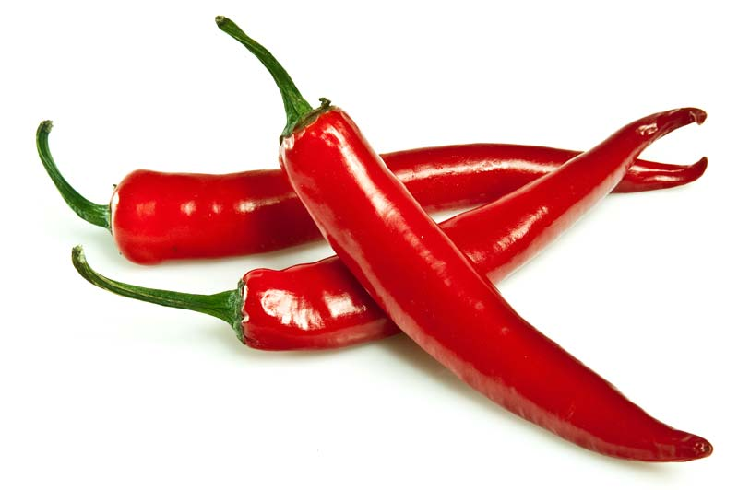
Number Talks
39-18
896-675
1549-1211
Tip: A good strategy to use for these questions would be adding up!
e.g. 80-59= 59+?=80
59+1=60, 60+10+10=80
1+10+10=21
59+21=80 = 80-59=21

Slide 10
Number Talks - Answers
39-18
896-675
1549-1211
21
221
338

Slide 11
Multiplication and Division
Yesterday you revised multiplying and dividing by 0,1,10 and 100.
Today I would like you to practise some of these skills. I’ve attached your maths sheets onto the next slide.
The answers are on the slide after this – no peeking!
Good luck!

Slide 12
Multiplication and Division

Slide 13
Answers

Slide 14
Maths
As there’s a Sumdog competition on at the moment, I thought that you should use your maths time to play Sumdog. Get playing!!!

Slide 15
Spelling
Red group – we are still focusing on the phoneme f, ff and ph. Think of your words: after, faint, faithful, family, traffic, daffodil, difficult, graph, telephone, elephant.
Green group – I would like you to think about the phoneme igh - high, sigh, night, fright, sight, bright, might, light.
Purple group – I would like you to think about the phoneme ng. Your words are: bang, gang, hang, king, ring, sing, long, sung.
Today I would like all groups to practise syllabification (break your words into syllables.) I always find clapping the sounds helps me to do this. Look at the poster on the next page to help you.

Slide 16
Spelling

Slide 17
Literacy - Reading
Please login to Scholastic using the link: https://educator-slz03.scholasticlearningzone.com/slz-portal/#/login3/GBRWY9D
I have assigned a new book for you. Please read a few chapters.
Alternatively if you have a book at home, choose one and read a few chapters.

Slide 18
Health and Wellbeing
Yesterday we had a look at making healthy snacks and the skills you need to create something delicious in the kitchen!
Today as we get closer to Sports’ Day next Tuesday, let’s be a little more energetic with a dance and then some yoga!
Please click the links below:
Dance
Yoga

Slide 19
Spanish
I would like you to go to www.radiolingua.com/learnathome
Click on the Primary Spanish button.
Watch lesson 5 video – Counting in Spanish (the link on the video says counting in French but it is Spanish!)
I’ve attached the worksheets on the blog.

Slide 20
Good Work!
By Amelia
By Charlie

Slide 21
Grid Work
If you still feel up to it, why not try to do an activity from the new grid but no more than 2 activities per day.

Slide 22
Prayer at the End of the Day
God our Father, as we finish our day’s work, we thank all who have helped and supported us today, and we ask you to help us use your gifts so that we may relax and rest as you would wish. St. Barbara – Pray for us.

Slide 23
You’re Finished!!!
Well done boys and girls you are now officially finished for today!
Don’t worry if you didn’t manage to complete all the activities and well done if you did!
I’ll be back next Monday but remember if you need to contact me for anything you can email me gw09grantmary4@glow.sch.uk
See you next week! ☺☺☺

