Slide 1
P5/4 – Monday 18th May
Good morning boys and girls!
I hope you all had a lovely weekend. I’m sure you have all watched the video that the boys and girls who should’ve made their First Holy Communion made. It was absolutely beautiful! I’ve missed all your lovely faces! ☺
I’ve attached some more activities for you to try today. Remember do only what you can.
Mrs Grant ☺

Slide 2
Timetable for today
R.E. – Prayers, Angelus Challenge, First Holy Communion Preparation, Ten Commandments
Numeracy – Number Talks (Chilli Challenge), Multiplication and Division
Literacy – Spelling, Reading
HWB – Healthy Eating
Spanish – Video 5 – Counting in Spanish
Grid – Maximum of 2 activities from the new grid

Slide 3
Morning Prayer
God our Father, as we prepare to begin our work, we ask you to help us use properly, the many gifts you have given us, so that we may fully benefit from our day together. St. Barbara – Pray for us.

Slide 4
Diocese of Motherwell
The Diocese of Motherwell are encouraging families to participate in the Angelus Challenge. They are releasing videos every weekday on YouTube to help children with their participation. Please find day 12 below:
Day 12 Angelus Challenge
When you have completed this why not colour in a flower on the Angelus Prayer Card. Please find this uploaded onto the blog on the website.

Slide 5
R.E. – Sacrament of First Holy Communion
I know some of you were preparing for the sacrament of First Holy Communion and although we are unsure about exactly when this might be; it is important that we still prepare for this very special sacrament.
The Diocese of Motherwell has very kindly made available the First Holy Communion booklet we were working on in school and at home. Please click here to download a copy. Please be aware of copyright:
“Each Sacramental Workbook is copyright. Consent is granted to copy, distribute and share these Sacramental Workbooks up to the time that our Government have allowed pupils return to normal school activities. They will be removed from this website thereafter. In downloading the content you agree to these terms.”

Slide 6
R.E. – Sacrament of First Holy Communion
Today I would like you to reflect on your Sacramental journey. Please take a moment in a quiet place and close your eyes to reflect.
Complete page 22 of your Communion booklet. If you can’t remember your Act of sorrow please see below to help you:
Act of Sorrow
O my God, I thank you for loving me. I am sorry for all my sins, for not loving others and not loving you. Help me to live like Jesus and not sin again. Amen

Slide 7
R.E.
Yesterday was the sixth Sunday of Easter. In the Gospel, Jesus said that if you love him, you will keep his commandments.
Commandments are rules. However God’s rules are all about love – about loving God and each other. If we love someone, we try our very best to show that by being polite, kind, generous and happy when we talk to them or about them to others.
You have rules and home and we have rules in school. Just like the Ten Commandments, our rules are all about looking after each other and doing the best for each other so that we can all be happy together at home or in school.

Slide 8
R.E.
Sometimes we break the rules – adults as well as children. If we break God’s rules, we call that sin. Don’t worry though, we can make it better.
Just like at home or in school, if we are sorry and say that to the person we have hurt – and try our best not to do it again – God will forgive us because he loves each one of us so much.
We can read about the Ten Commandments which were given to Moses in the Old Testament which is the first section of the Bible.
You can see them on the next slide. Read them or ask an adult for help then chat to someone in your family about them.

Slide 9
R.E.

Slide 10
R.E.
In the New Testament (the second section of the Bible), Jesus spoke about love all of the time. In fact, he made a ‘New Commandment.’
He asked us all to, ‘ Love one another as I have loved you.’
If you think about it – we all love ourselves and look after ourselves.
Jesus is saying simply that we should love everyone else as much as we love ourselves. If we all did that, the world would be a much happier place! In fact, if we all did that then we would be following the Ten Commandments without even realizing it!
At Easter, Pope Francis told us that we should love and care for each other, ‘No ifs, no buts!’

Slide 11
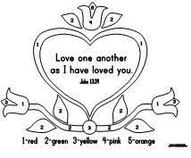
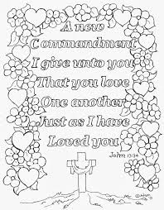
R.E.
Today, let’s think about how we love each other: our family and our friends. I would like you to choose one of the following activities. You can download and print a picture or you can make one of your own. When you have finished it, place it somewhere where all of the family can see it to remind yourselves of how just much you love and care for each other. Please email your picture to me at gw09grantmary4@glow.sch.uk

Slide 12
Numeracy
Please have a go at this chilli challenge. Remember to choose the chilli that you think will challenge you. Try to work out the answer in your head and think about all the strategies we have learned to work out the answer. I wonder which strategy you used? If you solve it using one strategy try using another strategy.
The answers are on the slide after the chilli challenge so make sure you don’t go too far ahead until you’re ready!
Good luck!

Slide 13
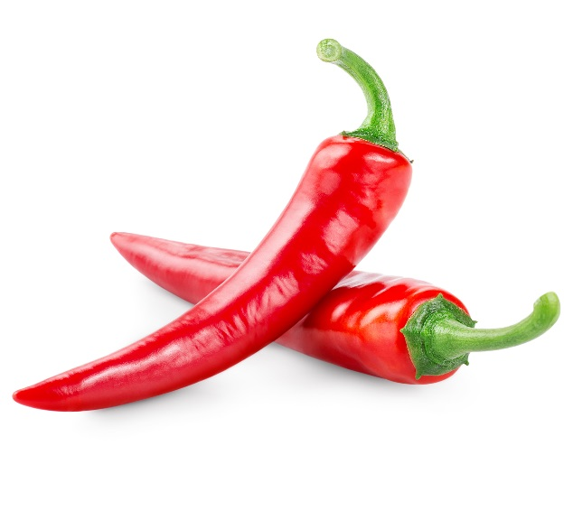
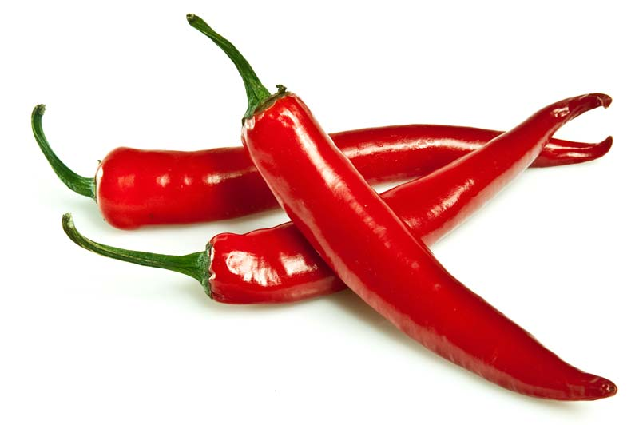
Number Talks
20-8
400-274
1000-671
Tip: A good strategy to use for these questions would be adding up!
e.g. 80-59= 59+?=80
59+1=60, 60+10+10=80
1+10+10=21
59+21=80 = 80-59=21

Slide 14
Number Talks - Answers
20-8
400-274
1000-671
12
126
329

Slide 15
Multiplication
Today I would like you to revise how to multiply by 0,1,10 and 100.
Remember when you multiply any number by 0 the answer is 0! 20x0=0, 504 x0=0, 5x6x7x8x0x9 - the answer is 0!!!
When multiplying by 1 the answer is the same. 5x1=5, 71x1=71.
When multiplying by 10 move all the digits one place to the left and add a 0 in the empty ones column – 51x10=510.
Multiplying by 100 move all the digits two places to the left and put a 0 in the empty spaces (two 0s) – 51x100=5100
Please click the link here to watch a video explaining and try the quiz at the end too.

Slide 16
Spelling
Red group – we are still focusing on the phoneme f, ff and ph. I would like you to write out the words after, faint, faithful, family, traffic, daffodil, difficult, graph, telephone, elephant and diacritically mark them.
Green group – I would like you to think about the phoneme igh - high, sigh, night, fright, sight, bright, might, light. I would like you to diacritically mark them.
Purple group – I would like you to think about the phoneme ng. Your words are: bang, gang, hang, king, ring, sing, long, sung. I would like you to write out your words with how many sounds each word has. Remember to use your spelling fingers!

Slide 17
Literacy - Reading
Please login to Scholastic using the link: https://educator-slz03.scholasticlearningzone.com/slz-portal/#/login3/GBRWY9D
I have assigned a new book for you. Please read a few chapters.
Alternatively if you have a book at home, choose one and read a few chapters.

Slide 18
Health and Wellbeing
Healthy Snack Day!
We’re heading towards our Virtual Sports’ Day next Tuesday and what better way to prepare than to think about healthy snacks for the day.
They don’t need to be fancy…just healthy and delicious.
Have a look at some of these on the next slide:

Slide 19
Health and Wellbeing

Slide 20
Health and Wellbeing
Try to create a healthy snack of your own. What ingredients might you need?
Cooking Skills for Learning, Life and Work!
Depending upon your age, you could practise some of these skills as you prepare your snack. You might need to ask an adult for help.
You will be using skills that will be with you for the rest of your life. These skills are progressive. That means that if you haven’t peeled or sliced ingredients before (see the Primary 1 list) you will need to practise these before you move on to the next list!
Remember to wash your hands before you begin!

Slide 21
Health and Wellbeing
At Early Level Primary 1 | First Level Primary 2- Primary 4 | Second Level Primary 5 – Primary 7
o Peeling o Slicing o Mixing o Spreading | o Washing ingredients o Peeling o Cutting o Juicing o Grating | o Weighing o Measuring o Kneading o Chopping o Baking o Grilling

Slide 22
Health and Wellbeing
Once you have made your snack, take a picture before you eat it and share it with all of us!
You can email your picture to gw09grantmary4@glow.sch.uk or upload it onto Twitter with an adult’s permission. Happy Healthy Snack Day!

Slide 23
Spanish
I would like you to go to www.radiolingua.com/learnathome
Click on the Primary Spanish button.
Watch lesson 5 video – Counting in Spanish (the link on the video says counting in French but it is Spanish!)
I’ll attach your worksheets tomorrow.

Slide 24
Grid Work
If you still feel up to it, why not try to do an activity from the new grid but no more than 2 activities per day.

Slide 25
Prayer at the End of the Day
God our Father, as we finish our day’s work, we thank all who have helped and supported us today, and we ask you to help us use your gifts so that we may relax and rest as you would wish. St. Barbara – Pray for us.

Slide 26
You’re Finished!!!
Well done boys and girls you are now officially finished for today!
Don’t worry if you didn’t manage to complete all the activities and well done if you did!
I’ll be back tomorrow but remember if you need to contact me for anything you can email me gw09grantmary4@glow.sch.uk
See you tomorrow! ☺☺☺

