Slide 1
P5/4 – Friday 15th May
Good morning boys and girls!
I hope you have enjoyed the tasks we have set this week. Please try to complete the activities for today but if you can’t please do not worry. You can adapt them to suit you and your family in any way you can.
If you need anything please email me anytime.
gw14waughmanda@glow.sch.uk or AMcGill@st-barbaras.n-lanark.sch.uk
Mrs McGill

Slide 2
Timetable for today
R.E. – Prayers, Angelus Challenge
Assessment – Literacy & Numeracy
IDL –Symmetry in Nature
Health – Be Kind & Stay Active
Grid – Maximum of 2 activities from the new grid
Golden Time!

Slide 3
Morning Prayer
God our Father, as we prepare to begin our work, we ask you to help us use properly, the many gifts you have given us, so that we may fully benefit from our day together in school. St. Barbara – Pray for us.

Slide 4
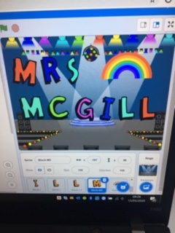
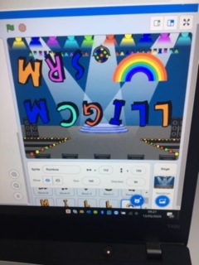
ICT
Did you have fun coding a superhero yesterday?
I had fun using the Animate A Name game. I took some pictures of my design to show you!

Slide 5
Diocese of Motherwell
The Diocese of Motherwell are encouraging families to participate in the Angelus Challenge. They are releasing videos every weekday on YouTube to help children with their participation. Please find day 11 below:
https://www.youtube.com/watch?v=soAnPOYiCWI
When you have completed this why not colour in a flower on the Angelus Prayer Card. Please find this uploaded onto the blog on the website.

Slide 6
Assessment – Spelling Test
Please complete a spelling test for the words you have been asked to learn this week.
If possible ask an adult to read them out to you. You can self assess them by looking at the next slide.
If you got any wrong please continue to work on these at home- good luck!

Slide 7
Assessment – Spelling Test
Red group – words with ff and ph.
Green group –high, sigh, night, fright, sight, bright, might, light.
Purple group –bang, gang, hang, king, ring, sing, long, sung.
How did you do?

Slide 8
Assessment – Learning Logs
Please copy and complete the sentences below in your jotter.
This week I have learned….
This week I have enjoyed…
Next week I want to learn…
Next week my target is…
Ask an adult to email me your answers if you can.

Slide 9
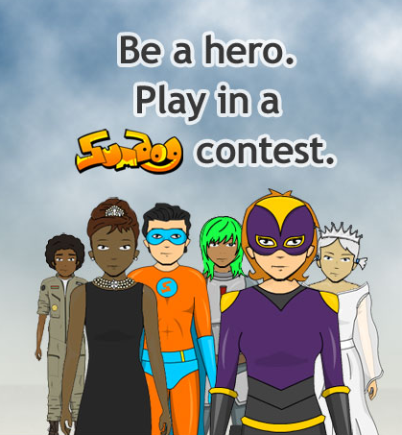
Numeracy
🏆 NLC CONTEST 🏆
FRIDAY 15TH MAY UNTIL THURSDAY 21ST MAY.
COME ON BOYS AND GIRLS OF PRIMARY 5/4!
LET'S SHOW EVERYONE HOW MUCH WE LOVE A SUMDOG COMPETITION.
WHO WILL BE OUR TOP CLASS/PUPILS THIS TIME?
Simply log in to play.

Slide 10
Numeracy – Table of the Week
Set a timer and write the multiplication table you have been working on.
Remember to take a note of how long it took you to complete it and try to beat that time next week.
Good luck!

Slide 11
IDL
Recap on what the children have learned about butterflies from last week – can they recall some key facts? This symmetry song might be helpful - https://www.youtube.com/watch?v=SJlhywRfvh8
Explore symmetry in nature – set the children a challenge to find things which are (like butterflies) symmetrical in nature. To give them a start, you might want to suggest that they look at some fruit and vegetables in the house. Here is a link to help - https://kidminds.org/symmetry-in-nature-for-kids-fun-with-fruits-and-vegetables/

Slide 12
IDL
Using the fruit and vegetables from the experiment, the children may want to explore the features of each half further through painting and print. Can they create a work of art?
Taking symmetry outside – ask the children to find things which are symmetrical outside. They might want to do this as part of a family activity when out for a walk. For some examples of symmetry in nature - https://www.youtube.com/watch?v=J-ykLPy9Un8 Don’t forget that rainbows can be symmetrical too!

Slide 13
IDL
Using the learning from symmetry in nature – building on the knowledge about plants which have symmetry, honeycombs and butterflies, invite the children to think about how they could encourage more bees and butterflies into their garden. Develop this into ideas about planting flowers and/or vegetables. Sunflowers might be idea to plant as the children can measure how tall they grow over time. (https://www.rhs.org.uk/education-learning/gardening-children-schools/family-activities/grow-it/grow/sunflower)

Slide 14
IDL
Why not invite the children to draw a sunflower or a flower of their own choice? A step by step guide can be accessed here - https://www.youtube.com/watch?v=yIOmduNQvtE. Some images might also give them some ideas - https://www.bing.com/images/search?q=Sunflower+Painting+by+Kids&FORM=RESTAB

Slide 15
IDL
If there is time, the children could look at Van Gogh’s ‘Sunflowers’ also (https://www.bing.com/images/search?q=Van%20Gogh%20sunflowers&qs=n&form=QBIR&sp=-1&pq=van%20gogh%20sunflower&sc=8-18&sk=&cvid=B784056E039043C49C4E4495C2CE5EA10 ) To access a step by step guide to re-creating the ‘Sunflowers’, this drawing tutorial might be helpful in the initial drawing of the picture - https://www.youtube.com/watch?v=lZ__t656tnI and the following link - https://www.youtube.com/watch?v=eYQDHgApivA – in looking at colour and texture.

Slide 16
IDL
Take this creativity into the kitchen and learn how to cook tomato pizza. For a fun recipe, join Jamie Oliver, Petal and Buddy to make the family dinner - https://www.youtube.com/watch?v=K2RB1KcNtAM The children might even make their pizza symmetrical!

Slide 17
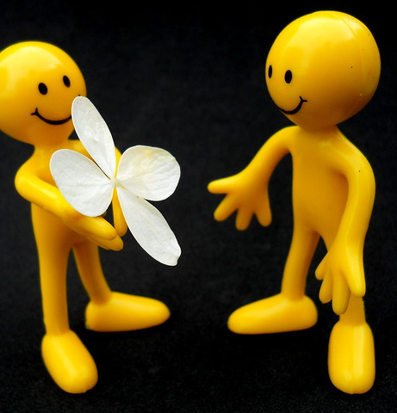
Health – Be Kind
Health – Please do something kind for a member of your family or a neighbour. You can do whatever you like but here are some ideas to get you started
Say good morning or good afternoon, with a smile, to as many people as you can when you are doing daily exercise.
Write a letter to someone you care about. Tell them you miss them and look forward to seeing them soon. Enclose a lovely photo or a drawing.
Think of something nice to say to each of your family members.
This Photo by Unknown Author is licensed under CC BY

Slide 18
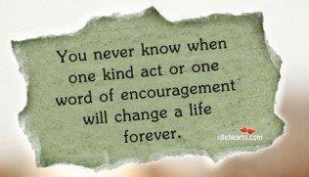
Health – Be Kind
Health – Please do something kind for a member of your family or a neighbour. You can do whatever you like but here are some ideas to get you started
Ask someone to tell you all about something they are interested in.
Ask someone at home, “How can I help?”
Make someone in your family a drink or snack without being asked.

Slide 19
Health – Stay Active
Please choose one of the below to complete today.
Joe Wicks on YouTube.
Make your own Keep Fit Video
Just Dance on youtube
Cosmic Yoga

Slide 20
Grid Work
If you still feel up to it, why not try to do an activity from the new grid but no more than 2 activities per day.

Slide 21
Golden Time
Take a break and have a play – you have earned it!

Slide 22
Prayer at the End of the Day
God our Father, as we finish our day’s work, we thank all who have helped and supported us today, and we ask you to help us use your gifts so that we may relax and rest as you would wish. St. Barbara – Pray for us.

Slide 23
You’re Finished!!!
Well done boys and girls you are now officially finished for this week!
Have a lovely weekend and I will be back next Wednesday.
Take care,
Mrs McGill

