Slide 1
P5/4 – Thursday 14th May
Good morning boys and girls! Ready for another fun filled day?
Please try to complete the activities for today but if you can’t please do not worry. You can adapt them to suit you and your family in any way you can.
If you need anything please email me anytime.
gw14waughmanda@glow.sch.uk or AMcGill@st-barbaras.n-lanark.sch.uk
Mrs McGill

Slide 2
Timetable for today
R.E. – Prayers, Angelus Challenge, First Holy Communion preparation.
Numeracy – Number Talks (Chilli Challenge), Sumdog Challenge
Literacy – Writing A Recount
Health – Be kind & Stay Active
ICT –Grid – Maximum of 2 activities from the new grid

Slide 3
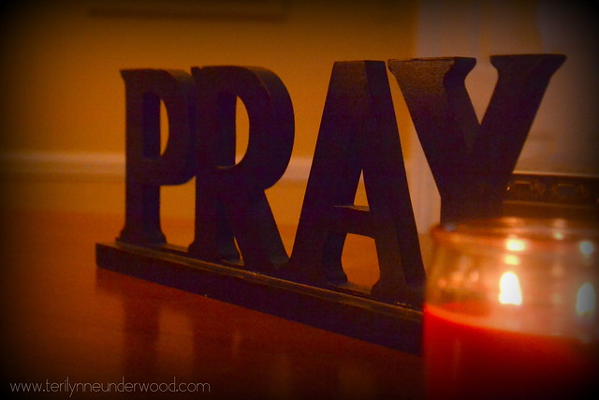
Morning Prayer
God our Father, as we prepare to begin our work, we ask you to help us use properly, the many gifts you have given us, so that we may fully benefit from our day together in school. St. Barbara – Pray for us.

Slide 4
Diocese of Motherwell
The Diocese of Motherwell are encouraging families to participate in the Angelus Challenge. They are releasing videos every weekday on YouTube to help children with their participation. Please find day 10 below:
https://www.youtube.com/watch?v=WqlJawaNxlM
When you have completed this why not colour in a flower on the Angelus Prayer Card. Please find this uploaded onto the blog on the website.

Slide 5
R.E. – Sacrament of First Holy Communion
I know some of you were preparing for the sacrament of First Holy Communion and although we are unsure about exactly when this might be; it is important that we still prepare for this very special sacrament.
The Diocese of Motherwell has very kindly made available the First Holy Communion booklet we were working on in school and at home. Please click here to download a copy. Please be aware of copyright:
“Each Sacramental Workbook is copyright. Consent is granted to copy, distribute and share these Sacramental Workbooks up to the time that our Government have allowed pupils return to normal school activities. They will be removed from this website thereafter. In downloading the content you agree to these terms.”

Slide 6
R.E. – Sacrament of First Holy Communion
“As soon as Jesus was baptised, he went up out of the water. At that moment heaven was opened, and he saw the Spirit of God descending like a dove and alighting on him” Matthew 3:16
I would like you to read pages 20 & 21 in your Holy Communion booklet and complete them. This is a time you can reflect on your Reconciliation. How did you feel? Can you remember the hymns you sang? Who were you sitting next to?
You could look through photographs of that special day and talk about it with family members.

Slide 7
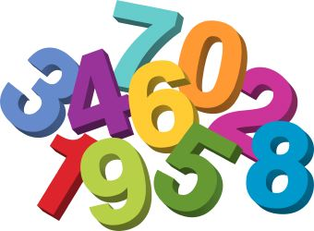
Numeracy
Please have a go at this chilli challenge. Remember to choose the chilli that you think will challenge you. Try to work out the answer in your head and think about all the strategies we have learned to work out the answer.
The answers are on the slide after the chilli challenge so make sure you don’t go too far ahead until you’re ready!
Good luck!

Slide 8
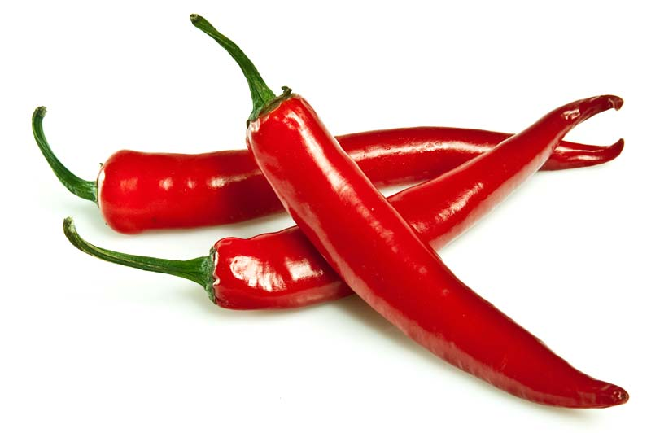
Number Talks
20-18
406-13
2071- 1061

Slide 9
Number Talks - Answers
20-18
406-13
2071- 1061
2
393
1010

Slide 10
Numeracy
Subtraction
Please complete the Sumdog challenge set for you. The challenge will run from today until Friday at 3pm.
If you can’t remember your login details please send me an email and I can get them for you.

Slide 11
Writing
Writing A Recount
Please use the BBC Bitesize resources to help you write a recount about one of the below –
My life so far or My lockdown experience so far
How I found my hobby
A funny story from my life
https://www.bbc.co.uk/bitesize/articles/zkpvbdm

Slide 12
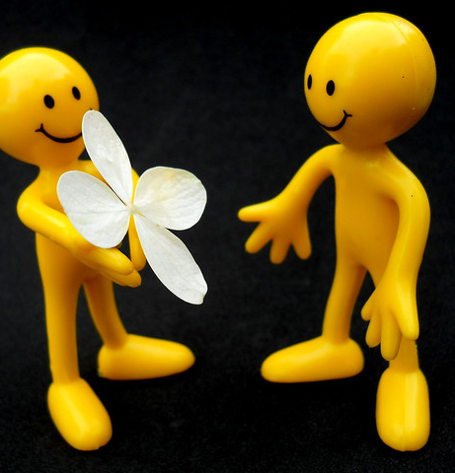
Health – Be Kind
Health – Please do something kind for a member of your family or a neighbour. You can do whatever you like but here are some ideas to get you started
Say good morning or good afternoon, with a smile, to as many people as you can when you are doing daily exercise.
Write a letter to someone you care about. Tell them you miss them and look forward to seeing them soon. Enclose a lovely photo or a drawing.
Think of something nice to say to each of your family members.
This Photo by Unknown Author is licensed under CC BY

Slide 13
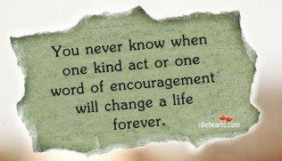
Health – Be Kind
Health – Please do something kind for a member of your family or a neighbour. You can do whatever you like but here are some ideas to get you started
Ask someone to tell you all about something they are interested in.
Ask someone at home, “How can I help?”
Make someone in your family a drink or snack without being asked.

Slide 14
ICT
Coding skills. Please follow the link below and choose a coding activity.
It includes videos to show you what to do and you can choose whatever activity you wish.
https://hourofcode.com/uk/learn
I am going to try Animate A Name and will show you how I get on tomorrow.
https://csfirst.withgoogle.com/c/cs-first/en/animate-a-name/animate-a-name/animate-a-name.html

Slide 15
Grid Work
If you still feel up to it, why not try to do an activity from the new grid but no more than 2 activities per day.

Slide 16
Prayer at the End of the Day
God our Father, as we finish our day’s work, we thank all who have helped and supported us today, and we ask you to help us use your gifts so that we may relax and rest as you would wish. St. Barbara – Pray for us.

Slide 17
You’re Finished!!!
Well done boys and girls you are now officially finished for today!
Don’t worry if you didn’t manage to complete all the activities and well done if you did!
Have a good rest tonight and back to work tomorrow!

