Slide 1
Similes and metaphors How can using a simile or metaphor help improve my descriptive writing?

Slide 2
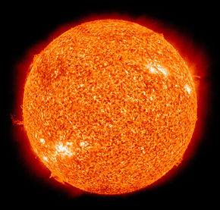
The Sun
The sun is like a pool of golden snakes glistening in the sky, slithering in circles.
The sun is like a ball, yellow and shining.
Copy down the simile you think is the best one
And explain what you think a simile is.

Slide 3
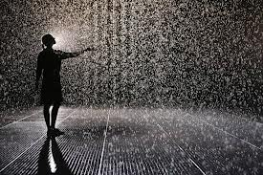
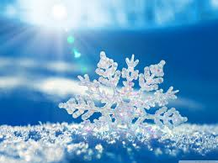
A simile is when you compare something to another thing that has a similar quality using the word like or as.
Copy and complete the following sentences:
The rain sounded like _____________ .
The wind whistled like ____________ .
The sun was as hot as ______________ .
The beautiful snow glistens like ____________ .

Slide 4
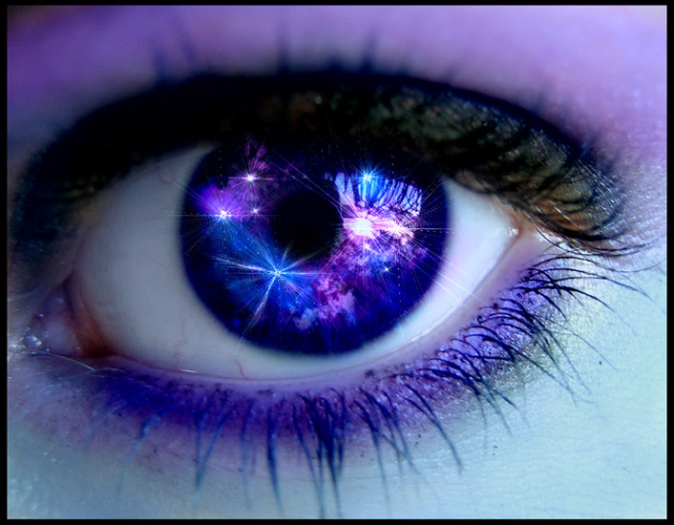
(Simile) Her eyes shone like diamonds. = (Metaphor) Her eyes were diamonds. Write your own definition of metaphor.

Slide 5
Quick thinking! Simile or metaphor
The boss’s words were crystal clear.
She was as white as a ghost.
He was a man mountain.
The baby was an octopus grabbing everything.
The bar of soap was like a slippery eel.
He was as busy as a beaver.
She was brave like a lion.
The screaming noise was a knife in my ears.
The thunder beat across the sky like a drum.
The rain was ice trickling down my face.

Slide 6
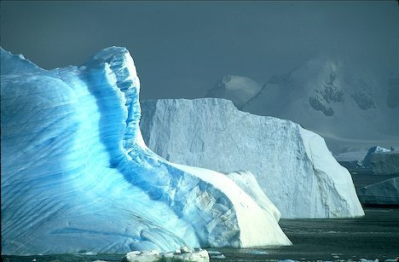
Frozen Planet 1) As you watch the clip note down any interesting things that you see. 2) Come up with 5 Similes and 5 metaphors based on the things you saw in the Frozen Planet clip.
http://www.youtube.com/watch?v=MwdWMmFeXIo

