Slide 1
P5/4 – Tuesday 12th May
Good morning boys and girls!
I hope you enjoyed your long weekend and had a break from work. As it was an in-service day yesterday – Mrs McGill and I had a catch up on the phone discussing your work. Don’t worry it was all good! ;)
I’ve attached some more activities for you to try today. Remember do only what you can.
Mrs Grant ☺

Slide 2
Timetable for today
R.E. – Prayers, Angelus Challenge, First Holy Communion preparation
Numeracy – Number Talks (Chilli Challenge), Subtraction
Literacy – Spelling, Reading
P.E. – Dancing
Spanish – Talking about your age
Grid – Maximum of 2 activities from the new grid

Slide 3
Morning Prayer
God our Father, as we prepare to begin our work, we ask you to help us use properly, the many gifts you have given us, so that we may fully benefit from our day together. St. Barbara – Pray for us.

Slide 4
Diocese of Motherwell
The Diocese of Motherwell are encouraging families to participate in the Angelus Challenge. They are releasing videos every weekday on YouTube to help children with their participation. Please find day 8 below:
Day 8 Angelus Challenge
When you have completed this why not colour in a flower on the Angelus Prayer Card. Please find this uploaded onto the blog on the website.

Slide 5
R.E. – Sacrament of First Holy Communion
I know some of you were preparing for the sacrament of First Holy Communion and although we are unsure about exactly when this might be; it is important that we still prepare for this very special sacrament.
The Diocese of Motherwell has very kindly made available the First Holy Communion booklet we were working on in school and at home. Please click here to download a copy. Please be aware of copyright:
“Each Sacramental Workbook is copyright. Consent is granted to copy, distribute and share these Sacramental Workbooks up to the time that our Government have allowed pupils return to normal school activities. They will be removed from this website thereafter. In downloading the content you agree to these terms.”

Slide 6
R.E. – Sacrament of First Holy Communion
“As soon as Jesus was baptised, he went up out of the water. At that moment heaven was opened, and he saw the Spirit of God descending like a dove and alighting on him” Matthew 3:16
I would like you to read page 17 in your Holy Communion workbook and think about what the scripture is saying. Discuss your Baptism with your family. It might be nice to look at a picture of your Baptism too.
Please complete page 18 of your workbook.

Slide 7
Numeracy
Please have a go at this chilli challenge. Remember to choose the chilli that you think will challenge you. Try to work out the answer in your head and think about all the strategies we have learned to work out the answer. I wonder which strategy you used? If you solve it using one strategy try using another strategy.
The answers are on the slide after the chilli challenge so make sure you don’t go too far ahead until you’re ready!
Good luck!

Slide 8
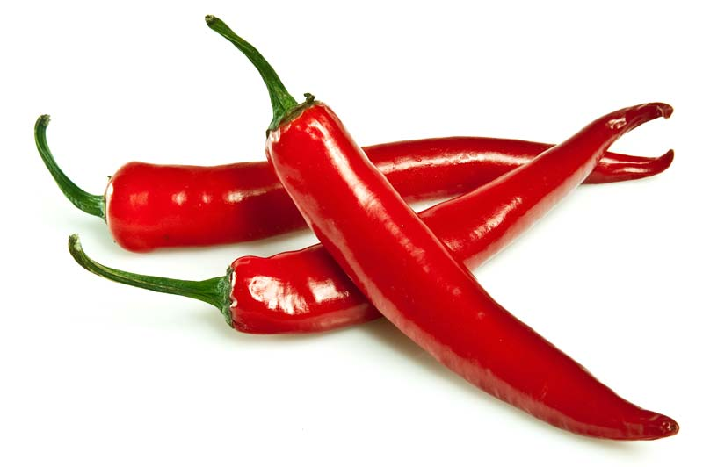
Number Talks
41+39
1332+1331
8749+8751
Tip: A good strategy to use for these questions would be using doubles/near doubles
e.g. 6+7 =
5(+1) + 5 (+2) =
5+5 = 10, 1+2 = 3
!0+3 = 13

Slide 9
Number Talks - Answers
41+39
1332+1331
8749+8751
80
2663
17500

Slide 10
Subtraction
Today I would like you to revise how to subtract using the column method. This is a method we practised lots in class. Remember it is very important to line up the numbers using the correct columns or your answers will be wrong. Also it is important to remember you start at the right and work towards the left. (The ones (units) column first).
e.g.
152
-121
As you can see the sum above has been lined up properly. You are start with 2 – 1, then 5-2 and finish with 1-1. The answer to the sum is 31.

Slide 11
Subtraction
Please click this link to watch some videos explaining subtraction using the column method.
Now try some subtraction examples.

Slide 12
-
Three Digit
Take
Two Digit
Find the difference between
the highlighted pairs of numbers
in each question.

Slide 13
264
486
589
793
812
965
37
42
49
67
86
92
215

Slide 14
264
486
589
793
812
965
37
42
49
67
86
92
879

Slide 15
264
486
589
793
812
965
37
42
49
67
86
92
419

Slide 16
264
486
589
793
812
965
37
42
49
67
86
92
775

Slide 17
264
486
589
793
812
965
37
42
49
67
86
92
172

Slide 18
264
486
589
793
812
965
37
42
49
67
86
92
522

Slide 19
264
486
589
793
812
965
37
42
49
67
86
92
751

Slide 20
264
486
589
793
812
965
37
42
49
67
86
92
394

Slide 21
264
486
589
793
812
965
37
42
49
67
86
92
770

Slide 22
264
486
589
793
812
965
37
42
49
67
86
92
916

Slide 23
264
486
589
793
812
965
37
42
49
67
86
92
552

Slide 24
264
486
589
793
812
965
37
42
49
67
86
92
178

Slide 25
264
486
589
793
812
965
37
42
49
67
86
92
449

Slide 26
264
486
589
793
812
965
37
42
49
67
86
92
540

Slide 27
264
486
589
793
812
965
37
42
49
67
86
92
701

Slide 28
264
486
589
793
812
965
37
42
49
67
86
92
197

Slide 29
264
486
589
793
812
965
37
42
49
67
86
92
928

Slide 30
264
486
589
793
812
965
37
42
49
67
86
92
744

Slide 31
264
486
589
793
812
965
37
42
49
67
86
92
503

Slide 32
264
486
589
793
812
965
37
42
49
67
86
92
720

Slide 33
Spelling
Red group today I would like you to think about the phoneme f and the different representations – ff and ph. Make 3 columns and write down some words in each of these columns.
Green group – I would like you to think about the phoneme igh - high, sigh, night, fright, sight, bright, might, light. Write out your words 3 times.
Purple group – I would like you to think about the phoneme ng. Your words are: bang, gang, hang, king, ring, sing, long, sung. Write your words 3 times.

Slide 34
Literacy - Reading
Please login to Scholastic using the link: https://educator-slz03.scholasticlearningzone.com/slz-portal/#/login3/GBRWY9D
You had a book assigned to you a couple of weeks ago. I would like you to finish this book and try the quiz at the end.
Alternatively if you have a book at home, choose one and read a few chapters.

Slide 35
P.E.
Boys and girls today I would like you to put on some music and dance around. Give it your best moves.
You’ll be happy to know I have not got a link showing my dance moves !!!

Slide 36
Spanish
I would like you to go to www.radiolingua.com/learnathome
Click on the Primary Spanish button.
Watch lesson 4 video – Talking about your age
I have attached worksheets on the website for you to try after you watch the video.

Slide 37
Grid Work
If you still feel up to it, why not try to do an activity from the new grid but no more than 2 activities per day.

Slide 38
Prayer at the End of the Day
God our Father, as we finish our day’s work, we thank all who have helped and supported us today, and we ask you to help us use your gifts so that we may relax and rest as you would wish. St. Barbara – Pray for us.

Slide 39
You’re Finished!!!
Well done boys and girls you are now officially finished for today!
Don’t worry if you didn’t manage to complete all the activities and well done if you did!
I’ll be back next Monday but remember if you need to contact me for anything you can email me gw09grantmary4@glow.sch.uk
See you Monday! ☺☺☺

