Slide 1
P5/4 – Wednesday 6th May
Good morning boys and girls!
I hope you have enjoyed the tasks Mrs Grant has set you this week.
Please try to complete the activities for today but if you can’t please do not worry. You can adapt them to suit you and your family in any way you can.
If you need anything please email me anytime.
gw14waughmanda@glow.sch.uk or AMcGill@st-barbaras.n-lanark.sch.uk
Mrs McGill

Slide 2
Timetable for today
R.E. – Prayers, Angelus Challenge
Numeracy – Number Talks (Chilli Challenge), Sumdog Challenge
Literacy – Spelling, & Reading
Health – First Aid & Stay Active
Grid – Maximum of 2 activities from the new grid

Slide 3
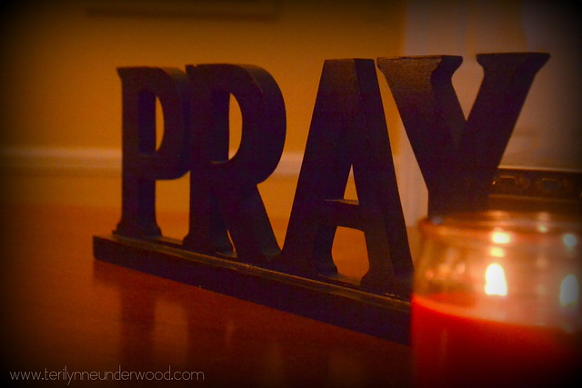
Morning Prayer
God our Father, as we prepare to begin our work, we ask you to help us use properly, the many gifts you have given us, so that we may fully benefit from our day together in school. St. Barbara – Pray for us.

Slide 4
Diocese of Motherwell
The Diocese of Motherwell are encouraging families to participate in the Angelus Challenge. They are releasing videos every weekday on YouTube to help children with their participation. Please find day 4 below:
https://www.youtube.com/watch?v=j6Morf7lTok
When you have completed this why not colour in a flower on the Angelus Prayer Card. Please find this uploaded onto the blog on the website.

Slide 5
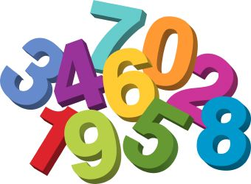
Numeracy
Please have a go at this chilli challenge. Remember to choose the chilli that you think will challenge you. Try to do work out the answer in your head and think about all the strategies we have learned to work out the answer.
The answers are on the slide after the chilli challenge so make sure you don’t go too far ahead until you’re ready!
Good luck!

Slide 6
Number Talks
18+7
330+26
1201+2662

Slide 7
Number Talks - Answers
18+7
330+26
1201+2662
25
356
3863

Slide 8
Numeracy
Place Value – Sumdog Challenge
Please log into Sumdog and complete the challenges set for you. The challenges will run between now and Thursday at 3pm.
I will login each day to check how you are getting on and can set more if you get these finished.
If you can’t remember your login details please send me an email and I can get them for you.

Slide 9
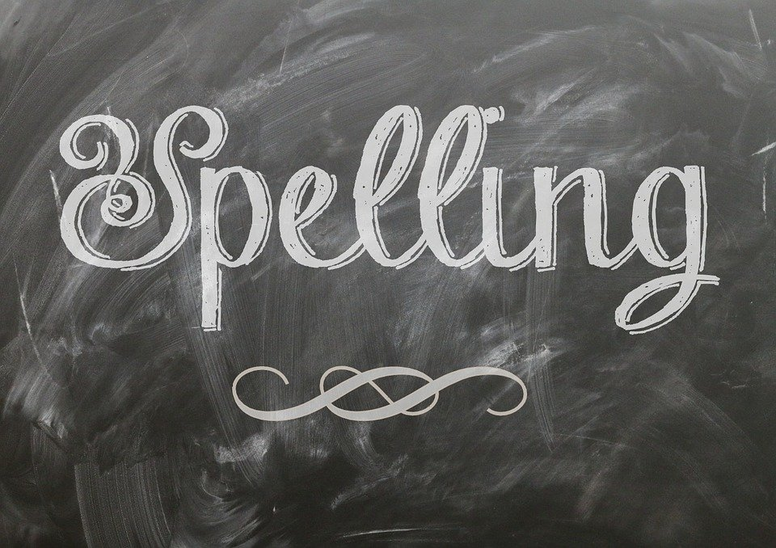
Literacy
Please find your spelling words below for each group:
Red group & green group -
flasks classes disasters spots tray
churches hobbies flies flashes lorries
babies days
Spelling words for the purple group are: bill, hill, mill, will, bell, fell, tell, sell
It is a lovely day – get outside if you can! Use anything you have to practise writing your words. Use chalk, a water bottle/ water gun or washing up liquid bottle and try writing the words outside somewhere!

Slide 10
Literacy
Reading
Just like last week I would like you to use the activity pack to read a story of your choice and answer the questions that follow. (The answers are at the end so you can check your understanding).
If you have any problems downloading it I can send an email with it attached.
https://www.literacyshedplus.com/en-gb/browse/free-resources/reading-comprehension-plus/reading-packs-ages-7-11

Slide 11
Health
First Aid – Please see the powerpoint attached on the blog and complete the worksheet attached.
If you can’t access the worksheet you could copy it into your jotter as best you can and complete it there.

Slide 12
Health – Stay Active
Please choose one of the below to complete today.
Joe Wicks on YouTube.
Jumpstart Johny dance and workouts on Youtube.
Oti Mabuse dance classes.
Make your own gym, set up fitness stations and complete the exercises of your choice (example – running on the spot, skipping, jumping etc.. )
Go a long walk and see how many different colours you can find in the environment.

Slide 13
Grid Work
If you still feel up to it, why not try to do an activity from the new grid but no more than 2 activities per day.

Slide 14
Prayer at the End of the Day
God our Father, as we finish our day’s work, we thank all who have helped and supported us today, and we ask you to help us use your gifts so that we may relax and rest as you would wish. St. Barbara – Pray for us.

Slide 15
You’re Finished!!!
Well done boys and girls you are now officially finished for today!
Don’t worry if you didn’t manage to complete all the activities and well done if you did!
Have a good rest tonight and back to work tomorrow!

