Slide 1
P5/4 – Tuesday 5th May
Good morning boys and girls!
I hope you all had a lovely day yesterday.
I’ve attached some more activities for you to try today. Remember do only what you can.
Mrs Grant ☺

Slide 2
Timetable for today
R.E. – Prayers, Angelus Challenge, May Altar
Numeracy – Number Talks (Chilli Challenge), Addition
Literacy – Spelling, Grammar, Reading
P.E. – Tuesday work out with Go Noodle
Spanish – Saying how you’re feeling activities
Grid – Maximum of 2 activities from the new grid

Slide 3
Morning Prayer
God our Father, as we prepare to begin our work, we ask you to help us use properly, the many gifts you have given us, so that we may fully benefit from our day together. St. Barbara – Pray for us.

Slide 4
Diocese of Motherwell
The Diocese of Motherwell are encouraging families to participate in the Angelus Challenge. They are releasing videos every weekday on YouTube to help children with their participation. Please find day 3 below:
Angelus Challenge Day 3
When you have completed this why not colour in a flower on the Angelus Prayer Card. Please find this uploaded onto the blog on the website.

Slide 5
May Altar
May is the month of Mary and if we were in class we would have created a beautiful May Altar to honour Our Lady. If you haven’t already done so, why not create your own May Altar at home. I’ve attached a photograph of my May Altar on the next slide.
If you want to send me a picture of your May Altar, please email me at gw09grantmary4@glow.sch.uk and I will upload onto Twitter or send it straight to Twitter using @St_BarbarasPS

Slide 6
Mrs Grant’s May Altar

Slide 7
Numeracy
Please have a go at this chilli challenge. Remember to choose the chilli that you think will challenge you. Try to do work out the answer in your head and think about all the strategies we have learned to work out the answer. I wonder which strategy you used? If you solve it using one strategy try using another strategy.
The answers are on the slide after the chilli challenge so make sure you don’t go too far ahead until you’re ready!
Good luck!

Slide 8
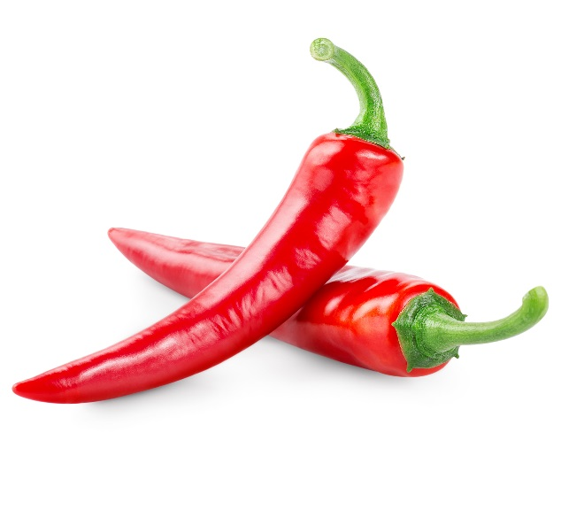
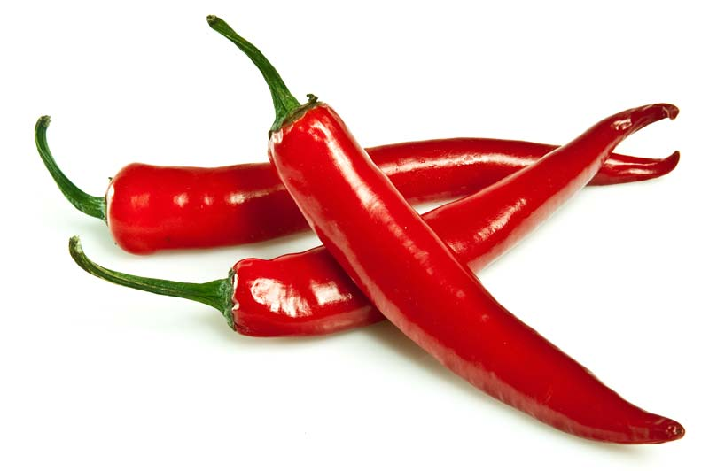
Number Talks
24+26
231+233
9849+9851
Tip: A good strategy to use for these questions would be using doubles/near doubles
e.g. 6+7 =
5(+1) + 5 (+2) =
5+5 = 10, 1+2 = 3
!0+3 = 13

Slide 9
Number Talks - Answers
24+26
1231+1233
9849+9851
50
2464
19700

Slide 10
Addition
Yesterday you revised the column method of addition and watched some videos and tried some activities. If needed please click the link to watch again.
Today I would like you to put into practice what you have learned and have a go at the maths worksheets that are uploaded onto the blog on the website.

Slide 11
Literacy – Spelling
Today I would like you to write out your spelling words using UPPERCASE and lowercase. Then to make it harder and to really get you thinking about how to spell the word I want you to do one letter UPPERCASE and one letter lowercase.
e.g. churches – ChUrChEs
FLASKS – fLaSkS
As a reminder your spelling words are on the next slide.

Slide 12
Literacy – Spelling and Grammar
These are the spelling words for the red group and green group today.
flasks classes disasters spots tray s
churches hobbies flies flashes lorries
babies days
Spelling words for the purple group are: bill, hill, mill, will, bell, fell, tell, sell

Slide 13
Literacy – Grammar
Yesterday we looked at singular and plural nouns.
Today I would like you to revise identifying nouns - both common and proper nouns.
Please click on the link to watch some videos and try some activities.
Good luck!

Slide 14
Literacy - Reading
Please login to Scholastic using the link: https://educator-slz03.scholasticlearningzone.com/slz-portal/#/login3/GBRWY9D
An e-book has been assigned for you. You can read it on your own and/or listen to the audio as you read. Please also try the quiz at the end of the book.
Alternatively if you have a book at home, choose one and read a few chapters.

Slide 15
P.E.
Please complete some Go Noodle workouts today and have some fun with it. I know you all secretly enjoy doing all those silly dances in the class ☺

Slide 16
Spanish
I would like you to go to www.radiolingua.com/learnathome
Click on the Primary Spanish button.
Watch lesson 3 video – Saying how you’re feeling
I have uploaded worksheets a and b on to the blog on the website for you to complete.

Slide 17
Grid Work
If you still feel up to it, why not try to do an activity from the new grid but no more than 2 activities per day.

Slide 18
Prayer at the End of the Day
God our Father, as we finish our day’s work, we thank all who have helped and supported us today, and we ask you to help us use your gifts so that we may relax and rest as you would wish. St. Barbara – Pray for us.

Slide 19
You’re Finished!!!
Well done boys and girls you are now officially finished for today!
Don’t worry if you didn’t manage to complete all the activities and well done if you did!
I’ll be back next Monday but remember if you need to contact me for anything you can email me gw09grantmary4@glow.sch.uk
See you Monday! ☺☺☺

