Slide 1
Numeracy Task
Place Value
Please move to ‘Slideshow Mode’ for this task. Thank you!

Slide 2
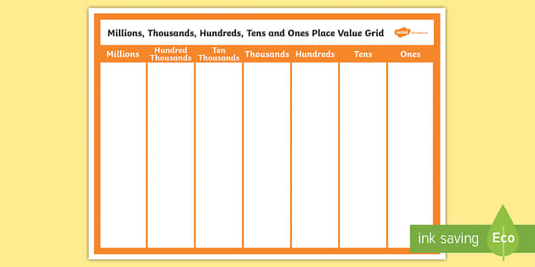
Place Value
Today we are going to explore recognizing numbers up to one million or 1 000 000.
Use the grid below as a reminder before you begin.
In the following slides, look at the number and identify the number and later the value of each digit.
Remember to use ‘slide show’ as the answers follow each question!

Slide 3
Say this number out loud:
321
Three hundred and twenty-one

Slide 4
Say this number out loud:
807
Eight hundred and seven

Slide 5
Say this number out loud:
6713
Six thousand, seven hundred and thirteen

Slide 6
Say this number out loud:
4 692
Four thousand, six hundred and ninety-two

Slide 7
Say this number out loud:
53 861
Fifty-three thousand, eight hundred and sixty-one

Slide 8
Say this number out loud:
742 903
Seven hundred and forty-two thousand, nine hundred and three

Slide 9
Say this number out loud:
931 814
Nine hundred and thirty-one thousand, eight hundred and fourteen

Slide 10
Say this number out loud:
2 000 000
Two million

Slide 11
Now please look at the following numbers and say the value of the digit indicated in each.
For example:
936
900

Slide 12
354
300

Slide 13
2698
2000

Slide 14
5092
90

Slide 15
11 749
11 000

Slide 16
22 630
2000

Slide 17
36 541
1

Slide 18
908 504
900 000

Slide 19
23 569
500

Slide 20
68 213
8000

Slide 21
123 506
20 000

Slide 22
99 999
90 000

Slide 23
2057
0

Slide 24
63 205
200

Slide 25
89 346
80 000

Slide 26
75 207
7

Slide 27
319 548
300 000

Slide 28
201 569
1 000

Slide 29
852 369
800 000

Slide 30
1 000 000
1 000 000

Slide 31
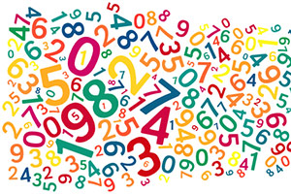
We’ll have more fun with numbers tomorrow!

