Slide 1
P5/4 – Friday 24th April
Good morning boys and girls!
Remember to take breaks and get outside when you can.
Please try to complete the activities for today but if you can’t please do not worry. You can adapt them to suit you and your family in any way you can.
If you need anything please email me anytime.
gw14waughmanda@glow.sch.uk or AMcGill@st-barbaras.n-lanark.sch.uk
Mrs McGill

Slide 2
Timetable for today
R.E. – Prayers, The Angelus
Assessment – Literacy & Numeracy
IDL – Feelings
Health – Help around the house & Stay Active
Grid – maximum of two activities
Golden Time

Slide 3
ICT
Did you have fun coding a superhero yesterday?
I took a video on my mobile of Sarah the Firefighter but I can’t include it this powerpoint because the file is too big. Here are some pictures of Sarah instead.

Slide 4
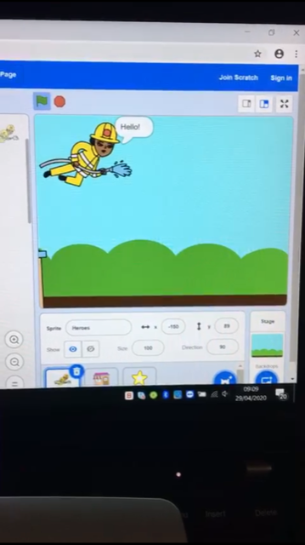
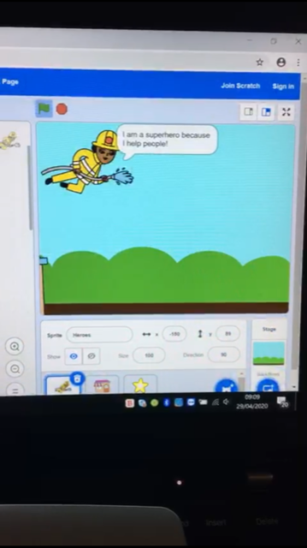
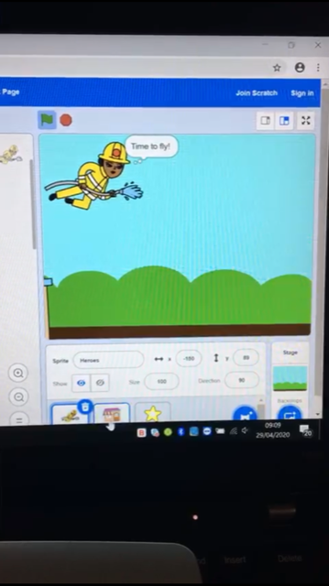
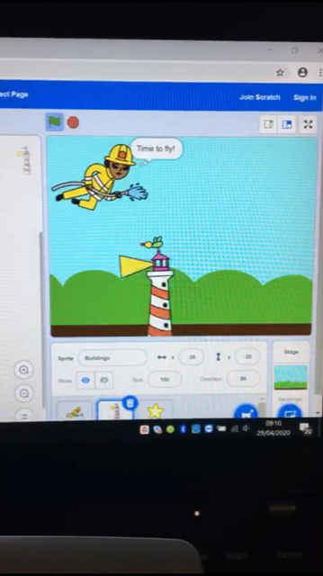
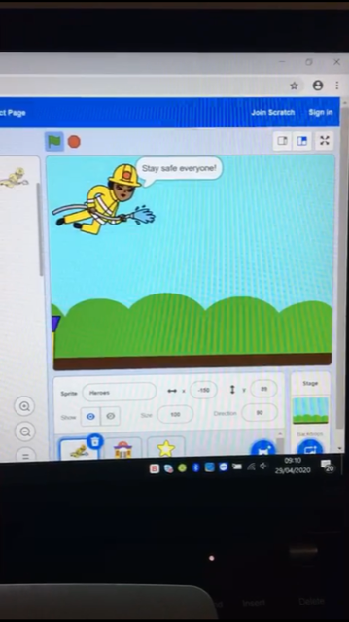
ICT

Slide 5
Morning Prayer
God our Father, as we prepare to begin our work, we ask you to help us use properly, the many gifts you have given us, so that we may fully benefit from our day together in school. St. Barbara – Pray for us.

Slide 6
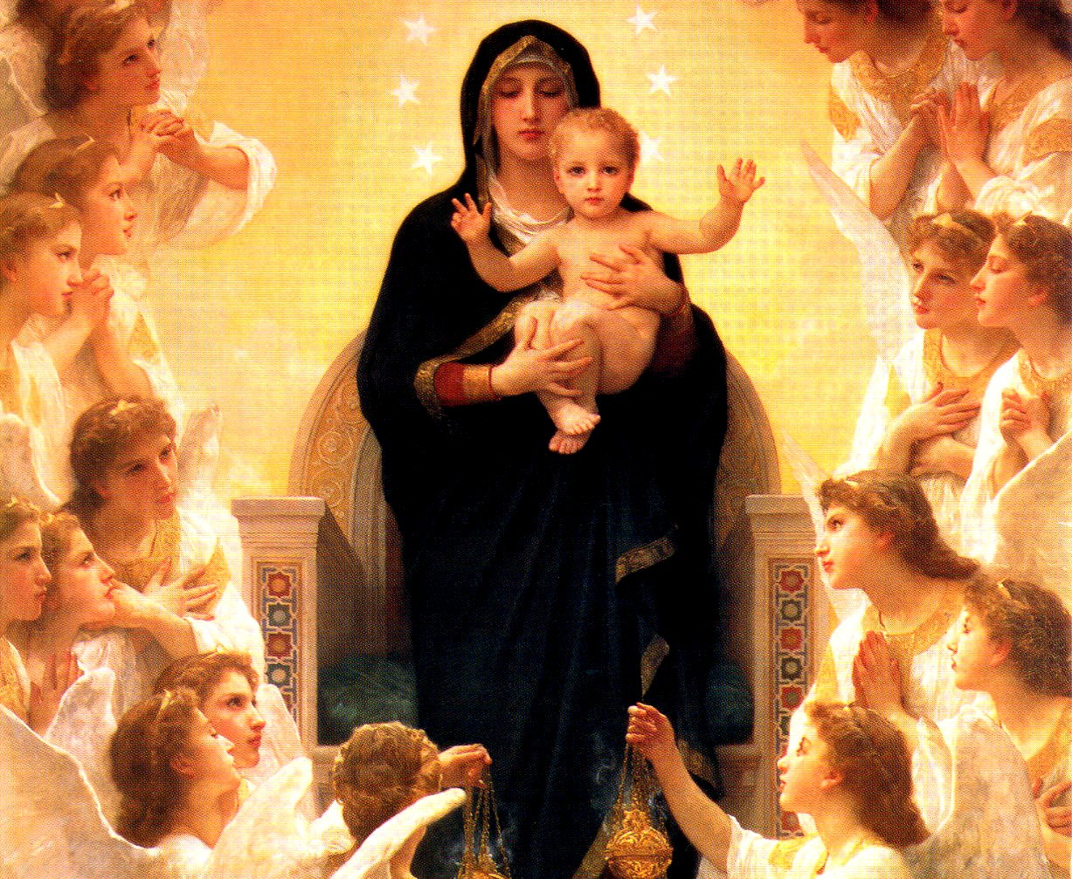
May – The Month of Mary
A way of honouring Mary is to pray The Angelus at noon each day. The Angelus means angels and Mary has been given the title Queen of the Angels.

Slide 7
The Angelus Prayer
Create a special area at home where you can watch the video below.
Join in with the prayer, the words are on the video and on the next slides for you.
https://www.youtube.com/watch?v=P2Lw3p1Z1pw&feature=youtu.be

Slide 8
The Angelus Prayer
The Angel of the Lord declared to Mary: And she conceived of the Holy Spirit.
Hail Mary, full of grace, the Lord is with thee; blessed art thou among women and blessed is the fruit of thy womb, Jesus. Holy Mary, Mother of God, pray for us sinners, now and at the hour of our death. Amen.
Behold the handmaid of the Lord: Be it done unto me according to Thy word.
Hail Mary, full of grace, the Lord is with thee; blessed art thou among women and blessed is the fruit of thy womb, Jesus. Holy Mary, Mother of God, pray for us sinners, now and at the hour of our death. Amen.
And the Word was made Flesh: And dwelt among us.
Hail Mary, full of grace, the Lord is with thee; blessed art thou among women and blessed is the fruit of thy womb, Jesus. Holy Mary, Mother of God, pray for us sinners, now and at the hour of our death. Amen.

Slide 9
The Angelus Prayer
Pray for us, O Holy Mother of God, that we may be made worthy of the promises of Christ. Let us pray:
Pour forth, we beseech Thee, O Lord, Thy grace into our hearts; that we, to whom the incarnation of Christ, Thy Son, was made known by the message of an angel, may by His Passion and Cross be brought to the glory of His Resurrection, through the same Christ Our Lord.
Amen.

Slide 10
May – The Month of Mary
If you can, print the DOM Daily Angelus Challenge card from the blog or design your own!

Slide 11
Assessment – Spelling Test
Please complete a spelling test for the words you have been asked to learn this week.
If possible ask an adult to read them out to you. You can self assess them by looking at the next slide.
If you got any wrong please continue to work on these at home- good luck!

Slide 12
Assessment – Spelling Test
Red – nineteen, million, surprise, care, busy, accident, below, cloudy, eleven, football
Green – fall, tall, small, stall, also, always, already, usual, capital, pedal
Purple – throat, toast, goat, road, boat, coat (Remember your spelling fingers!)
How did you do?

Slide 13
Assessment – Learning Logs
Please copy and complete the sentences below in your jotter.
This week I have learned….
This week I have enjoyed…
Next week I want to learn…
Next week my target is…
Ask an adult to email me your answers if you can.

Slide 14
Numeracy – Mental Maths Test
Please answer the below questions in your jotter -
Write the number four hundred and two in figures.
What is 6 times 4?
What is half of 32?
Write the next odd number after 49.
What is the difference between80 and 53?

Slide 15
Numeracy – Mental Maths Test
Please answer the below questions in your jotter
6. What is 35 shared between 5?
7. Multiply 46 by 100
8. What is 446 rounded to the nearest 10?
9. How many 50p coins make £8?
10. Mrs McGill has 18 comics, Mrs Grant has 30 comics. How many more comics does Mrs Grant have?

Slide 16
Numeracy – Mental Maths Test
Answers
Write the number four hundred and two in figures. 402
What is 6 times 4? 24
What is half of 32? 16
Write the next odd number after 49. 51
What is the difference between80 and 53? 27

Slide 17
Numeracy – Mental Maths Test
Answers
6. What is 35 shared between 5? 7
7. Multiply 46 by 100. 4600
8. What is 446 rounded to the nearest 10? 450
9. How many 50p coins make £8? 16
10. Mrs McGill has 18 comics, Mrs Grant has 30 comics. How many more comics does Mrs Grant have? 12

Slide 18
Numeracy – Table of the Week
Set a timer and write the multiplication table you have been working on.
Remember to take a note of how long it took you to complete it and try to beat that time next week.
Good luck!

Slide 19
IDL
Building on from last week’s rainbow activities today is all about feelings.
What makes us happy, sad, angry, worried?
The following are some different activity ideas you could try (some will require adult support.)
Make a worry monster with a big mouth so that it can eat up worries – the children might want to use junk modelling or even paper mache (recipe - https://www.bbcgoodfood.com/howto/guide/how-make-paper-mache)
What will it look like? What is its name?

Slide 20
IDL
Encourage children, with an adult, to make their own bubbles. A recipe can be found here with good instructions on how to make a bubble wand - https://wredtedart.com/bubble-recipe/?cn-reloaded=1
Now invite the children to take their bubbles and their monster outside and blow away those worries.

Slide 21
IDL
If the children want to try some meditation, they could use the You Tube Floating Bubble Meditation - https://www.youtube.com/watch?v=zxcJ8y7RcjU
Invite the children to think about who their trusted adults are and who they can talk to if they have a worry – they may want to make a card for their special person or send them a picture of them with their worry monster.

Slide 22
Health
Help around the house – please help someone at home with a chore of their choice today.
Stay Active - Please choose one of the below to complete today.
Joe Wicks on YouTube.
Jumpstart Johny dance and workouts on Youtube.
Oti Mabuse dance classes, this week the theme is pop.
Make your own gym, set up fitness stations and complete the exercises of your choice (example – running on the spot, skipping, jumping etc.. )

Slide 23
Grid Work
If you still feel up to it, why not try to do an activity from the new grid but no more than 2 activities per day.

Slide 24
Golden Time
Take a break and have a play – you have earned it!

Slide 25
Prayer at the End of the Day
God our Father, as we finish our day’s work, we thank all who have helped and supported us today, and we ask you to help us use your gifts so that we may relax and rest as you would wish. St. Barbara – Pray for us.

Slide 26
You’re Finished!!!
Well done boys and girls you are now officially finished for this week!
Have a lovely weekend and I will be back next Wednesday.

