Slide 1
All About Spring

Slide 2
Spring
Spring is one of the four seasons.
spring
summer
autumn
winter

Slide 3
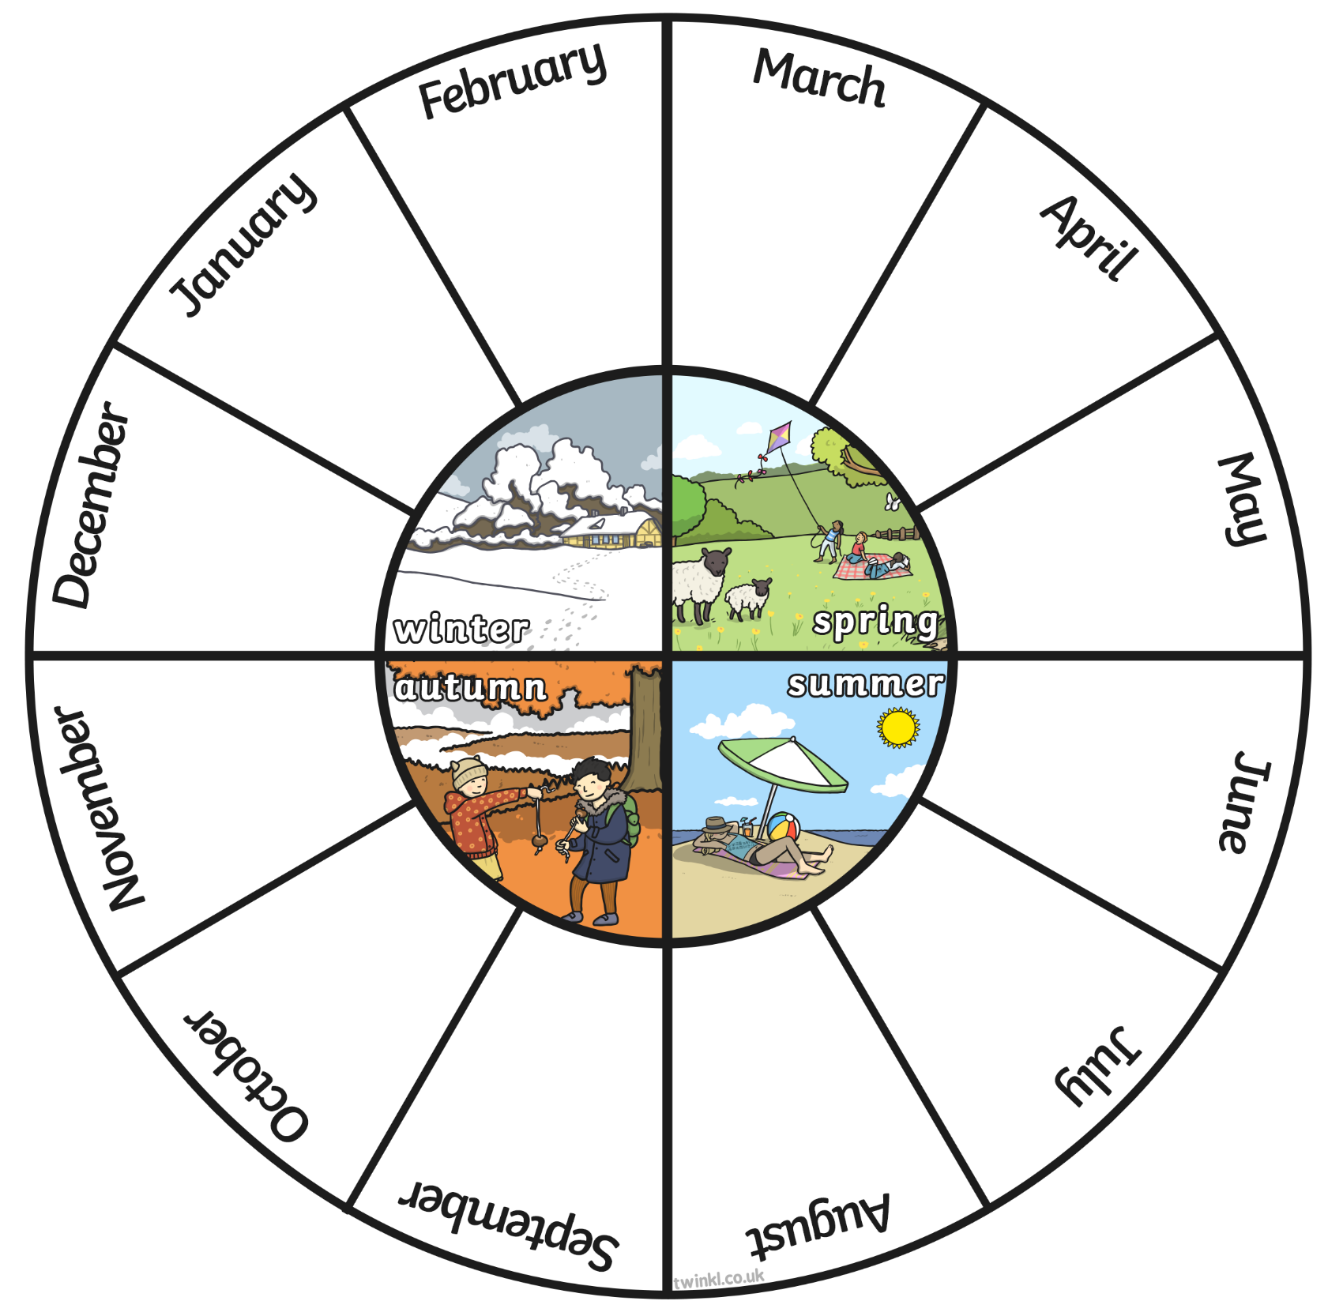
Months and Seasons
The spring months are March, April and May.
With a partner, look at the seasons wheel.
Name the winter months.
If the month is October, what season is it?
If the month is March, how many months are there until summer begins?

Slide 4
What Does Spring Look Like?

Slide 5
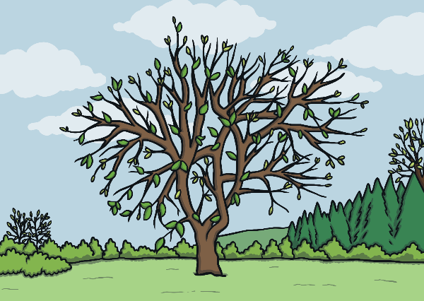
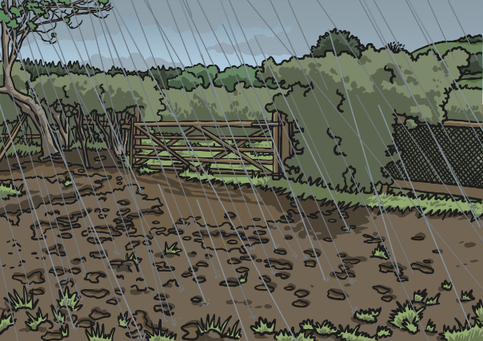
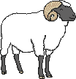
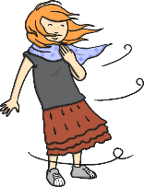
Spring Weather
Spring weather can be mixed.
What kinds of weather can we experience in spring?

Slide 6
Lighter Evenings
You might notice that the daylight gets longer and longer during the spring months. It may still be light when you go to bed!
Month | Sept | Oct | Nov | Dec | Jan | Feb | Mar | April | May | June | July | Aug
Hours of sunlight | 13 | 11 | 9 | 8 | 8 | 10 | 12 | 14 | 15 | 16 | 16 | 14

Slide 7
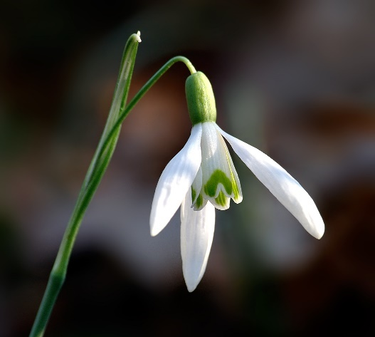
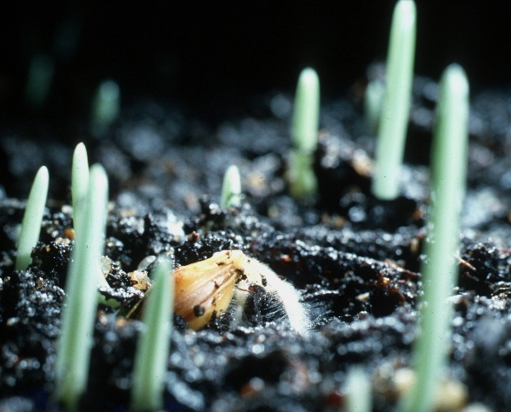
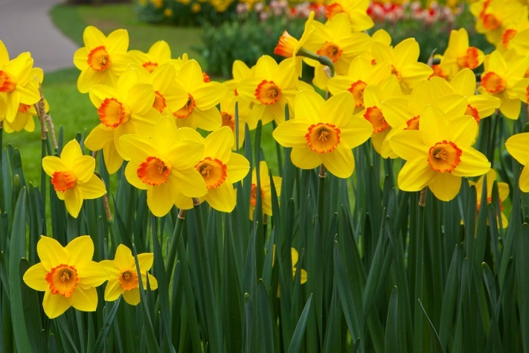
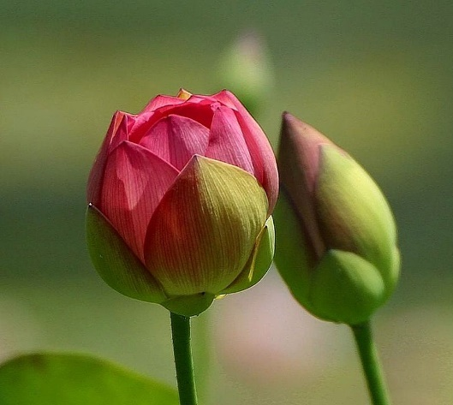
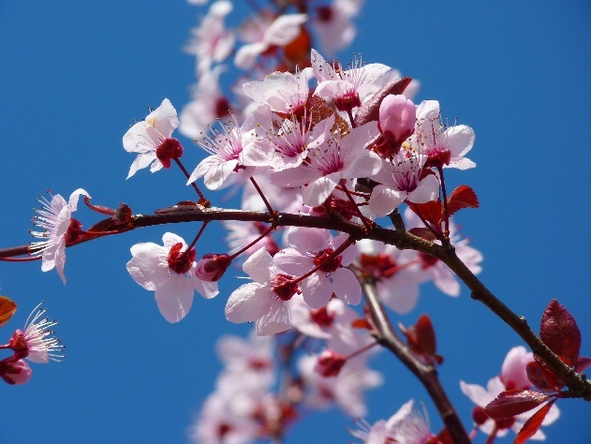
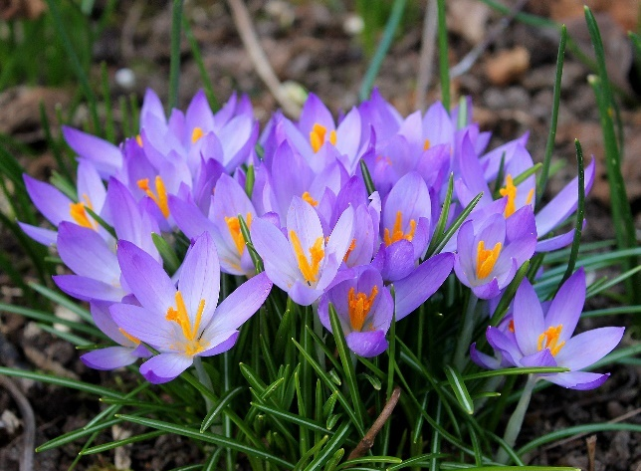
More Signs of Spring
You might notice new life springing up all around you!
snowdrop
bulbs shooting
daffodils
flower buds
blossom
crocuses

Slide 8
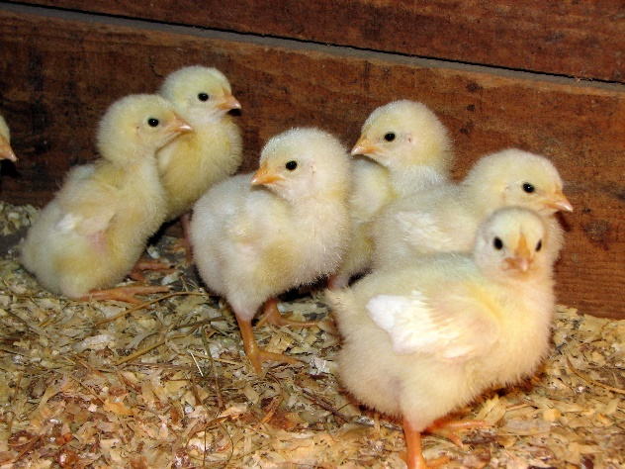
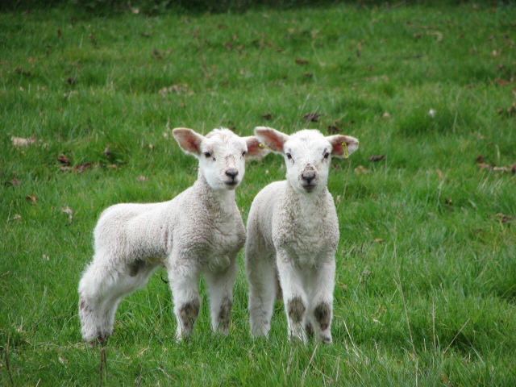
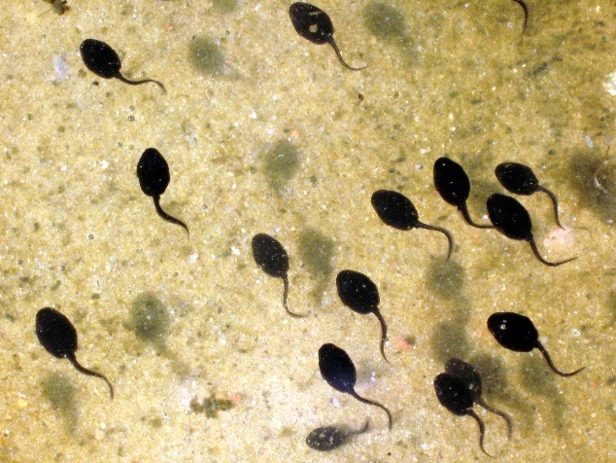
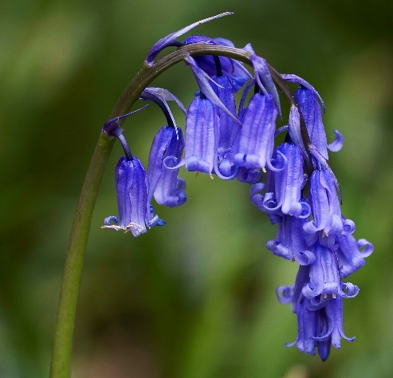
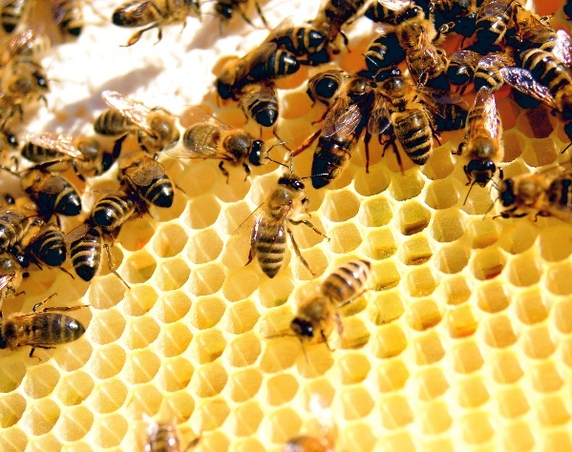
More Signs of Spring
chicks
lambs
tadpoles
You might spot bluebells and crocuses growing in woodland areas.
bluebells
bees

Slide 9
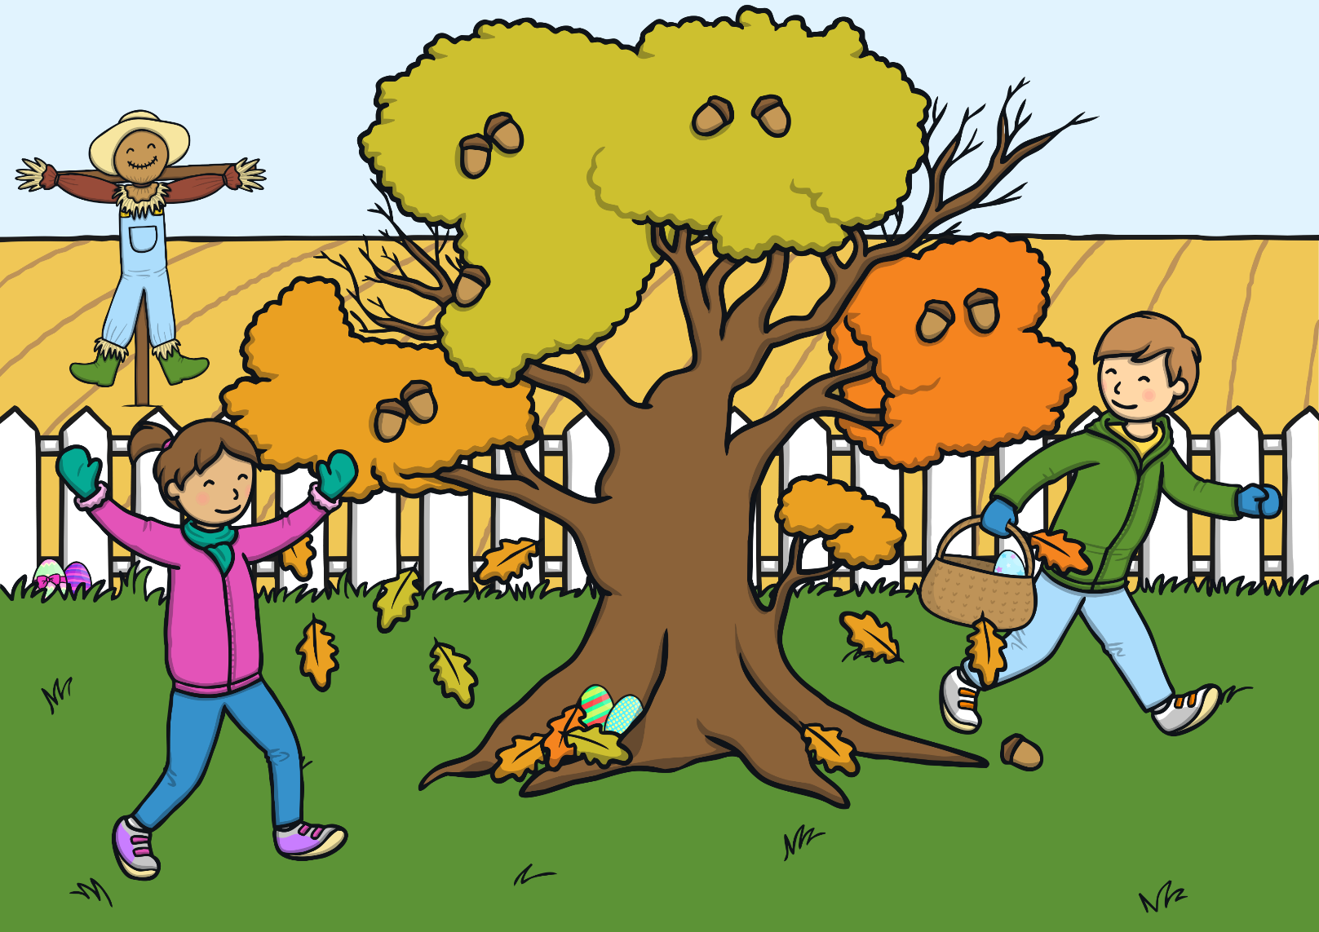
How Is Spring Different to Autumn?

Slide 10
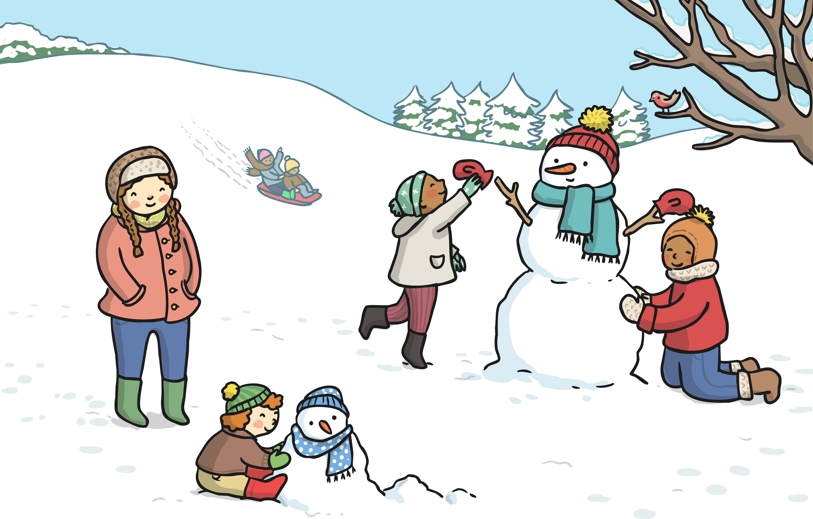
How Is Spring Different to Winter?

Slide 11
How Is Spring Different to Summer?

Slide 12
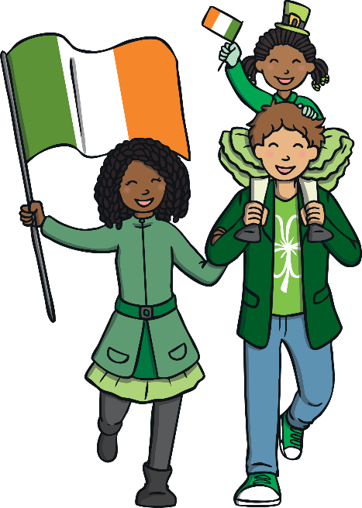
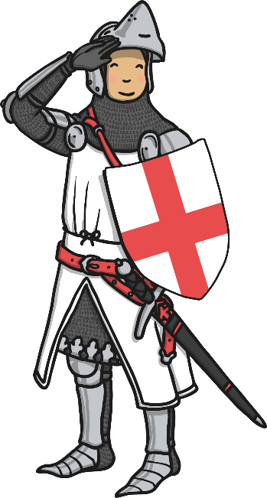
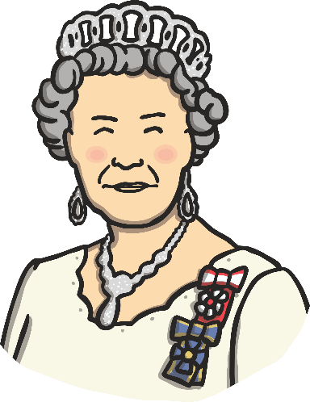
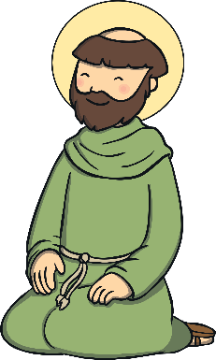
Some Special UK Spring Dates
St. David’s Day (Wales) – 1st March
St. Patrick’s Day (Ireland) – 17th March
Queen Elizabeth II’s birthday – 21st April
St. George’s Day (England) – 23rd April
Will you be celebrating any of these events?

Slide 13
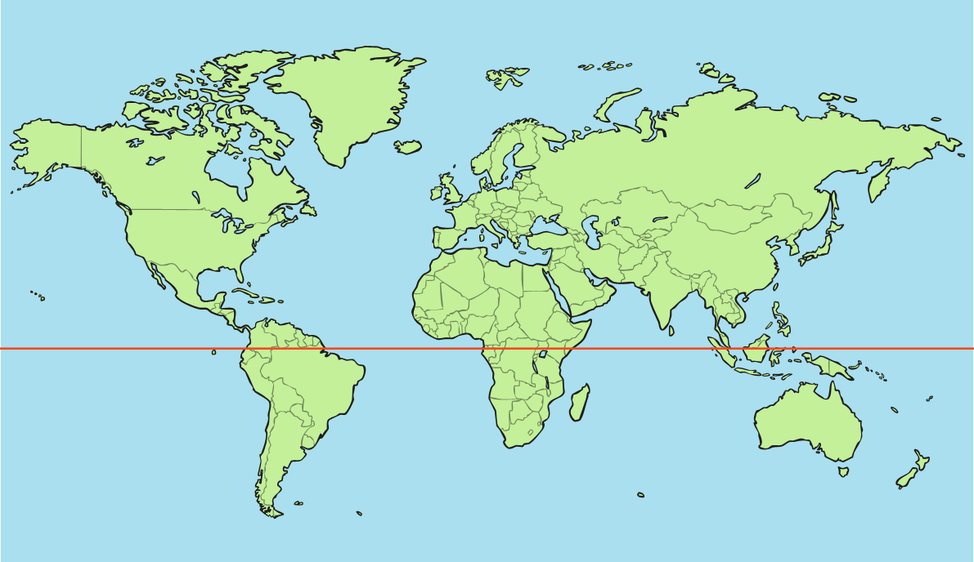
Spring around the World
Spring falls in different months of the year, depending on where you are in the world.
The UK (United Kingdom) is in the northern hemisphere of the earth. The bottom half is called the southern hemisphere. The two hemispheres are split by an imaginary line called the equator. The closer you are to the equator, the hotter the temperature.
northern hemisphere
equator
southern hemisphere

Slide 14
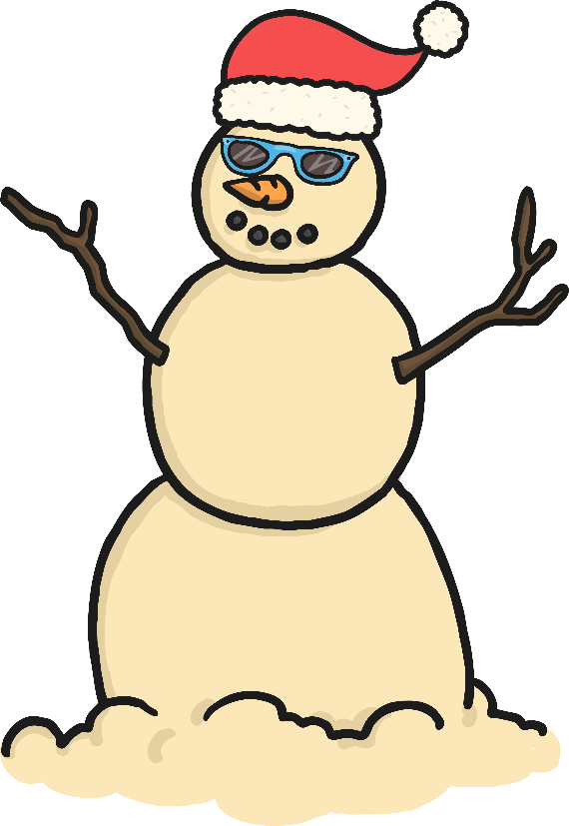
Spring around the World
In the southern hemisphere, in countries like Australia, spring is in September, October and November!
Winter – June, July, August
Summer – December, January, February
Autumn – March, April, May

Slide 15
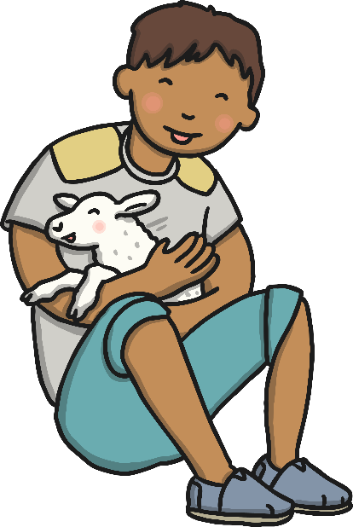
What Did You Find Out about Spring?
Order the UK seasons below:
summer winter autumn spring
Now share 2 things you have learned about spring with your partner.

