Slide 1
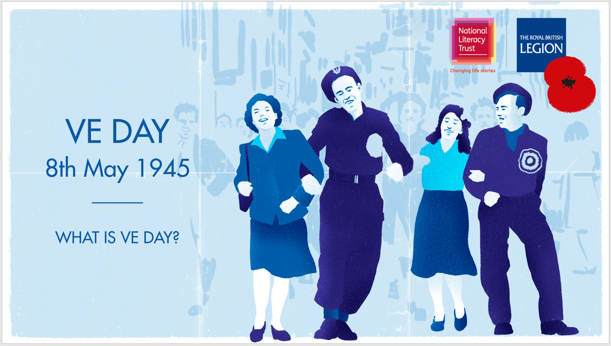
Welcome and contents
What is VE Day?
What did Churchill say on VE Day?
How did people celebrate VE Day in 1945?
How many people lost their lives?
The story of my auntie’s Dad…
People had different feelings about VE Day…
VE Day 75: celebrating at home…

Slide 2
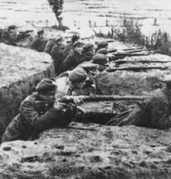
What is VE Day ?
VE Day is Victory in Europe Day. It was the day fighting stopped in Europe and was the day the solders and prisoners of war began to think of returning home; it was a day of mixed feelings. It was the end of the war for the British people. They had overcome Germany, Austria and Italy and had won the war in Europe . People came to London to see the royal family on front of Buckingham Palace and the streets were very crowded . It was a huge party for everyone in the country.

Slide 3
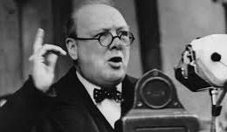
What did Churchill say on VE Day?
‘’Lets turn our thoughts to this day of triumph and sorrow’’ .
Said Winston through the radio. Everyone was listening he was meaning that everyone had different thoughts on VE day. There are endless reasons to be sad or happy it was just as he said a day of triumph and sorrow.

Slide 4
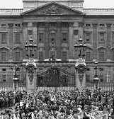
How did people celebrate VE day in 1945
Aften Churchill’s speech, people came out all over the country to celebrate the end of the war in Europe, they danced and in Scotland some people even played bagpipes and in London the people came out from the houses and made their way to Buckingham Palace .

Slide 5
How many people lost their lives?
18 000 000
Service people killed
45 000 000
Civilians killed
67 000
People died in air raids

Slide 6
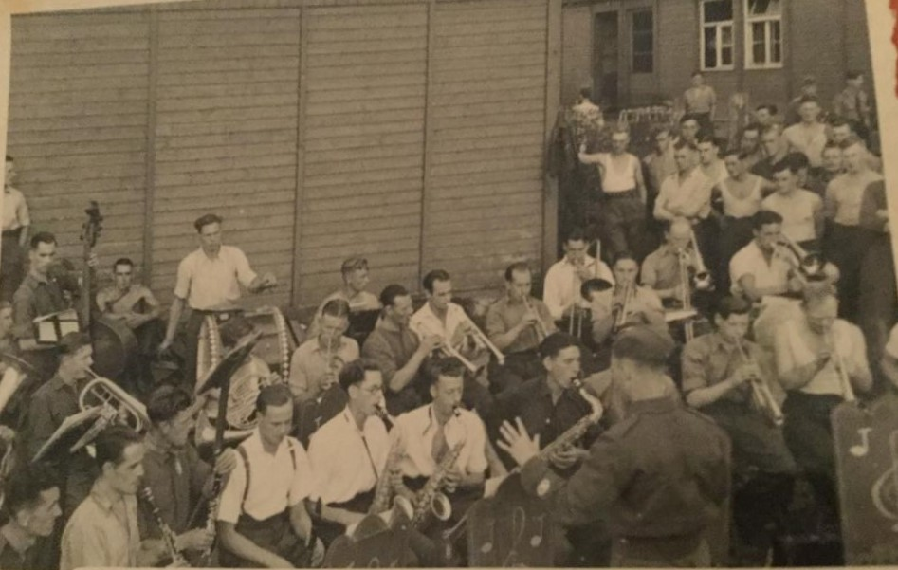
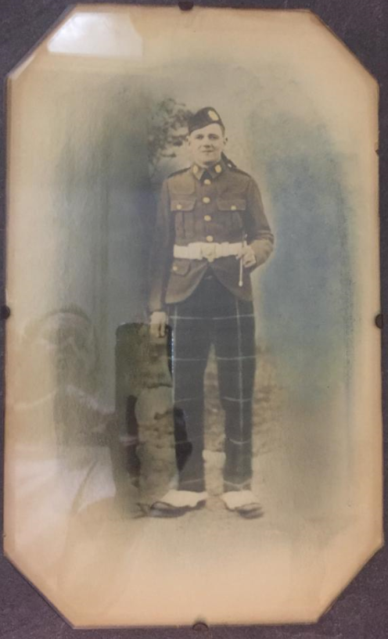
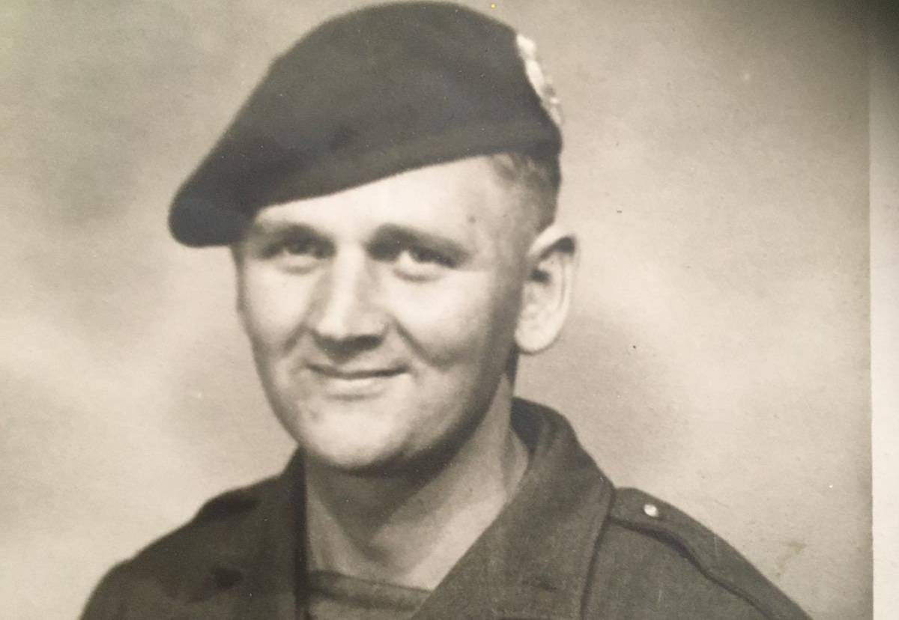
The story of my auntie's dad…
My aunties dad’s name was Thomas Hutchison and he fought with the Highland Light Infantry battalion, Glasgow. He was captured by the Germans in May 1940. He went to a prisoner of war in Poland called Lamsdor. This is the German name for the camp that he stayed in and the and the Nazis often renamed their sites to sound more German.

Slide 7
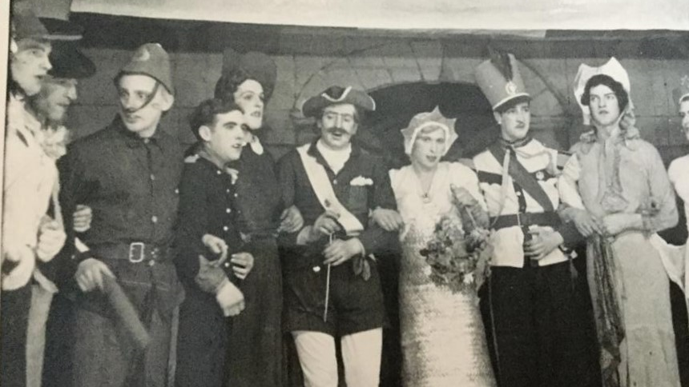
Life in the camp
This is a picture of the pantomime Cinderella that was performed by the camp concert party. Cinderella dress was made from folded silver paper from cigarette packets. You might be surprised that the prisoners look so happy that pictures were taken in the camp . In fact the prisoners were given cameras by the Germans and encouraged to take photos so that the Red Cross would see they were being treated fairly and within the rules.

Slide 8
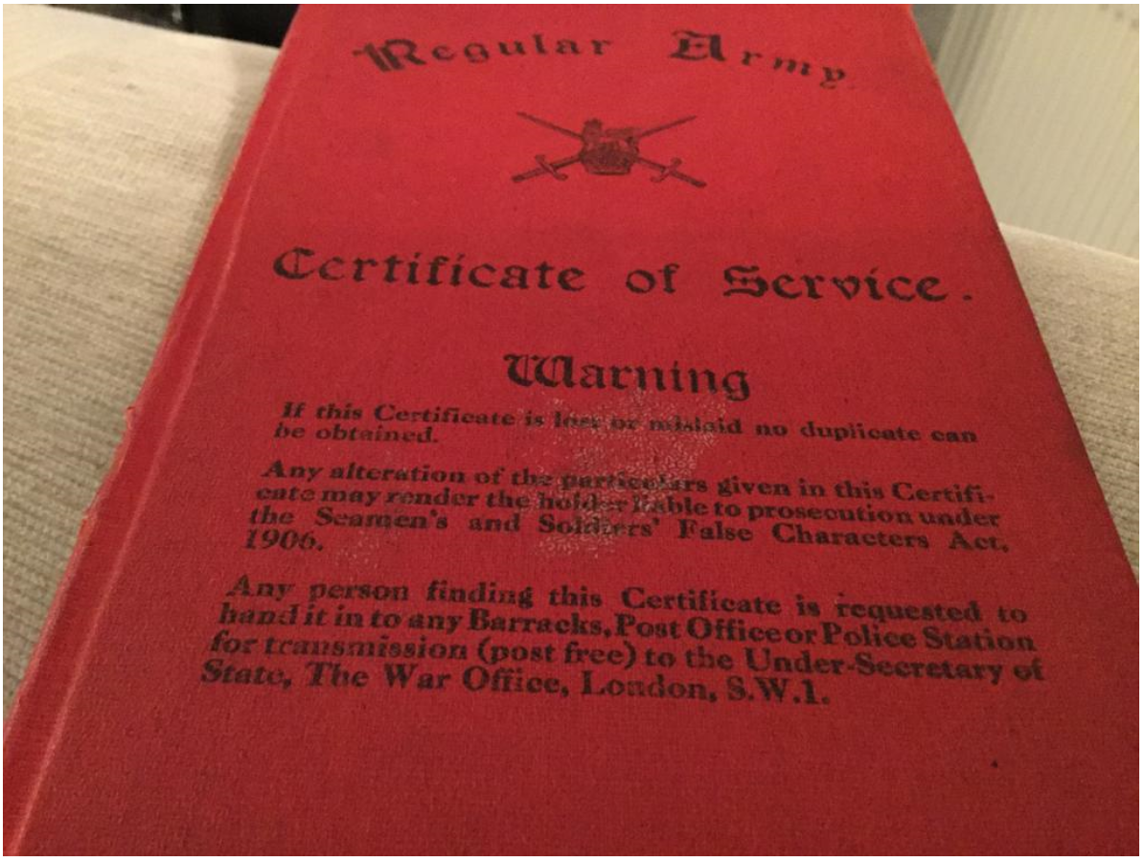
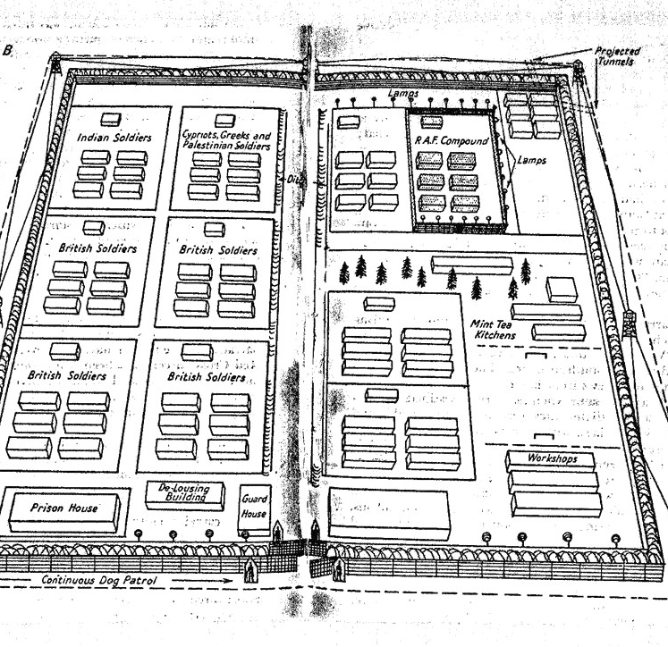
Lamsdorf
Poland
He tried to escape three times and was caught and put in solitary confinement for a week at a time. But, in January of 1945, he was released by the American solders and was told to walk all the way home from Poland to France. He and his friend made it to Czechoslovakia but, they saw planes over head and thought they where enemy so they hid in a hay pile. Unfortunately, he dropped all of his papers and his camera and made a final escape to freedom!!! After the war, the farmer had them all returned to him back in Glasgow.

Slide 9
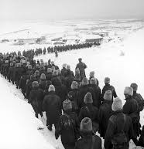
The Long March
The Long March was when all the people in the prisoner of war camps began their journey to return home; they had to walk hellish distances and walk though national borders. They walk hundreds of miles to get home to there families.

Slide 10
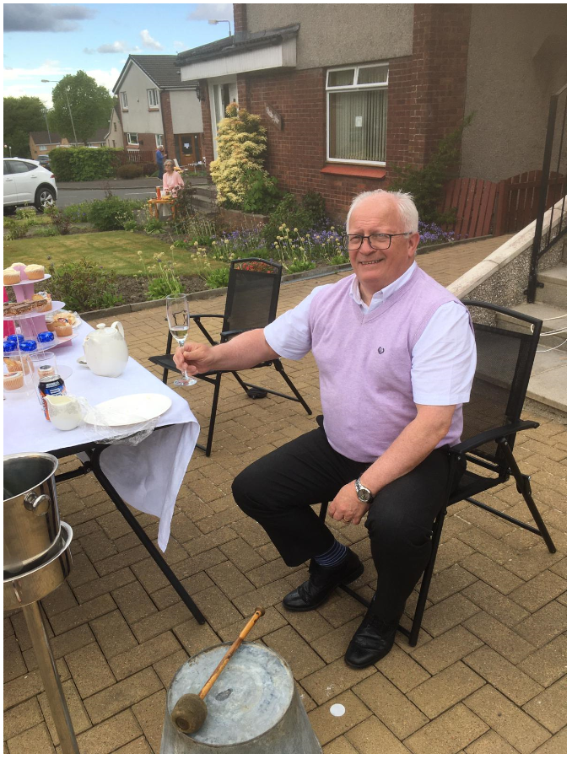
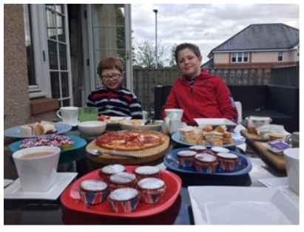
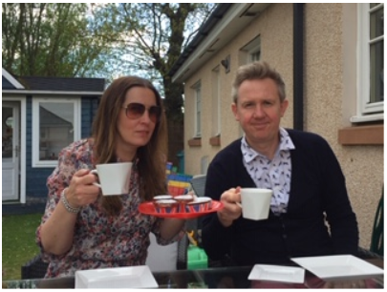
VE Day celebrating at home
This VE day we have to stay at home and protect the NHS hero on the front line but that does not stop us from celebrating at home you can have a VE day party in your house or have a tea party out in your garden.

Slide 11
